Slide 1
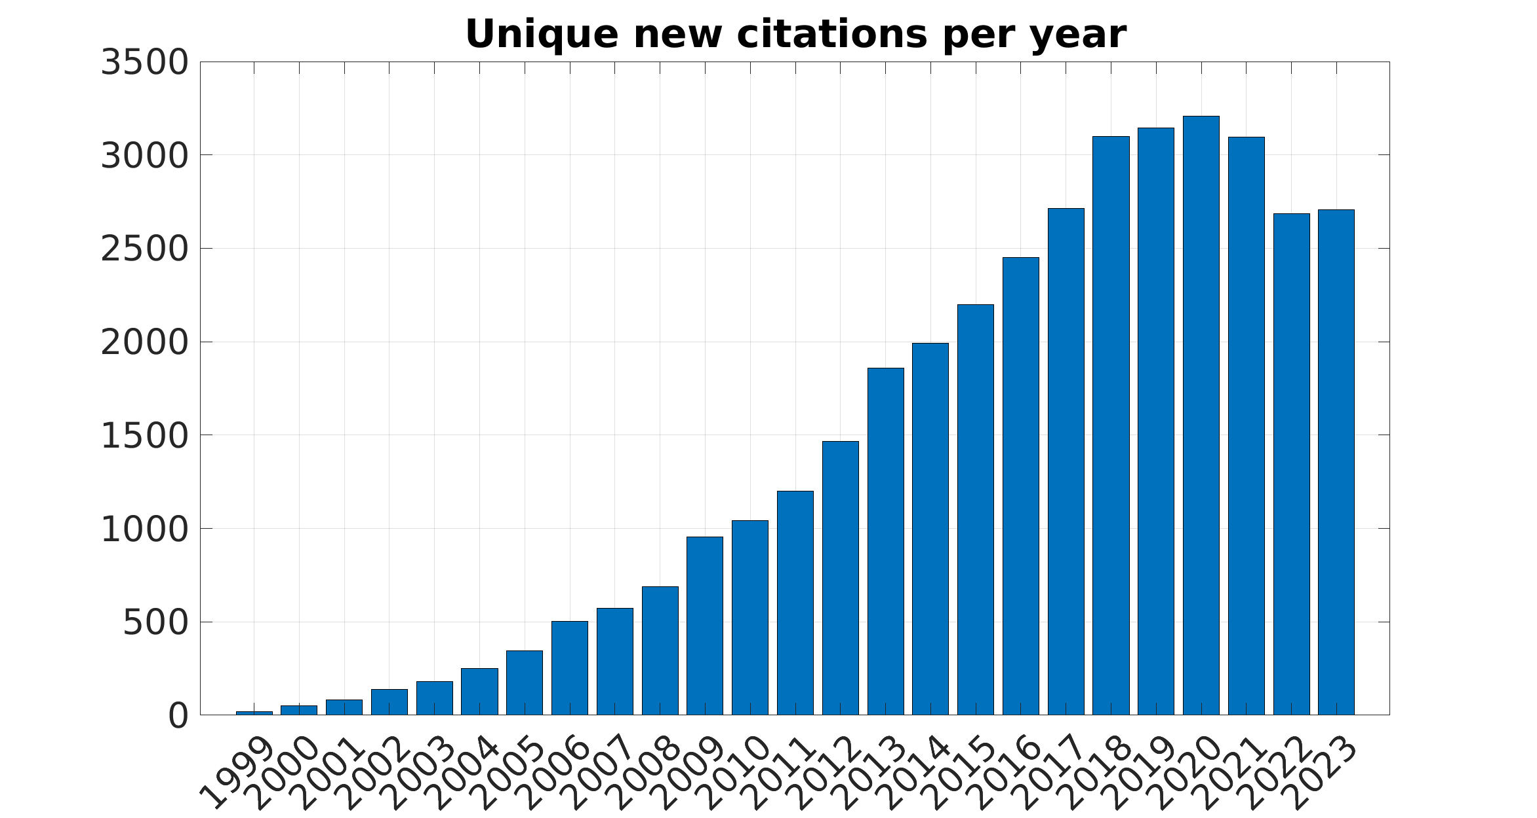

Slide 2
Installing Psychtoolbox
What's new in Psychtoolbox-3?
Kleiner, Mario, David Brainard, and Denis Pelli. "What's new in Psychtoolbox-3?." (2007): 14.
Psychtoolbox website:
http://psychtoolbox.org/
https://www.psychtoolbox.net/
Beginner tutorial:
https://peterscarfe.com/ptbtutorials.html
How to download and install:
http://psychtoolbox.org/download.html
System requirements:
http://psychtoolbox.org/requirements.html

Slide 3
Understanding Monitor Functionality
Screen('Preference', 'SkipSyncTests', 1); %enable this if you got screen error
The command Screen('Preference', 'SkipSyncTests', 1); in Psychtoolbox is used to bypass the synchronization tests that Psychtoolbox performs when opening a window. Here's a simpler explanation of what this command does and when to use it:
Purpose of the Command
Screen Synchronization Tests:
When you start an experiment, Psychtoolbox performs several checks to ensure that the timing of stimulus presentation is accurate. These checks, known as synchronization tests, make sure that the monitor's refresh rate and the timing of your stimuli are perfectly aligned.
What the Command Does:
Screen('Preference', 'SkipSyncTests', 1); tells Psychtoolbox to skip these synchronization tests. The 1 parameter means "yes, skip the tests."
Why Skip Sync Tests?
You might want to skip the synchronization tests if you encounter errors or warnings that prevent your experiment from running. These errors can sometimes happen on systems where the synchronization tests are too strict or on setups where perfect timing is not possible due to hardware limitations.

Slide 4
Understanding Monitor Functionality
PsychDefaultSetup(2);
PsychDefaultSetup(2) is a command in Psychtoolbox that helps you quickly set up your experiment with some useful default settings. Think of it as a "starter pack" for your experiment.
What Does It Do?
When you use PsychDefaultSetup(2), it does three main things to help you get started:
Unify Key Names:
It makes sure that the names of the keyboard keys are the same no matter what kind of computer you are using (Windows, macOS, or Linux). This way, when you refer to keys in your code, you don't have to worry about differences between operating systems.
Set Color Range:
It sets the range for colors to be between 0 and 1. This means that when you specify colors in your experiment, you can use numbers like 0.5 (which means 50% brightness) and not worry about different ranges for different screens.
Set Debugging Level:
It turns on some helpful debugging visuals. These visuals can help you see if your experiment is running correctly and identify any problems.

Slide 5
Understanding Monitor Functionality
screens = Screen('Screens'); #Identifying Available Screens
screenNumber = max(screens); # Selecting the screen
By selecting the maximum screen number, this command is typically choosing the external monitor (if one is connected), assuming the primary monitor is indexed as 0 and any additional monitors are indexed with higher numbers.

Slide 6
Understanding Monitor Functionality
white = WhiteIndex(screenNumber);
black = BlackIndex(screenNumber);
grey = white / 2;
WhiteIndex(screenNumber): This function returns the color value for white on the specified screen. The color value for white is typically the maximum value that the screen can display.
For most screens, this value is 255 if the screen uses an 8-bit color depth per channel (standard RGB).
BlackIndex(screenNumber): This function returns the color value for black on the specified screen. The color value for black is typically the minimum value that the screen can display.
For most screens, this value is 0.

Slide 7
Understanding Monitor Functionality
[window, windowRect]=PsychImaging('OpenWindow', screenNumber, white);
The command [window, windowRect] = PsychImaging('OpenWindow', screenNumber, white); in Psychtoolbox is used to create a window on the specified screen with a specific background color.

Slide 8
Understanding Monitor Functionality
[screenXpixels, screenYpixels] = Screen('WindowSize', window);
%returns the size of the specified window in pixels
ifi = Screen('GetFlipInterval', window);
%The function measures and returns the time it takes for the screen to refresh. This value is essential for ensuring precise timing of visual stimuli.
From the inter-frame interval, you can calculate the refresh rate of the monitor using the formula refreshRate = 1 / ifi. For example, if ifi is 0.01667 seconds, the refresh rate is 60 Hz.

Slide 9
Understanding Monitor Functionality
[xCenter, yCenter] = RectCenter(windowRect);
%RectCenter(windowRect): This function computes the center coordinates of the rectangle specified by windowRect.
windowRect: A rectangle defined by four values [left, top, right, bottom]. In the context of a Psychtoolbox window, windowRect typically represents the size and position of the window in screen coordinates.
Screen('BlendFunction', window, 'GL_SRC_ALPHA', 'GL_ONE_MINUS_SRC_ALPHA');
%Screen('BlendFunction'): This function sets the blending mode for drawing operations in the specified window
HideCursor() %hiding your cursor during the task
sca; %exits from psychtoolbox

Slide 10
Handling Mouse and Keyboard Inputs
Keyboard:
Kbname
[keyIsDown,secs, keyCode] = KbCheck;
KbStrokeWait;
KbQueueCreate, KbQueueStart, KbQueueCheck, KbQueueStop: These functions provide a more advanced and flexible way of handling keyboard input by setting up a queue to capture key presses.
GetSecs
WaitSecs
activeKeys = [KbName('space'), KbName('ESCAPE')];
RestrictKeysForKbCheck(activeKeys);

Slide 11
Drawing Basic Shapes and Lines
Screen('DrawDots', window, [dotXpos dotYpos], dotSizePix, dotColor, [], 2);
Screen('Flip', window);
%This command basically draws all of our previous
% commands onto the screen
baseRect = [0 0 200 250]; %size of the rectangle
centeredRect = CenterRectOnPointd(baseRect, xCenter, yCenter);
rectColor = [1 0 0]; % red
Screen('FillRect', window, rectColor, centeredRect);

Slide 12
Drawing Basic Shapes and Lines
baseRect = [0 0 200 250];
maxDiameter = max(baseRect) * 1.01;
centeredRect = CenterRectOnPointd(baseRect, xCenter, yCenter);
rectColor = [1 0 0];
Screen('FillOval', window, rectColor, centeredRect, maxDiameter); %making an oval
Screen('Flip', window);

Slide 13
Drawing Basic Shapes and Lines
%polygon
numSides = 7;
anglesDeg = linspace(0, 360, numSides + 1);
anglesRad = anglesDeg * (pi / 180);
radius = 200;
rectColor = [1 0 0];
yPosVector = sin(anglesRad) .* radius + yCenter;
xPosVector = cos(anglesRad) .* radius + xCenter;
isConvex = 1;
% Draw the rect to the screen
Screen('FillPoly', window, rectColor, [xPosVector; yPosVector]', isConvex);
% Flip to the screen
Screen('Flip', window);

Slide 14
Drawing Basic Shapes and Lines
%Fixation cross
Screen('TextFont', window, 'Ariel');
Screen('TextSize', window, 36);
[xCenter, yCenter] = RectCenter(windowRect);
% Here we set the size of the arms of our fixation cross
fixCrossDimPix = 40;
% Now we set the coordinates (these are all relative to zero we will let
% the drawing routine center the cross in the center of our monitor for us)
xCoords = [-fixCrossDimPix fixCrossDimPix 0 0];
yCoords = [0 0 -fixCrossDimPix fixCrossDimPix];
allCoords = [xCoords; yCoords];
% Set the line width for our fixation cross
lineWidthPix = 4;
% Draw the fixation cross in white, set it to the center of our screen and
% set good quality antialiasing
Screen('DrawLines', window, allCoords,...
lineWidthPix, white, [xCenter yCenter], 2);
% Flip to the screen
Screen('Flip', window);

Slide 15
Moving shapes
baseRect = [0 0 200 200];
rectColor = [0 0 1];
amplitude = screenXpixels * 0.25;
frequency = 0.2;
angFreq = 2 * pi * frequency;
startPhase = 0;
time = 0;
vbl = Screen('Flip', window);
waitframes = 1;
topPriorityLevel = MaxPriority(window);
Priority(topPriorityLevel);
%This function call determines the highest possible priority level that can be set for the current window.

Slide 16
while ~KbCheck
% Position of the square on this frame
xpos = amplitude * sin(angFreq * time + startPhase);
% Add this position to the screen center coordinate. This is the point
% we want our square to oscillate around
squareXpos = xCenter + xpos;
% Center the rectangle on the centre of the screen
centeredRect = CenterRectOnPointd(baseRect, squareXpos, yCenter);
% Draw the rect to the screen
Screen('FillRect', window, rectColor, centeredRect);
% Flip to the screen
vbl = Screen('Flip', window, vbl + (waitframes - 0.5) * ifi);
% Increment the time
time = time + ifi;
end

Slide 17
vbl = Screen('Flip', window, vbl + (waitframes - 0.5) * ifi);
vbl: Vertical blank timestamp of the last screen flip. This is a high-precision timestamp indicating when the last Screen('Flip') happened.
waitframes: The number of frames to wait before the next flip. In this case, it is set to 1, meaning the next flip should occur after one frame.
ifi: Inter-frame interval. This is the time in seconds between each screen refresh (essentially the inverse of the refresh rate).
vbl + (waitframes - 0.5) * ifi: This expression calculates the exact time for the next flip. By using waitframes - 0.5, the flip is scheduled slightly before the next frame's deadline. This helps in achieving precise timing for smooth animations.
time = time + ifi;
time = time + ifi: Adds the inter-frame interval (ifi) to time, effectively increasing the time variable by the duration of one frame. This keeps the animation progressing frame by frame.

Slide 18
Handling Mouse and Keyboard Inputs
%mouse
SetMouse(round(rand * screenXpixels), round(rand * screenYpixels), window);
SetMouse(0, 0, window);
[x,y,buttons] = GetMouse(window); %x and y of the clicked location

Slide 19
Displaying Text
Screen('FillRect', window, black);
string_text='Are you ready?\n\n(Press any key to start the experiment)';
DrawFormattedText(window, string_text,'center', screenYpixels * 0.5 ,white);
Screen('Flip', window);
KbWait;

Slide 20
Working with Images
imageTexture = Screen('MakeTexture', window, images);
Screen('DrawTexture', window, imageTexture, [], [], 0)
Screen('Flip', window);
Screen('FillRect', window, [1 1 1]);

Slide 21
Incorporating Voice
InitializePsychSound(1);
nrchannels = 2;
freq = 44100;
pahandle = PsychPortAudio('Open', [], 1, 1, freq, nrchannels);
PsychPortAudio('Volume', pahandle, 0.5);

Slide 22
Integrating Video
moviename=['movies.mp4'];
Screen('FillRect', window, [0 0 0]);
movie = Screen('OpenMovie', window, moviename);
Screen('PlayMovie', movie, 1);
Screen('CloseMovie', movie);

Slide 23
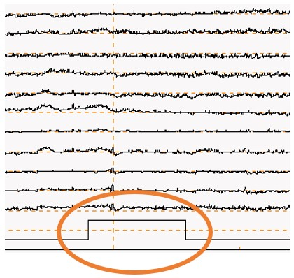
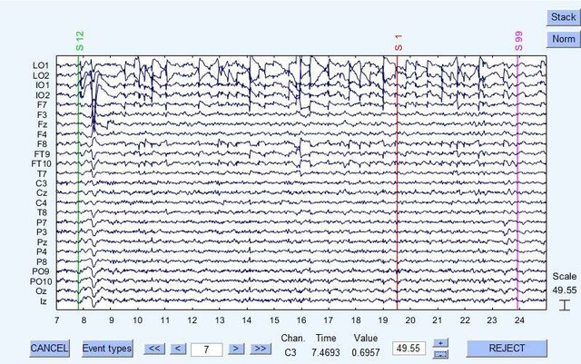

Slide 24
Where and how we put the triggers?
What is your trigger?
Is it parallel port? Serial port? Photodiode?
You need to put your trigger code exactly before flip function
ioObj = io64;
status = io64(ioObj);
address = hex2dec('D100'); %standard LPT1 output port address
data_out=0; %sample data value
io64(ioObj,address,data_out);

Slide 25
Full Project
Stroop task
Raven task

