Slide 1
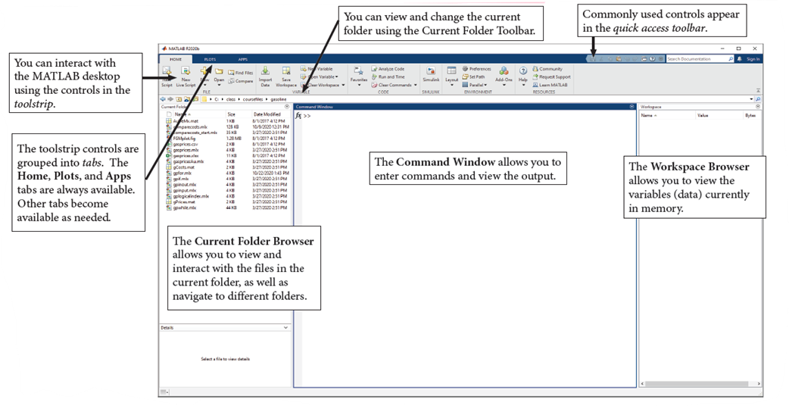
The MATLAB Desktop

Slide 2
How to use help?
MATLAB help and documentation can show you
The various ways to call a function
The algorithm implemented by a function
Examples of how to use a function
Links to related functions
Tutorials and background information

Slide 3
How to use help?
To display documentation on a particular function, type the word "doc" and the name of the function:
doc plot
For quick help on the function in the Command Window, type
help plot
The MATLAB Help browser opens to the appropriate documentation. If you want to search or browse the documentation, enter
doc
to open the Help browser to its main page. You can then search by keywords or browse by topic.

Slide 4
input
Input and Output in programming can be understood as the communication between a computer programme and its user. The Input is seen as a user providing input/data into a programme and the Output is understood as outputting/returning some form of processed data to the user. In MATLAB, the command window can be used to execute commands on inputs which is usually some form data. The MATLAB Workspace keeps track of all variables and hence the inputs and outputs from various code executions on MATLAB. This lesson will be split into two parts: part a and part b. In part a we go over the different input/output systems in MATLAB and touch on reading and writing file contents.
Consider an example of displaying the term "Hello World!" in the command window, using the built-in MATLAB function disp() the input would be "Hello World!" and the output would be a text displaying the phrase.
This is the simplest idea of an input output relationship in programming.
input = "Hello World!";
disp(input)
Hello World!

Slide 5
input
prompt = 'Please Enter Subject Name:';
subject_name = input(prompt,'s');

Slide 6
Locating in a folder
Path=‘D:\psychtoolbox workshop’
cd (Path )
Pwd %current folder
dir %listing folder contents
A = dir(fullfile(pwd, '*.mat')); % getting just .mat files in current folder

Slide 7
Make a random Variable
rand
Returns a random scalar drawn from a uniform distribution in the interval (0,1)
randi
Returns a pseudorandom scalar integer between 1 and imax
randperm
Returns a raw vector containing a random permutation of the integers from 1 to n without repeating elements

Slide 8
How to import data in Matlab?
Load (.mat file)
Imread (image files)
Xlsread (.xlsx files)
Audioread (audio formats )

Slide 9
How to save data from Matlab?
Save
xlswrite
Writetable

Slide 10
Data types
There are many different data types, or classes, that you can work with in MATLAB. You can build matrices and arrays of the following data types:
floating-point
integer data
characters and strings,
logical true and false values, and so on
The following data types provide a way to store dissimilar types of data in the same container:
tables
timetables
structures
cell arrays

Slide 11
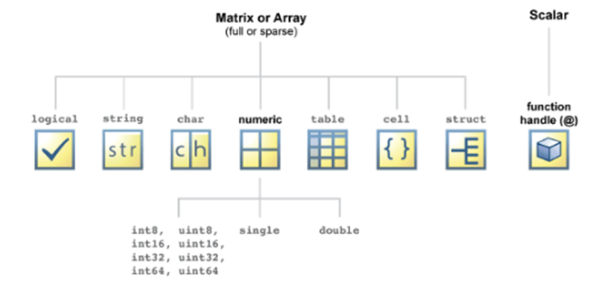
Data types
All the fundamental MATLAB classes are shown in the diagram below:
See this table that describes the fundamental classes in more detail.
Let’s see some examples using some of these fundamental data types.

Slide 12
Data types
str = "This is a string array" %Enclose text in double quotes to create a string
chr = 'This is a character array' %Enclose text in single quotes to create a character array
MATLAB displays strings with double quotes and character vectors with single quotes. The difference between these two data types, is that str will be stored as a 1-by-1 string or a string scalar whereas chr will be stored as a 1-by-12 character vector (confirm this in the Workspace browser).

Slide 13
Variables and Commands
Assigning Values to Variables
You can assign values to a variable using the equals sign (=), which is the assignment operator in MATLAB:
x = 6;
MATLAB computes the value of the expression on the right of the equals sign and then assigns that value to the variable named on the left.
If the variable on the left already exists, it is overwritten with the new value.
x = 42;
y = x/6; % y has the value 7
x = 3.14; % y still has the value 7
y = y - 1; % y is now 6

Slide 14
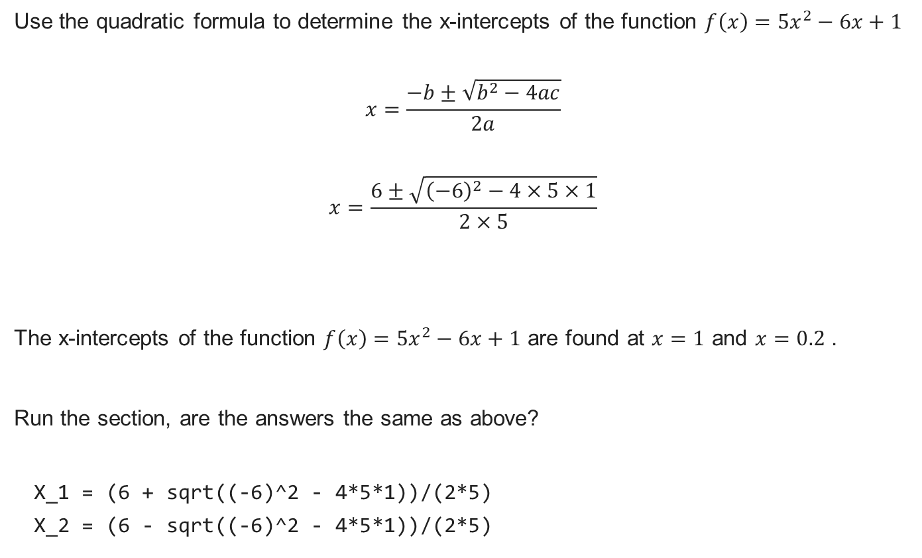
Making use of built-in Mathematical Functions
Use the quadratic formula to determine the x-intercepts of the function $f\left(x\right)=5x^{2}−6x+1$
$$x=\frac{−b±\sqrt{b^{2}−4ac}}{2a}$$
$$x=\frac{6±\sqrt{{\left(−6\right)}^{2}−4×5×1}}{2×5}$$
The x-intercepts of the function $f\left(x\right)=5x^{2}−6x+1$ are found at $x=1$ and $x=0.2$ .
Run the section, are the answers the same as above?
X_1 = (6 + sqrt((-6)^2 - 4*5*1))/(2*5)
X_2 = (6 - sqrt((-6)^2 - 4*5*1))/(2*5)

Slide 15

Arrays and Matrices
Introduction to arrays and matrices
The name MATLAB is an abbreviation of "MATrix LABoratory". MATLAB was designed to work with matrices as the fundamental unit of data.

Slide 16
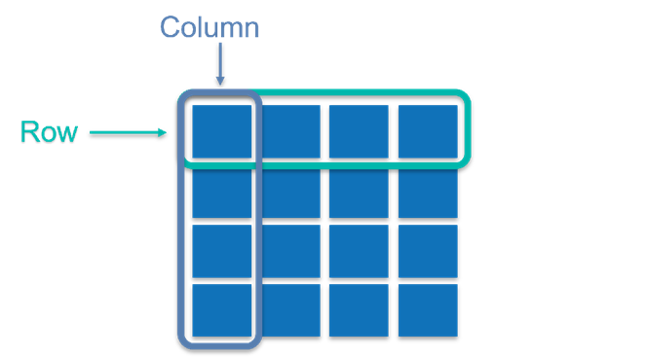
Arrays and Matrices
A matrix is regular two-dimensional grid, or table, of numbers, with rows and/or columns.

Slide 17
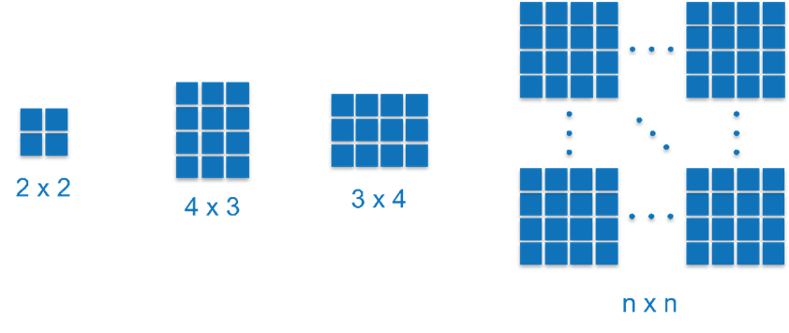
Arrays and Matrices
They can come in many shapes and sizes, and we have a special case when there is only a single row and/or column.

Slide 18
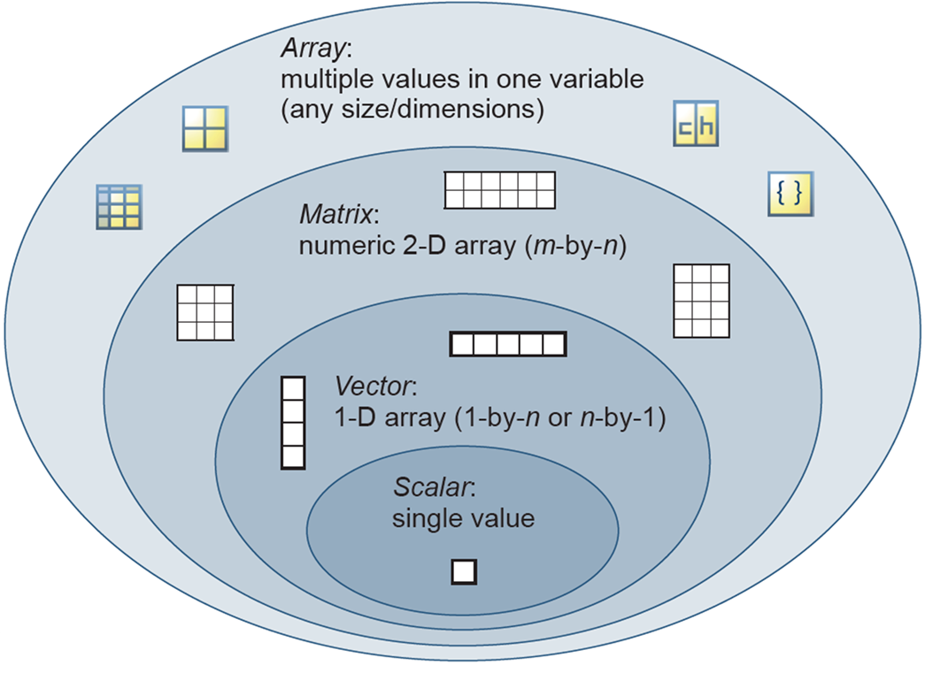
Arrays and Matrices
Let us consider what MATLAB understands arrays and matrices to be. Refer to the image below, beginning at the smallest, inner most oval and working our way to the largest, outer most oval. When there is only one row and one column, we have a scalar value. A scalar value would be any numerical value that includes the digits 0 to 9, in a positive or negative form, for example 5 or-5.

Slide 19
Array creation
Creating vectors by specifying each element individually
We use square brackets, [], in MATLAB to denote numeric arrays. There are a few ways of creating an array in MATLAB. As MATLAB's convention defines observations as rows and columns as variables of the observations, let us begin by creating some row vectors. To separate values in a row vector you can either use a space or a comma:
a_1 = [1 2 3 4]
a_1 = 1×4
1 2 3 4
a_2 = [1, 2, 3, 4]
a_2 = 1×4
1 2 3 4
Note: MATLAB interprets a comma as a separator and not a decimal point.

Slide 20
Array creation
To create a column vector, simply use a semi-colon to separate the values:
a_3 = [1; 2; 3; 4]
a_3 = 4×1
1
2
3
4
You can interchange between row and column vectors by transposing between one and the other. This is done by including an inverted comma after the closing square bracket, for example
a_4 = [1; 2; 3; 4]’
a_4 = 1×4
1 2 3 4

Slide 21

Array creation
Now you try! Create a row vector called x_1 with the values 2, 4, 6, and 8.
x_1 = [2, 4, 6, 8]
x_1 = 1×4
2 4 6 8

Slide 22
Array creation
Creating vectors of equally spaced element values
Typing out each element of a vector can be tedious and time consuming. In the case where you require a vector to be created with equally spaced element values, there are two approaches available.
Method 1: Using the notation var = start : step size : end
a_5 = 1:2:10
a_5 = 1×5
1 3 5 7 9
a_6 = 10:-2:1
a_6 = 1×5
10 8 6 4 2
We use the colon operator to create regularly spaced vectors, index into arrays, and define the bounds of a for loop. For now, we are considering its application in vector creation, but we will get to its other applications later on.

Slide 23
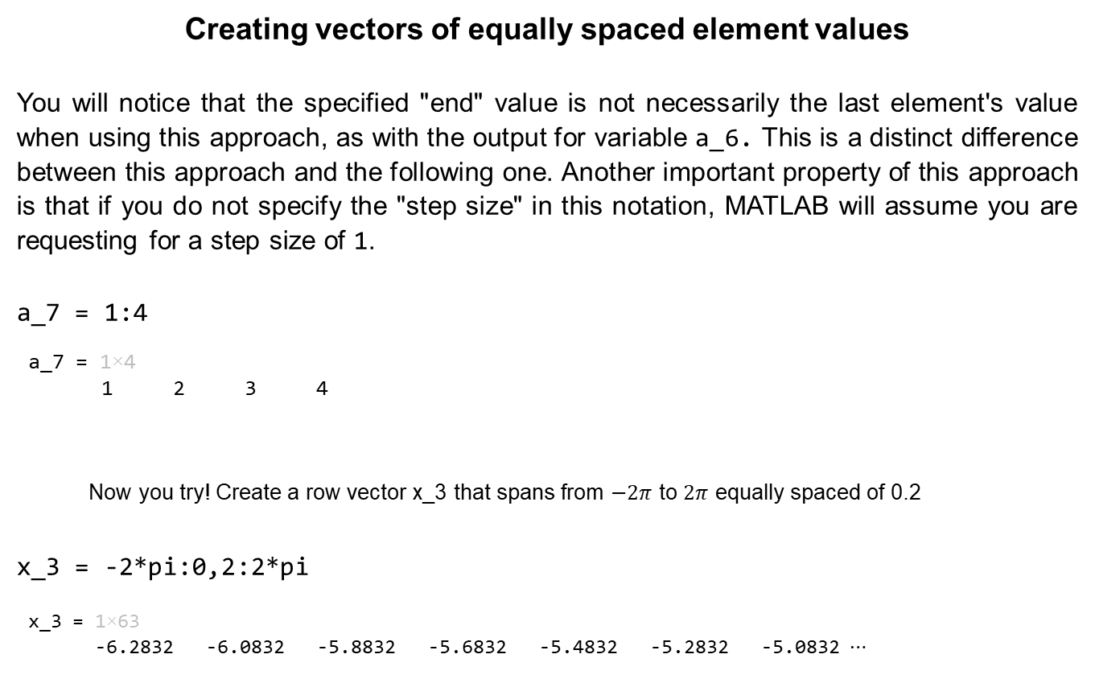
Array creation
Creating vectors of equally spaced element values
You will notice that the specified "end" value is not necessarily the last element's value when using this approach, as with the output for variable a_6. This is a distinct difference between this approach and the following one. Another important property of this approach is that if you do not specify the "step size" in this notation, MATLAB will assume you are requesting for a step size of 1.
a_7 = 1:4
a_7 = 1×4
1 2 3 4
Now you try! Create a row vector x_3 that spans from $−2π$ to $2π$ equally spaced of 0.2
x_3 = -2*pi:0,2:2*pi
x_3 = 1×63
-6.2832 -6.0832 -5.8832 -5.6832 -5.4832 -5.2832 -5.0832 ⋯

Slide 24
Array creation
Creating vectors of equally spaced element values
Method 2: Using the built in function var = linspace(start, end, number of elements)
a_8 = linspace(1,10,5)
a_8 = 1×5
1.0000 3.2500 5.5000 7.7500 10.0000
This approach gives the user direct control of the number of points/elements and ensures that the last element of the vector is the value specified by the user. MATLAB automatically calculates what step size is required given the user's input to the function. It is important to note that if the number of points/elements is not specified by the user, MATLAB will assume a default value of 100 points is required.

Slide 25
Array creation
Creating vectors of equally spaced element values
Now you try! Create a row vector x_4 that spans from 0 to 10 with 100 elements equally spaced.
x_4 = linspace(0,10)
x_4 = 1×100
0 0.1010 0.2020 0.3030 0.4040 0.5051 0.6061 ⋯

Slide 26
Array creation
Creating vectors using other built-in functions
There are a few built in functions you can leverage for creating vectors and matrices in MATLAB. This subsection will cover 3 examples of such functions, which will come in handy when trying to avoid computationally expensive iterative scripts/loops. Let us begin by creating a vector with all elements being the value 1, and then a second vector where all elements have a value of 0. Both of these functions expect two inputs, one for the number of rows, r, and the next for the number of columns, c, i.e. var = ones(r, c) or var = zeros(r, c)
b_1 = ones(1,5)
b_1 = 1×5
1 1 1 1 1
b_2 = zeros(1,5)
b_2 = 1×5
0 0 0 0 0

Slide 27
Array creation
Next, let us create a vector or values drawn from a uniform distribution in the interval (0, 1). The function rand is used to do this, following the same notation as the functions ones and zeros, var = rand(r, c)
b_3 = rand(1,5)
b_3 = 1×5
0.8147 0.9058 0.1270 0.9134 0.6324
Now you try! Create a row vector x_5 that spans from 0 to 10 with 100 elements equally spaced.
x_5 = linspace(0,10)
x_5 = 1×100
0 0.1010101010101010 0.2020202020202020 ⋯

Slide 28
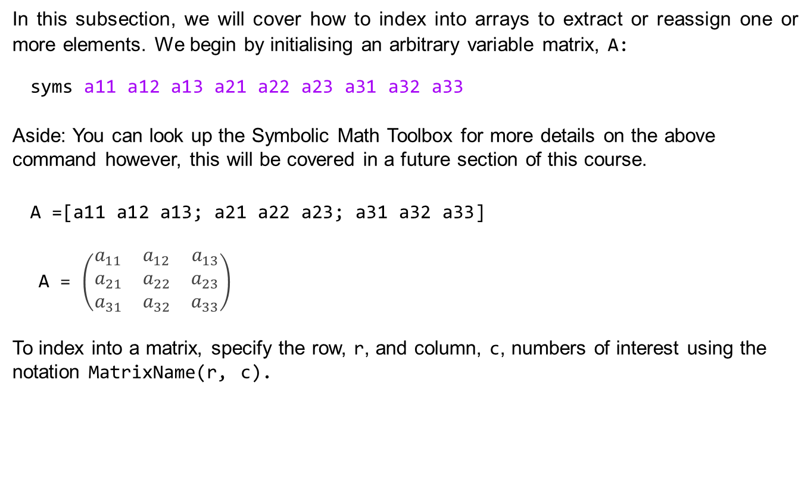
Array Indexing
In this subsection, we will cover how to index into arrays to extract or reassign one or more elements. We begin by initialising an arbitrary variable matrix, A:
syms a11 a12 a13 a21 a22 a23 a31 a32 a33
Aside: You can look up the Symbolic Math Toolbox for more details on the above command however, this will be covered in a future section of this course.
A =[a11 a12 a13; a21 a22 a23; a31 a32 a33]
A = $\left(\begin{matrix}a_{11} & a_{12} & a_{13} \\ a_{21} & a_{22} & a_{23} \\ a_{31} & a_{32} & a_{33}\end{matrix}\right)$
To index into a matrix, specify the row, r, and column, c, numbers of interest using the notation MatrixName(r, c).

Slide 29
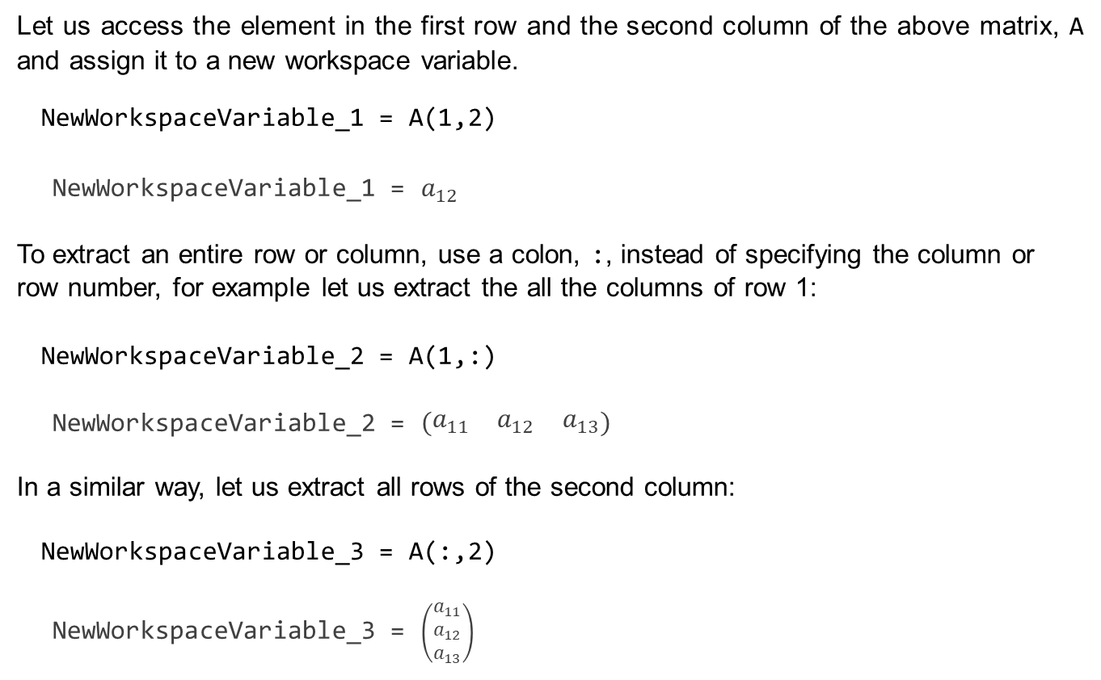
Array Indexing
Let us access the element in the first row and the second column of the above matrix, A and assign it to a new workspace variable.
NewWorkspaceVariable_1 = A(1,2)
NewWorkspaceVariable_1 = $a_{12}$
To extract an entire row or column, use a colon, :, instead of specifying the column or row number, for example let us extract the all the columns of row 1:
NewWorkspaceVariable_2 = A(1,:)
NewWorkspaceVariable_2 = $\left(\begin{matrix}a_{11} & a_{12} & a_{13}\end{matrix}\right)$
In a similar way, let us extract all rows of the second column:
NewWorkspaceVariable_3 = A(:,2)
NewWorkspaceVariable_3 = $\left(\begin{matrix}a_{11} \\ a_{12} \\ a_{13}\end{matrix}\right)$

Slide 30

Array Indexing
When referencing rows or columns, MATLAB interprets a colon as all the rows or columns (as seen above). Sometimes only specific elements of the array are required, so being able to specify this in a single command is useful. MATLAB allows referencing elements in an array by specifying the indices/positions in an array, for example let us extract the elements from column 2 until the last column, of row 1 in matrix A:
NewWorkspaceVariable_4 = A(1,2:end)
NewWorkspaceVariable_4 =
You'll notice that instead of specifying the end index value, 3, the syntax end was used. This is a convenient way to index the last element in an array without first determining its value, and this approach to coding assists with code readability.

Slide 31

Array Indexing
So far, we have covered how to reference from an array to create a new workspace variable. Now, we will consider how to replace/overwrite an element in an array. As we references a row and column above when extracting the element value, we now use assignment to that element value, i.e. the matrix reference will be on the left-hand side of the equals sign MatrixName(r, c) = value. Let us replace the element in column 3 of the first row with the value 10:
A(1,3)=10
A =
Note:The element has now been replaced by the value 10. This operation cannot be undone, and the only way to have a value in column 3 of the first row, is to reassign that variable to the element position.

Slide 32
Array Indexing
The assignment operation to an array row or column can also be used to remove/delete the row or column respectively, by assigning the entire row or column to an empty array []. As an example, let us remove the entire first row of the matrix A:
A(1,:) = []
A =

Slide 33

Array Indexing
Now you try! Create a 3-by-3 symbolic matrix A as demonstrated in the beginning of the Array indexing section.
syms a11 a12 a13 a21 a22 a23 a31 a32 a33
A =[a11 a12 a13; a21 a22 a23; a31 a32 a33];
Extract the element from the third column and second row, and assign it to the variable x_6.
x_6 = A(2, 3)
x_6 =
Extract the entire third row, and assign it to the variable x_7.
x_7 = A(3, :)
x_7 =

Slide 34

Array Indexing
Replace the element in third row and second column with the value 5.
A(3, 2) = 5
A = $\left(\begin{matrix}a_{11} & a_{12} & a_{13} \\ a_{21} & a_{22} & a_{23} \\ a_{31} & 5 & a_{33}\end{matrix}\right)$

Slide 35
Array concatenation
Array concatenation is the process of combining two or more arrays into a single array. There are two ways of concatenating arrays; horizontally and vertically, both of which use the notation you learnt in the Creating vectors by specifying each element individually subsection.
To concatenate horizontally, simply use the square bracket (and comma) notation used when combining elements into a row vector, i.e. NewMatrix = [Matrix_1 Matrix_2] or NewMatrix = [Matrix_1, Matrix_2]. It is important that the number of columns is the same for all the arrays being concatenated.

Slide 36
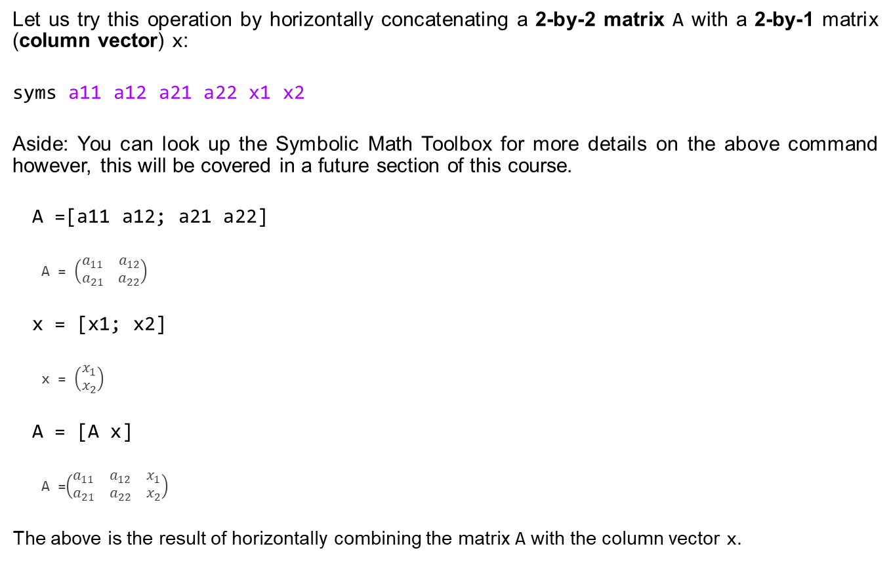
Array concatenation
Let us try this operation by horizontally concatenating a 2-by-2 matrix A with a 2-by-1 matrix (column vector) x:
syms a11 a12 a21 a22 x1 x2
Aside: You can look up the Symbolic Math Toolbox for more details on the above command however, this will be covered in a future section of this course.
A =[a11 a12; a21 a22]
A = $\left(\begin{matrix}a_{11} & a_{12} \\ a_{21} & a_{22}\end{matrix}\right)$
x = [x1; x2]
x = $\left(\begin{matrix}x_{1} \\ x_{2}\end{matrix}\right)$
A = [A x]
A =$\left(\begin{matrix}a_{11} & a_{12} & x_{1} \\ a_{21} & a_{22} & x_{2}\end{matrix}\right)$
The above is the result of horizontally combining the matrix A with the column vector x.

Slide 37
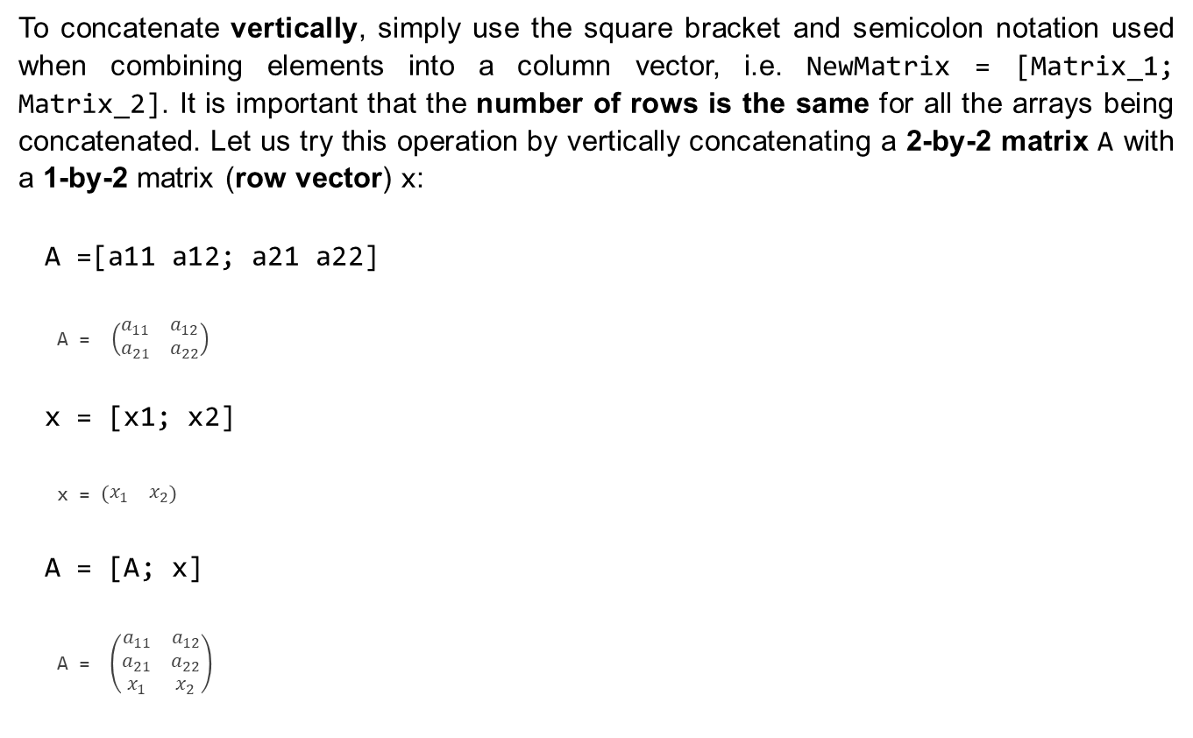
Array concatenation
To concatenate vertically, simply use the square bracket and semicolon notation used when combining elements into a column vector, i.e. NewMatrix = [Matrix_1; Matrix_2]. It is important that the number of rows is the same for all the arrays being concatenated. Let us try this operation by vertically concatenating a 2-by-2 matrix A with a 1-by-2 matrix (row vector) x:
A =[a11 a12; a21 a22]
A = $\left(\begin{matrix}a_{11} & a_{12} \\ a_{21} & a_{22}\end{matrix}\right)$
x = [x1; x2]
x = $\left(\begin{matrix}x_{1} & x_{2}\end{matrix}\right)$
A = [A; x]
A = $\left(\begin{matrix}a_{11} & a_{12} \\ a_{21} & a_{22} \\ x_{1} & x_{2}\end{matrix}\right)$

Slide 38
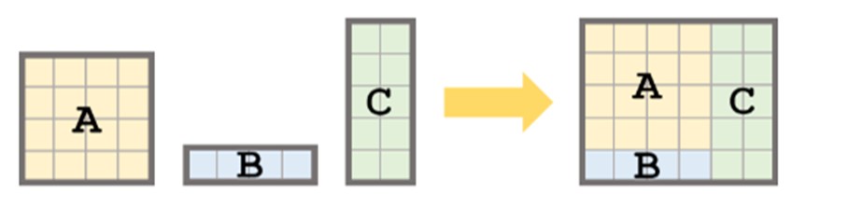
Array concatenation
Horizontal and vertical concatenation can also be combined in a single operation as long as the dimensions match, i.e. the number of rows and columns are equal when concatenating vertically and horizontally respectively. For example, consider 3 matrices, A, B, and C which have the dimensions 4-by-4, 1-by-4, and 5-by-2 respectively. What command will combine all three matrices into a single matrix with dimensions 6-by-6?
The above image illustrates graphically how this operation should take place. There is a vertical concatenation of A and B, and then a horizontal concatenation of the result with matrix C.

Slide 39
Array concatenation
Let us begin by defining the three matrices:
syms a11 a12 a13 a14 a21 a22 a23 a24 a31 a32 a33 a34 a41 a42 a43 a44 b11 b12 b13 b14 c11 c12 c21 c22 c31 c32 c41 c42 c51 c52
A = [a11 a12 a13 a14;
a21 a22 a23 a24;
a31 a32 a33 a34;
a41 a42 a43 a44];
B = [b11 b12 b13 b14];
C = [c11 c12;
c21 c22;
c31 c32;
c41 c42;
c51 c52];

Slide 40
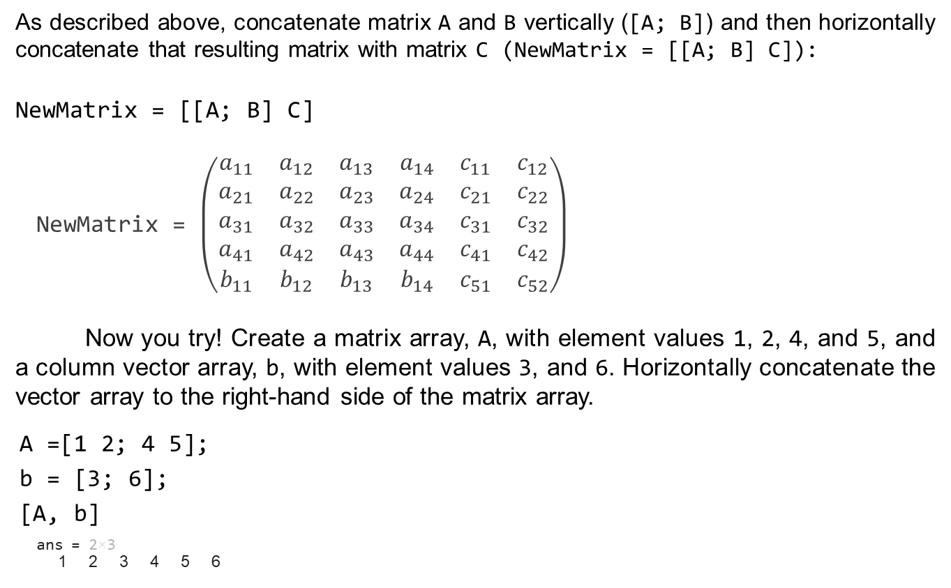
Array concatenation
As described above, concatenate matrix A and B vertically ([A; B]) and then horizontally concatenate that resulting matrix with matrix C (NewMatrix = [[A; B] C]):
NewMatrix = [[A; B] C]
NewMatrix = $\left(\begin{matrix}a_{11} & a_{12} & a_{13} & a_{14} & c_{11} & c_{12} \\ a_{21} & a_{22} & a_{23} & a_{24} & c_{21} & c_{22} \\ a_{31} & a_{32} & a_{33} & a_{34} & c_{31} & c_{32} \\ a_{41} & a_{42} & a_{43} & a_{44} & c_{41} & c_{42} \\ b_{11} & b_{12} & b_{13} & b_{14} & c_{51} & c_{52}\end{matrix}\right)$
Now you try! Create a matrix array, A, with element values 1, 2, 4, and 5, and a column vector array, b, with element values 3, and 6. Horizontally concatenate the vector array to the right-hand side of the matrix array.
A =[1 2; 4 5];
b = [3; 6];
[A, b]
ans = 2×3
1 2 3 4 5 6

Slide 41
Operate with functions on arrays
To get us started, let us define 2 vector arrays a and b with 5 equally spaced element values as follows:
a = 10:10:50
a = 1×5
10 20 30 40 50
b = 5:-1:1
b = 1×5
5 4 3 2 1

Slide 42
Operate with functions on arrays
Let us consider the element-wise multiplication and division of the vector arrays a and b, denoted respectively by the operators .* and ./
a.*b
ans = 1×5
50 80 90 80 50
a./b
ans = 1×5
2 5 10 20 50
Note that the vector arrays, a and b, have the same dimensions, and the output has the same dimensions as the input arrays. Consult the documentation for times and rdivide for more information about their other operating properties.

Slide 43
Operate with functions on arrays
Now you try! Consider the following 2 vector arrays, quantity, price_per_pack, which represent the number of pears in a fruit pack, and its corresponding selling price in ZAR per fruit pack, respectively.
quantity = 2:2:8;
price_per_pack = [10 18 25.5 30];
Determine the selling price per unit (pear) when a fruit pack is chosen, i.e. use element-wise division of price_per_pack by quantity.
price_per_pack./quantity
ans = 1×4
5.000000000000000 4.500000000000000 4.250000000000000 ⋯

Slide 44
Operate with functions on arrays
There are many operators that can be applied directly to arrays, including trigonometric, logarithmic, and other mathematical functions. Let us demonstrate this by first creating an array of values in the interval [0, 2π], and then operating on the array with the sin, tan, and log functions.
x = linspace(0,2*pi)
x = 1×100
0 0.0635 0.1269 0.1904 0.2539 0.3173 0.3808 ⋯
y_1 = sin(x)
y_1 = 1×100
0 0.0634 0.1266 0.1893 0.2511 0.3120 0.3717 ⋯
y_2 = tan(x)
y_2 = 1×100
0 0.0636 0.1276 0.1927 0.2595 0.3284 0.4003 ⋯
y_3 = log(x)
y_3 = 1×100
-Inf -2.7572 -2.0641 -1.6586 -1.3709 -1.1478 -0.9655 ⋯

Slide 45
Operate with functions on arrays
Next, let us create a vector or values drawn from a uniform distribution in the interval (0, 1). The function rand is used to do this, following the same notation as the functions ones and zeros, var = rand(r, c)
b_3 = rand(1,5)
b_3 = 1×5
0.8147 0.9058 0.1270 0.9134 0.6324
Now you try! Create a row vector array, x, with 5 equally spaced element values between -1 and 1. Determine the absolute value of this array using the abs function.
x = linspace(-1,1,5)
x = 1×5
-1.0000 -0.5000 0 0.5000 1.0000
abs(x)
x = 1×5
1.0000 0.5000 0 0.5000 1.0000

Slide 46
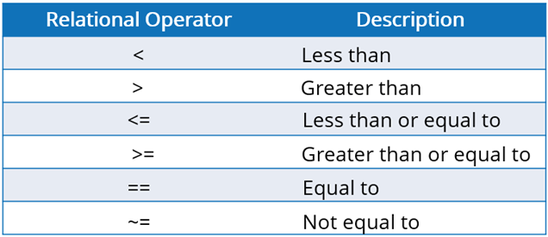
Relational Operators
Relational operators, also known as conditional operators, are used to compare two variables/values to determine if the condition is true or false, for example the outcome of π ≥ 3 would be true while the outcome of π ≤ 3 would be false. The outcomes of such statements are logical values which can only take on a value of 1 (when true) and 0 (when false). The following table has the relational operators you'll need for programming:

Slide 47
Relational Operators
Let us put these into practice by considering the example mentioned above:
pi >= 3
ans = logical
1
pi <= 3
ans = logical
0
Note: The outputs are of type logical.

Slide 48
Relational Operators
Now you try! As with functions, relational operators can also be applied to arrays, let us demonstrate this through some exercises. Let us consider two randomly generated integer vectors arr_1 and arr_2:
arr_1 = randi(50,[1 10])
arr_1 = 1×10
18 30 12 38 13 26 35 45 48 28
arr_2 = randi(50,[1 10])
arr_2 = 1×10
7 8 13 43 13 41 13 47 18 10

Slide 49
Relational Operators
Which elements of arr_1 is greater than or equal to the corresponding element in arr_2? Assign the answer to the variable logical_arr_1 for use later on.
logical_arr_1 = arr_1 >= arr_2
logical_arr_1 = 1×10 logical array
1 1 0 0 1 0 1 0 1 1
Which elements of arr_2 is greater than 10? Assign the answer to the variable logical_arr_2 for use later on.
logical_arr_2 = arr_2 < 10
logical_arr_2 = 1×10 logical array
1 1 0 0 0 0 0 0 0 0

Slide 50
Relational Operators
Now you try! In the two exercise questions above, we saw the application of relational operators to the vector arrays. Now, let us consider two exercises that demonstrate the application of relational operators on matrix arrays. Consider the following two randomly generated integer matrices, arr_3 and arr_4:
arr_3 = randi(50,[4 4])
arr_4 = randi(50,[4 4])
Which elements of arr_3 is less than their corresponding elements in arr_4?
arr_3 < arr_4
Which elements of arr_4 is greater than or equal to 20?
arr_4 >= 20
Note: Relational operators can be applied to arrays of any order. We only covered the application of relational operators in the case of scalar, vector, and matrix arrays. Consult the documentation for the Array Comparison with Relational Operators for more information.

Slide 51
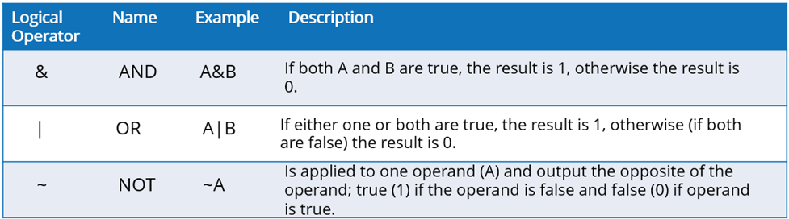
Logical Operators
Logical operators are used to compare two statements to determine if the condition is true or false. As with relational operators, the outcome of a comparison using a logical operator will be of type logical, which can only take on a value of 1 (when true) and 0 (when false). The following table has the basic logical operators you'll need for programming:
These operators can be applied to scalars and arrays of higher orders/dimensions.

Slide 52
Logical Operators
Let us consider the above-mentioned operators to logical_1 and logical_2 as defined below:
logical_1 = true;
logical_2 = false;
logical_1 & logical_2
ans = logical
0
logical_1 | logical_2
ans = logical
1
~logical_1
ans = logical
0
3

Slide 53
Logical Operators
In a similar way, we can apply logical operators on logical arrays, of any order. Recall the logical arrays we computed in the previous subsection, log_arr_1 and log_arr_2, let us apply the & operator to them.
logical_arr_1
logical_arr_1 = 1×10 logical array
1 1 0 0 1 0 1 0 1 1
logical_arr_2
logical_arr_2 = 1×10 logical array
1 1 0 0 0 0 0 0 0 0
logical_arr_1 & logical_arr_2
ans = 1×10 logical array
1 1 0 0 0 0 0 0 0 0

Slide 54
Logical Operators
Note: If you have cleared your workspace, you will need to run the section where logical_arr_1 and logical_arr_2 are defined. The logical arrays produced will be different each time you run the section, this is because they are based on randomly generated integer arrays.
Now you try! Create a row vector, arr_5, with 5 elements between the values of 1 and 10 using the randi function. Determine which elements are smaller than 4 or greater than 6.
arr_5 = randi(10, [1 5])
arr_5 = 1×5
3 8 8 4 6
arr_5 < 4 | arr_5 > 6
ans = 1×5 logical array
1 1 1 0 0

Slide 55
Logical Operators
Let us now define this using some code. We assume that an answer of "yes" and "no" are true and false, respectively.
Question_1_Answer = true;
Question_2_Answer = true;
Should we light a candle for our study area?
~Question_1_Answer && ~Question_2_Answer
ans = logical
0

Slide 56
For Loops
For loops are used for iterating over a sequence such as an array, a set or a string. For loops are used in instances where an algorithm needs to be repeated for a specified number of times, and only stopping once the ideal number of iterations has been reached. The common structure if a for loop is specified as follows:
for i = v
Loop body
end
All For loop statements begin with the keyword "for”, followed by what is called an iteration variable (in this example, i) which represents each of our list items at a single time. This variable is set equal to our list (v) which in this example contains a list of names. The loop body contains the instruction that will be repeated for all elements in the list. Finally, the loop is closed by using the keyword "end". It should be noted that for loops in MATLAB require the "end" declaration at the end of the loop body to complete the structure of a for loop.

Slide 57
For Loops
The standard process begins at the iteration variable where an element from the list is taken into the loop body where a set of instructions are executed on the variable, this process happens iteratively for all elements in the list. In our names example this would look like this,
In this example we will create an array with 3 names, refer to week 2 to learn more about how to create different arrays. Using square brackets [] will give an array whilst {} brackets will give a cell array. All elements in array related brackets [] must be of the same data type and elements in a cell array {} can have different data types.
for i = ["John", "Freddy", "Lisa"]
disp(i)
end
For loops can be used with different data structures. For example, a for loop can be used to sum numbers in an array.
sum = 0;
for i = 1:10
sum = sum + i
end

Slide 58
For Loops
Now Try for Yourself!
In the line below, using a for loop statement, find the sum of the array "numbers" and assign it to the variable "counter".
numbers = [2, 4, 6];
counter = 0;
for i = numbers
counter = counter + i;
end
disp(counter)

Slide 59
While Loops
While loops are another kind of loop structure. Whilst for loops can be used unconditionally (without a condition), while loops can be iterated based on a specified condition. For example, given a list of numbers, you may want to sum the first 10 numbers on the list with summing all elements in the list. The common structure of a while loop is specified as follows:
while (condition)
Loop body
end
The keyword for starting a while loop is "while" followed by a condition which will terminate the loop but otherwise continue unless the condition has been met. This is followed by the loop body where a set of instructions are executed and just like the for loop, an "end" keyword is used to close the while loop.

Slide 60

While Loops
An example is given as follows,
sum = 0;
while sum <= 10
sum = sum + 1
end
In the for loop example, an iteration variable "i" was used based on the elements of a list, however, in the above example, the while loop uses an independent variable that is initialised to 0. The condition in the while loop states that if the independent variable is less than 10, the variable will be incremented by 1. This while loop terminates once the independent variable goes over 10.
The idea of using a loop structure can be greatly appreciated in numerical computations where usually the same piece of code is repeatedly executed. In real world applications, the error of repeatedly executing a piece of code can be reduced by using a loop structure. Loops can be nested in MATLAB. The for loops can be nested within while loops, and vice versa. To finish a loop, there should be a matching end statement.

Slide 61
While Loops
Now Try for Yourself!
In the line below, using a while loop statement, individually display the apples element in the "fruits" array.
fruits = ["apricot", "pears", "pineapples", "apples"];
for i = fruits
disp(i)
end
disp(counter)
apricot
pears
pineapples
apples

Slide 62
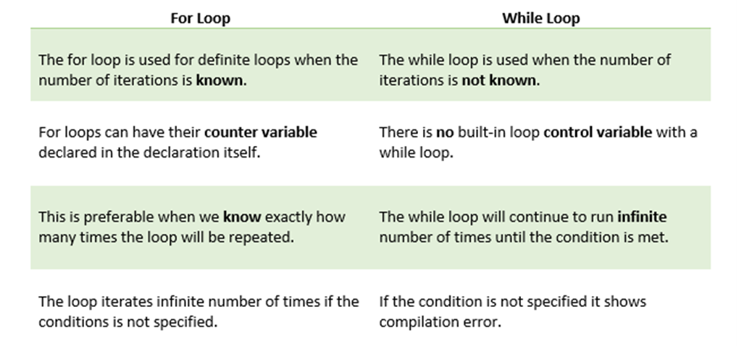
While Loops
Some notable differences between for loops and while loops are given in the table below,

Slide 63
Conditional Structures
Conditional structures are supported in many programming languages. Conditional structures are used to specify the use of specific parts in an algorithm that need to be executed. As different conditions are met, different pieces of code are executed. The most common conditional statement is the if-else-end statement. We will have a look at various conditional statements in this section.

Slide 64
Conditional Structures
The simplest form of a condition structure in pseudo-code is:
if (condition)
statement1
end
where "condition" is an expression.
This reads as follows:
"If the 'condition' is true, then, the commands in 'statement1' must be executed.
'end' indicates that the condition is complete.
If the "condition" is not true, then the "statement group" can be bypassed.
Consider a list of names ["Paul", "Sam", "Seth", "Heather", "Sally"] where you only want to print the names that begin with the letter "S".
A conditional if statement can be used to check that the first letter of each name contains an "S" and then proceed to print the name.

Slide 65
Conditional Structures
A simple conditional statement can be extended to check for multiple conditions by using an "elseif" statement. In the generalised pseudo-form this is described as follows,
if (condition 1)
statementGroup1
elseif (condition 2)
statementGroup2
else
statementGroup (n + 1)
end
If condition 1 is satisfied, execute statement group 1,
otherwise if condition 2 is true then execute statement group 2 and so on
and if no statement group is satisfied, the only option is the statement group that is enclosed after the else statement.

Slide 66
Conditional Structures
MATLAB Live Editors contain interactive control tasks that you can use to declare variables. An example is a slide bar, using interactive control tasks allows you to make your Live Editor worksheet robust and it is easier to change variables, update condition values and see the output.
Let's look at a process in code.
aRandomValue = 44
if aRandomValue > 0
msgString = sprintf('The Random value is: %d', aRandomValue)
elseif aRandomValue < 0
msgString = sprintf('The Random value is: %d', aRandomValue)
else
msgString = "The random value is zero"
end
Read more about the sprintf() built-in function which formats data into strings or character vectors.

Slide 67
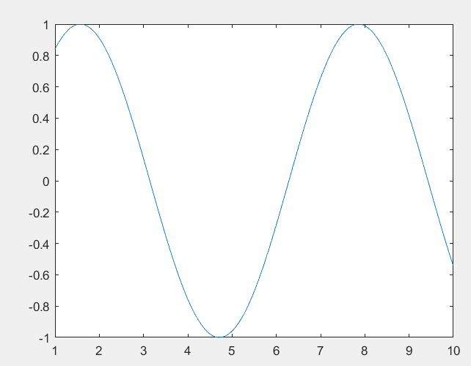
How to plot?
X=1:10;
Y=sin(X)
Plot (X,Y)

Slide 68
Calling a function
function e = entropy(x)
p(1) = (length(find(x==1)) + eps) ./ length(x);
p(2) = (length(find(x==2)) + eps) ./ length(x);
p(3) = (length(find(x==3)) + eps) ./ length(x);
e = - sum(p .* log2(p));
end
X=[1 2 3 3 1 2 3 3 3 1 1 1 3];
Y= entropy(X)

