Slide 2
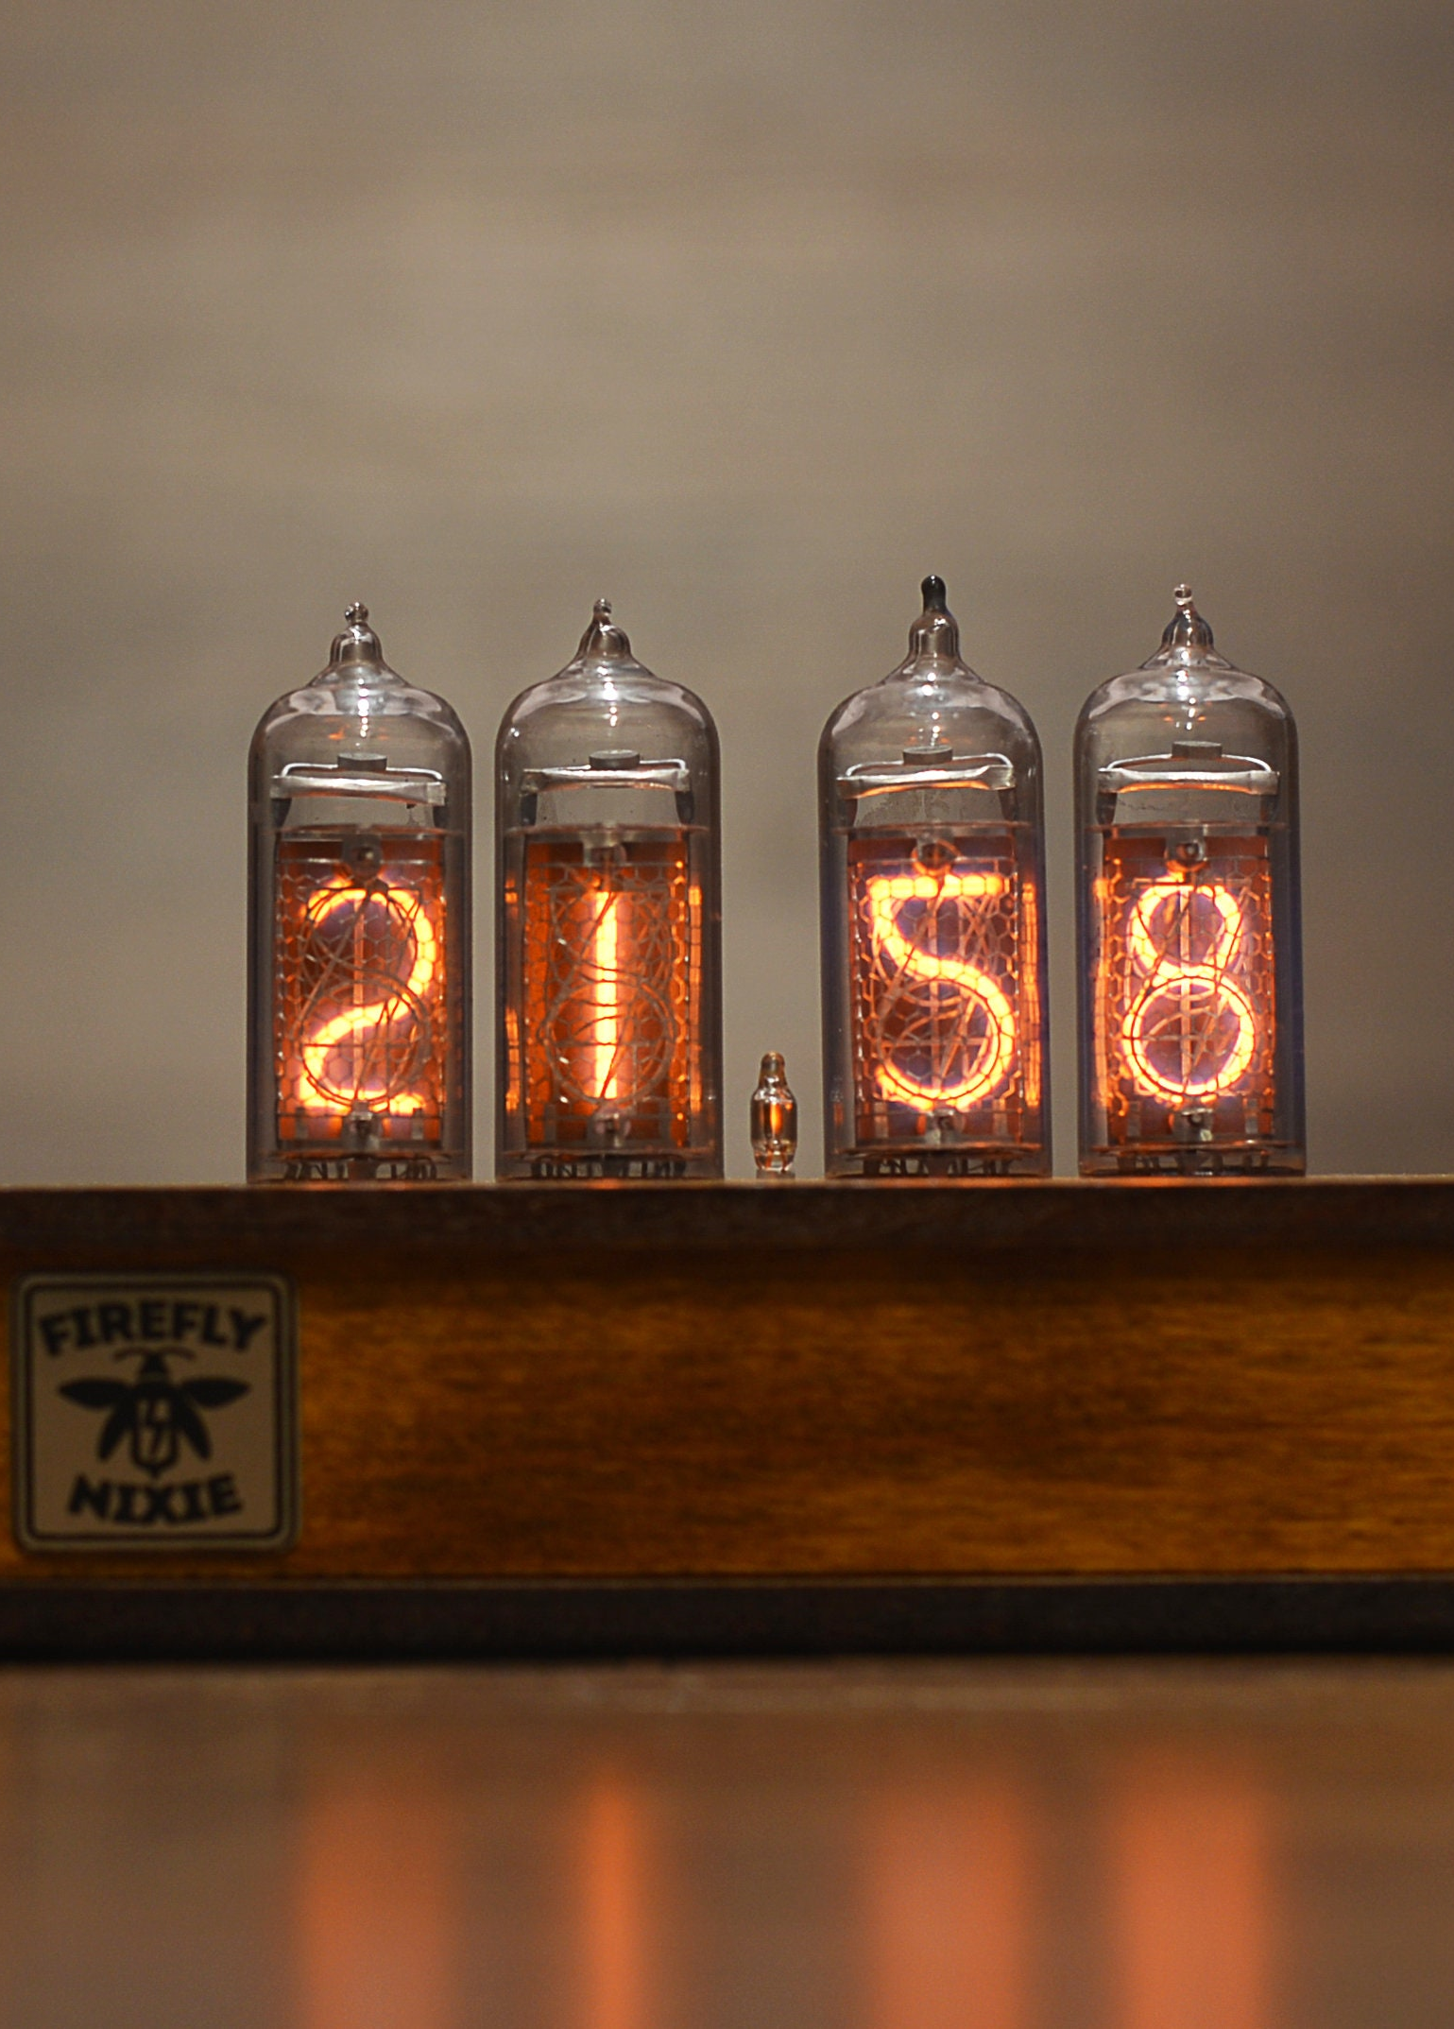
Expectations of the soldering station
Small footprint
Uses the JCB C245 soldering iron serie
Based on Elektors soldering station schematic
Design based of a nixie tube clock

Slide 3
Design process

Slide 4
Printed circuit board design
SMD components
5 schematics
Routed in rooms

Slide 5
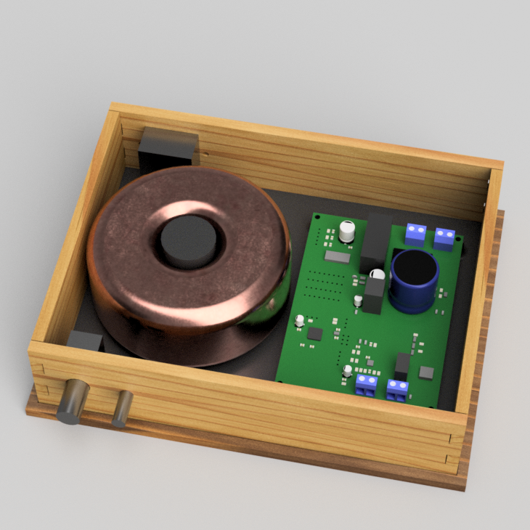
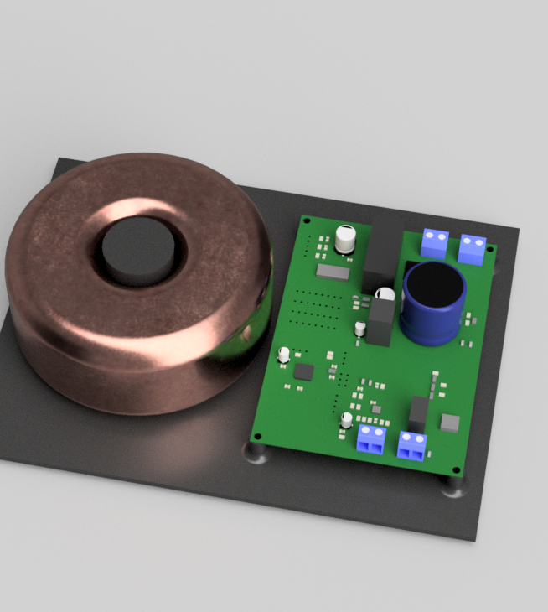
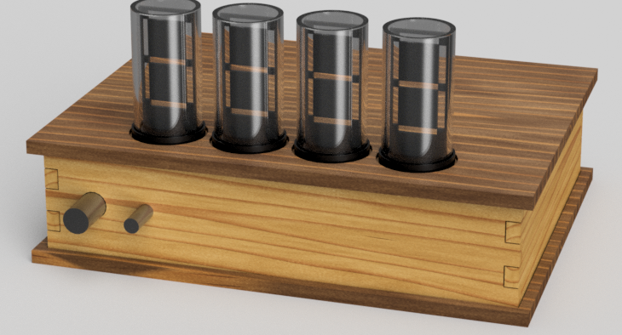
Case design
Led filament nixie tube
Parametrically design

Slide 6
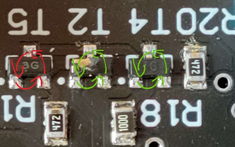
Electronic testing
Passed
Failed
Continuity test
DC power supply
5 volt
VCC
Realtor
5 volt
VCC
Mains voltage test -> transistor error

Slide 7
Result

