Slide 2
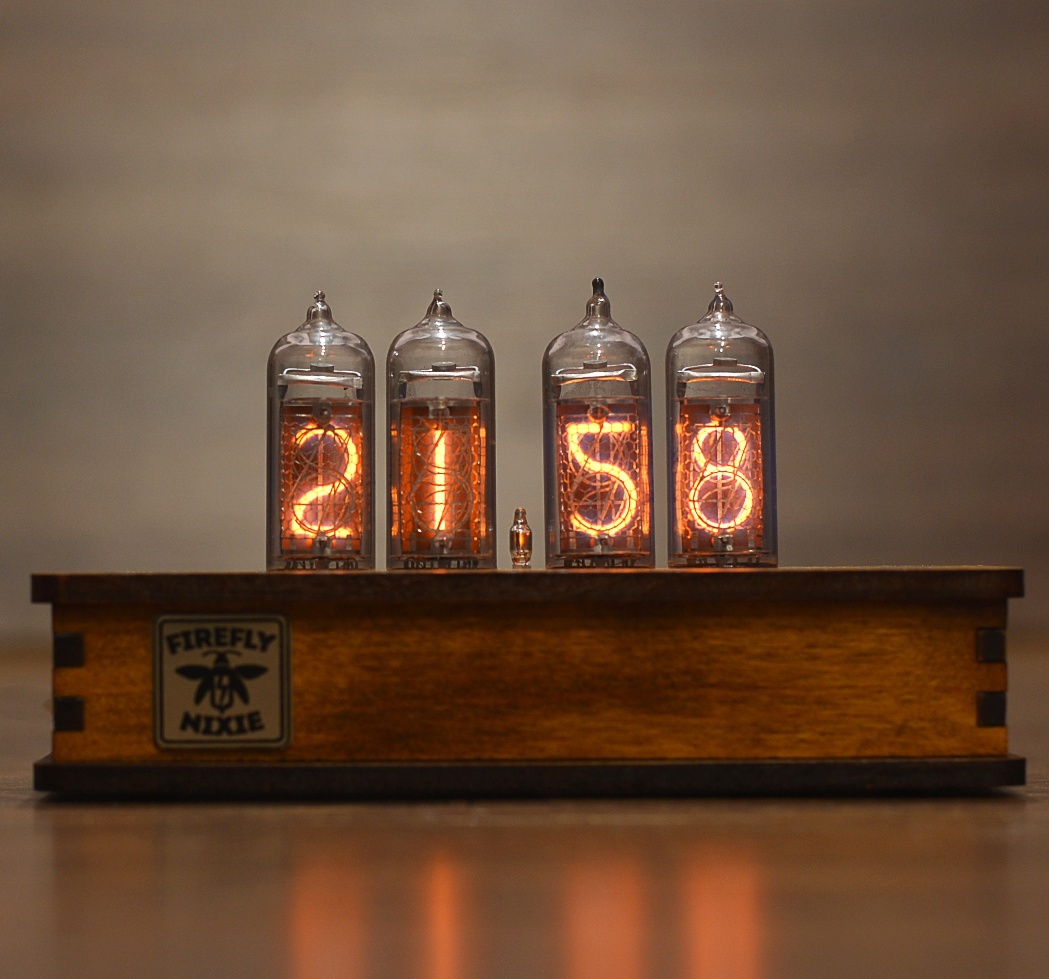
Expectations for the soldering station
Small footprint
Uses the JCB C245 soldering iron serie
Based on Elektors soldering station schematic
Design based of a nixie tube clock

Slide 3
Design process

Slide 4
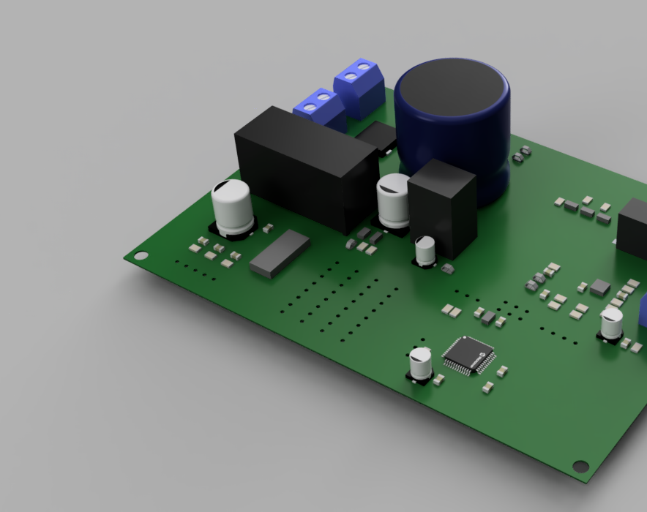
Printed circuit board design
SMD components
5 schematics
Routed in rooms

Slide 5
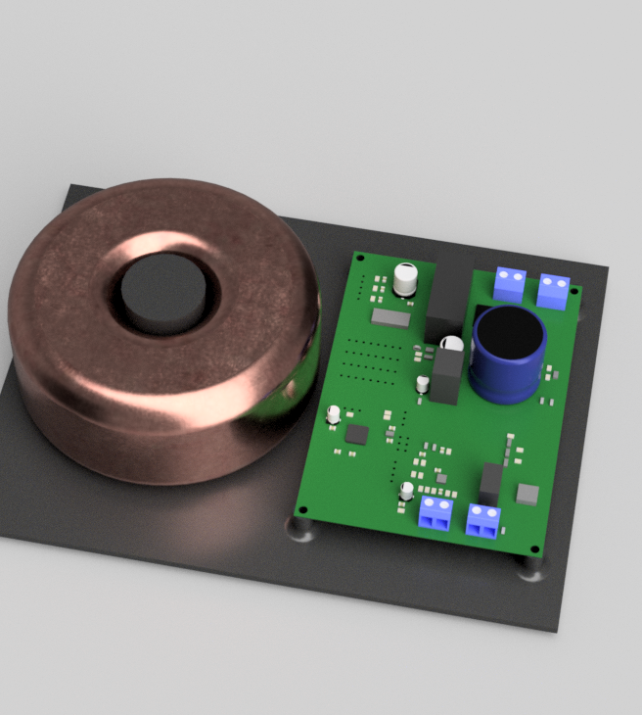
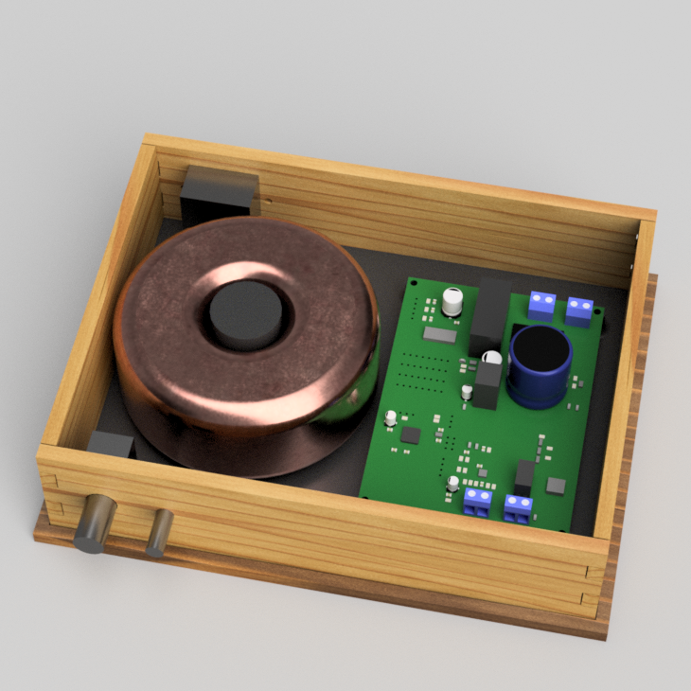
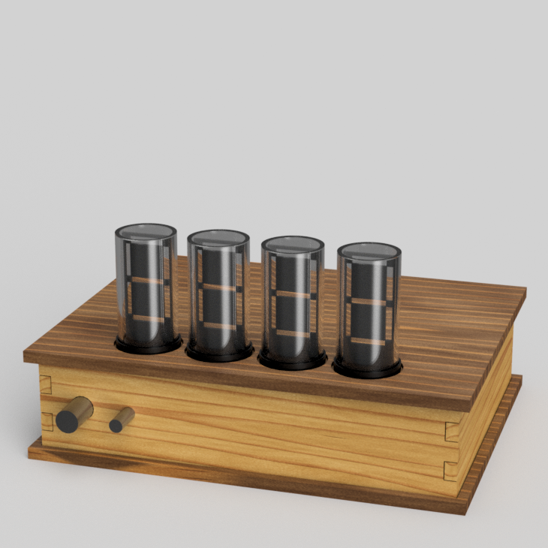
Case design
Led filament nixie tube
Parametrically designed

Slide 6
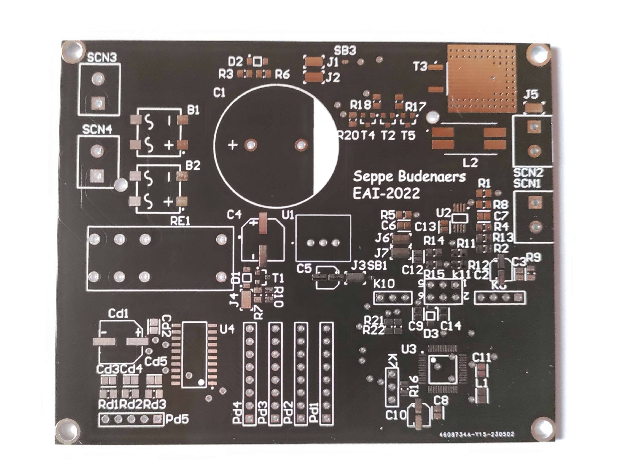
Electronic testing
Passed
Continuity test
DC power supply
5 V
VCC
Realtor
5 V
VCC

Slide 7
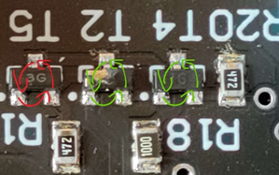
Electronic testing
Failed
Mains Voltage test

Slide 8
Result

