Slide 1
Automated curriculum learning under a safety constraint — progress, 21 October
Giuseppe Hannen
1 The per-context constraint works
2 The best policy was hiding a problem
3 What was tried
4 The result, side by side

Slide 2
1 · One λ follows the curriculum; the constraint never holds where the policy is deployed
PPO-Lagrange holds its constraint with one scalar λ, updated from the cost of whatever the curriculum samples. Every arm so far: at the budget on its own distribution, three to four times over it on level 3.
 | published PPO-Lagrange | contextual CMDP (this work)
multiplier | one scalar λ | a function λ(ω), fitted each round to what the integrator asks for
policy | sees sensors only | is told the context ω: hazard counts, goal radius
critics | see sensors only | see sensors and ω
forms of λ(ω) | — | network: a small MLP · additive: monotone per factor, so an unseen context's λ is bounded by its neighbours'
Constraint per context, policy told the context: the curriculum can no longer move the constraint.

Slide 3
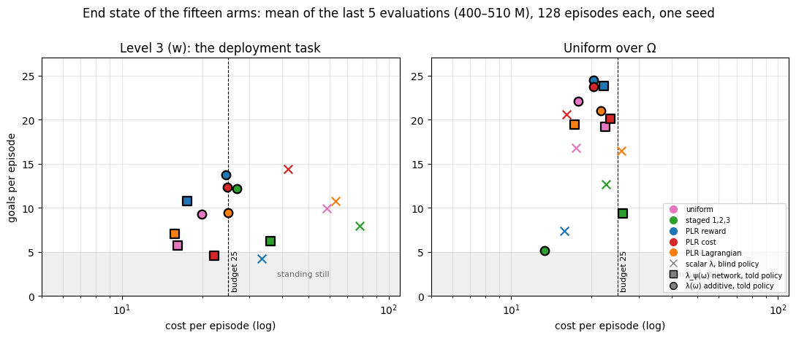
1 · Every arm under λ(ω) ends at the budget on level 3; additive keeps more return
Fifteen arms, 500 M steps. Scalar λ: none on budget. λ(ω): all on budget; additive > network on return everywhere. Additive is the default.

Slide 4
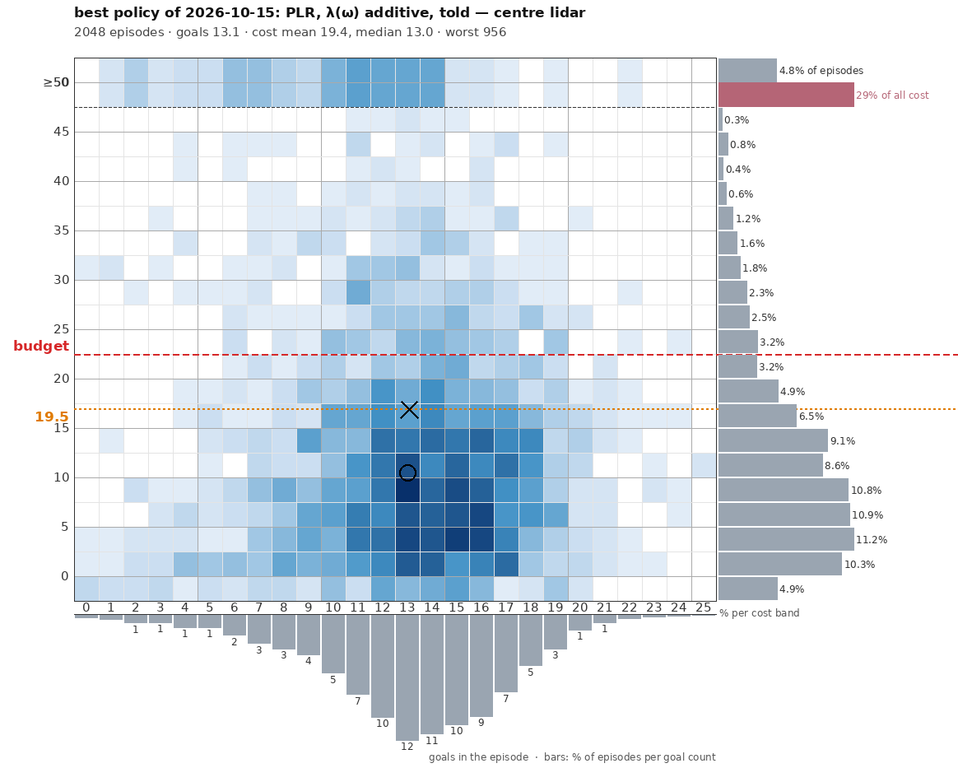
2 · Replaying the best policy: the typical episode costs half the budget
Every episode on a grid: goals across, cost up; colour = share of episodes.
○ median: cost 13.
× mean: 19.4.
The top row is every episode costing 50 or more: 1 in 20 of the episodes, 29 % of all the cost.
Orange line: the budget left for the other 95 % once those few are paid for.
Those few set the multiplier. Every other episode pays for them with caution.
A constraint on the mean is met by a policy whose failures are few and large.

Slide 5
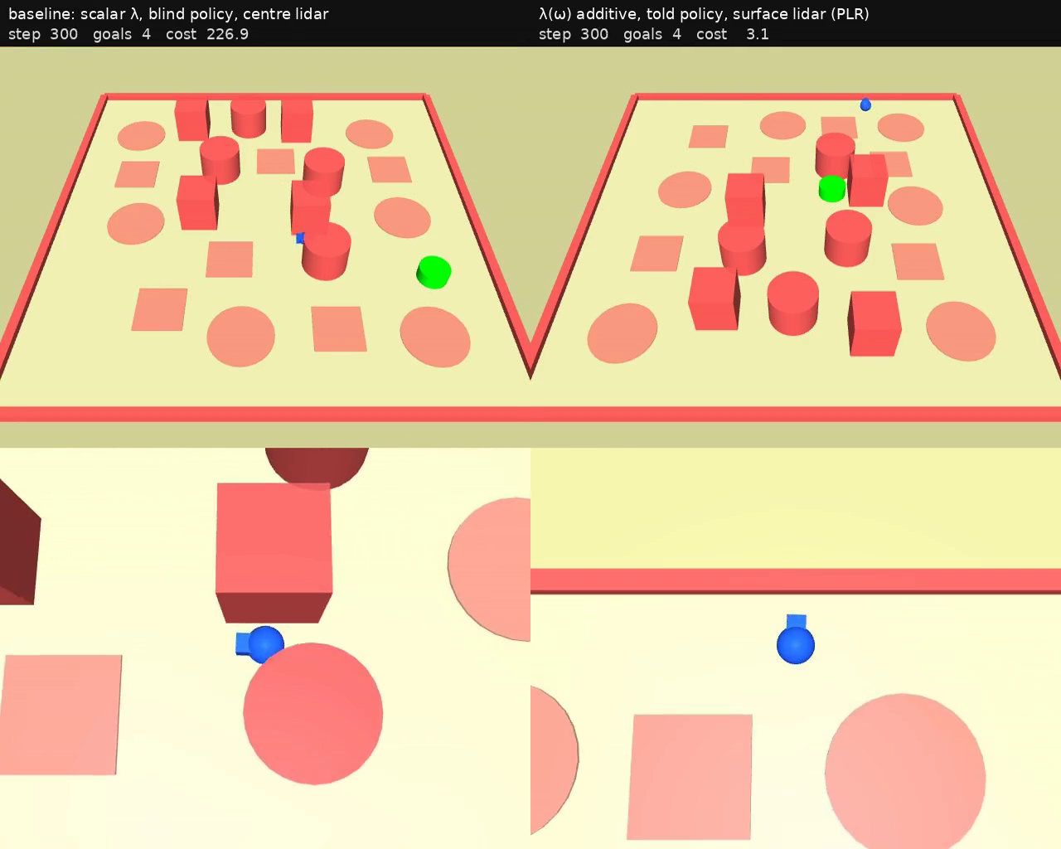
2 · The failure: a gap too narrow, tried again and again
Left: the published baseline (one λ, blind). Right: the best contextual policy — after the fix of part 3.
The agent drives into a gap, is pushed back, approaches again, for the rest of the episode. The border flashes red at every contact.
Why it cannot learn otherwise: the lidar reads the distance to each hazard's centre. A flat disc it may cross and a solid cylinder it cannot look identical, and the width of a gap is not in the observation at all.
Whether the gap is passable is not a function of what the policy sees.

Slide 6
3 · Three remedies, after one measurement
Measured first, on 384 replayed episodes: contact is intermittent — 68 touches over 700 steps, never more than 10 in a row, a median of 32 steps between touches.
 | the idea | what happened
a camera | shows kind, extent and occlusion, on every suite | the same failure with the wall in frame; evaluations swing between checkpoints — set aside
geometry | the lidar as two arrays, passable and solid, reading the hazards' surface — the missing fact, in the sensor it already reads | next slide
memory | a trace of recent sensors, actions and costs (τ = 32 steps, the median interval between touches) — so it can know it has been here | next slide
a cost rising with sustained contact | charge pressing, not brushing | not run: there is no sustained contact to charge
Five arms at 500 M, judged by the per-episode metrics the evaluator now logs and by 2048 replayed episodes each.

Slide 7
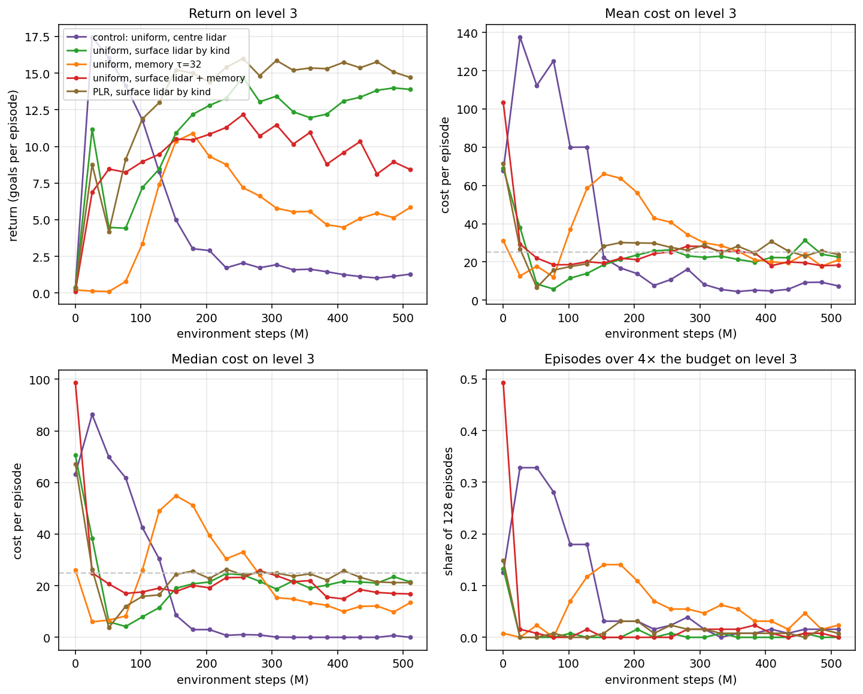
3 · Surface lidar: the median meets the mean and the tail is gone. Memory alone: neither
The failure was perceptual. The surface lidar is the observation from here; the memory stays available and off.

Slide 8
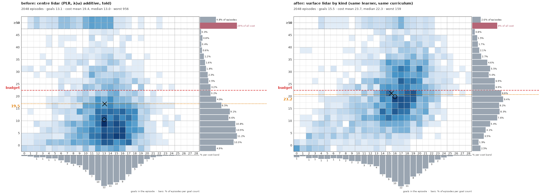
4 · Before and after, same learner and curriculum: the cloud moves up to the budget and right
The top row falls from 29 % of all cost to 8 %; the budget left for the ordinary episodes rises from 19.5 to 23.2 of 25; goals 13.1 → 15.5.

Slide 9
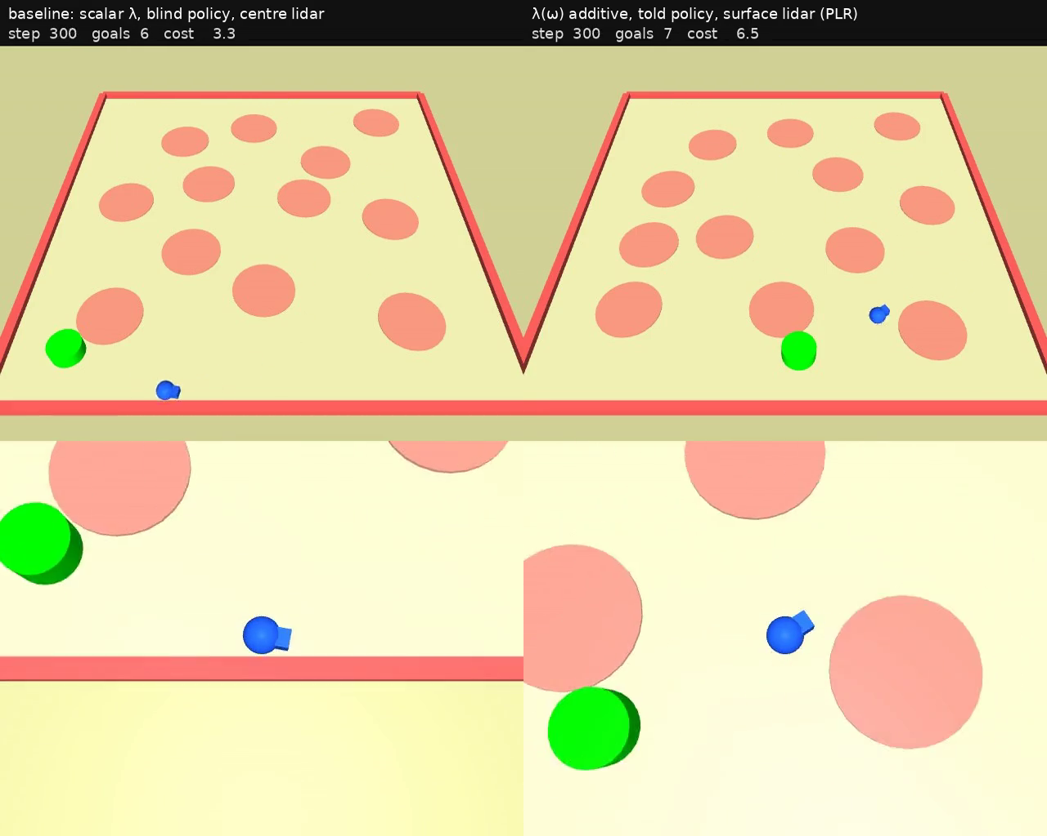
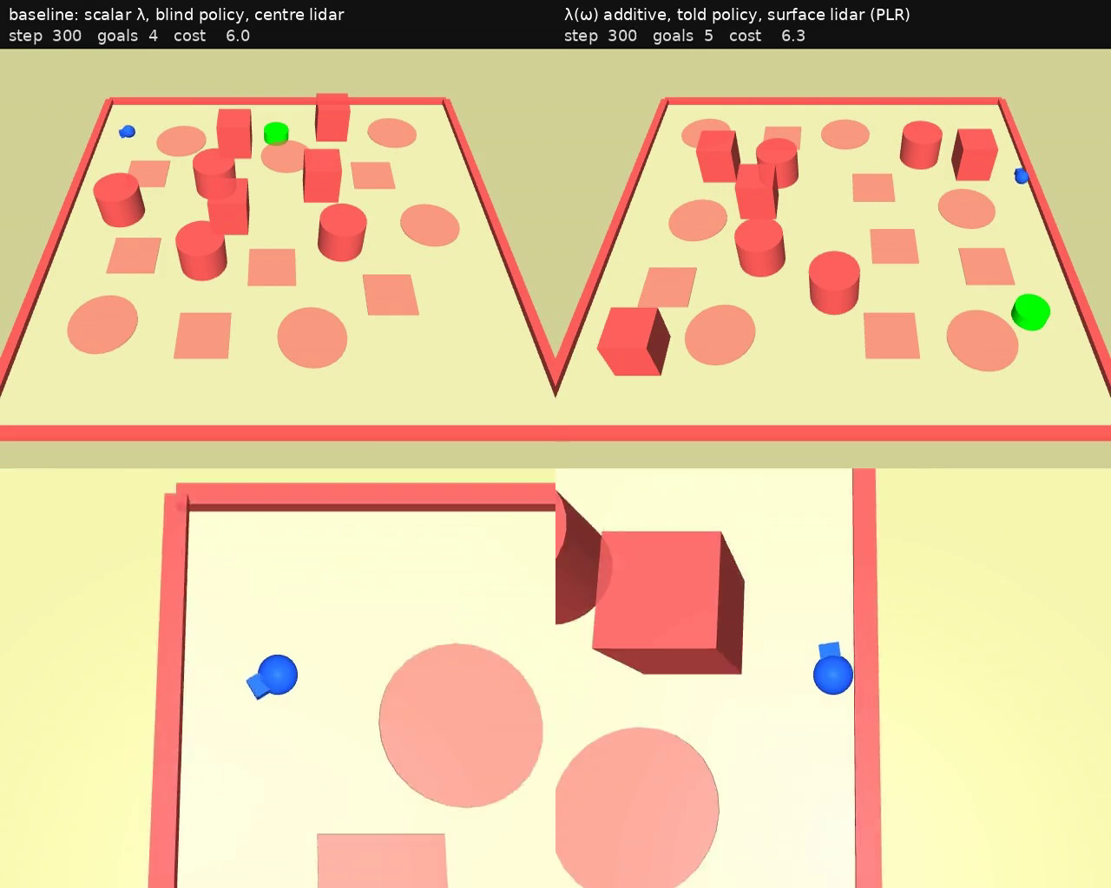
4 · The published baseline against the best contextual policy, typical episodes
Level 1 — the baseline hoards the budget; the contextual policy spends it
Level 3 — the contextual policy under budget, the baseline over
One constraint, one policy: at the budget on every level, more goals than the baseline on every level, a worst case eight times smaller.

Slide 10
Two things to say honestly, and what comes next
Avoidance, not escape
Next
The agent enters a trap a third as often. Once inside, it gets out no more often than before.
• A second seed before any claim about which curriculum is best (PLR led uniform under both lidars, one seed each).
• Task 2: the held-out hazard-count band — the first generalisation test, on an observation whose cost is not set by a tail.
• Recovery once inside a trap: a recurrent policy, or targeted experience.
• For Tristan: the surface lidar and the memory part, both opt-in.
A mean constraint spends the budget
Met by a policy that uses it, the budget is exceeded in four episodes of ten, by small amounts. That is what the constraint asks for — and the per-episode metrics now say so.

