Slide 1

Shark attacks:
some stats and insurance considerations
Team

Slide 2
Project overview
General stats:
Number of attacks rising?
What is the demographics of victims? Age, gender?
Men are more at higher risk to be attacked than women?
What are the shark attack hotspots?
What activities were linked to shark attacks?

Slide 3
Data wrangling and cleaning
Column names -> lower case, replace empty spaces with underscores: df.columns = df.columns.str.lower().str.replace(" ", "")
Remove columns not containing useful text information: df.drop(columns=['source','name','pdf','href','hrefformula','unnamed:11','casenumber', 'casenumber.1', 'originalorder', 'unnamed:21', 'unnamed:22'], inplace=True)
Remove empty rows: df.dropna(how ='all', inplace=True)
CAST non-null YEAR values to int: df['year'] = df['year'].apply(lambda i: int(i) if pd.notna(i) else i)
Formatting info on injuries:
df.injury = df.injury.apply(lambda i: "unknown" if pd.isna(i) else i)
df.injury = df.injury.apply(lambda i: str(i))
df.injury = df.injury.apply(lambda i: i.lower())
CAST non-null AGE values to numerical format: df.age_numeric = pd.to_numeric(df.age, errors='coerce')

Slide 4
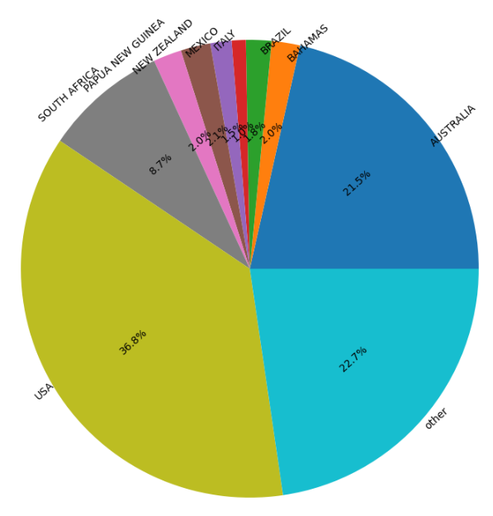
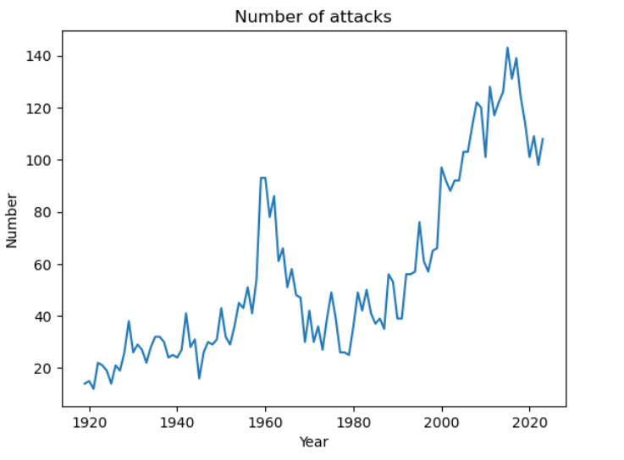
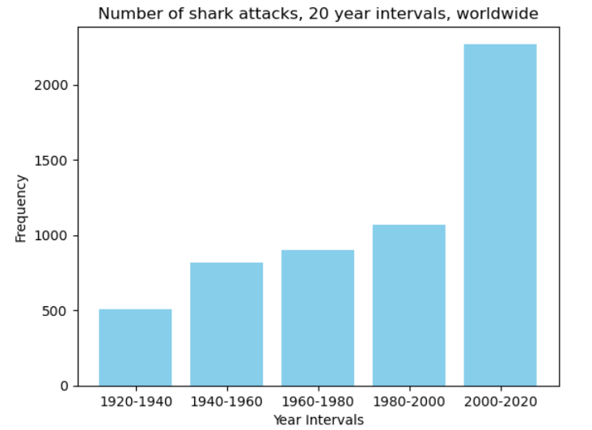
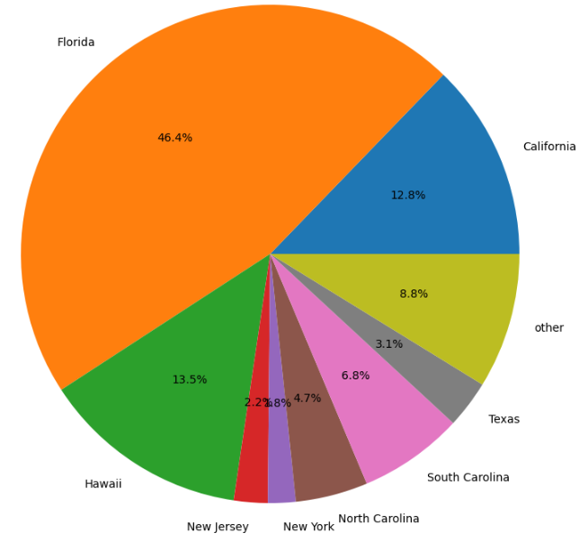
EDA: INCIDENCE
WORLDWIDE
More people have access to potentially hazardous activities (like surfing etc.)?
What is the cause of the peak incidence in early 60s?
Possible explanation: Broader access to leisure activities -> high incidence -> preventive measures? (Labeling danger zones, shark defense nets etc.)

Slide 5
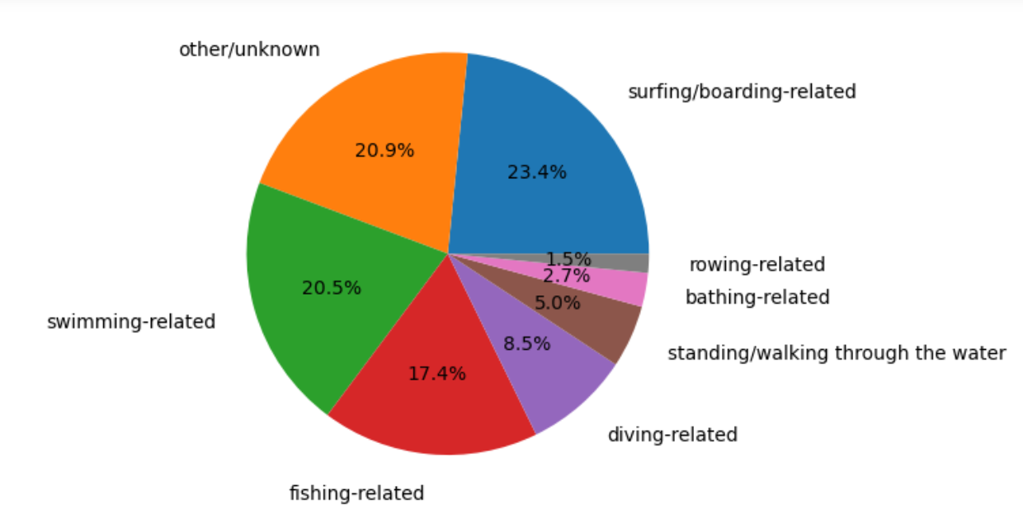
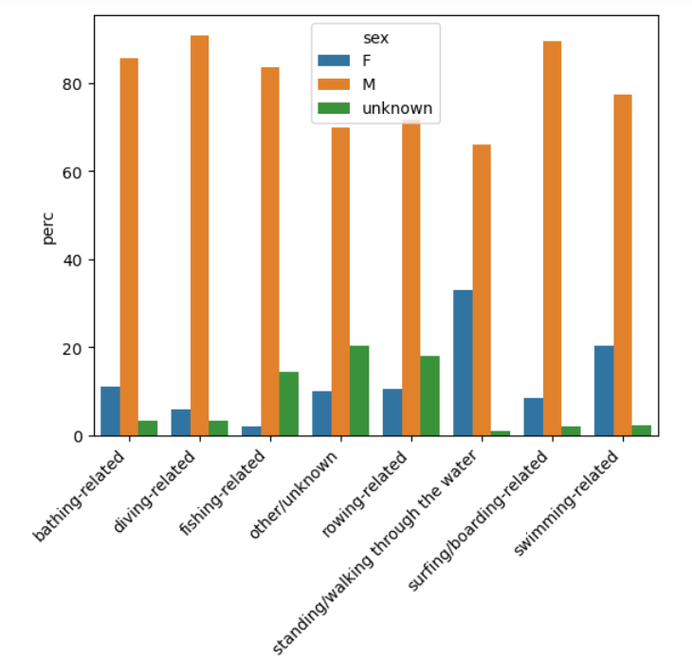
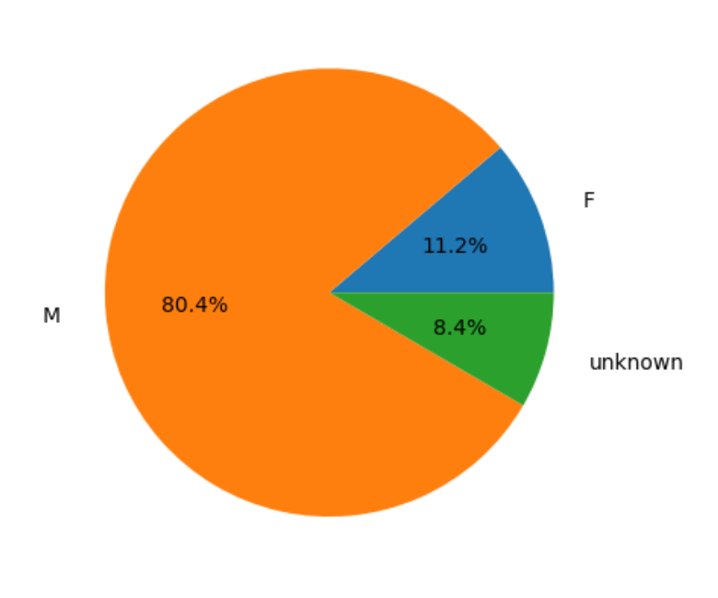
EDA: SEX RATIO, ACTIVITIES, AGE OF VICTIMS
Men are more prone to high-risk activities?
1432 people died / 6943 total number of attacks
21% of all attacks were surely fatal
median age 24 years, mean 28 years, max 87, min 1

Slide 6
Major obstacle
To deal with a bunch of text results to categorize
Regex -> Mapping

Slide 7
Conclusions and insights
Yes, the incidence of shark attacks is rising
Yes, men are at higher risk comparing to women
Shark attack hotspots are predominantly USA (Florida, Hawaii, California) and Australia, but some attacks were registered in EU as well (e.g. Italy, Croatia, Spain)

Slide 8


Business Case/Hypothesis
We are a Data Analyst in a Insurance Company called “Shark Attack”. Our Goal is to identify risk factors, which would affect the fees for a shark attack insurance. The riskier an individual behaves, the higher the fee should be.
Hypothesizes:
Gender is a risk factor
Age is a risk factor
The activity is a risk factor

Slide 9
Restrictions of the Data
Problem:
We don’t have data about the whole population in the waters. For example: If more men are involved in shark incidents - is it because there behaviour is riskier or is it because there are just way more men than women in the waters?
Solution:
We use the type of incidents as a proxy for risky behaviour. The bigger the share of “provoked” incidents, the riskier the behaviour is and the higher the insurance fee should be.

Slide 10
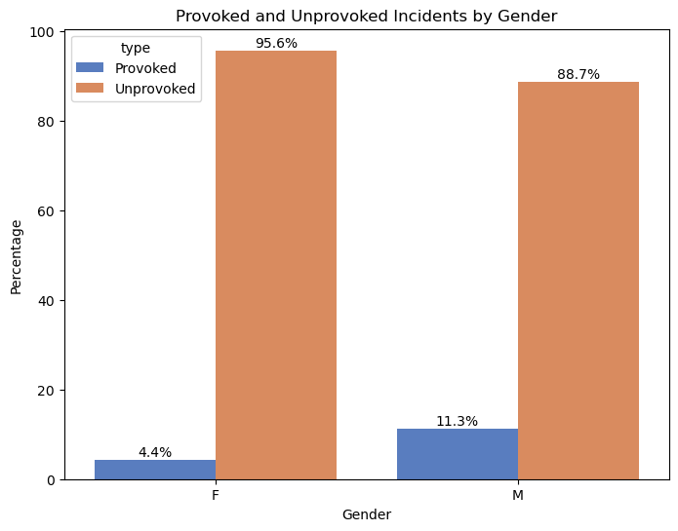
Risk Factor: Gender
The share of provoked incidents
for males is almost three times
as high as for females.
Conclusion: Men should pay a
higher fee than women.

Slide 11
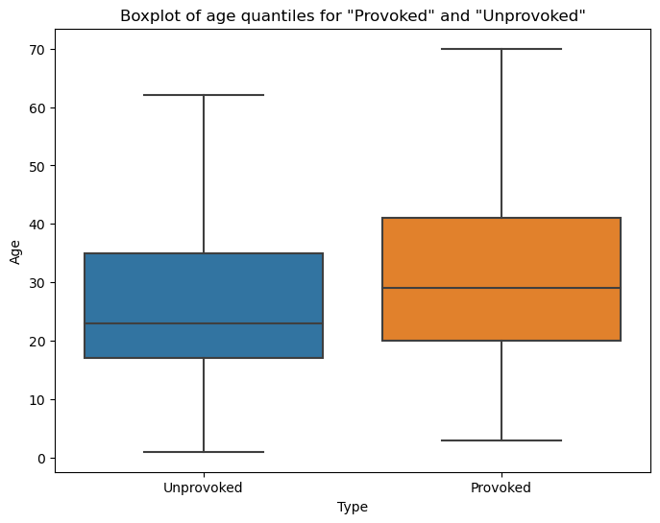
Risk Factor: Age
There is not a big difference
between the age distributions of
“Provoked” and “Unprovoked”
incidents.
Conclusion: All ages should pay the
same fee.

Slide 12
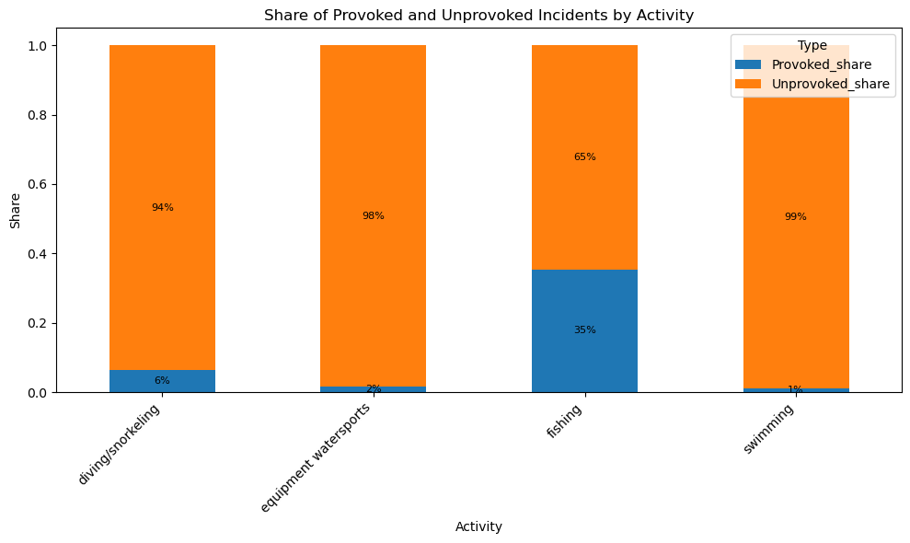
Risk Factor: Activity
Fishing is by far riskiest
activity.
Conclusion: Fishing should
be excluded from the
police or demanding a way
higher fee.

Slide 13
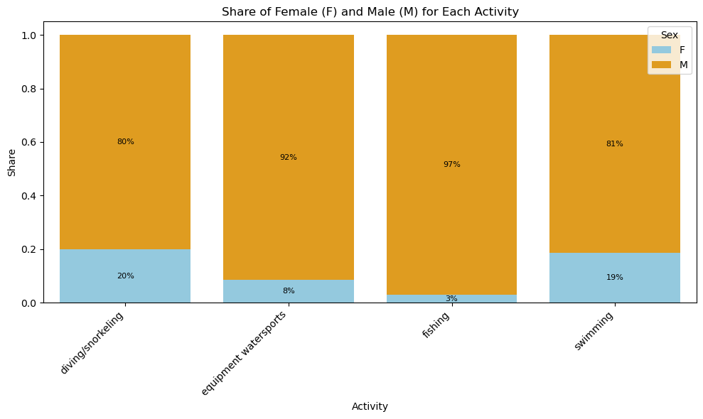
Is Gender really an issue?
Fishing is by far the riskiest activity and has also by far the biggest share of males.
Maybe it’s not the Gender alone or even at all, that is predicting riskier behaviour?

Slide 14
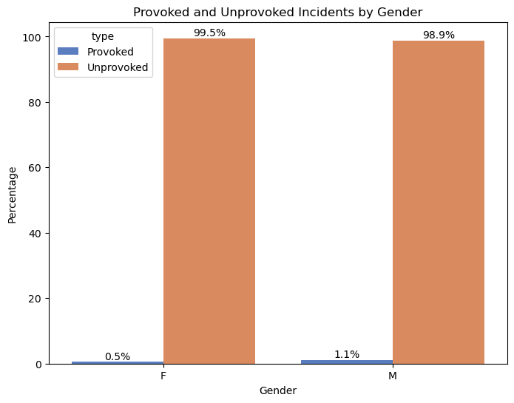
Activity: Swimming
Share of provoked incidents among men is twice as high as the share of provoked incidents among females.

Slide 15
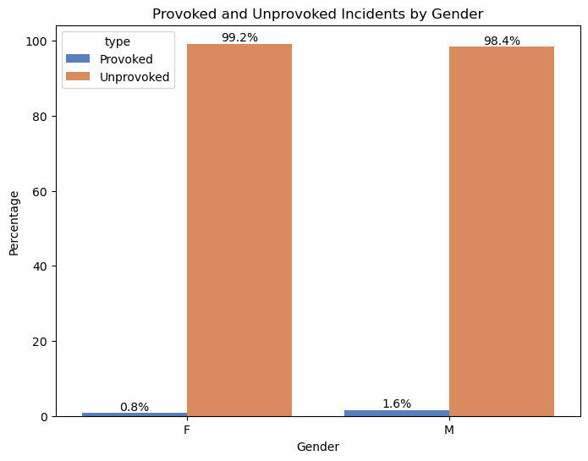
Activity: Equipment Watersports
Share of provoked incidents among men is twice as high as the share of provoked incidents among females.

Slide 16
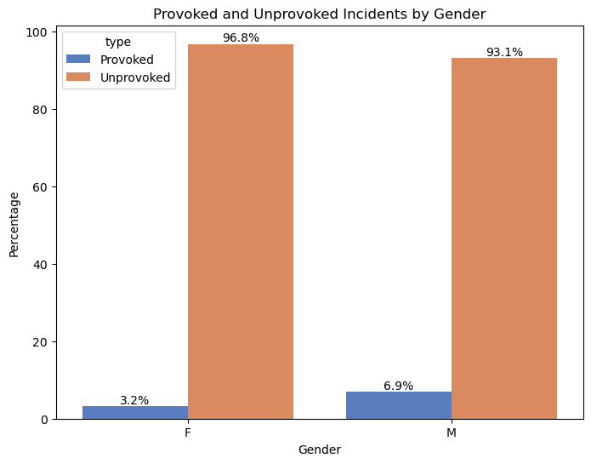
Activity: Diving/Snorkeling
Share of provoked incidents among men is twice as high as the share of provoked incidents among females.

Slide 17
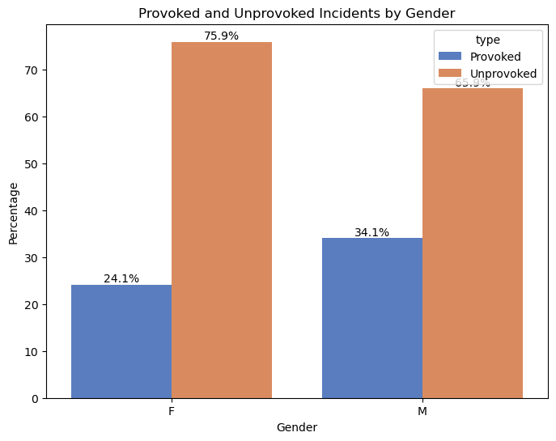
Activity: Fishing
Share of provoked incidents among men is a bit higher than the share of provoked incidents among females.
Conclusion: The activity makes up for some amount of the gender risk gap, but not for the whole.

Slide 18
Conclusions
Hypothesis a): Gender is a risk factor. Males should pay a higher insurance fee.
Hypothesis b): Age is not a risk factor. The insurance fee should be the same for all ages.
Hypothesis c): Activity is a risk factor. Insurances covering Fishing should charge a way higher fee or even exclude this activity at all.

Slide 19

Thank you for your attention and be careful on a beach next time!

