Slide 1
Install plumed
https://www.plumed.org/doc-v2.8/user-doc/html/_installation.html
> ./configure --prefix=change_to_install_dir
> make -j 4
> make doc # this is optional and requires proper doxygen version installed
> make install
add plumed to .bashrc
export PLUMED_ROOT=/path/to/plumed/lib/plumed/
export PATH=/path/to/plumed/bin:$PATH
export LD_LIBRARY_PATH=/path/to/plumed/:$LD_LIBRARY_PATH
Install gromacs (CPU version, for GPU version see http://sobereva.com/457)
https://manual.gromacs.org/
> cd gromacs-2021.4
> plumed patch -p
> mkdir build
> cd build
> cmake .. -DGMX_BUILD_OWN_FFTW=ON -DREGRESSIONTEST_DOWNLOAD=ON -DCMAKE_INSTALL_PREFIX=INSTALL_DIR
> make
> make check
> sudo make install
add gmx to .bashrc
source /INSTALL_DIR /bin/GMXRC

Slide 2
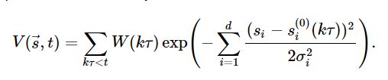

MetaDynamics
In a metadynamics simulations a history dependent bias composed of intermittently added Gaussian functions is added to the potential
This potential forces the system away from the kinetic traps in the potential energy surface and out into the unexplored parts of the energy landscape.
The free energy can be reconstructed from a metadynamics calculation because the final bias is given by:
Example plumed input
d1: DISTANCE ATOMS=3,5
d2: DISTANCE ATOMS=2,4
restraint: METAD ARG=d1,d2 SIGMA=0.2,0.2 HEIGHT=0.3 PACE=500
PRINT ARG=d1,d2,restraint.bias STRIDE=100 FILE=COLVAR

Slide 3
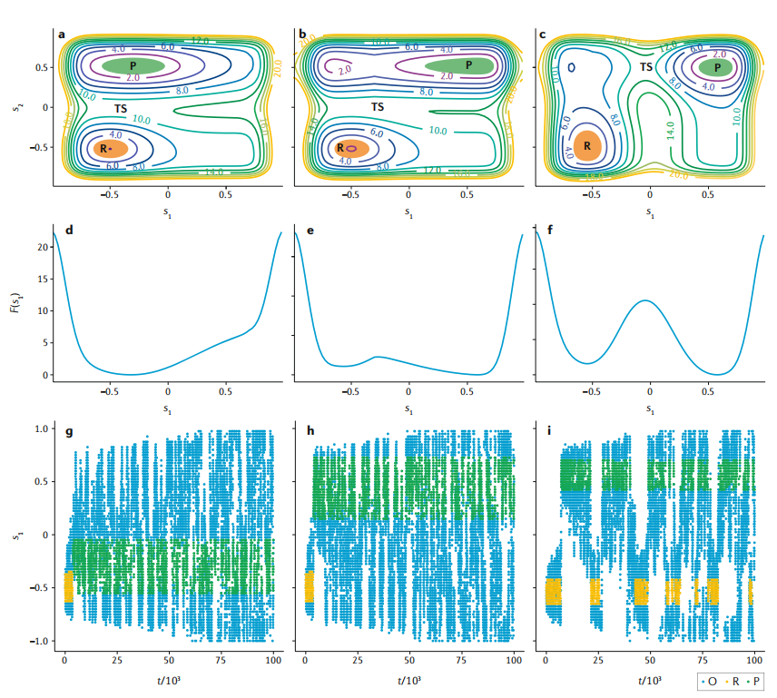
Choosing the CVs
For a multistable system, a minimum criterion for this low-​dimensional projection is that different metastable states should correspond to different values of the CVs.
CVs should be able to distinguish transition states.
The number of employed CVs should not be too large.

Slide 4
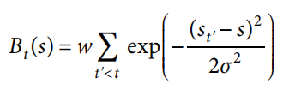
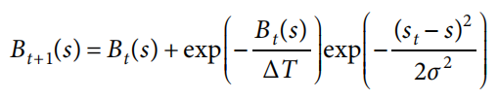
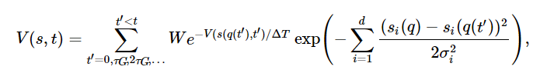
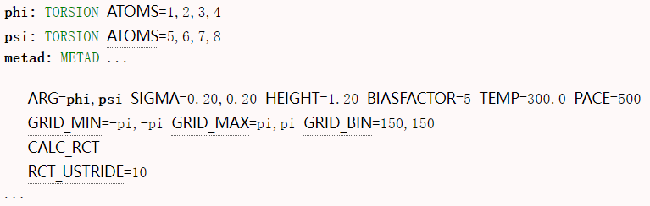
Well-tempered metadynamics
adding a decaying exponential function
MetaDynamics
Well-tempered metadynamics
ΔT(T for temperature) is written in terms of a so-​called BIAS FACTOR $γ=\frac{T+∆T}{∆T}$
This method ensures that the bias converges more smoothly.
If boundary conditions are properly treated, non-​well-​tempered metadynamics is guaranteed to reach a stationary state in which the bias potential fluctuates. This stationary state is conditional on filling the relevant free-​energy wells. Well-​tempered metadynamics, instead, reaches a quasi-​equilibrium state, in which the bias potential provides an exact estimator for the free energy. Such a quasi-​equilibrium state is guaranteed for only an infinitely long trajectory.
Example plumed input
How to choose BIASFACTOR

Slide 5

How to choose SIGMA, HEIGHT and BIASFACTOR IN WELL-TEMPERED METAD
When adding a new gaussian, the width $W(kτ)$ and sigma $σ_{i}$ should be chosen.
For well-tempered metaD, a bias factor should be chosen, and height became a initial height
ΔT(T for temperature) is written in terms of a so-​called BIAS FACTOR $γ=\frac{T+∆T}{∆T}$
Initial height: half kT should be fine.
Bias factor: 5-10 for most biology system.
Sigma: is estimated from the fluctions of the collective variables in an unbiased run.
https://www.youtube.com/watch?v=q0RHlFAk544&list=PLmdKEn2znJEld8l6Hp9PXf4EursC4-8nC&index=13&t=1190s

Slide 6
Filling a multidimensional space becomes more expensive as the dimensionality of the space grows. Because the overall idea of metadynamics is to disfavour the conformations that have been already visited, if the number of CVs is too large, the system will never return to exactly the same value of all the CVs.
Approaches that employ replicas to allow a large number of CVs to be biased alternately or simultaneously can be used to alleviate this requirement.
In the first case, bias-​exchange metadynamics, each replica biases a single CV, so that a large number of CVs can be simultaneously probed.
In the second case, multiple independent biases are constructed to flatten the distribution of multiple CVs using well-​tempered metadynamics. All CVs are biased in all replicas, but the ΔT parameter is modulated across the replica ladder, so that one replica provides unbiased sampling and the other replicas provide the capability to easily cross barriers.
In both cases, coordinates are exchanged between replicas using an acceptance ratio that depends on the value of the biased CV of the different replicas.
Another approach, parallel-​bias metadynamics, reproduces the character of bias-​exchange metadynamics by using a single replica for which the weight (or probability) for each of the variables to be biased is computed on the fly, thus with the practical advantage of allowing simulation of a single replica.

Slide 7

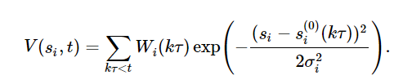
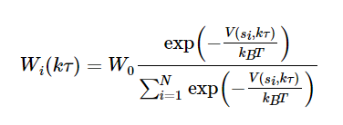

Parallel Bias metadynamics
Multiple low-dimensional bias potentials are applied in parallel. In the current implementation, these have the form of mono-dimensional metadynamics bias potentials:
where:
To ensure the convergence of each mono-dimensional bias potential to the corresponding free energy, at each deposition step the Gaussian heights are multiplied by the so-called conditional term:
where W₀ is the initial Gaussian height.
The PBMetaD bias potential is defined by:
Example plumed input
d1: DISTANCE ATOMS=3,5
d2: DISTANCE ATOMS=2,4
pb: PBMETAD ARG=d1,d2 SIGMA=0.2,0.2 HEIGHT=0.3 PACE=500 FILE=HILLS_d1,HILLS_d2
PRINT ARG=d1,d2,pb.bias STRIDE=100 FILE=COLVAR

