Slide 1
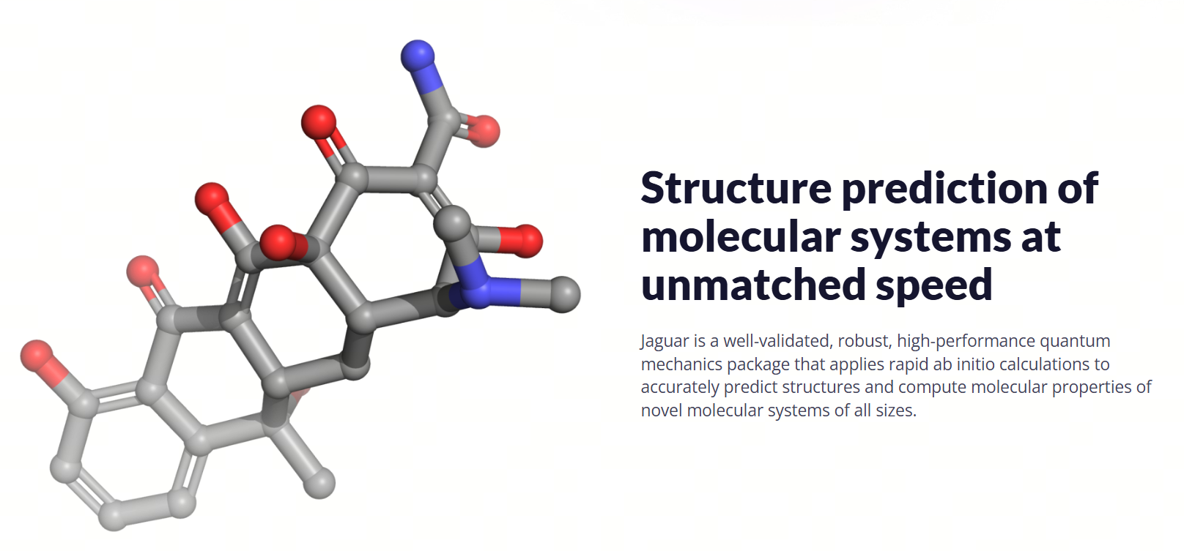
QM Calculation
Naf Guo

Slide 2
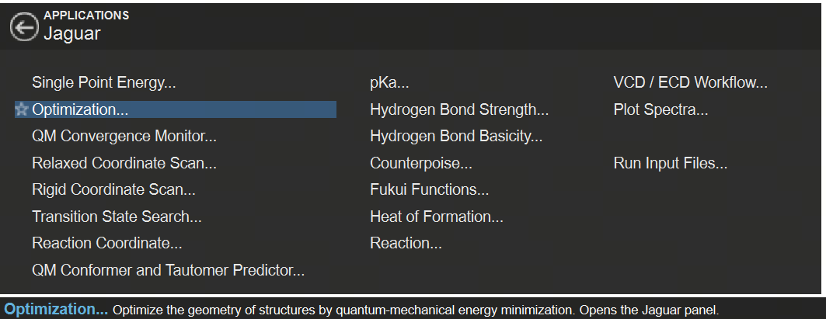
Develop Pharmacophore Hypothesis

Slide 3
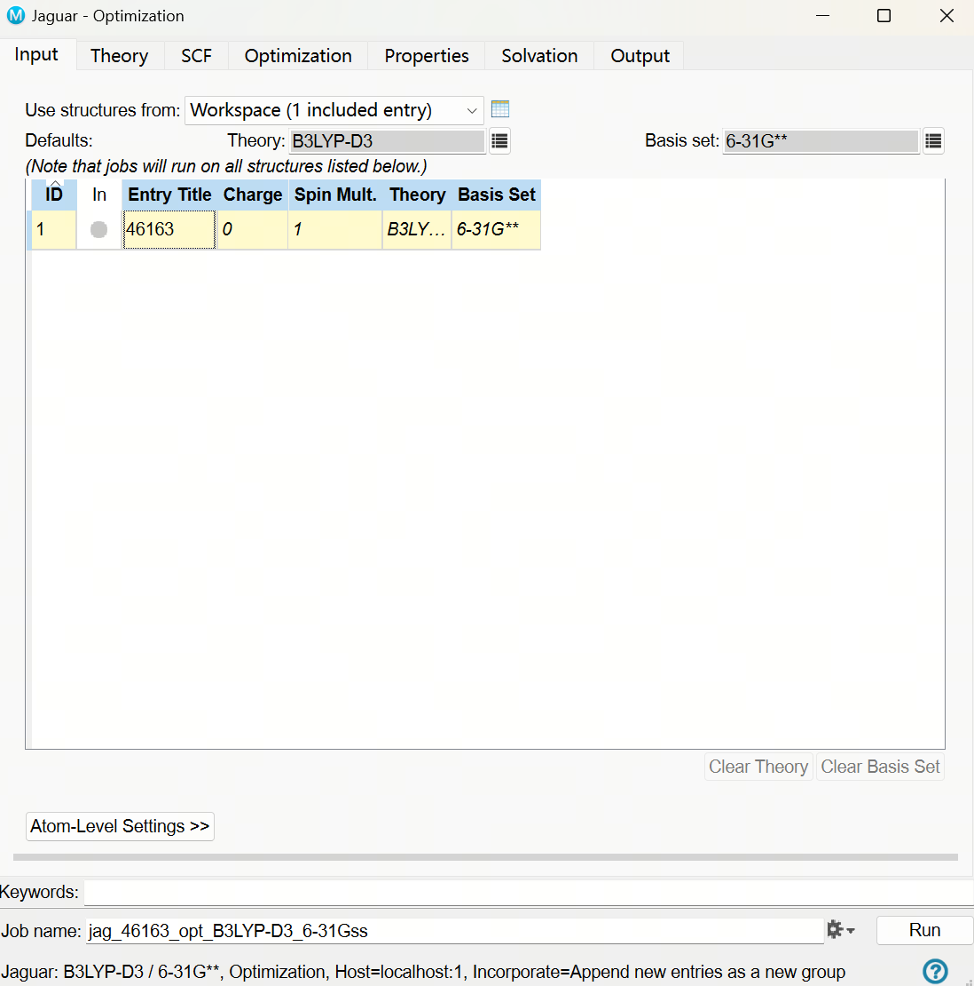
Develop Pharmacophore Hypothesis

Slide 4
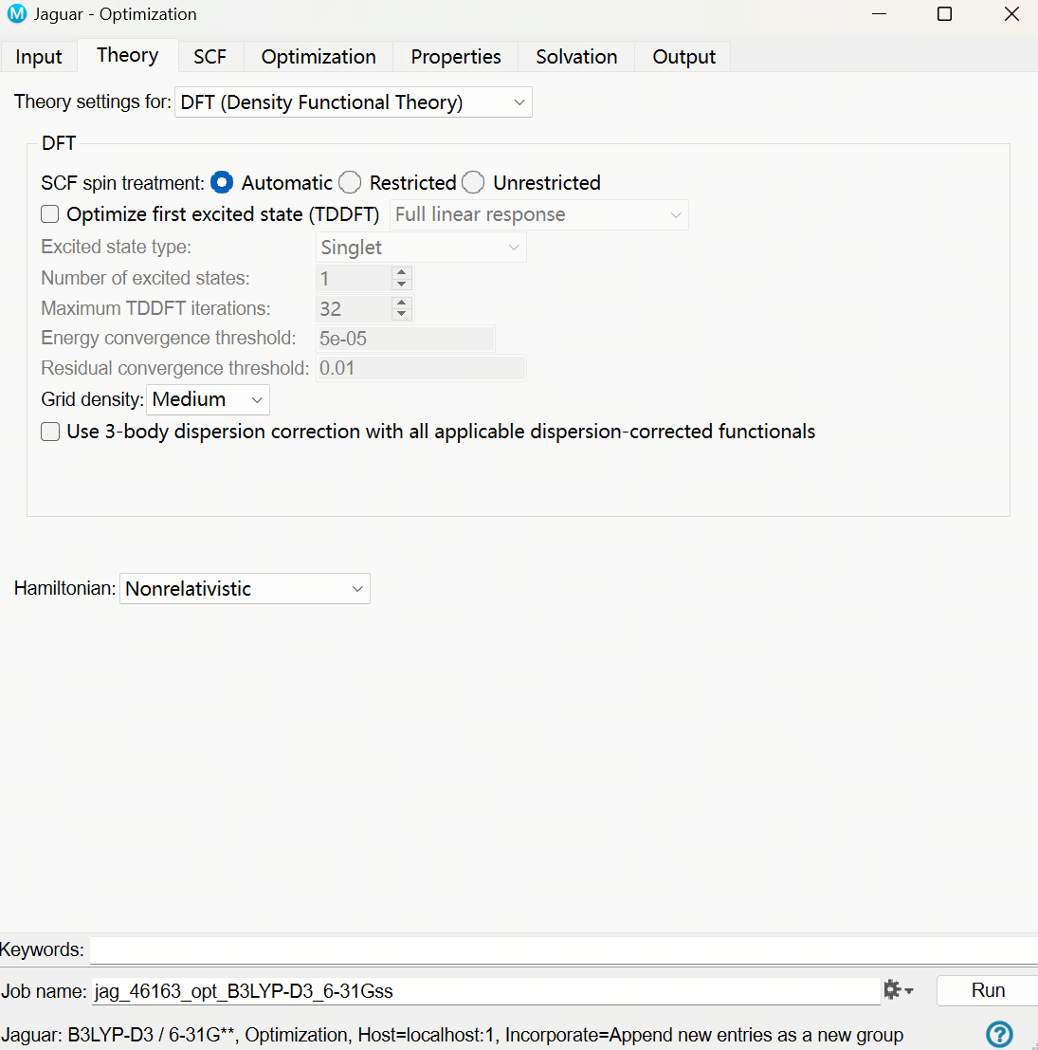
Develop Pharmacophore Hypothesis

Slide 5
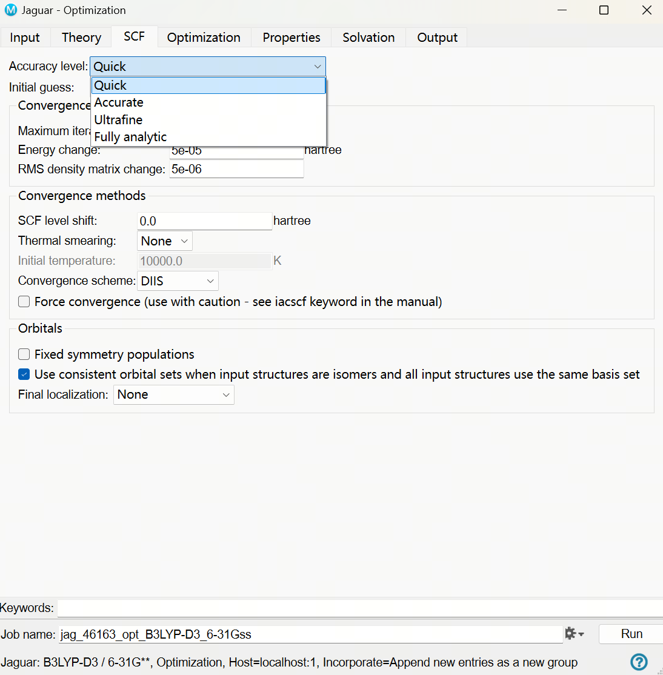
Develop Pharmacophore Hypothesis

Slide 6
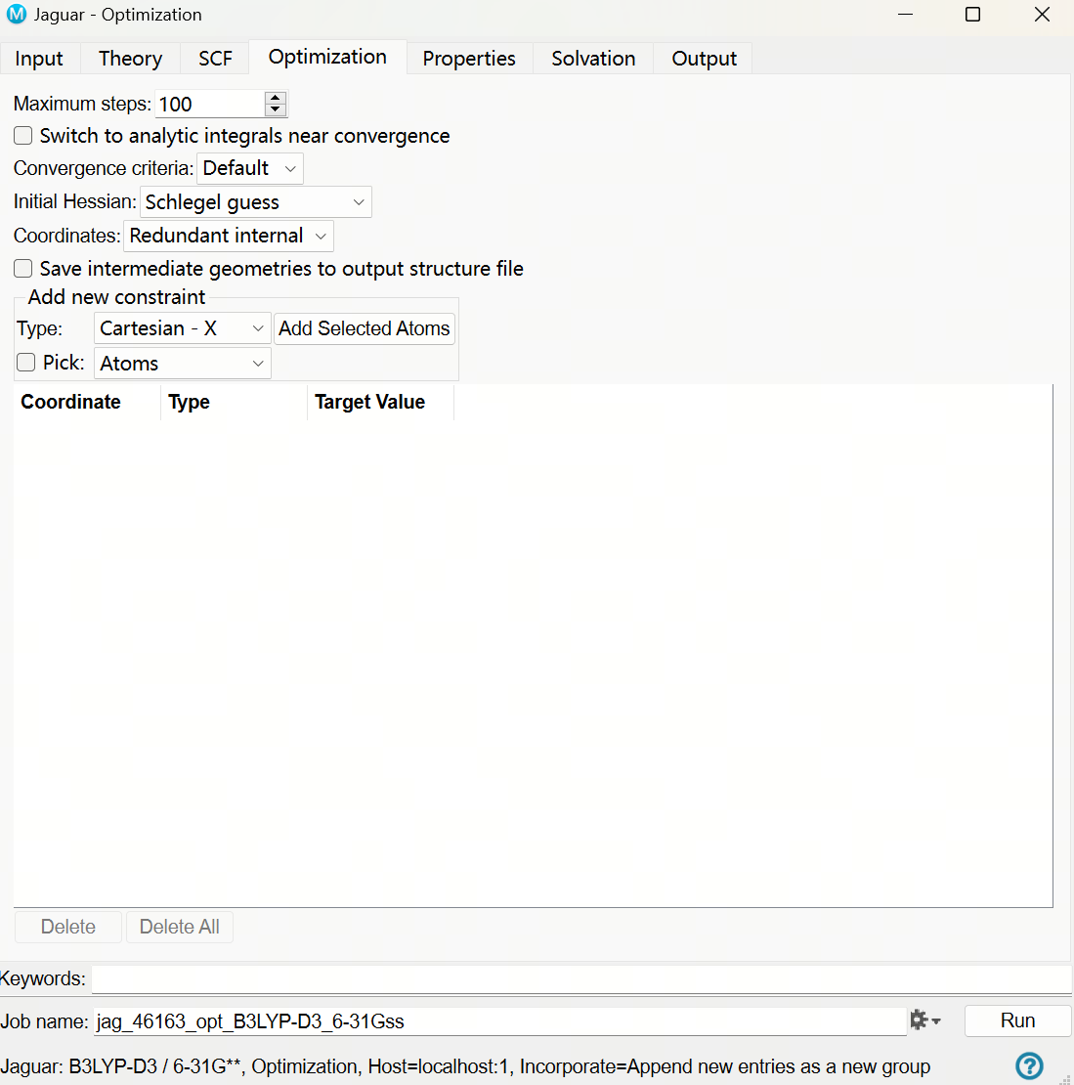
Develop Pharmacophore Hypothesis

Slide 7
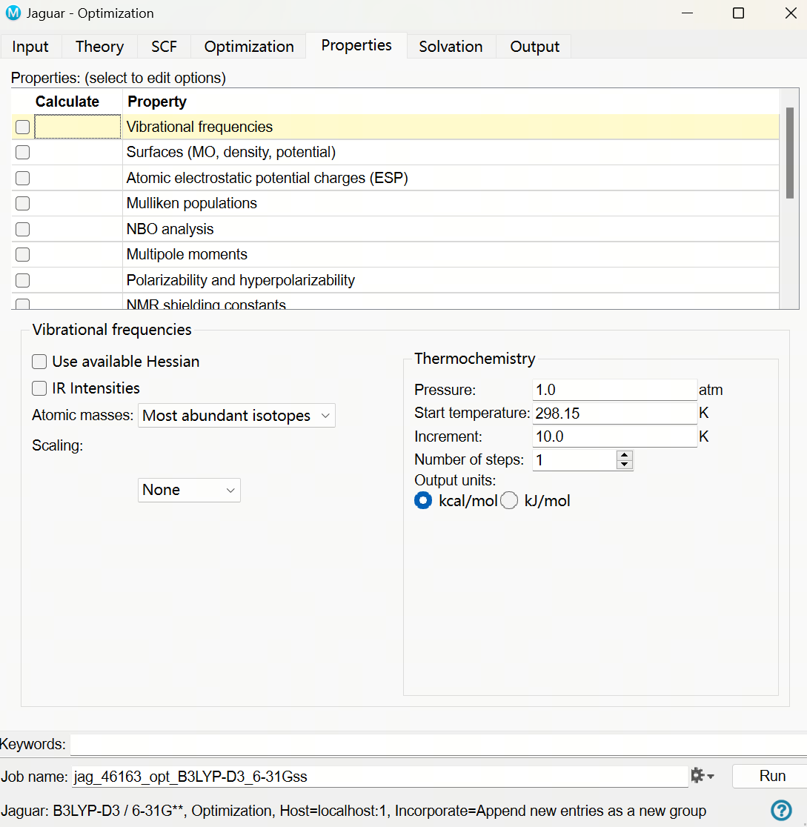
Develop Pharmacophore Hypothesis

Slide 8
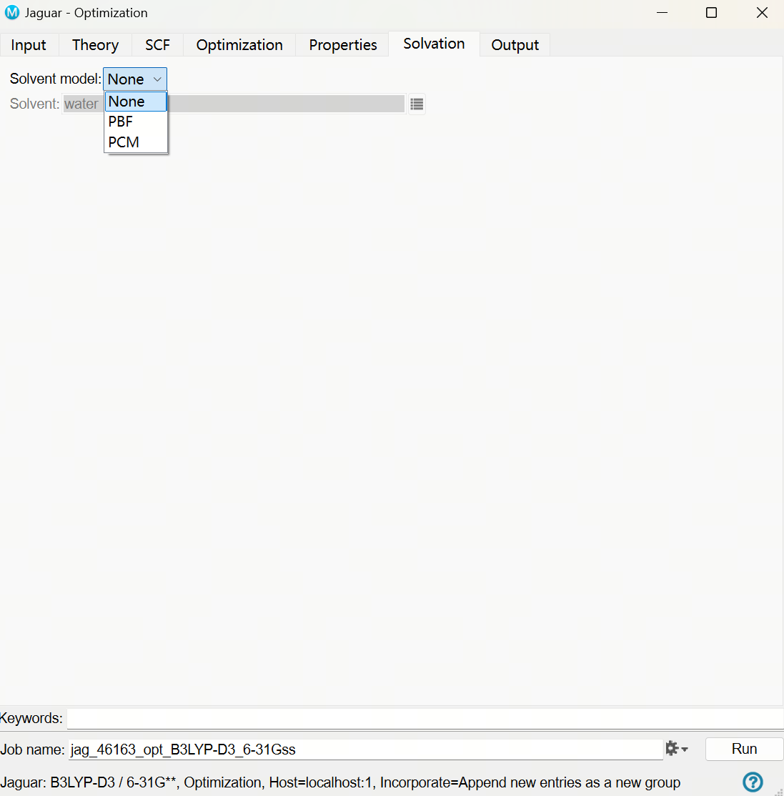
Develop Pharmacophore Hypothesis

Slide 9
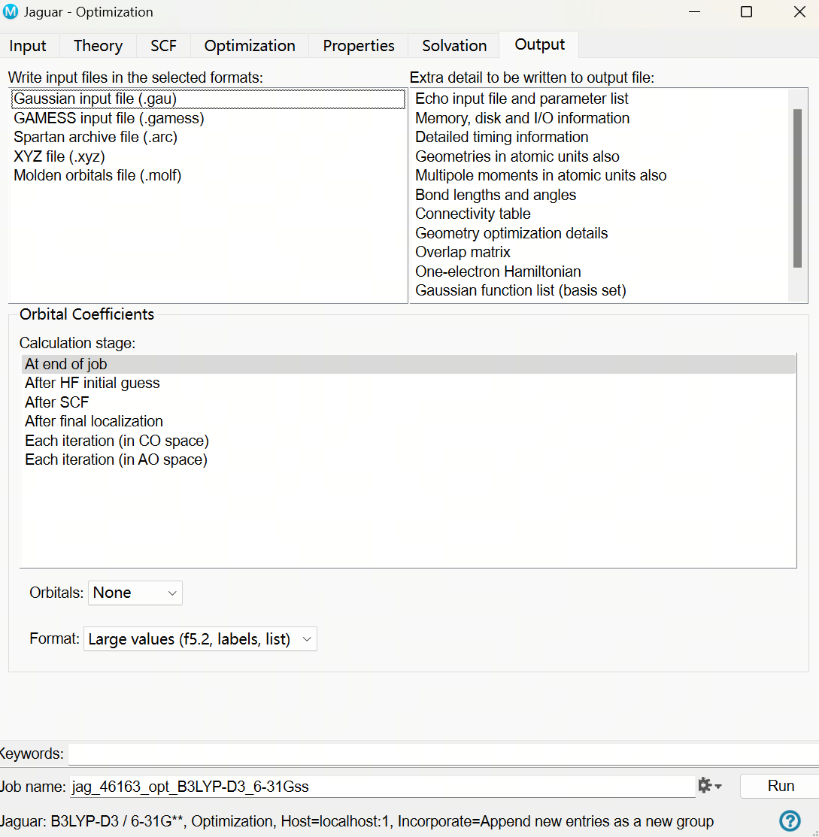
Develop Pharmacophore Hypothesis

Slide 10
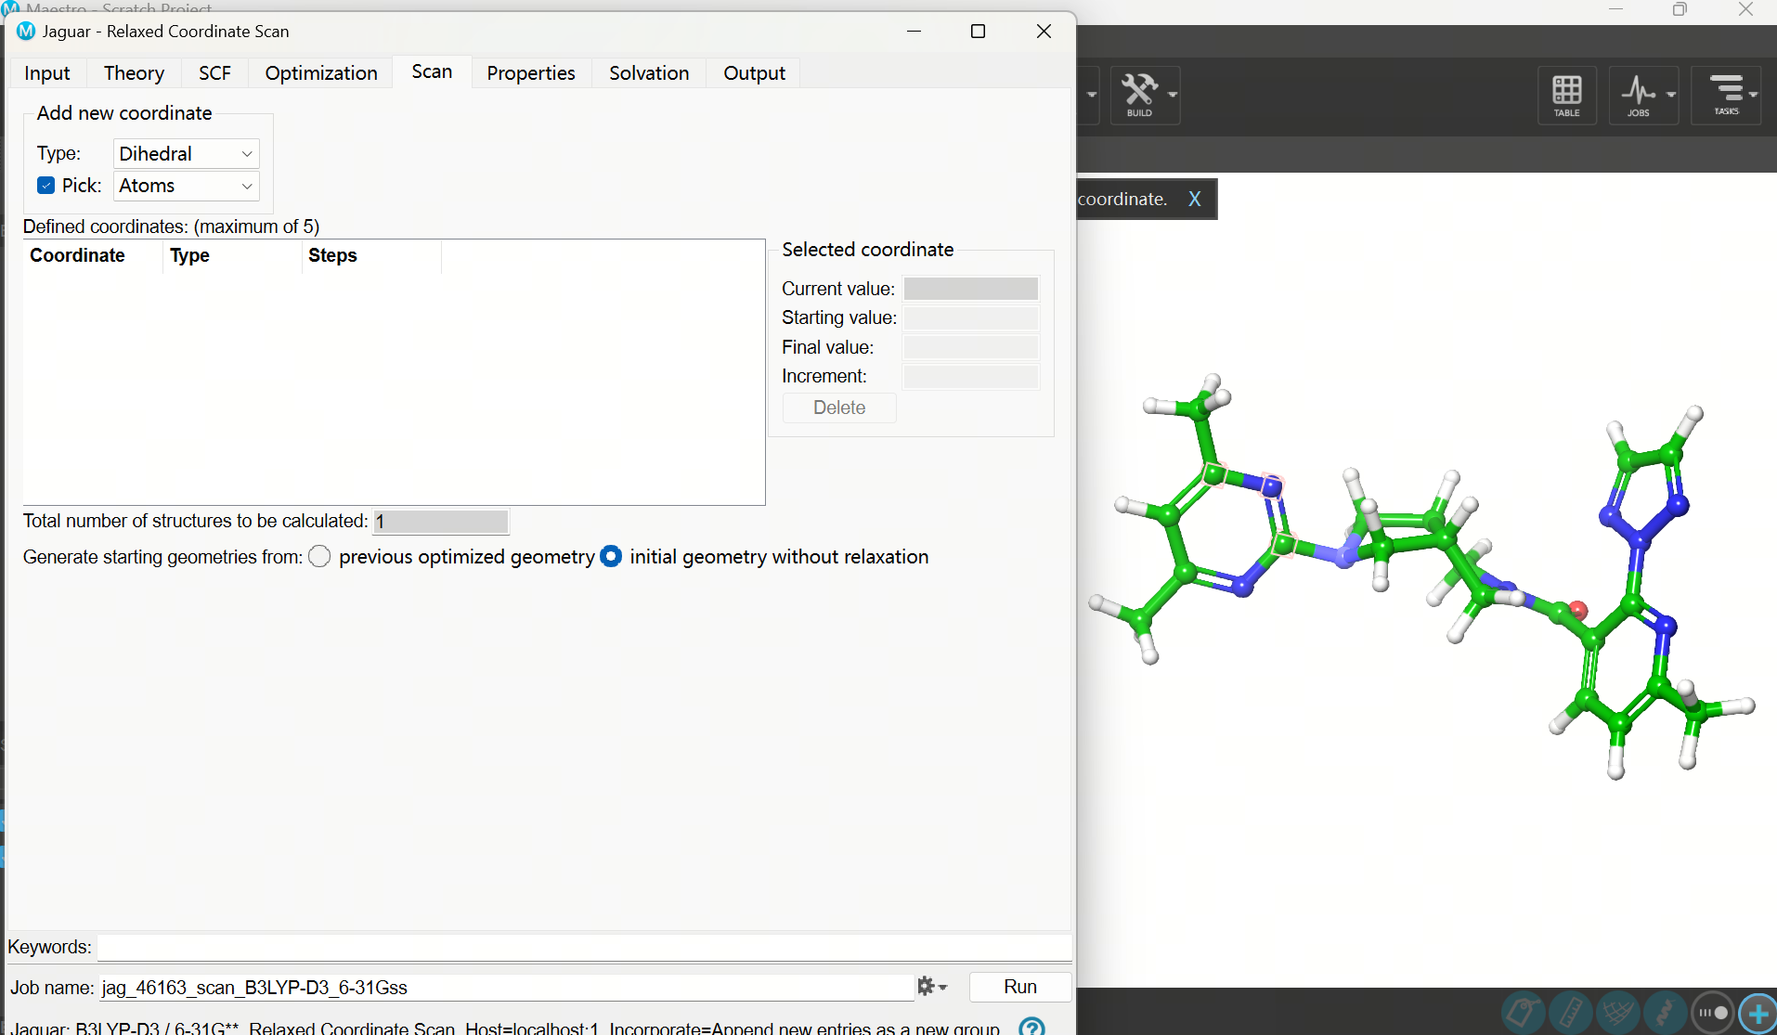
Develop Pharmacophore Hypothesis

Slide 11
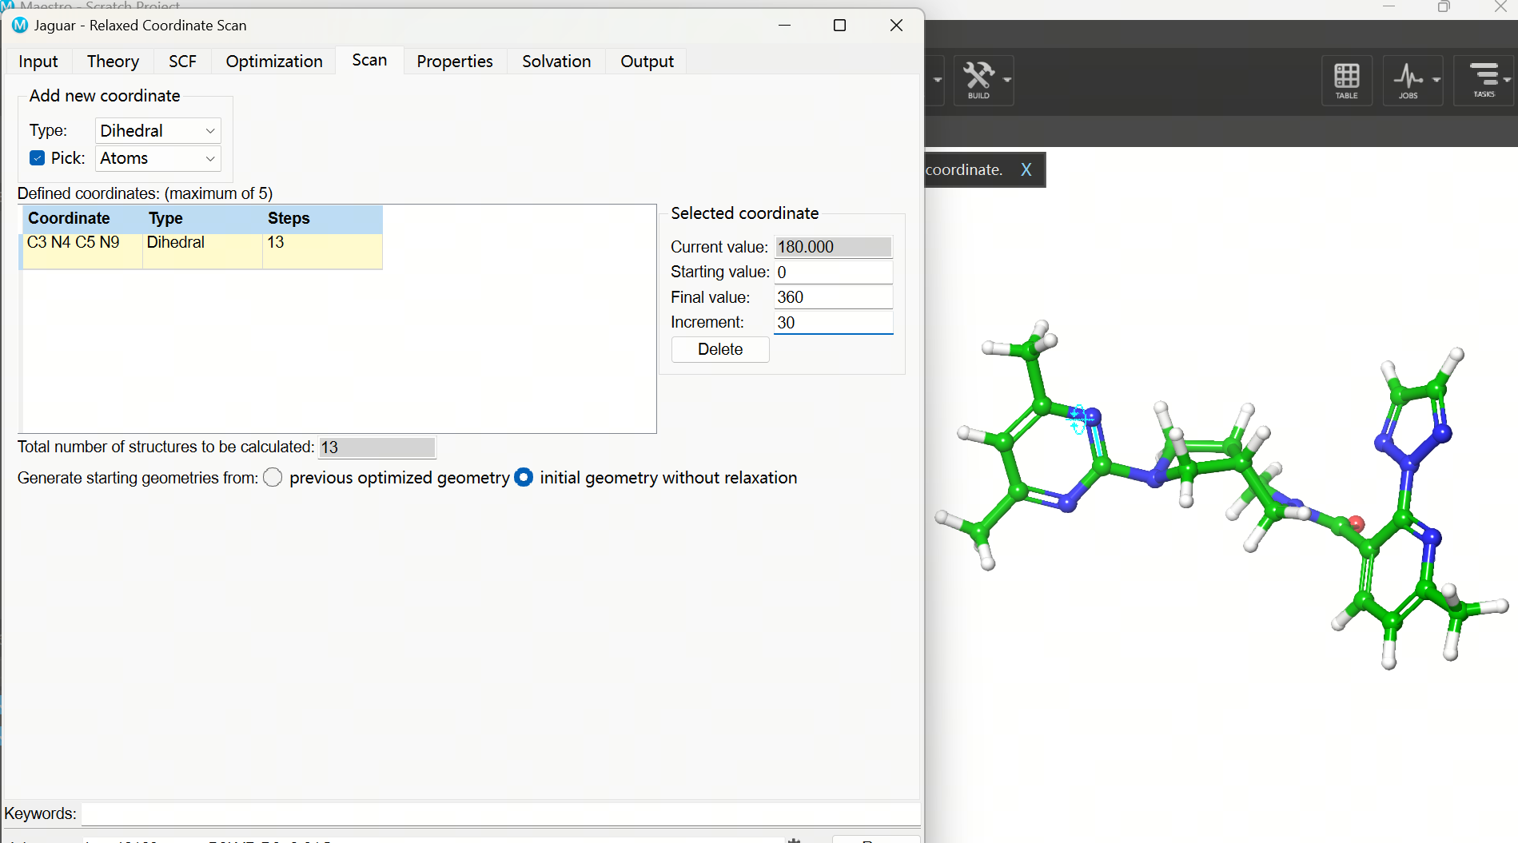
Develop Pharmacophore Hypothesis

Slide 12
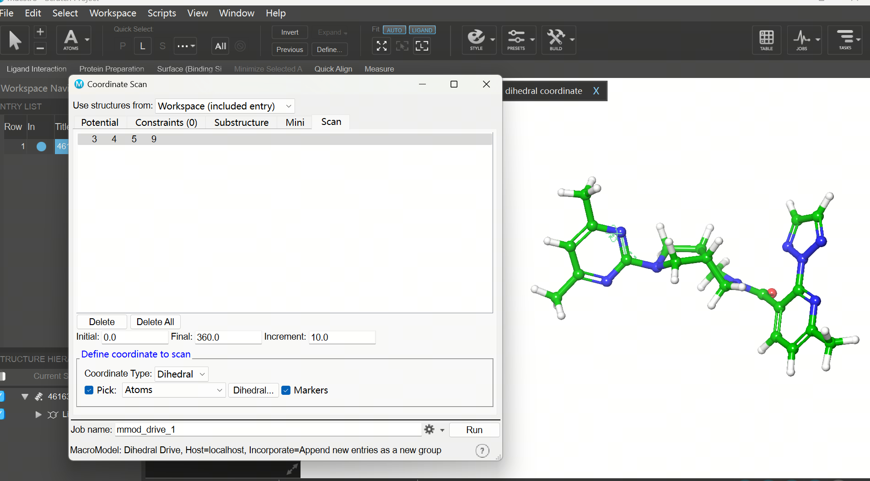
Develop Pharmacophore Hypothesis

