Slide 1

Analysis of Master's Stage 2
By Jason Beck, Gabriel Rosado , Seth Lachance, and Deven Seerattan

Slide 2
Information about the dATASET
VCT or VALORANT Champions Tour, Stage 2 Happened in Reykjavík, Iceland.
This data set includes 50 players from 10 different teams.
Notes:
Define KDA and KD

Slide 3
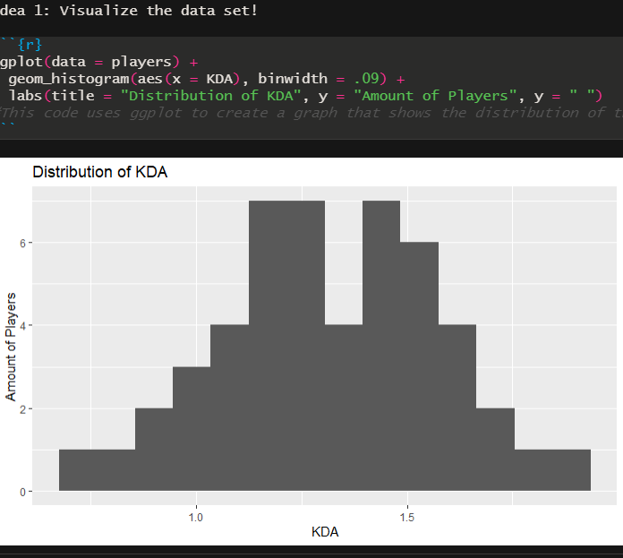
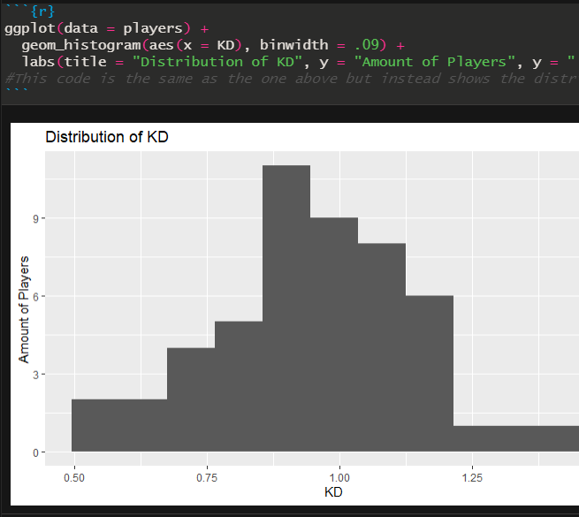
Visualize the data set
In our first histogram it shows the distribution of KDA (kills,deaths,and assists) of all the players combine showing a significant rise between 1.00 to 1.5 KDA.
Our second histogram shows only the distribution of KD (Kill,Death) of all player combine showing a rise from 0.75 to 1.00 . Completely dropping off when reaching 1.25.

Slide 4
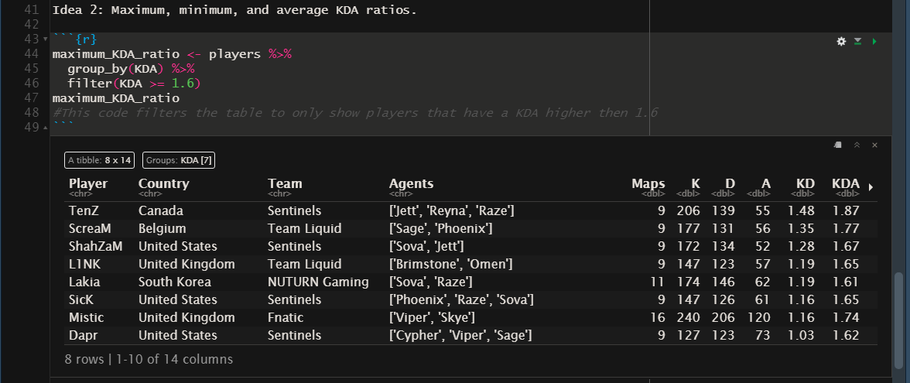
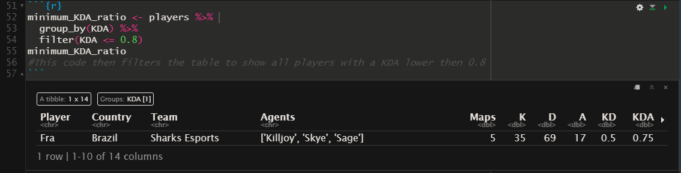
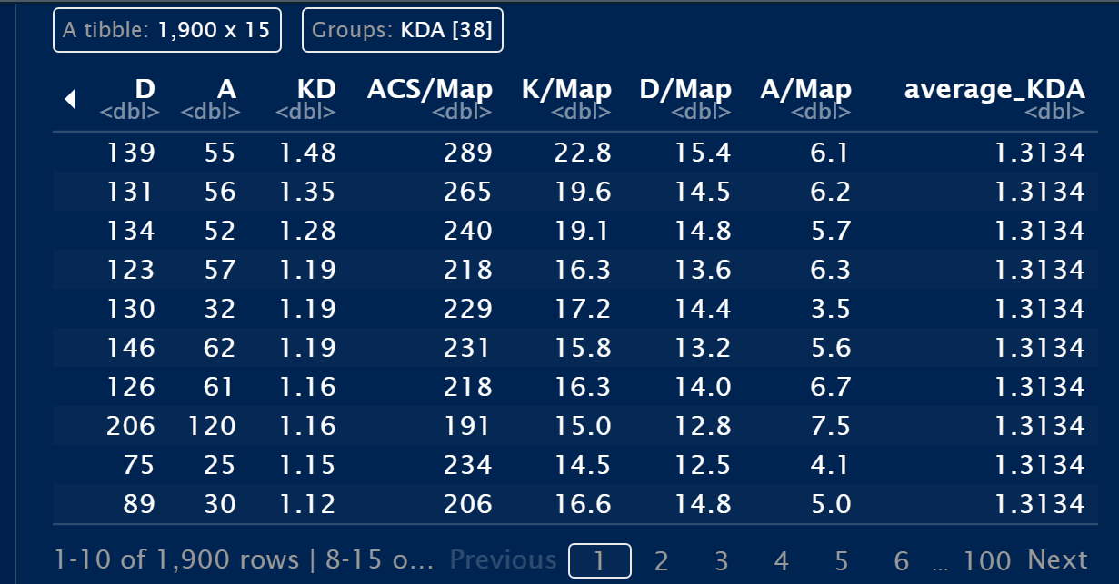
Maximum, minimum, and average KDA ratios.
In the first data frame we looked for people with a kda of 1.6 or higher and the maximum kda was from Tenz which was 1.87 KDA, the highest in the entire competition.
In the second data frame , we look for minimum KDA below a 0.8 which was 0.75 KDA from player named Fra.
The third data frame , we look for the average kda overall which ended up as 1.3134.

Slide 5
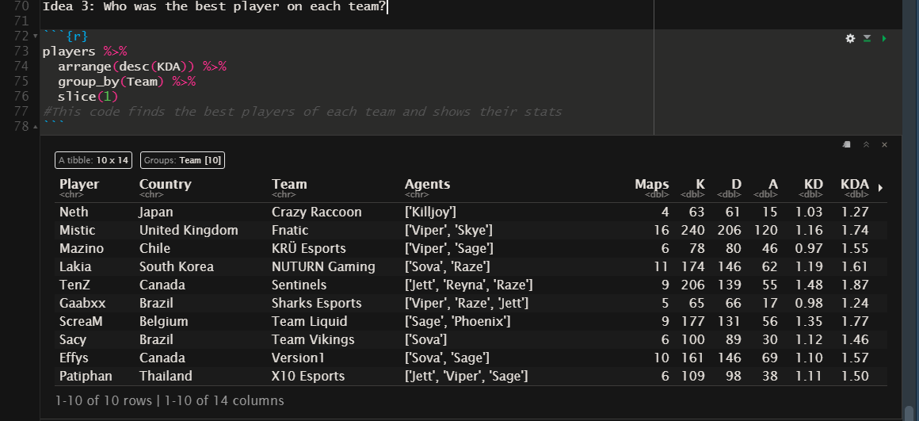
Who was the best player on each team?
The chart here shows players from each team that were the mvp of their team.

Slide 6
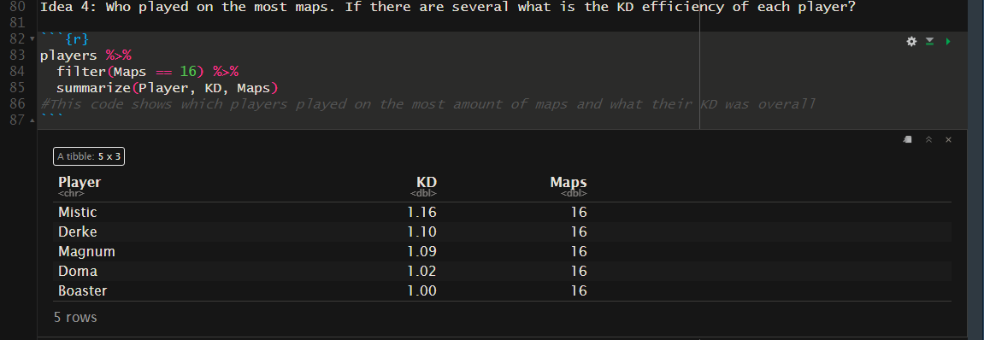
Who played on the most maps. If there are several what is the KD efficiency of each player?
Then we questioned if the number of maps played effects a player's KD.
We filter out the players who played the most maps and showed their KD.
Showing that all the players were below average KD.

Slide 7
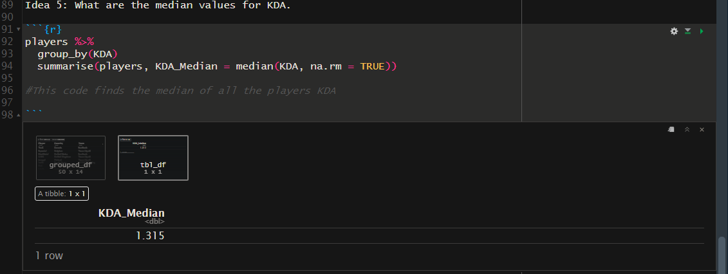
What are the median value for KDA?
This segment of code shows that the median value for KDA is 1.315.

Slide 8

CONCLUSION
In the end we were able to practice and apply all our new R/Rstudio skills that we learned from this course such as ggplot and dplyr, in order to neatly and accurately show off the stats of these players of this game that we all enjoy playing.

Slide 9
Works cited
https://github.com/Septicon/final_project_ds
https://coryschmitz.com/VALORANT
https://www.kaggle.com/jaykumar1607/valorant-masters-2021-player-map-data

