Slide 1
Introduction to Programming
Lesson 1

Slide 2
Objectives
Skills/Concepts | MTA Exam Objectives
Understanding Computer Programming | Understand computer storage and data types (1.1)
Understanding Decision Structures | Understand computer decision structures (1.2)
Understanding Repetition Structures | Identify the appropriate method for handling repetition (1.3)
Understanding Exception Handling | Understand error handling (1.4)
Notes:
Tip: Add your own speaker notes here.

Slide 3
Algorithms
Algorithm refers to a method for solving problems.
Common techniques for representing an algorithms:
Flowchart
Decision Tables.
Flowcharts and Decision Tables
More precise than natural languages | Less formal and easier to use than programming languages

Slide 4
Flowcharts
A flowchart is a graphical representation of an algorithm.
Common Flowchart Symbols
 | Start or end of an algorithm
 | Process or computational operation
 | Input or out operation
 | Decision making operation
 | Direction of the flow of control
Notes:
Tip: Add your own speaker notes here.

Slide 5
Flowchart Example
A flowchart that compares two numbers:
Start
Input x
Input y
X > y?
No
Output y
Yes
Output x
Stop

Slide 6
Decision Table
Useful for large number of conditions
Compact and readable format
A decision table to calculating discount:
Quantity < 10 | Y | N | N | N
Quantity < 50 | Y | Y | N | N
Quantity < 100 | Y | Y | Y | N
Discount | 5% | 10% | 15% | 20%

Slide 7
Introducing C#
Microsoft .NET Framework
An Execution Environment
Reusable Class Libraries
Language Compilers
The C# Programming Language
Part of the .NET Framework
High-level Language
Program needs to be compiled before they can be executed.
Case sensitive
Notes:
Tip: Add your own speaker notes here.

Slide 8
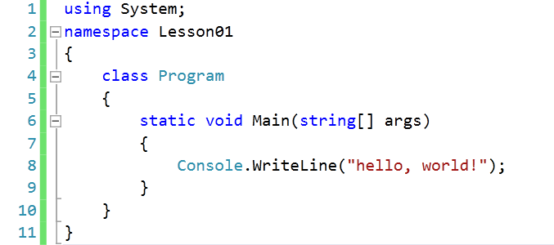
Structure of a C# Program

Slide 9
Elements of a C# Program
Select common elements of a C# program:
Data Types | Types of data in a program. Common data types are int (integers), char (single character value), float (floating point values).
Variables | Provides temporary storage during program execution. int number = 10;
Constants | Data fields whose value cannot be modified. const int i = 10;
Arrays | A collection of items in which each item can be accessed by a unique index. int[] numbers = { 1, 2, 3, 4, 5 };
Operators | Symbols that specify which operation to perform on operands before returning a result.
Methods | Methods are code blocks containing a series of statements. Methods can receive input via arguments and can return a value to the caller.

Slide 10
Decision Structures
The if Statement
The if-else Statement
The switch Statement

Slide 11
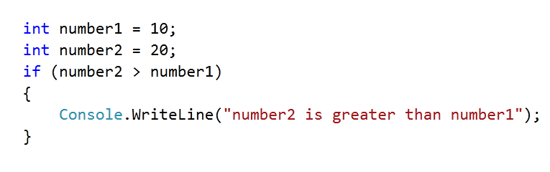
The if Statement
The if statement will execute a given sequence of statements only if the corresponding Boolean expression evaluates to true.
Notes:
Tip: Add your own speaker notes here.

Slide 12
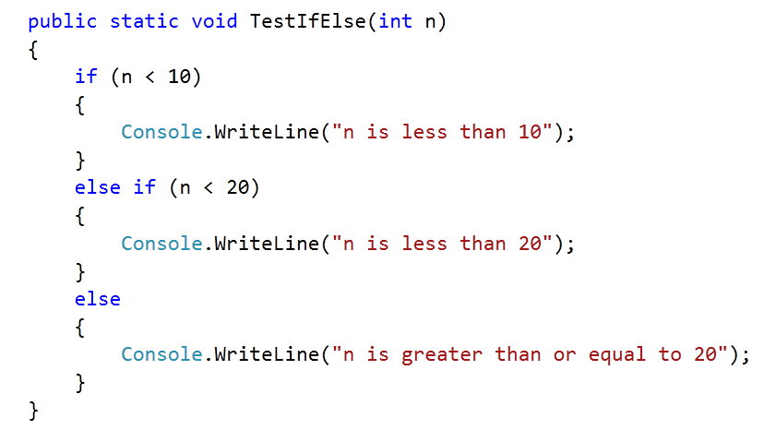
The if-else Statement
The if-else statement allows your program to perform one action if the Boolean expression evaluates to true and a different action if the Boolean expression evaluates to false.
Notes:
Tip: Add your own speaker notes here.

Slide 13
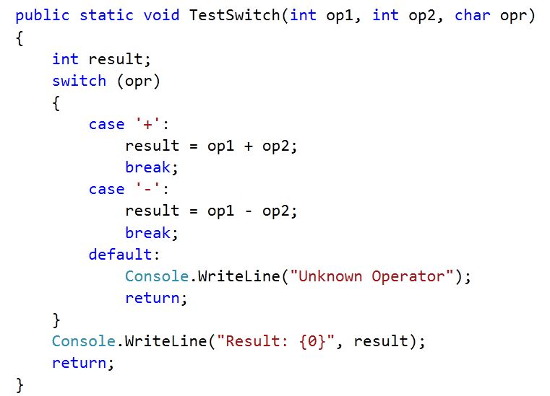
The switch Statement
The switch statement allows multi-way branching. In many cases, using a switch statement can simplify a complex combination of if-else statements.
Notes:
Tip: Add your own speaker notes here.

Slide 14
Repetition Structures
The while Loop
The do-while Loop
The for Loop
The foreach Loop
Recursion

Slide 15
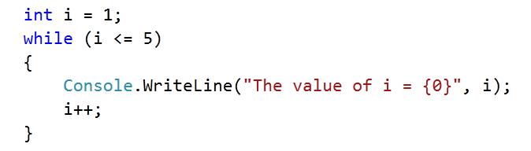
The while Loop
The while loop repeatedly executes a block of statements until a specified Boolean expression evaluates to false.
Notes:
Tip: Add your own speaker notes here.

Slide 16
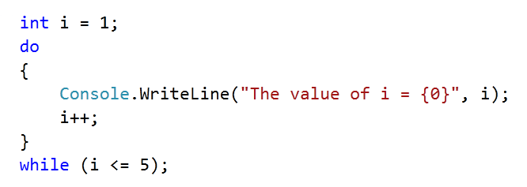
The do-while Loop
The do-while loop repeatedly executes a block of statements until a specified Boolean expression evaluates to false. The do-while loop tests the condition at the bottom of the loop.
Notes:
Tip: Add your own speaker notes here.

Slide 17
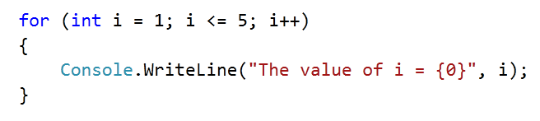
The for Loop
The for loop combines the three elements of iteration—the initialization expression, the termination condition expression, and the counting expression—into a more readable code.
Notes:
Tip: Add your own speaker notes here.

Slide 18
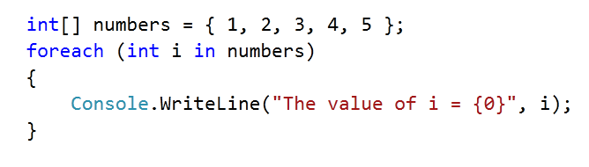
The foreach Loop
The foreach loop is an enhanced version of the for loop for iterating through collections such as arrays and lists.
Notes:
Tip: Add your own speaker notes here.

Slide 19
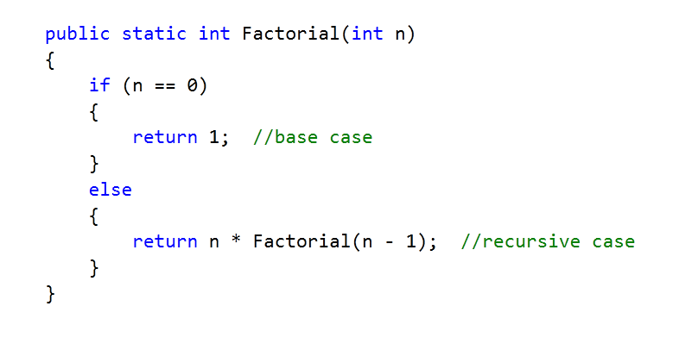
Recursion
Recursion is a programming technique that causes a method to call itself in order to compute a result.
Notes:
Tip: Add your own speaker notes here.

Slide 20
Exception Handling
An exception is an unexpected error condition that occurs during program execution.
When exception occurs, the runtime creates an exception object and “throws” it.
Unless you “catch” the exception, the program execution will terminate.
Exceptions are an object of the System.Exception class or one of its derived classes.
Example: DivideByZeroException exception object is thrown when the program attempts to divide by zero.
Example: FileNotFoundException exception object is throws when the program cannot find a given file.
Notes:
Tip: Add your own speaker notes here.

Slide 21
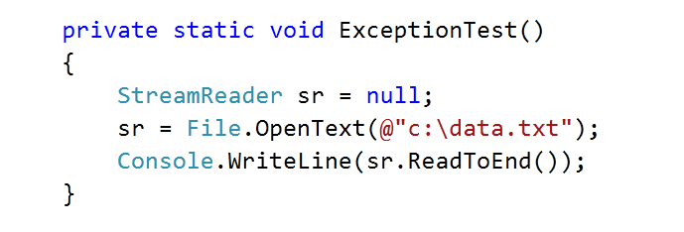
Unhandled Exceptions
What happens when the file c:\data.txt is not found in this code?

Slide 22
Handling Exceptions with try-catch
Place the code that throws the exceptions inside a try block.
Place the code that handles an exception inside a catch block.
You can have more than one catch blocks for each try block. Each catch block handles a specific exception type.
A try block must have at least a catch block or a finally block associated with it.

Slide 23
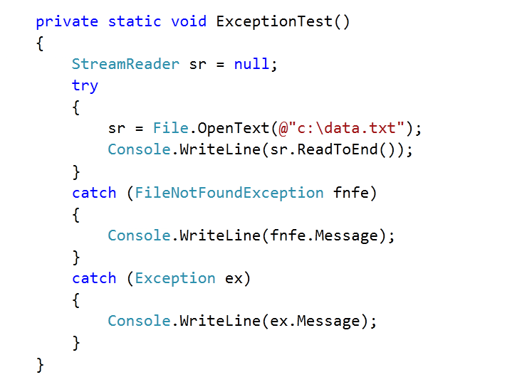
Exception Handling Sample

Slide 24
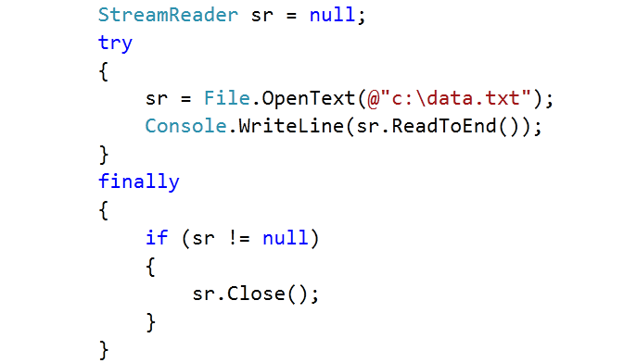
The finally Block
The finally block is used in association with the try block.
The finally block is always executed regardless of whether an exception is thrown.
The finally block is often used to write clean-up code.

Slide 25
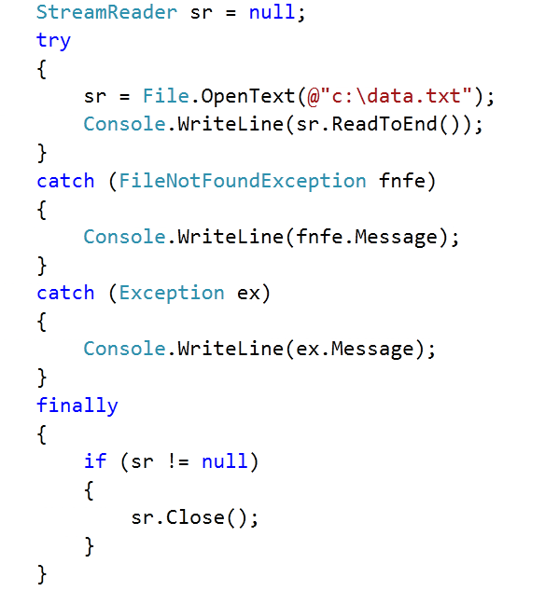
try-catch-finally Example

Slide 26
Recap
Algorithms
Flowchart, decision table
C# Programming Language
Variables, constants, data types, arrays, operators, methods
Decision Structures
if, if-else, switch
Repetition Structures
while, do-while, for, foreach, recursion
Exception Handling
try-catch, try-finally, try-catch

