Slide 2
Project Background
Context – Logickube provided us with customer journey data from advertisement touch-points (channels) to conversion success/failure.
Problem – Logickube is interested in maximising profits through efficient budget allocation on advertisement channel distribution.
Opportunity – QUT Statistics WIL unit provides potential free labour for the company.

Slide 3
Service Need / Strategic Need
Needs/Benefits – efficient budget allocation, customer insight for company and partners, students (we) produce a model that is useful in multiple scenarios [long-term benefit]. We improve analytical skills on datasets that reflect real-world scenarios.
Stakeholder Benefits – Logickube is looking for innovative ways to forecast advertisement impact on customer conversion.

Slide 4
Objectives
Product – predictive models that may be beneficial to improved efficiency on advertisement management.
SMART
Specific: A model that forecasts probability for customer conversion depending on attribution pathways via channel touch-points.
Measurable: Quantitatively conveys information relative to the goals.
Achievable: Yes.
Relevant: Predictive model and methods should be applicable and easily extendable to similar datasets about customer conversion advertisement pathways.
Time-bound: Requires completion within 3-month period.

Slide 5
Assumptions, Exclusions & Constraints
Assumptions – the channels provided are the only channels that a customer can interact with. Definition of conversion is consistent for all customers. Each conversion has equal weight.
Exclusions – long-term outcomes will be unknown, so there won’t be any knowledge on if product is a success.
Constraints - only 3 people in group who cannot work full-time on it, and project requires to be completed within 10 week period.

Slide 6
Approach
Linear at some points, iterative at others. There will be certain tasks that require priority to continue, i.e. initial predictive model, assessment submission deadlines.
Prototypes will be built and then improved upon until final model is satisfactory to us and the marking criteria.
High-level Project Lifecycle – consistent communication and contribution between all members, which include new ideas and perspectives. Proof-reading and model testing on each others prototypes to ensure reproducible models and methods.

Slide 7
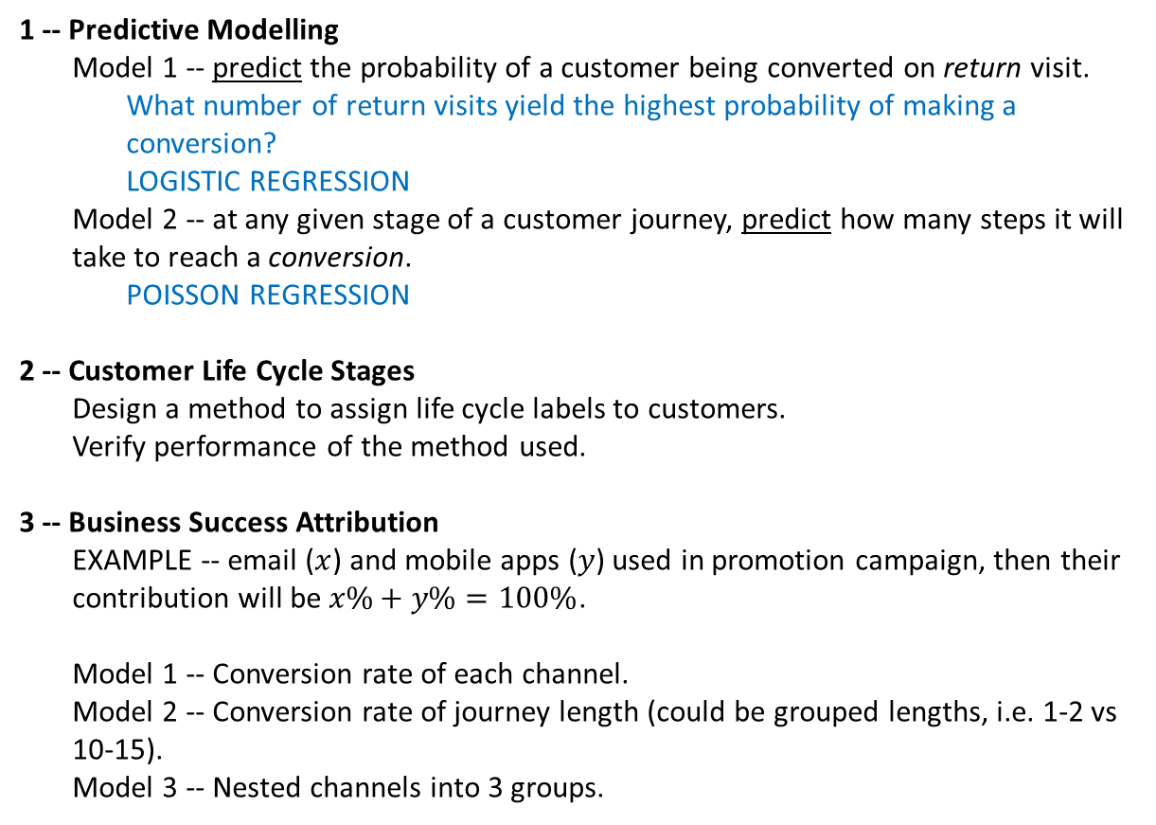
Scope – Product Breakdown Structure
1 -- Predictive Modelling
Model 1 -- predict the probability of a customer being converted on return visit.
What number of return visits yield the highest probability of making a conversion?
LOGISTIC REGRESSION
Model 2 -- at any given stage of a customer journey, predict how many steps it will take to reach a conversion.
POISSON REGRESSION
2 -- Customer Life Cycle Stages
Design a method to assign life cycle labels to customers.
Verify performance of the method used.
3 -- Business Success Attribution
EXAMPLE -- email ($x$) and mobile apps ($y$) used in promotion campaign, then their contribution will be $x\%+y\%=100\%$.
Model 1 -- Conversion rate of each channel.
Model 2 -- Conversion rate of journey length (could be grouped lengths, i.e. 1-2 vs 10-15).
Model 3 -- Nested channels into 3 groups.

Slide 8
Scope – Work Breakdown Structure
1 -- Predictive Modelling
Model 1 & 2
ASSUMPTIONS
DATA CLEANING – (1) new dataset without non-returning customer data. (2)
FEATURE ENGINEERING – extending dataset columns for deeper analysis between groups.
LITERATURE REVIEW – for model decisions.
MODEL FITTING
MODEL TESTING
IMPROVE AND LOOSEN CONSTRAINTS
2 -- Customer Life Cycle Stages
Design a method to assign life cycle labels to customers.
ASSUMPTIONS – breaking down life cycle labels depending on data.
Verify performance of the method used.
PREDICTIVE MODEL INTEGRATION
3 -- Business Success Attribution
Model 1, 2 & 3
LITERATURE REVIEW – attribution models.
MODEL ITERATION COMPARISON – (2) Journey touch-point length, and (3) nested channels

Slide 9
Organisational Breakdown Structure
Task 1 – Retief, Colby, Seb all work together to complete satisfactory model. FINISH THIS BEFORE PROCEEDING.
Initial planning stage would finish with the GOAL of satisfactory models for Task 1, then breakdown following tasks afterward.
Task 2 – One member dedicated to task?
Task 3 – Other two members dedicated to task?
Support
Shen Liu – Logickube CEO who is the representative to reach out to for the company.
James McGree – unit coordinator, helpful support for the mathematical side of project.
Robert Hoffman – Project management guidance.
Alex Liu – knowledgeable guy.

Slide 10
Responsibility Allocation Matrix

Slide 11
Key Milestone and Schedule

Slide 12
Budget

Slide 13
Risks and Issues Management

Slide 14
Stakeholder Management

Slide 15
Quality Management

Slide 16
Implementation Plan

Slide 17
Lessons Learned

