Slide 1
SnagPy 3
Sergio Frasca
for the Rome Virgo Data Analysis group

Slide 2
Che fare ?
Il lavoro procede con qualche intoppo: problemi ad aggiornare le versioni di Python e package.
Meta possibile: analizzare i dati di O4 appena disponibili, il che significa avere una versione quasi completa («β») per la fine dell’anno.
Punto critico: sviluppare la lettura dai raw data (frame e HDF5), con l’uso della classe DS: non è difficile, ma non vorrei farlo io, a parte una supervisione per lo sviluppo dei DS.
Ottimo lavoro di Riccardo e Marco sulla documentazione con l’uso di Sphinx. D’ora in poi la SnagPy_UG non conterrà più la reference guide (se non un breve accenno) e sarà sviluppata essenzialmente per temi.

Slide 3
Organizzazione dei moduli nel package SnagPy
Moduli nel folder SnagPy:
GD the management of the basic container class for 1-D data
GD2 for the 2-D data
DS data stream management
MGD multiple GD
BASIC general management routines
SERV service programming routines
ML_PY for using Matlab objects
STAT statistics
SIGNAL signal processing routines
IMAGE image processing
ASTROTIME time and astronomy routines
GWDATA gravitational wave data (sources, antennas, periods…)
PSS periodic source search
BSD BSD analysis
GWOTH other gw analysis
GUISNAG guis for SnagPy
PARGPU parallel and GPU computing
WEB_SNAG routines for the web and phone and tablets apps
DEEPSNAG deep learning for SnagPy
FANCY_FIG fancy figures and film
Maturo
Qualcosa
Da fare
Altri subfolders:
- Exper experimental & test
- Pers personal
- Projects funz. e script per prog.
- Examples script di esempio
- Gwdata antenne, sour, ecc.
- Doc manuali e help
- docs Sphinx documentation

Slide 4
Di cosa parliamo
Problemi che ho avuto.
I DS e l’accesso ai raw data
Qualche funzione o tema:
CW_histogram
gd_pows e gd_welch
gd_spectrogram
gd_period

Slide 5
La classe DS (Data Stream)
As a gd is a “group of data” of determined (known and not too big) length, a ds (Data Stream) is used to handle sampled data (in time domain) with unknown (or very big) length, of which one has at a given moment just a chunk.
The basic idea is the client-server metaphor: the client asks for chunks of data, defining at the beginning the modalities and then calling iteratively the server.
There are three fundamental operations:
Initial setting
ds Servicing
Client Processing

Slide 6
Initial Setting
At this stage, a ds is created and the modalities of the data service are defined. This is done mainly by the methods ds (the constructor) and edit_ds (a modifier). At this stage the fundamental constants of the ds are set:
len basic length of chunks
dt sampling time
capt caption
type (1: not interlaced 2: interlaced by the half, alternate y1 and y2)
treq initial requested time
Some parameters are initialized.
A particular method is reset_ds, that resets the variables to the initial values.

Slide 7
ds Servicing
This is done by particular methods that carry out the ds server operation. Examples are:
data simulation servers, as
signal_ds, that creates continuous signals (sinusoid,ramp,…)
noise_ds, that simulates a noise of given power spectrum
data access servers, as
fr2ds, that accesses data in frame format
h52ds, that accesses data in HDF5 format
bsd2ds, that access data from bsds
other, as
gd2ds, that creates a ds from a “long” gd

Slide 8
Interlaced operations
The necessity of interlaced operations is due to how frequency domain filtering is performed.
The interlaced operations has the following scheme (y1 and y2 are the two alternating buffers that serve the data):
Interlaced operation:
chunk 1 y1 0 1 1 1 | 1
chunk 2 y2 1 1 1 2 |
chunk 3 y1 1 2 2 2 | 2 No new data
chunk 4 y2 2 2 2 3 |
chunk 5 y1 2 3 3 3 | 3 No new data
chunk 6 y2 3 3 3 4 |
Moreover, in the case of interlaced operations, the data are shifted of len/4: the first len/4 data are set to 0; this because to not overlook the beginning data.

Slide 9
Client Processing
This is done by functions that operates on the chunks served by a ds server. Examples are
pows_ds, ipows_ds, ipows_ds_ng, that compute running power spestra, with different characteristics
running_ds, that does running plot of the data
stat_ds, that performs running statistics.
write_snf_ds, to store the data on a file (see the SNF section).
Typically a client ds processor works independently of the type of the ds server.

Slide 10
ds transformation
This is performed by a ds transformer, that has both the characteristics of a ds server and of a client processor. Examples are
to_interlace_ds, that transforms a type 1 ds to a type 2 ds
de_interlace_ds, that transforms a type 2 ds to a type 1 ds
ffilt_go_ds, that creates a frequency domain filtered ds, from another ds.
A ds transformer has the same “duties” of a ds server, for the generated ds.

Slide 11
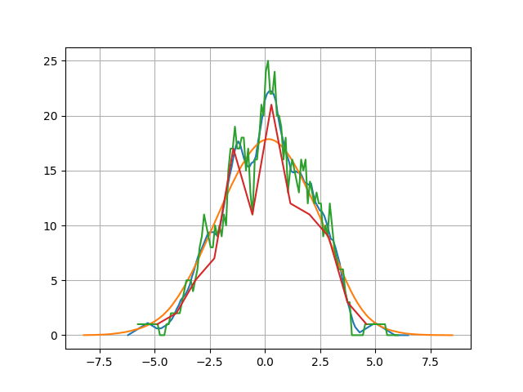
CW_histogram
This function uses linear filter procedure to produce histograms. We can use different moving average filters (namely triangular, gaussian, rectangular and any other user choice). The values can be “weighted”. The result is normally a better estimation of the probability density of the data especially in case of low numerosity.
Examples:
>>> y=np.random.randn(100)*2
>>> out,dic,fun=STAT.CW_histogram(y,typ='tri')
>>> out1,dic1,fun1=STAT.CW_histogram(y,typ='gau')
>>> out2,dic2,fun2=STAT.CW_histogram(y,typ='rec')
>>> stat,Hist=GD.stat_gd(y,12)
>>> GD.newfig()
>>> GD.plot_gd(out)
>>> GD.plot_gd(out1)
>>> GD.plot_gd(out2)
>>> GD.plot_gd(Hist)

Slide 12
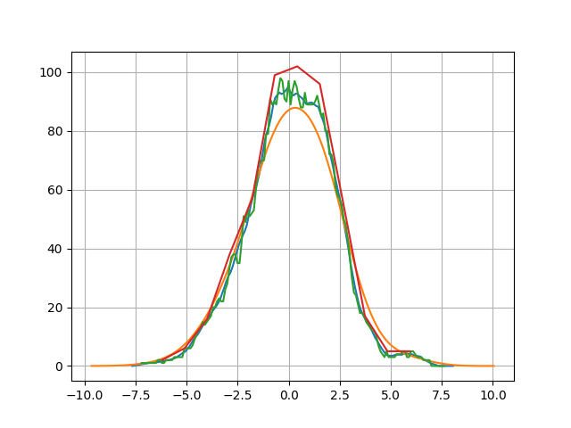
Table:
N = 100
xmean = 0.07272396010818402
xmedian = 0.13018008281292792
xstd = 1.9357823522046353
xskew = -0.13044953095050532
xkurt = -0.2646605027619664
type = Gaussian
mu_hist = 0.06938821144710516
sig_hist = 2.1710251925929915
With other numbers and parameters:

Slide 13
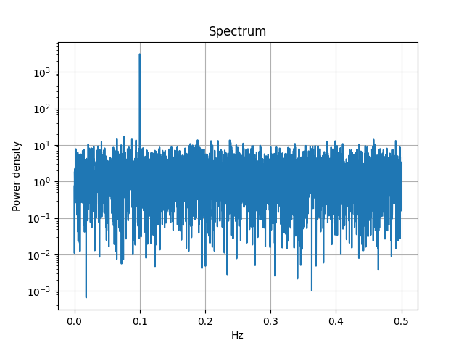
gd_pows & gd_welch
>>> gg=GD.rand_gd(10000,'norm')
>>> gg1=GD.set_gd(10000,'sin',par2=0.1)
>>> gg2=gg+gg1
>>> S=STAT.gd_pows(gg2)
>>> GD.newfig()
>>> PH=GD.plot_helper(scale='lilo')
>>> GD.plot_gd(S,P_H=PH)

Slide 14
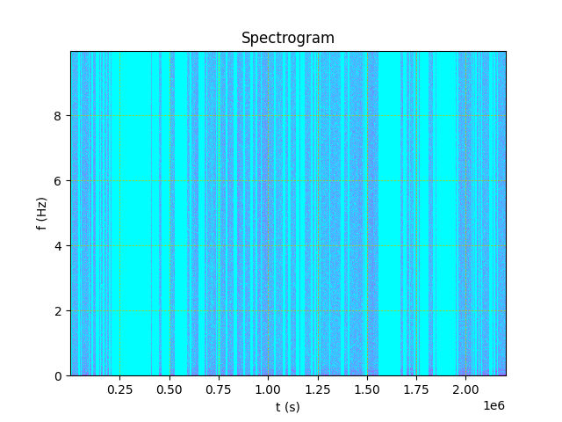
gd_spectrogram
>>> g=ML_PY.gd_lm7('L_C02_20170104_0060_0070_O2_tfstr.mat')
>>> spec,tt,ff=STAT.gd_spectrogram(g,1000)
>>> GD2.show_gd2(spec)
type 1
n 88060000
m 20000
n/m 4403.0
ini 500.0
dx 500.0
ini2 0
dx2 0.0005
y [[0.000000…
5.98135467e-05 4.28094276e-05]]
capt
cont 0
SnagPy gd2 created on Thu Feb 23 17:23:12 2023
>>> GD2.grey_map(spec,fun='log')

Slide 15
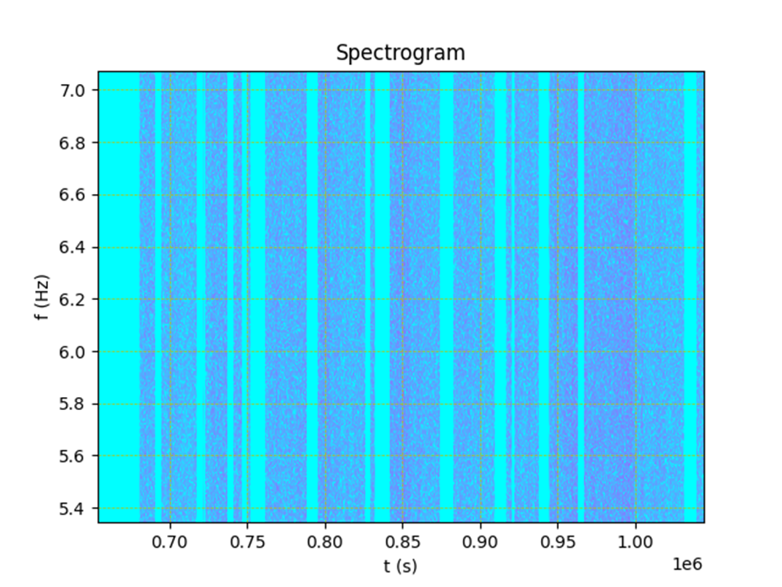
zooming:

Slide 16
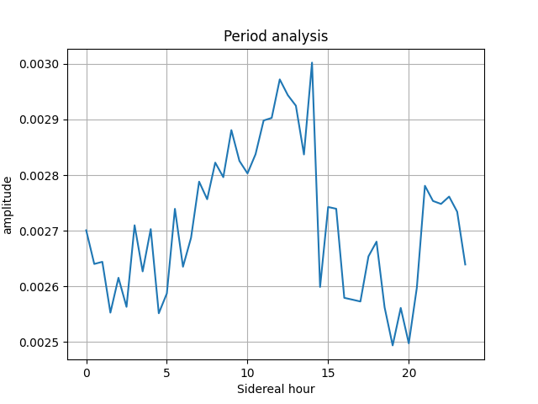
gd_period
>>> g=ML_PY.gd_lm7('L_C02_20170104_0060_0070_O2_tfstr.mat')
>>> period,meanp,harm,perclean,win=STAT.gd_period(g,'sid')
>>> GD.newfig()
>>> GD.plot_gd(period)
>>> GD.post_plot('Period analysis','Sidereal hour','amplitude')

