Slide 1


ZOIDBERG
T-DEV-810
Thibault Delerue
Gustave Julien
Simon Casteran
Vanessa Gonzalez

Slide 2
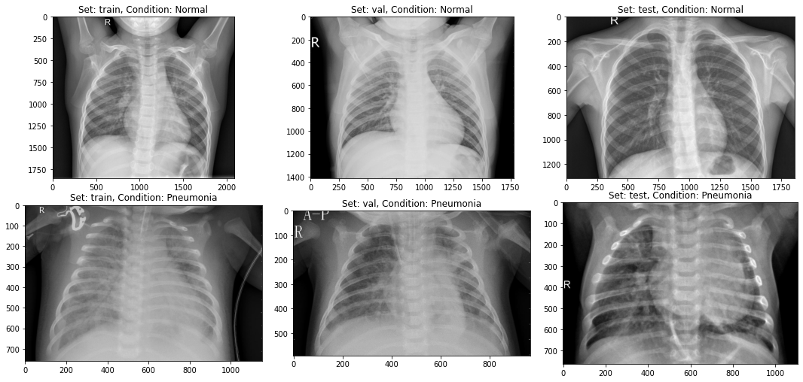
Project objectives
Compare machine learning models for image classification
Redact a research paper to expose our findings

Slide 3


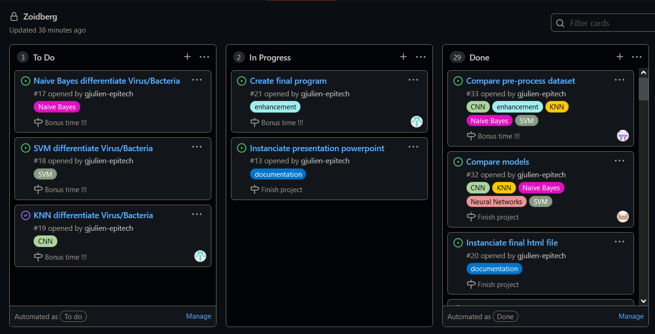

Project Management

Slide 4
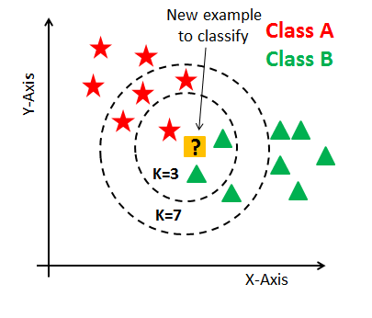
k-Nearest Neighbour (kNN)
Non-generalizing
Seeks the K closest neighbors
Bases prediction on majority vote accross these neighbors
Fast to use
Low false negatives
Huge memory usage
High number of false positives

Slide 5
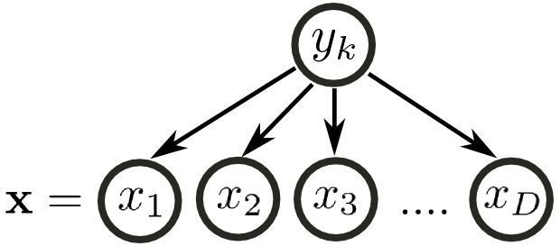
Naïve Bayes
Compare parameters individually
The more parameters, the worse the result
Not suitable for image classification

Slide 6
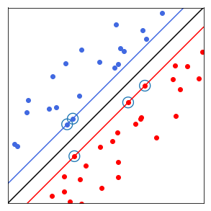
Support Vector Machine (SVM)
Decent with low dataset
Not good enough for medical radio scan classification
Worse than CNN on larger dataset

Slide 7
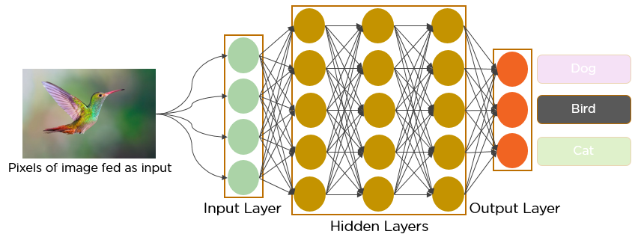
Convolutional Neural Network (CNN)
Really performant algorithm for image categorisation
The most data the more accurate the model is
Need a good GPU/CPU to create the model

Slide 8
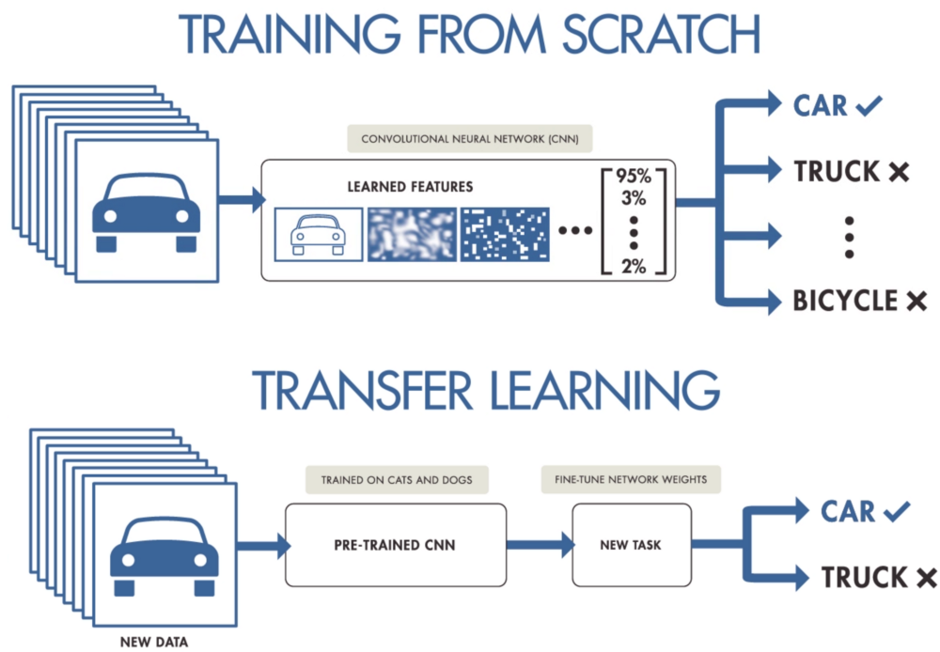
Transfer Learning
Need less data than CNN
Perform really well
Must choose carefully the right pre-trained model

Slide 9
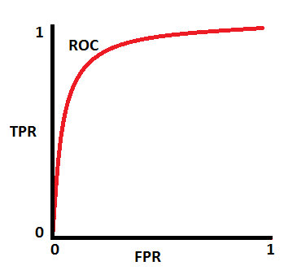
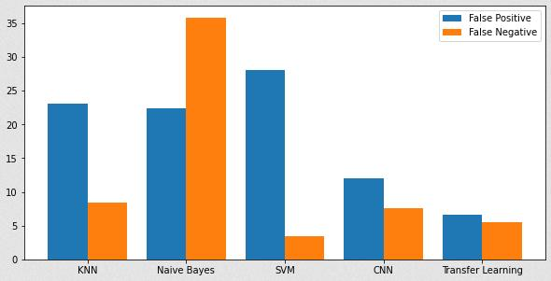
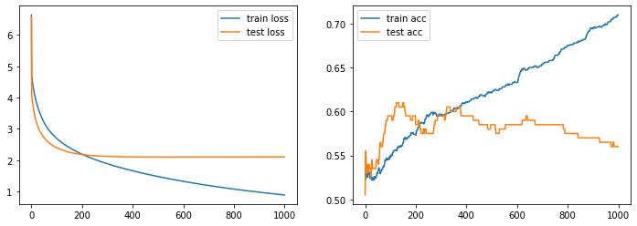
Metrics
Accuracy and false negative ratio are our priority
ROC AUC gives a better view of the model effectiveness than accuracy
Loss is useful to spot a model overfitting

Slide 10
Comparison of the models
Neural networks are better overall
Transfer Learning works better than CNN
SVM and kNN can be relevant for small datasets without too many parameters
Naïve Bayes is irrelevant for image classification

Slide 11
Bonus
Training CNN to differentiate Viral/Bacterial pneumonia
Creating Deep Neural Network from scratch
Creation of a Program for Doctors to detect Pneumonia
Research on Non-Supervised Neural Networks

Slide 12

Conclusion

