Slide 1
Data Analysis Workflow
Overview of code, analysis, and findings
By Henry Li

Slide 2
Project Context & Objectives
Business: EmporiUm – Student Bookstore Chain
Assigned territory: South Carolina
Assigned region: South
Stores analyzed: Charleston and Greenville
Objective: Evaluate sales performance and identify opportunities for next-quarter growth.

Slide 3
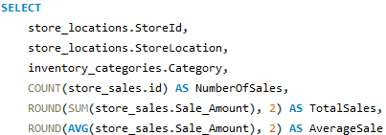
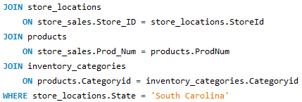
Code Walkthrough #1
Used SQL JOIN statements to connect sales with store locations.
Filtered sales to South Carolina.
Used SUM() to calculate total revenue.
Used MIN() and MAX() to identify the first and last transaction dates.
Used GROUP BY to separate sales by store.

Slide 4
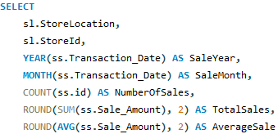
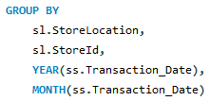
Code Walkthrough #2
Extracted transaction year and month using YEAR() and MONTH().
Calculated monthly revenue using SUM().
Calculated transaction counts using COUNT().
Calculated average transaction amounts using AVG().
Joined Products and Inventory_Categories to identify product categories.

Slide 5
Question Being Investigated
How much revenue does South Carolina generate?
How does South Carolina compare with the South region?
Which months generate the most revenue?
Which product categories perform best?
Which store performs better?
How can promotional efforts improve performance?

Slide 6
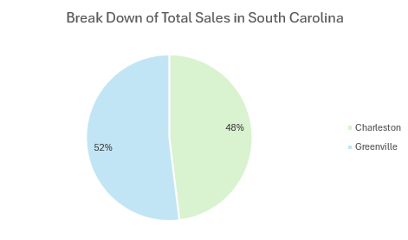
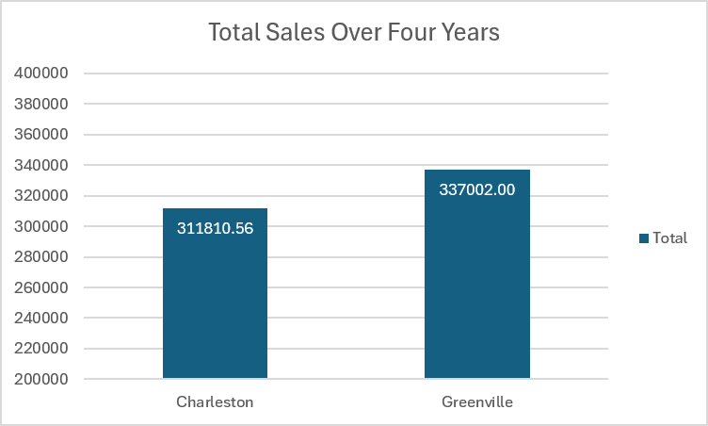
Exploratory Analysis
Total South Carolina revenue: $648,812.56.
Greenville generates approximately 52% of territory revenue.
Charleston generates approximately 48%.
Compare South Carolina revenue with total South region revenue.
Show monthly revenue trends by year and month.
Identify periods of stronger and weaker sales.

Slide 7
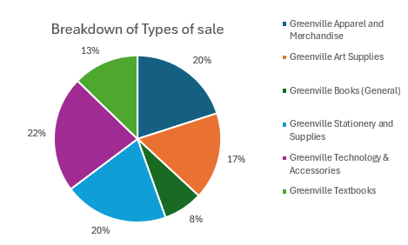
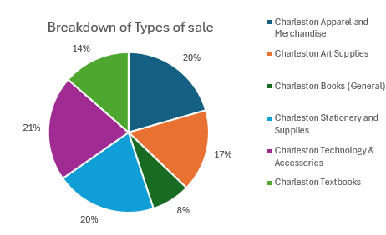
Deep-Dive Analysis
Technology & Accessories is the leading category at both stores.
Textbooks are the second-largest category.
Both stores have similar product category distributions.
Compare transaction counts by month and category.
Compare average transaction amounts by category.
Identify categories with opportunities for additional promotions.

Slide 8
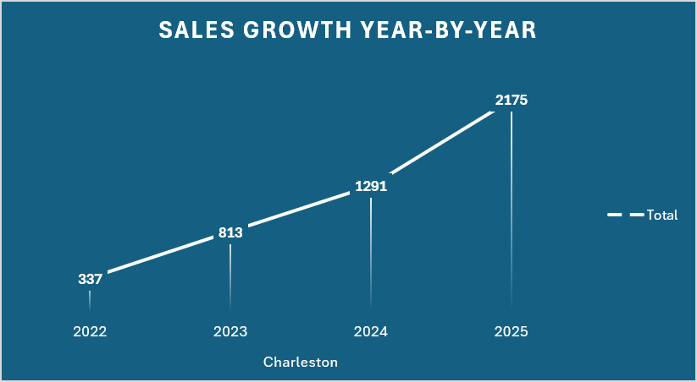
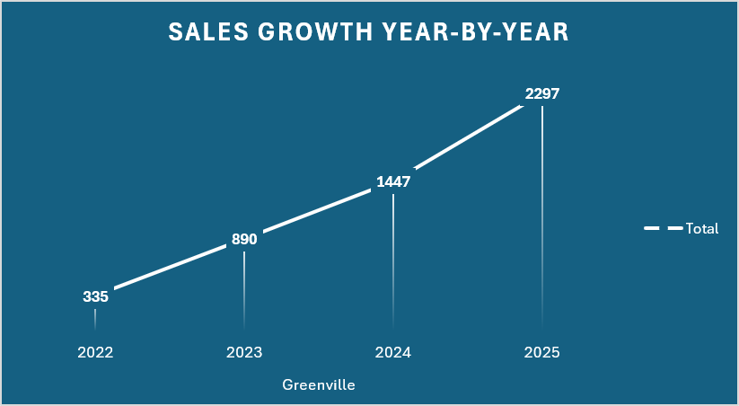
Deep Dive Analysis
Rank Charleston and Greenville by total revenue.
Greenville ranks first in total revenue.
Charleston ranks second.
Compare cumulative transaction activity from 2022–2025.
Charleston: 2,175 cumulative transactions by 2025.
Greenville: 2,297 cumulative transactions by 2025.

Slide 9
Insights & Recommendations
Increase targeted promotional efforts at both stores.
Prioritize Technology & Accessories and Textbooks.
Test product bundles and limited-time promotions.
Use smaller categories for additional promotional opportunities.
Monitor transaction counts, average transaction amounts, and revenue.
Evaluate whether promotions improve profitability.

Slide 10
Conclusion
Thank you

