Slide 1


CONTOSO
STORE
Data-Driven Sales Performance Review
Team 4

Slide 2

AGENDA
Overall Sales Performance
Sales by Category & Product
Monthly Sales Trends (Ordered vs. Delivered)
Geographic Sales Performance
Order Delivery Forecast
Promotion Effectiveness
Key Takeaways
Strategic Recommendations

Slide 3
OVERALL SALES PERFORMANCE
A 57.4% margin indicates a premium product mix and strong pricing power.
An average unit price of $226 supports the premium brand positioning.
A remarkably low return rate of 1.16% signifies high product quality and accurate marketing.

Slide 4

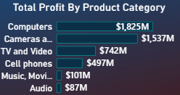
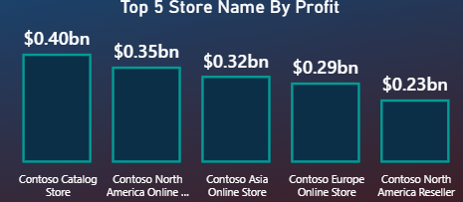
SALES BY CATEGORY & PRODUCT
The Computers category is the undisputed leader, driving nearly half of all revenue.
Laptops and Premium Televisions are the highest-value product segments.

Slide 5
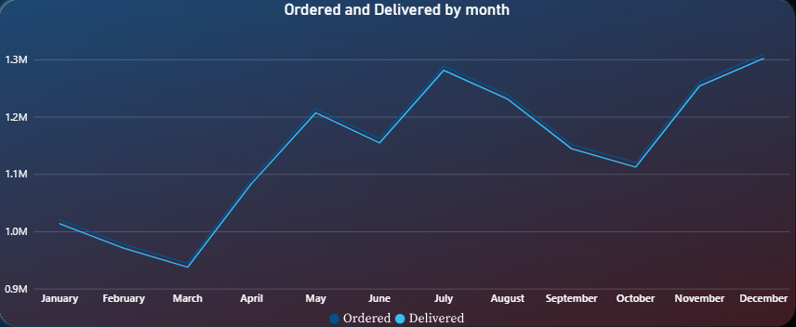
MONTHLY SALES TRENDS
INSIGHTS
A 2.6% gap ($220M) between orders and deliveries represents a significant revenue recognition delay.

Slide 6
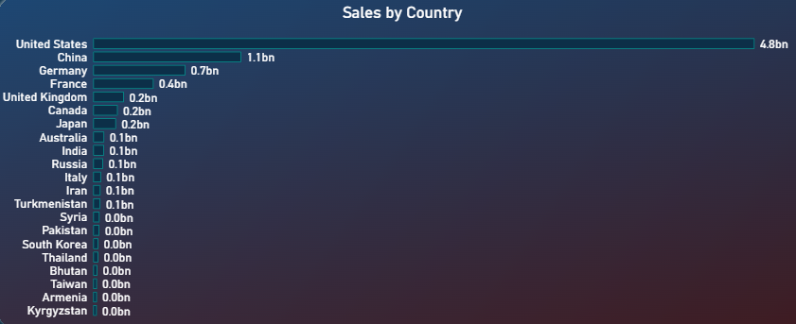
GEOGRAPHIC SALES PERFORMANCE
INSIGHTS
Revenue is heavily concentrated in North America and China, which together account for 70% of all sales.
This presents a strategic risk but also a clear opportunity for growth in the European market.

Slide 7
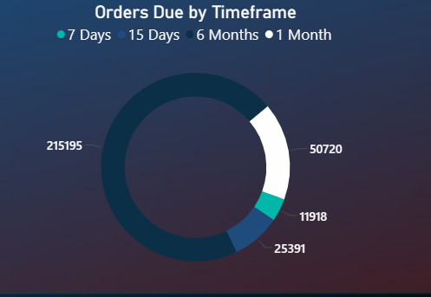
ORDER DELIVERY FORECAST
INSIGHTS
The backlog represents a $135M opportunity for immediate revenue recognition upon delivery.

Slide 8
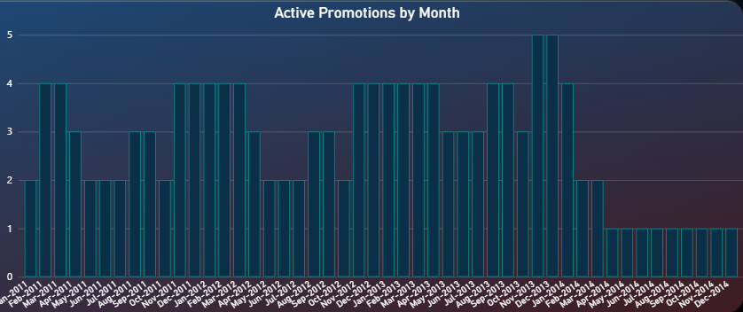
PROMOTION EFFECTIVENESS
INSIGHTS
Promotions are highly effective at driving volume and revenue, with a +34.8% increase in units sold.

Slide 9
KEY TAKEAWAYS
Computers category is the primary revenue driver.
The US and China are critical markets for sales growth.
Supply chain gaps (ordered vs. delivered) present an opportunity for optimization.
Promotions are actively used, but their direct ROI should be analyzed further.
Data access is secure and role-specific, ensuring the right users see the right data.
KEY

Slide 10
STRATEGIC RECOMMENDATIONS
Invest in Top Categories: Increase marketing and inventory for top-performing subcategories like Laptops.
Expand Geographic Focus: Leverage insights to push winning products in top countries.
Optimize Supply Chain: Analyze reasons for delivery delays to improve the ordered-to-delivered ratio.
Analyze Promotion ROI: Conduct a deep dive to measure the sales impact of promotions and optimize scheduling.
Enhance Dashboards: Continue developing operational dashboards for the sales team to track daily performance.
REC.

Slide 11
THANKS
FOR YOUR ATTENTION AND PARTICIPATION

