Slide 1
TASK 1
IRISH FLOWER SPECIES IDENTIFIER

Slide 2
CHECK OUT THE CODE FOR THIS PROJECT HERE
LINK:
https://docs.google.com/document/d/1M6vrivRGFDKRSRKM8xi6YG6CqinV1t3w/edit

Slide 3
EXPLANATION FOR CODE
import pandas as pd
This imports the pandas library and assigns it the alias pd, allowing us to refer to it as pd throughout the code.

Slide 4
EXPLANATION FOR CODE
import matplotlib.pyplot as plt
This imports the pyplot module from the matplotlib library and assigns it the alias plt.

Slide 5
EXPLANATION FOR CODE
from sklearn.tree import DecisionTreeClassifier
This imports the DecisionTreeClassifier class from the sklearn.tree module, which is used for building decision tree models.

Slide 6
EXPLANATION FOR CODE
from sklearn.model_selection import train_test_split
This imports the train_test_split function from the sklearn.model_selection module. It's used to split the dataset into training and testing sets.

Slide 7
EXPLANATION FOR CODE
from sklearn.metrics import accuracy_score
This imports the accuracy_score function from the sklearn.metrics module. It's used to evaluate the accuracy of the classifier.

Slide 8
EXPLANATION FOR CODE
data = pd.read_csv('DataSet/irish_dataset.csv')
This line reads a CSV file named 'irish_dataset.csv' from the 'DataSet' directory and stores it in a pandas DataFrame named data.

Slide 9
EXPLANATION FOR CODE
X = data.drop('Species', axis=1)
This line creates a DataFrame X containing all columns of data except the 'Species' column.

Slide 10
EXPLANATION FOR CODE
y = data['Species']
This line creates a Series y containing only the 'Species' column from the data DataFrame.

Slide 11
EXPLANATION FOR CODE
from sklearn.preprocessing import LabelEncoder
This imports the LabelEncoder function from the sklearn.metrics module. It's used to encode categorical labels into numerical values.

Slide 12
EXPLANATION FOR CODE
label_encoder = LabelEncoder()
This creates an instance of the LabelEncoder class from the sklearn.preprocessing module

Slide 13
EXPLANATION FOR CODE
y = label_encoder.fit_transform(y)
This line encodes the categorical labels in the y Series into numerical values using the fit_transform method of the LabelEncoder object.

Slide 14
EXPLANATION FOR CODE
X_train, X_test, y_train, y_test = train_test_split(X, y, test_size=0.2, random_state=42)
This line splits the features (X) and labels (y) into training and testing sets using the train_test_split function. It reserves 20% of the data for testing , 80% for training and sets the random state for reproducibility.

Slide 15
EXPLANATION FOR CODE
clf = DecisionTreeClassifier()
This line creates an instance of the DecisionTreeClassifier class, which will be used as the machine learning model.

Slide 16
EXPLANATION FOR CODE
clf.fit(X_train, y_train)
This line trains the decision tree classifier (clf) on the 80% of allocated training dataset (X_train and y_train).

Slide 17
EXPLANATION FOR CODE
y_pred = clf.predict(X_test)
This line makes predictions on the test set (X_test) using the trained classifier (clf) and stores the predicted labels in y_pred.

Slide 18
EXPLANATION FOR CODE
accuracy = accuracy_score(y_test, y_pred)
This line calculates the accuracy of the model by comparing the true labels (y_test) with the predicted labels (y_pred) using the accuracy_score function.

Slide 19

EXPLANATION FOR CODE
print("Accuracy:", accuracy*100, "%")
This line prints the accuracy of the model as a percentage.
Output :

Slide 20
EXPLANATION FOR CODE
species_data = {'Iris-setosa': data[data['Species'] == 'Iris-setosa'], 'Iris-versicolor': data[data['Species'] == 'Iris-versicolor'],'Iris-virginica': data[data['Species'] == 'Iris-virginica']}
This line creates a dictionary species_data where each key is a species name ('Iris-setosa', 'Iris-versicolor', 'Iris-virginica') and each value is a DataFrame containing only the rows corresponding to that species.

Slide 21
EXPLANATION FOR CODE
species_means = {species: species_data[species].drop('Species', axis=1).mean() for species in species_data}
This line calculates the mean values of the features for each species and stores them in a dictionary species_means.

Slide 22
EXPLANATION FOR CODE
fig, axs = plt.subplots(len(species_means), 1, figsize=(5, 5*len(species_means)))
This line creates subplots for each species with the number of rows equal to the number of species. The size of the figure is adjusted based on the number of species.

Slide 23
EXPLANATION FOR CODE
for i, species in enumerate(species_means): axs[i].pie(species_means[species], labels=species_means[species].index, autopct='%1.1f%%') axs[i].set_title(species)
This loop iterates over each species and its corresponding mean values, creating a pie chart for each species.
Creates a Pie chart for each of the species : Irish-setosa, Irish-versicolor and Irish-virginica. Each slice of the Pie chart is total percentage of : Sepal Length, Sepal Width, Petal Length and Petal Width (which contributes for determination of species of Irish Flower)

Slide 24
EXPLANATION FOR CODE
plt.tight_layout()
This adjusts the layout of the subplots to prevent overlap.

Slide 25
EXPLANATION FOR CODE
plt.show()
This displays the plot with all the pie charts.

Slide 26
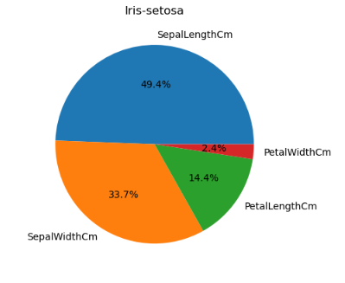
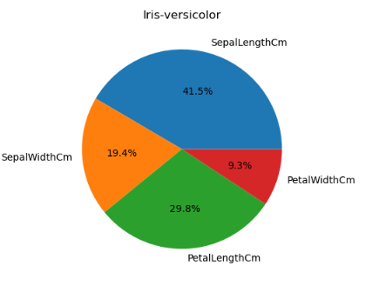
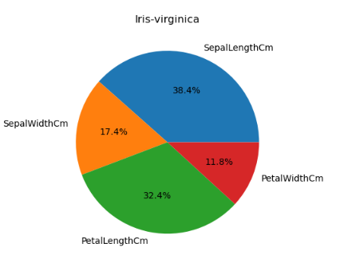
Output:

Slide 27
EXPLANATION FOR CODE
def calculate_accuracy(sepal_length, sepal_width, petal_length, petal_width):
user_input = [[sepal_length, sepal_width, petal_length, petal_width]]
prediction = clf.predict(user_input)
probabilities = clf.predict_proba(user_input)[0]
total = sum(probabilities)
accuracy_percentages = [prob / total * 100 for prob in probabilities]
return(prediction, accuracy_percentages)
This defines a function named calculate_accuracy that takes four parameters representing the sepal and petal measurements of a flower. It predicts the species of the flower and calculates the accuracy percentages for each species.
Then returns prediction and accuracy back.

Slide 28
EXPLANATION FOR CODE
def display_accuracy(prediction, accuracy_percentages):
classes = label_encoder.classes_
print("\nFlower according to description:")
for i, class_ in enumerate(classes):
print("{} = {:.2f}%".format(class_, accuracy_percentages[i]))
This defines a function named display_accuracy that takes the prediction and accuracy percentages as parameters. It displays the predicted flower species along with their corresponding accuracy percentages.

Slide 29
EXPLANATION FOR CODE
print("Enter sepal length: ")
sepal_length = float(input())
print("Enter sepal width: ")
sepal_width = float(input())
print("Enter petal length: ")
petal_length = float(input())
print("Enter petal width: ")
petal_width = float(input())
This prints a prompt asking the user to enter the sepal length.
This line reads the user's input for the sepal length and converts it to a floating-point number.
This prints a prompt asking the user to enter the sepal width.
This line reads the user's input for the sepal width and converts it to a floating-point number.
This prints a prompt asking the user to enter the petal length.
This line reads the user's input for the petal length and converts it to a floating-point number.
This prints a prompt asking the user to enter the petal width.
This line reads the user's input for the petal width and converts it to a floating-point number.

Slide 30
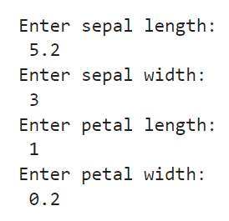
Output:

Slide 31
EXPLANATION FOR CODE
prediction, accuracy_percentages = calculate_accuracy(sepal_length, sepal_width, petal_length, petal_width)
This line calls the calculate_accuracy function with the user's inputs and stores the prediction and accuracy percentages returned by the function.

Slide 32
EXPLANATION FOR CODE
display_accuracy(prediction, accuracy_percentages)
This line calls the display_accuracy function to display the prediction and accuracy percentages.

Slide 33
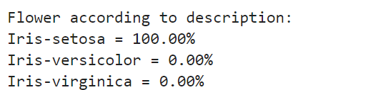
Output:

Slide 34
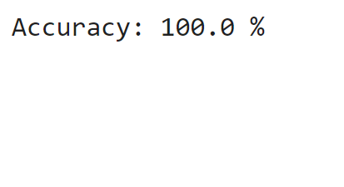
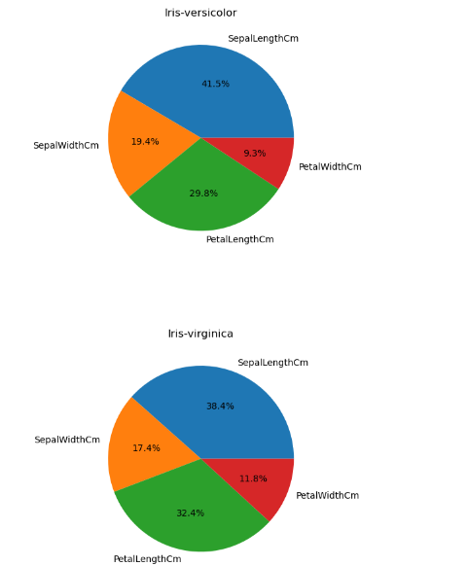
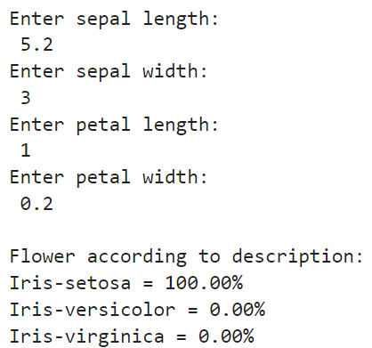
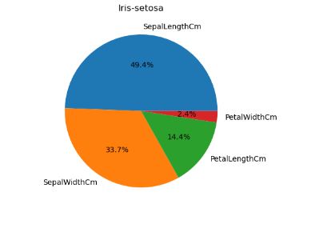

Total Output:

