Slide 1
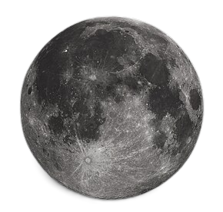

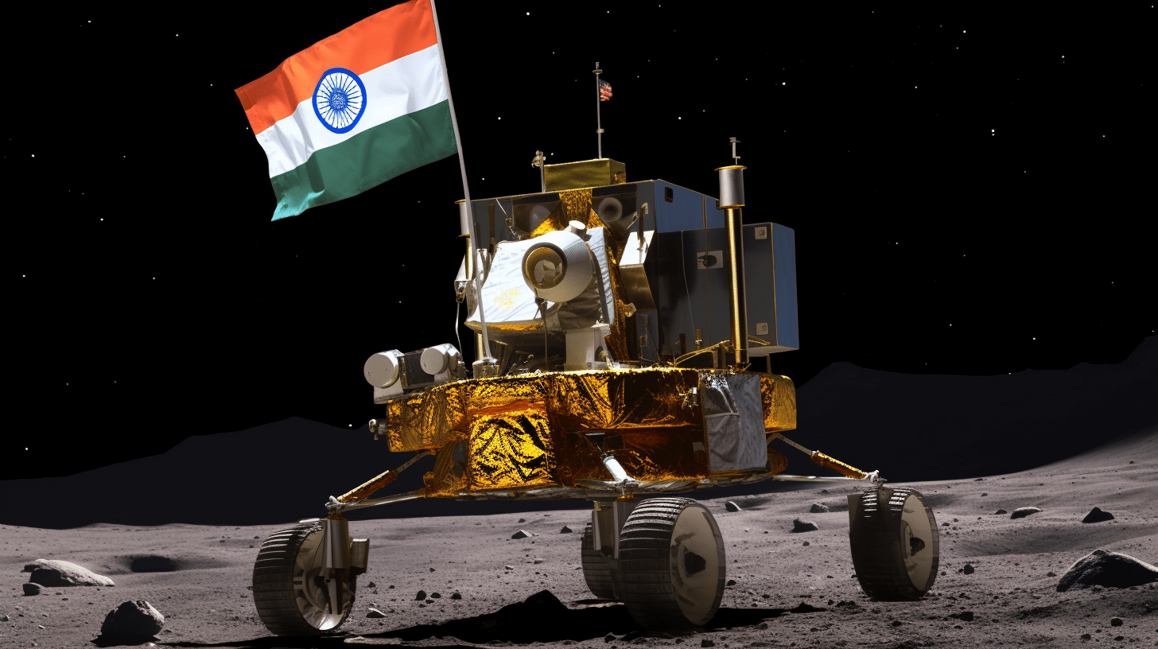
CHANDRAYAN ROVER PROJECT
Government Polytechnic Mujhana, Hata, Kushinagar
About Team-Members who complete this project under the guidance of -
Mr. Rahul Singh
Lecturer – Mechanical Engineering
Department of Mechanical Engineering (Production) 2023 - 2024

Slide 2
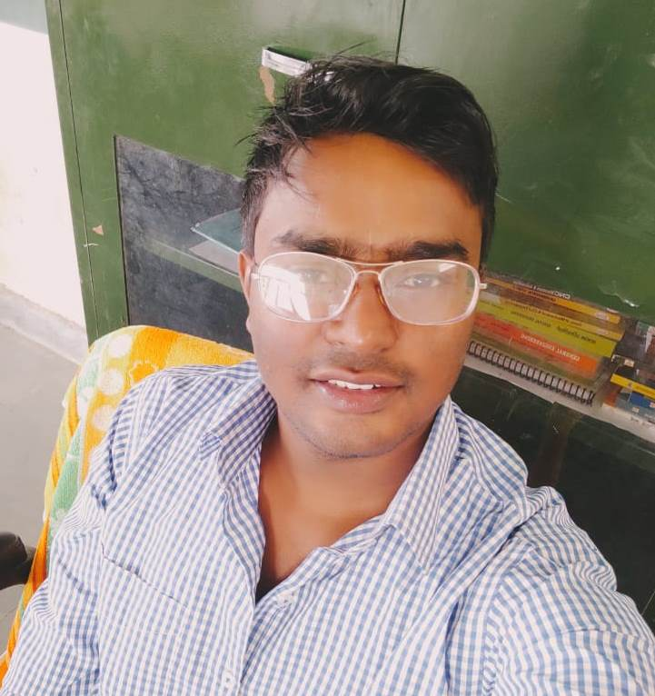
MENTOR
RAHUL SINGH
Just wanted to say a big thanks to our teacher who guided us through our Chandrayan Rover Project. Your support and advice really helped us to bring out best in our work.
Thank You, for being such a fantastic mentor !

Slide 3
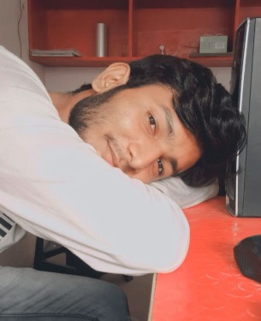
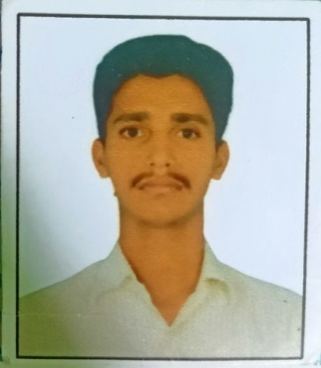
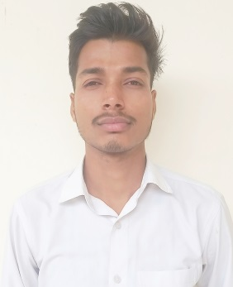

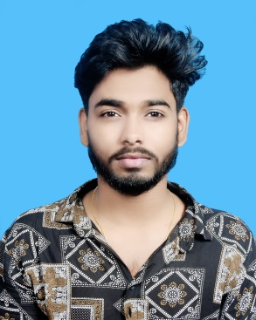
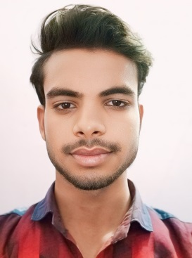
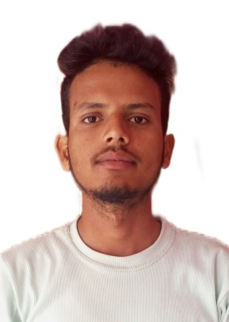
RAHUL KUSHWAHA

Slide 4







SERAJ AHAMAD

Slide 5


SATYAM TIWARI

Slide 6


VISHWAJEET KUMAR GOND

Slide 7



LAXMI NARAYAN CHAURASIA

Slide 8



RAJAT YADAV

