Slide 1
What is PMD?
PMD is a tool that checks your code for mistakes .It supports many programming languages, but it mainly works with Java and Apex
An open-source static code analysis tool
Used for static code analysis
Helps detect coding issues early
Supports Java, Apex, JavaScript, PLSQL, XML

Slide 2
Why Use PMD?
To write better code
To avoid bugs
To follow coding rules
To make code easier to maintain

Slide 3
How PMD Works
PMD reads source code
It checks the code against a set of rules
PMD finds issues by matching patterns
It creates a report
PMD scans code → applies rules → detects mistakes → shows a report.

Slide 4
Common PMD Rules
Unused variables
Empty catch blocks
Duplicate code
Long or complex methods
Unnecessary object creation
Bad naming conventions

Slide 5
Common PMD Rules
Unused variables
Empty catch blocks
Duplicate code
Long or complex methods
Unnecessary object creation
Bad naming conventions

Slide 6
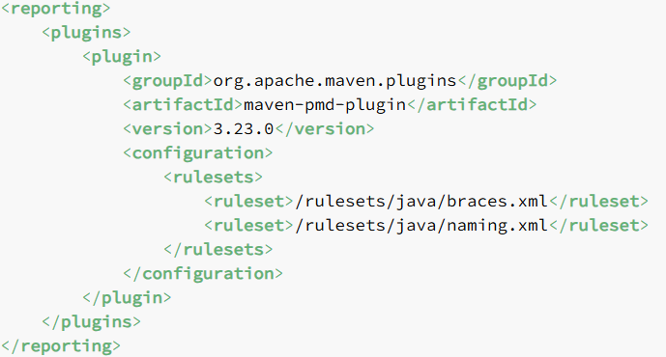
PMD in IDEs
IntelliJ plugin
Eclipse plugin
VS Code plugin

Slide 7
Conclusion
  PMD helps deliver clean, maintainable, and error-free code
  Easy to integrate and customize

