Slide 1
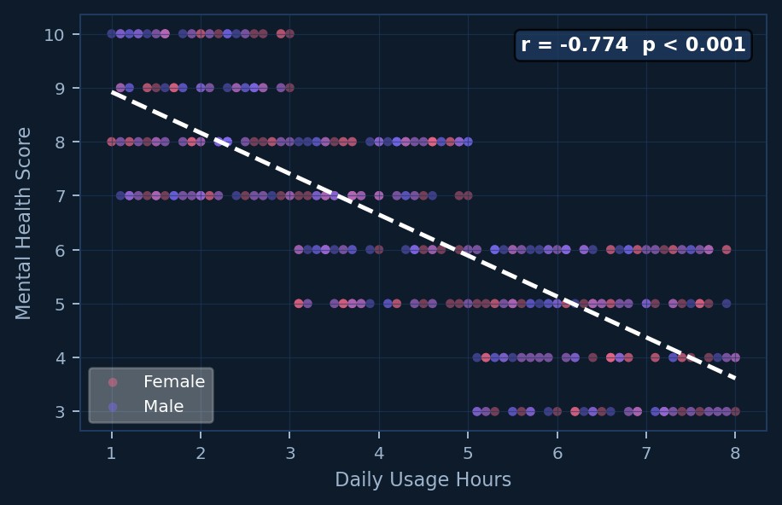
📱 Gen-Z Social Media
& Mental Health
Usage Hours vs. Mental Health Score
Each dot = one participant · Dashed line = regression trend
[Your Name] · Dr. Pierce · Spring 2025
THE PROBLEM
Gen-Z spends an average of 4.4 hrs/day on social media. Does this affect their mental wellbeing?
THE DATA
500
5
9
Participants
Countries
Variables
THE RESULT
📉 More usage → lower wellbeing (strong effect, r = −0.77)
r = −0.774 p < 0.001
🌙 Nighttime use alone didn't predict mental health (p = 0.96)
More screen time = lower mental health score
📲 Platform choice showed no significant MH differences
Data: Synthetic (AI-generated) · Methods: Pearson r, t-test, ANOVA · Tools: Python · pandas · seaborn · scipy

