Slide 1

NEW LIFE FOR SYRIAN REFUGEES IN TORONTO
A Potential Place for a Middle Eastern Restaurant for Syrian Refugees
Serap Gur

Slide 2
Introduction and Business Problem
As a result of Syrian civil war, more than half of the Syrian people has been displaced .
Neighbor countries-Turkey, Egypt, Iraq, Jordan, and Lebanon welcomed them in the first place
Gradually other countries such as Canada, USA, Germany began to welcome them
After the election of Prime Minister Justin Trudeau, under the resettlement initiative known as 26,172 Syrian refugees were resettled in Canada in 2015-2016
From these refuges, Toronto received the highest numbers of arrivals. In 2016, 11,405 refugees (including approximately 7.000 Syrian refugees) were resettled in Toronto.

Slide 3
Introduction and Business Problem
When these refugees were resettled, they were getting all the helps from the government.
However, gradually they want to be a part of the community and want to contribute to their host society.
Some of these refugees were businesspeople, they had small shops, restaurants, bakery, hairdresser salons and so on. In their hometown.
They already have the knowledge of their professions, but they do not know so much about Toronto, different cities, famous locations for businesses.

Slide 4
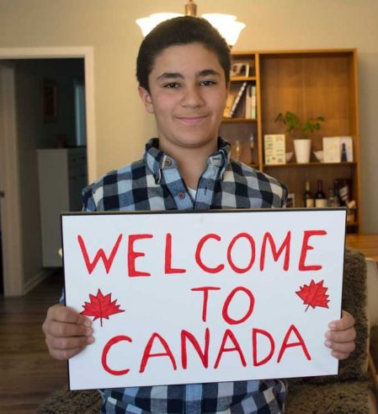
Main Research Question
For that reason in this study, we want to provide a solution to their business problem.
Our research question is, if a Syrian refugee wants to open a Middle Eastern restaurant, which location will be the best option?

Slide 5
Data information
To understand and explore and provide a solution to our research question, I use these data sets.
Open Neighborhoods data: 'https://en.wikipedia.org/wiki/List_of_postal_codes_of_Canada:_M'
Latitude and longitude of Neighborhoods
Foursquare Developers Access to venue data: https://foursquare.com/
Venue information of the Middle Eastern restaurants.

Slide 6
Methodology
Data from Wikipedia is used to get the list of the neighborhoods in Toronto
Beautiful Soup package is also used to extract data which is helpful for web scraping.
Then data is transformed into pandas data frame, and a table with the columns Postcode, Borough and Neighborhood is created.
There are some not assigned values for that reason these not assigned values are removed.
To get the latitude and longitude values, geocoders library is used.
As a result, the data framework contained the geographical coordinates of all neighborhoods in Toronto.

Slide 7
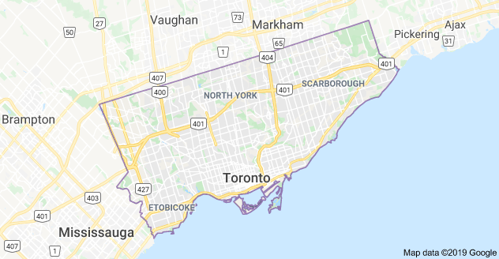
Methodology
Then by using Folium and geopy libraries I visualize the map of Toronto and neighborhoods. I explored some of the neighborhood by looking at Latitude and longitude values and searching some of the top venues in that neighborhood.

Slide 8
Methodology
Second part of the analysis depends on the Foursquare data.
The venues data from Foursquare are used.
First to check and see if there are any Mediterranean restaurants in Toronto by using search query.
Then each neighborhood is analyzed by grouping the rows by neighborhood and taking the mean on the frequency of occurrence of each venue category.
As a final analysis I used K-means clustering.
Main goal of the K-means algorithm is to partition the observations to the nearest clusters.
The neighborhoods are clustered into 3 categories based on the frequency of occurrence of Middle Eastern food.
As a result, there are 12 Mediterranean restaurants (such as Saha Mediterranean Fast Food, Mediterranean Restaurant, Taste of Mediterranean, Villa Madina Mediterranean Cuisine).

Slide 9
Results
Only restaurant data is filtered and used from the venues data. Specifically Middle Eastern type is searched. Then with K-means clustering, neighborhoods are clustered in to 3 categories.
Cluster 1: neighborhoods that they do not have any Middle Eastern restaurants
Cluster 2: neighborhoods that they have little number of Middle Eastern restaurants
Cluster 3: neighborhoods that they have high number Middle Eastern restaurants

Slide 10
Results
There is a scope in cluster 2 and 3, but not in 1 in these neighborhoods of Toronto.
Especially cluster 3, have high number of Middle Eastern restaurants. Specifically Central Bay Street, Studio District, Ryerson Garden District from this cluster have a significant number of Middle Eastern restaurants.
Most interestingly, these neighborhoods are also house for many international restaurants such as Chinese, Korean, Japanese, Italian, Thai, Indian and Mexican.
There can be two explanations of this. First there may be a high number of international community in these locations, or second, people who live in these neighborhoods like to eat international foods.

Slide 11
Conclusion
In this project, I try to help Syrian refugees and provide them some insights if they want to open a restaurant in Toronto.
Based on the analysis, I can recommend that Central Bay Street, Studio District, Ryerson Garden District can be a great location for a new Middle Eastern restaurant, since it looks like there is a high demand for international foods in here.
In addition , Dovertcourt village, Dufferin is another secondary option for a new Middle Eastern restaurant.
It is important to emphasize that this is only a research based on the existence of a Middle Eastern restaurant in a specific location. Of course there can be other factors such as population, diversity of population, income, age, gender, ethnicity of people who live in these neighborhoods can also be effective in success of a restaurant and they can also be included for further research.

