Slide 1

Introduction to OOP
Part 2
Operators, Program Constructs (Selection)

Slide 2
Arithmetic Operators
Add (+)
Subtract (-)
Multiply (*)
Divide (/)
Modulo/Modulus (%)
Find the remainder of a division.
35 + 5 = 40
5 – 2 = 3
4 * 2 = 8
10 / 2 = 5
282 % 120 = 42
“This also works “ + “for adding strings together”

Slide 3
Comparison Operators
Greater Than ( > )
Less Than ( < )
Equal To ( == )
Less than or equal to ( <= )
Greater Than or Equal To ( >= )
(40 >= 40)
(5 > 2)
(16 < 9)
(Deep Fried Chicken == Tasty)
(25 <= 50)
Not Equal To ( != )
(100 / 2) != 50

Slide 4
Logical Operators
AND (&&)
OR (||)
NOT (!)
XOR (^)
Returns false if both statements equate the same. i.e. They must be different to return True.
(1 == 2) && ( 6 < 10)
(1 == 2) || ( 6 < 10)
!(2==2)
(2==2) ^ (5 > 2)
(5 % 2) == 1 ^ (6 - 5) == 1
Notes:
False
True
False
False
True

Slide 5
Unary Operators
Increment ( ++ )
This operator takes a value and increases it by one.
Decrement ( -- )
This operator takes a value and decreases it by one.
Post vs Pre ( i++ / ++i)
Each of these operators can be used before or after a variable.
While both change the value of the variable, when used after, the original value is output in the statement and then it is incremented.
Notes:
False
True
False
False
True

Slide 6
Program Constructs
Selection constructs
Provide alternative paths by using statements like If and Switch.
Iteration constructs
Lets you repeat blocks of code. The For loop iterates a fixed number of times. A While loop iterates a variable number of times.
Sequence constructs
Change the flow of control when a program executes. Normally a program executes one line then goes on to the next line. You can jump to different line with keywords like Goto, Continue, Break. (Avoid the use of Goto statements because it can result in "spaghetti" code.) When you call a method, flow logic jumps to the code in the method and then returns to the calling programming.

Slide 7
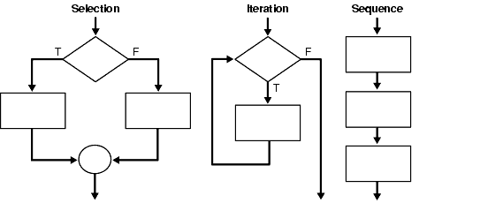
Program Constructs

Slide 8
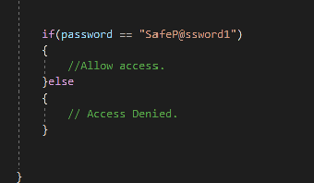
If else Statements
An IfElse statement is used to change the resolution of the statement being evaluated, and as a result the execution of the program. (Selection)
For example:
If(password == “SafeP@ssword1”)
{
//Allow access.
}else
{
// Access Denied.
}

Slide 9
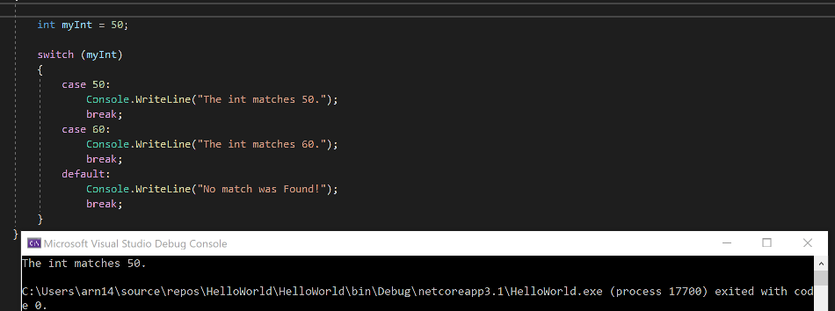
Switch Statement
A Switch Statement takes a variable and matches it against a series of conditions. If one condition matches, the switch executes the code in the block of the Switch statement that was true.
Pay particular attention to the formatting of the Switch statement.

