Slide 1
Introductory Programming Techniques
North Metropolitan TAFE
Courses:
Certificate III in Information Technology Certificate IV in IT (Programming) Certificate IV in IT (Networking) Certificate IV in IT (Cybersecurity) Certificate IV in IT (Web)

Slide 2


Conditional Execution
Chapter 3
Python for Everybody
www.py4e.com
Notes:
Note from Chuck. If you are using these materials, you can remove the UM logo and replace it with your own, but please retain the CC-BY logo on the first page as well as retain the acknowledgement page(s).

Slide 3
Comparison Operators
Boolean expressions ask a question and produce a Yes or No result which we use to control program flow
Boolean expressions using comparison operators evaluate to True / False or Yes / No
Comparison operators look at variables but do not change the variables
Python | Meaning
< | Less than
<= | Less than or Equal to
== | Equal to
>= | Greater than or Equal to
> | Greater than
!= | Not equal
Remember: “=” is used for assignment.

Slide 4
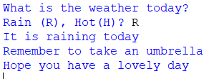

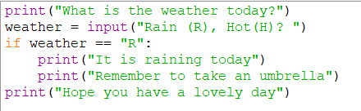




One-Way Decisions

Slide 5
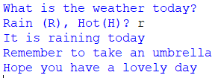
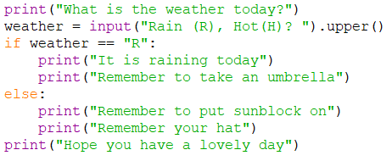
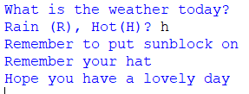
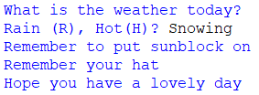

Two-way Decisions

Slide 6
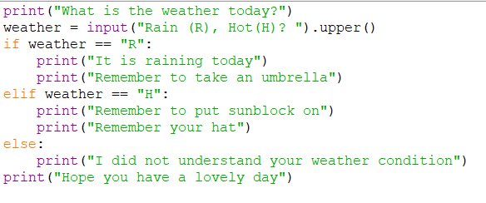

Multi-way Decisions

Slide 7
Warning: Turn Off Tabs!!
Atom automatically uses spaces for files with ".py" extension (nice!)
Most text editors can turn tabs into spaces - make sure to enable this feature
- NotePad++: Settings -> Preferences -> Language Menu/Tab Settings
- TextWrangler: TextWrangler -> Preferences -> Editor Defaults
Python cares a *lot* about how far a line is indented. If you mix tabs and spaces, you may get “indentation errors” even if everything looks fine

Slide 8
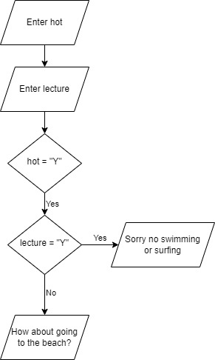
Nested decisions
Scenario:
The program ask if it is hot and if you have a TAFE lecture.
On hot days with TAFE lectures, display a message that you cannot go swimming or surfing.
On hot days without classes; displayed a message that you can go to the beach.
No message is displayed if it is not hot.

Slide 9
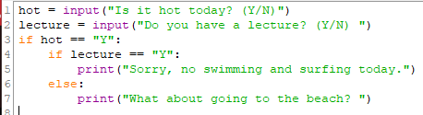
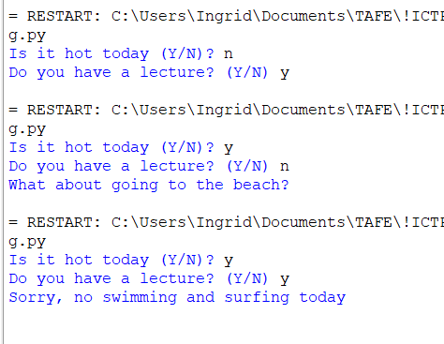
Nested decisions solution
Code | Output

Slide 10
Multi-way Puzzles
Which will never print regardless of the value for number?
if number < 2:
print('Below 2')
elif number >= 2:
print('Two or more')
else:
print('Something else')
if number < 2:
print('Below 2')
elif number < 20:
print('Below 20')
elif number < 10:
print('Below 10')
else:
print('Something else')

Slide 11
The try / except Structure
You surround a dangerous section of code with try and except
If the code in the try works - the except is skipped
If the code in the try fails - it jumps to the except section

Slide 12
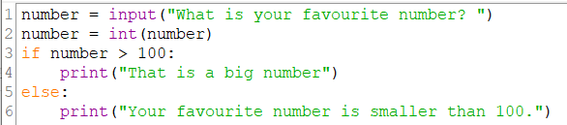
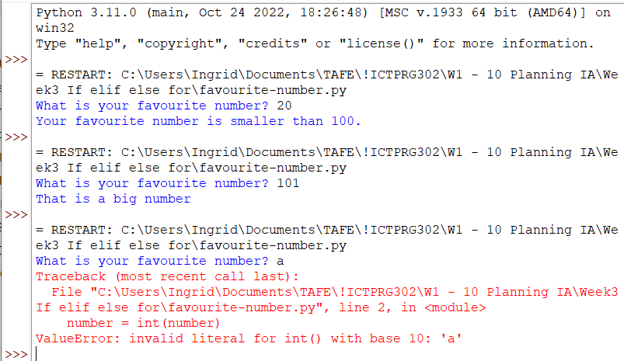
The try / except Structure
When do we need a try / except structure?

Slide 13
The try / except Structure
The program stops here

Slide 14
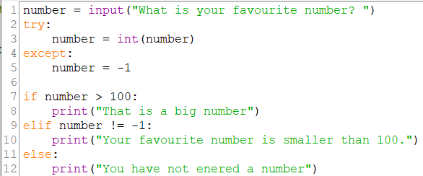
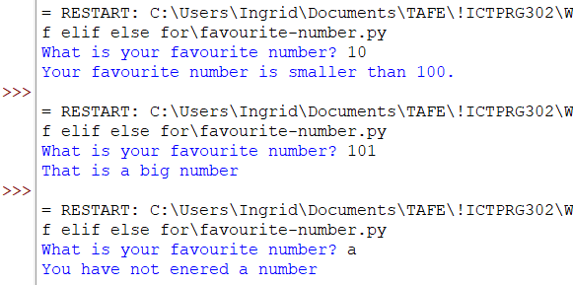
The try / except Structure
When the try: clause, line 2 fails - it drops into the except: clause, line 4 and the program continues.
If the try: clause succeeds - it skips the except: clause and the program continues at line 7.

Slide 15
Sample try / except
🛑 Warning
This is called a bare or naked except clause.
It will catch every and all errors. It is usually a poor practice to program this way.
We are not covering how to handle specific types of exceptions; we just want you to keep in mind that this is not a best practice.
Notes:
PEP 8 -- Style Guide for Python Code | Python.org
When catching exceptions, mention specific exceptions whenever possible instead of using a bare except: clause:
try: import platform_specific_module except ImportError: platform_specific_module = None A bare except: clause will catch SystemExit and KeyboardInterrupt exceptions, making it harder to interrupt a program with Control-C, and can disguise other problems. If you want to catch all exceptions that signal program errors, use except Exception: (bare except is equivalent to except BaseException:).
A good rule of thumb is to limit use of bare 'except' clauses to two cases:
If the exception handler will be printing out or logging the traceback; at least the user will be aware that an error has occurred.
If the code needs to do some cleanup work, but then lets the exception propagate upwards with raise. try...finally can be a better way to handle this case.
<Lecturer Note:> we’ll cover this in greater detail only in OO. But you may want to mention (especially to those doing a programming specialisation) that the exception is an object and that we can access methods in the object. Including printing the error or creating our own exceptions.
I also like to tell students that in the beginning they are better off under using exceptions than overusing them. In this course we’ll use except to validate input is numeric (ValueError) and to handle files.

Slide 16
PEP8 Standard
Correct | Wrong
counter = counter + 1 | counter=counter+1
submitted += 1 | submitted +=1
x = x*2 – 1 | x = x * 2 – 1
hypot2 = x*x + y*y | hypot2 = x * x + y * y
c = (a+b) * (a-b) | c = (a + b) * (a - b)
*Please note variable names are not following PEP8 standard, they should be descriptive
Notes:
PEP 8 -- Style Guide for Python Code | Python.org
When catching exceptions, mention specific exceptions whenever possible instead of using a bare except: clause:
try: import platform_specific_module except ImportError: platform_specific_module = None A bare except: clause will catch SystemExit and KeyboardInterrupt exceptions, making it harder to interrupt a program with Control-C, and can disguise other problems. If you want to catch all exceptions that signal program errors, use except Exception: (bare except is equivalent to except BaseException:).
A good rule of thumb is to limit use of bare 'except' clauses to two cases:
If the exception handler will be printing out or logging the traceback; at least the user will be aware that an error has occurred.
If the code needs to do some cleanup work, but then lets the exception propagate upwards with raise. try...finally can be a better way to handle this case.
<Lecturer Note:> we’ll cover this in greater detail only in OO. But you may want to mention (especially to those doing a programming specialisation) that the exception is an object and that we can access methods in the object. Including printing the error or creating our own exceptions.
I also like to tell students that in the beginning they are better off under using exceptions than overusing them. In this course we’ll use except to validate input is numeric (ValueError) and to handle files.

Slide 17
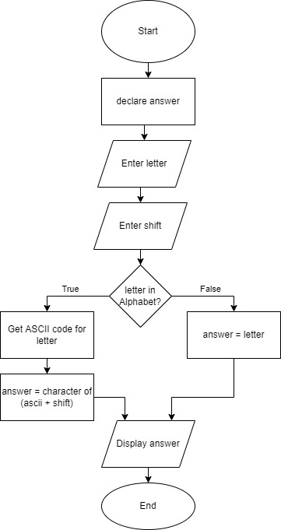
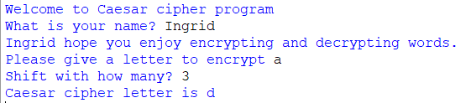
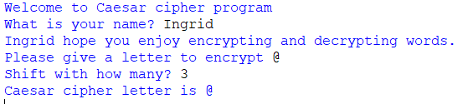
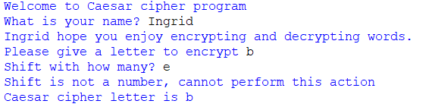
Caesar cipher
Tips:
if variable.isalpha(): can be used to check if a character is either a-z or A-Z
quit() stops the program

Slide 18
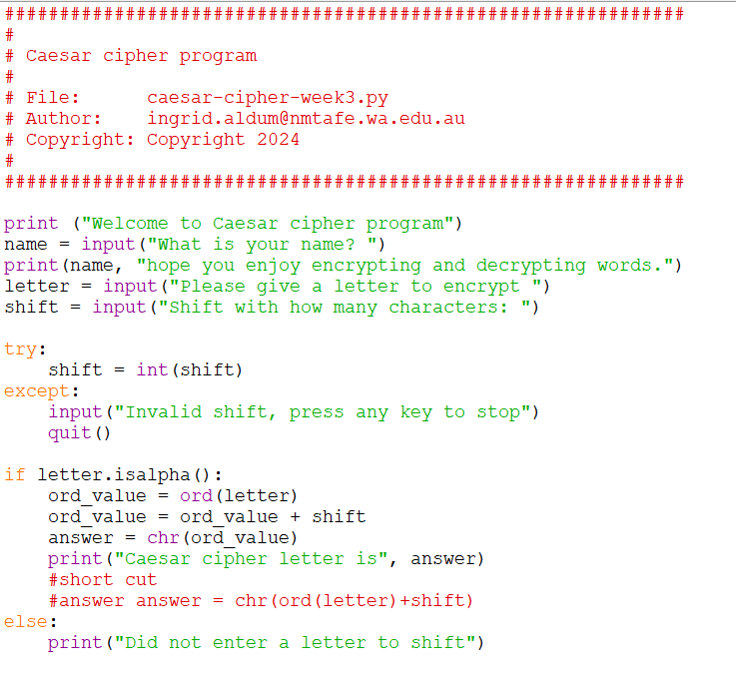
Caesar cipher

Slide 19
Summary
Comparison operators == <= >= > < !=
Indentation
One-way Decisions
Two-way decisions: if: and else:
Nested Decisions
Multi-way decisions using elif
try / except to compensate for errors

Slide 20
Additional Exercises
Write a program that prompts for a number and converts it from Celsius to Fahrenheit and check that it works
Extension:
Also prompt for unit and convert C<->F
Check that input can be converted into a float, and if it can’t end the program with a friendly message

Slide 21
Acknowledgements / Contributions
These slides are Copyright 2010- Charles R. Severance (www.dr-chuck.com) of the University of Michigan School of Information and made available under a Creative Commons Attribution 4.0 License. Please maintain this last slide in all copies of the document to comply with the attribution requirements of the license. If you make a change, feel free to add your name and organization to the list of contributors on this page as you republish the materials.
Initial Development: Charles Severance, University of Michigan School of Information
… Insert new Contributors and Translators here

