Slide 1
Introductory Programming Techniques
North Metropolitan TAFE
Course
Courses:
Certificate III in Information Technology Certificate IV in IT (Programming) Certificate IV in IT (Networking) Certificate IV in IT (Cybersecurity) Certificate IV in IT (Web)

Slide 2


Python Dictionaries
Chapter 9
Python for Everybody
www.py4e.com
Notes:
Note from Chuck. If you are using these materials, you can remove the UM logo and replace it with your own, but please retain the CC-BY logo on the first page as well as retain the entire last page.

Slide 3
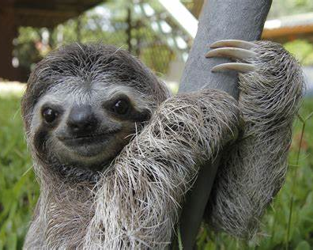
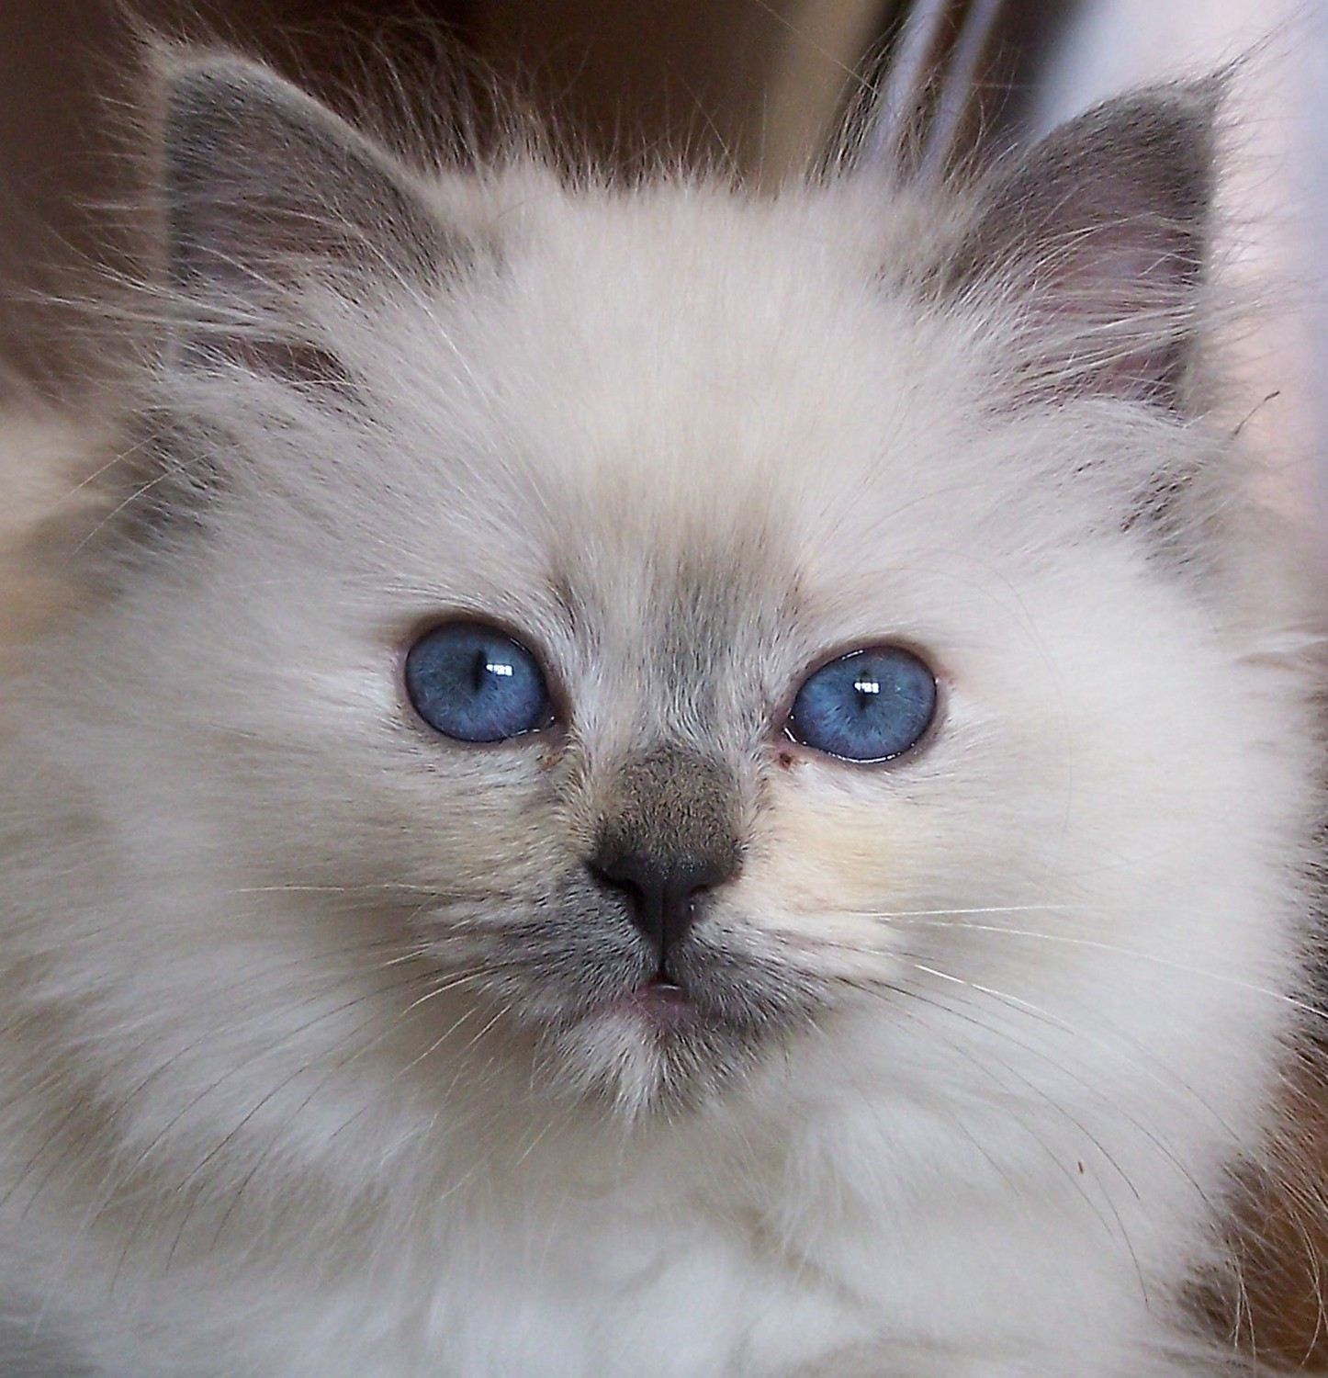
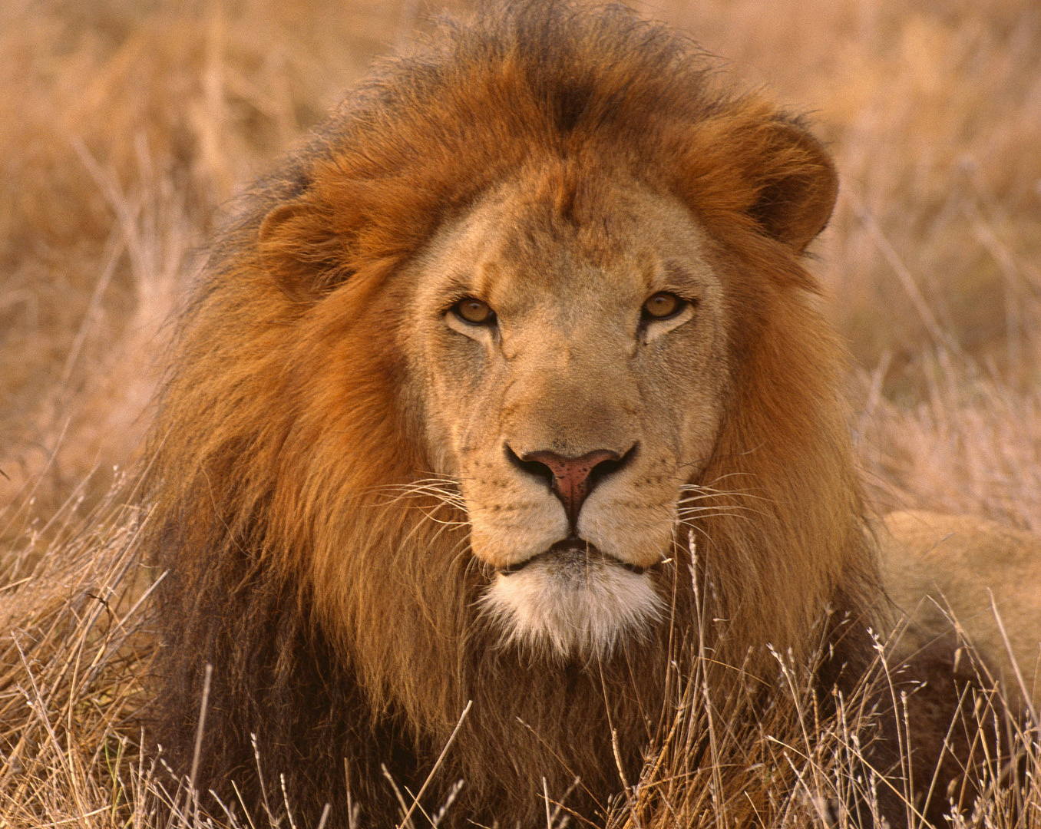
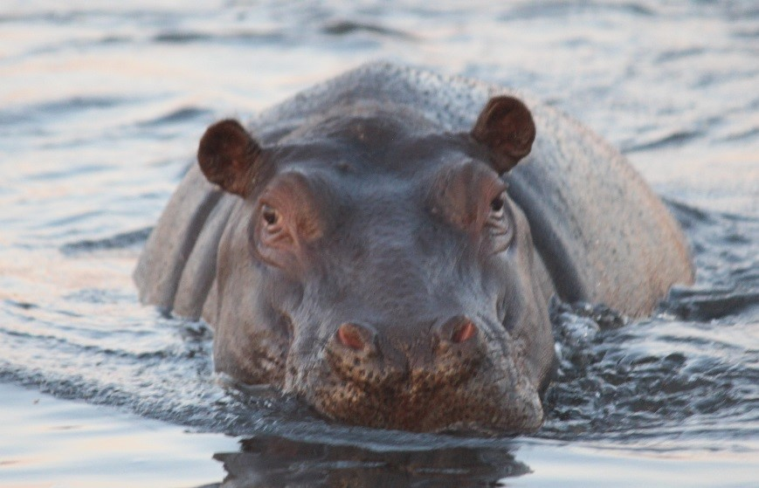
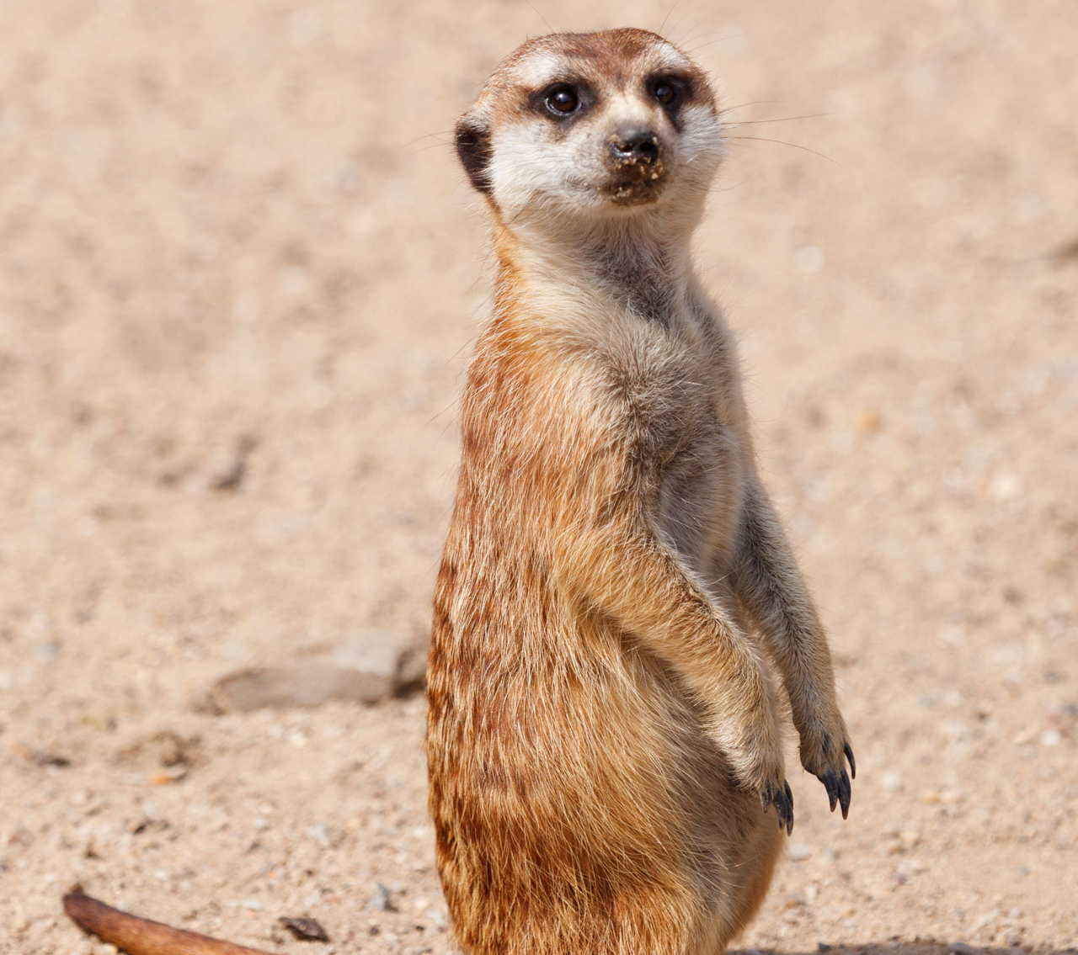
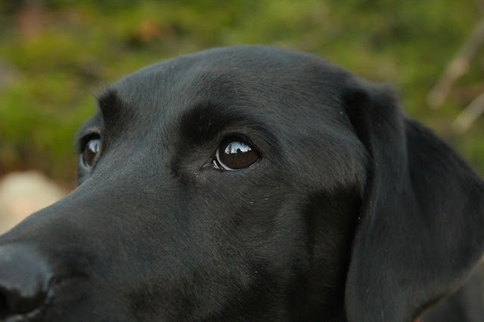
If you were an animal, what will you be?
Notes:
Fun warm-up activity. Students state if they were an animal which animal/bird etc. they would have been and the reason.
This can be saved as a dictionary to know who are the people that associate with a specific animal, lists will not work well to store this kind of information.
E.G
Dog: John, Susan, Luke
Cat: Allan, Craig, Mel
Eagle: Sarah
Sloth: Megan, Andrew

Slide 4
Two types of collections
List: A linear collection of values that stay in order.
What if we need to know the city a sport team is from?
Dictionary: A “bag” of values, each with its own label
It’s Python’s most powerful data collection
It allow us to do fast database-like operations
It has no fixed order
It has a key instead of an index value to look up values
Data is stored as a key : value pair

Slide 5
Dictionary: Popular names
 | Name | Number of people with the name
 | Charlotte | 25
2. | Olivia | 24
3. | Oliver | 17
4. | William | 15
5. | Isla | 10
6. | Jack | 9
7. | Mia | 5
8. | Thomas | 2

Slide 6
Creation of a dictionary
Create a Dictionary: names = {} or names = dict()
Enter names until only enter is pressed. If name exists the value will be one, else create a new record and the value is 1. Tip: to know if it exist - if name in names
Print the dictionary
Task | Code
Create an empty dictionary | #dictionary_name = {} or #dictionary_name = dict() names = {} or names = dict()
Add a value pair | #dictionary_name[key] = value names[name] = 1
Add one to an existing record | #dictionary_name[key] = dictionary_name[key] + 1 names[name] = names[name] + 1
Print a dictionary | #print(dictionary_name) print(names)
Code:
names = {}
while True:
name = input("Name: ")
if name == "":
break
elif name in names:
names[name] = names[name] + 1
else:
names[name] = 1
print(names)

Slide 7
Get Method
The get method:
checks if a key is in a dictionary
it assumes a default value if the key is not there
dictionary_name.get(keyname, default)
default: what the value will be if the keyname does not exist.

Slide 8
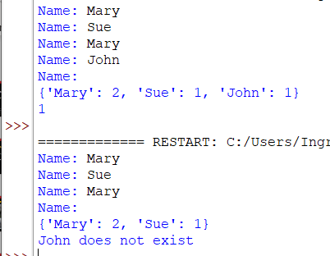
Get method example
Description | Code | Output
KeyError if the specific record does not exist. | print(names[“John"]) | Traceback (most recent call last): File "C:\Dictionary.py", line 11, in <module> print(names[“John"]) KeyError: ‘John'
get method | #Value: if the value that you want to use if #the key does not exist in the dictionary dictionary_name.get(key, value)
names = {}
while True:
name = input("Name: ")
if name == "":
break
elif name in names:
names[name] = names[name] + 1
else:
names[name] = 1
print(names)
print(names.get("John","John does not exist"))

Slide 9
Simplify code with get method
Original Code
Simplified Code
names = {}
while True:
name = input("Name: ")
if name == "":
break
elif name in names:
names[name] = names[name] + 1
else:
names[name] = 1
print(names)
names = {}
while True:
name = input("Name: ")
if name == "":
break
else:
names[name] = names.get(name, 0) + 1
print(names)

Slide 10
Displaying dictionary data
Description | Code
 | names= { “Charlotte": 25, “Olivia”: 24, “Oliver”: 17, “William”: 15, “Isla”: 10}
Loop over values | for name in names: print(name, names[name])
Print the value pairs | print(names.items())
Printing the key values | print(names.keys())
Printing a list of key values | print(list(names))
Printing the values of all the keys | print(names.values())

Slide 11
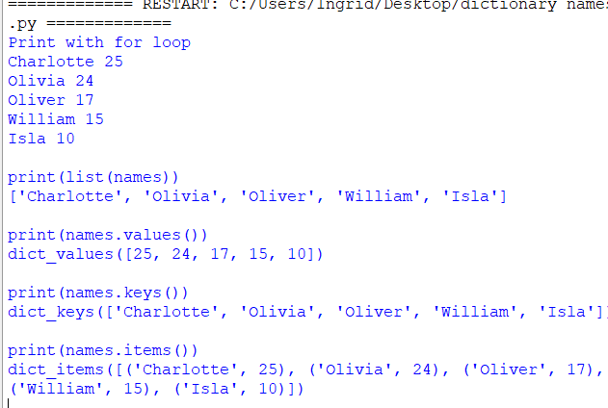
Printing Example
#print the data
names= {"Charlotte": 25,
"Olivia": 24,
"Oliver": 17,
"William": 15,
"Isla": 10}
print("Print with for loop")
for name in names:
print(name, names[name])
print("\nprint(list(names))")
print(list(names))
print("\nprint(names.values())")
print(names.values())
print("\nprint(names.keys())")
print(names.keys())
print("\nprint(names.items())")
print(names.items())

Slide 12
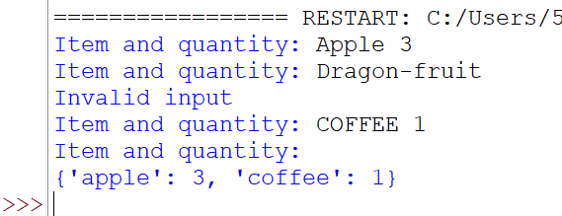
Grocery dictionary activity
To do | Test Data
Create an empty dictionary called groceries | Input: Apple 2 Dragon-fruit CoFFEE 1
Create a loop that will add groceries until the user press enter. Lowercase grocery items will be the key. If no quantity or quantity is not a number, display an error message. The quantity must be stored as an integer. Print your grocery dictionary | Input: Apple 2 CoFFEE 1 apple 3 Bread 1

Slide 13
Solution
groceries = {}
while True:
buy = input(“Enter Product & Quantity: ").lower()
if buy == '':
break
items = buy.split()
key = items[0]
try:
value = int(items[1])
except:
print(“Please enter a quantity with your order”)
break
if key in groceries:
groceries[key] = groceries[key] + value
else:
groceries[key] = value
print(groceries)

Slide 14
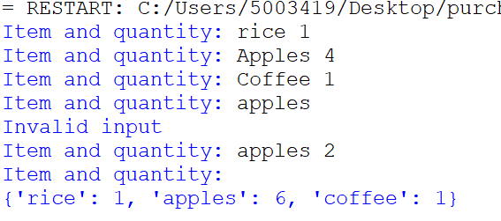
Grocery activity enhancement
To do | Test Data
Change your code to include the following requirements:
If the grocery item already exist, add the current amount to the existing amount. | Input: rice: 1 Apples: 4 Coffee: 1 Apples: 2

Slide 15
Solution(s)
Option 1
Option 2
groceries = {}
while True:
buy = input(“Enter Product & Quantity: ").lower()
if buy == "":
break
items = buy.split()
try:
value = int(items[1])
except:
print(“Please enter a quantity with your order”)
break
if items[0] in groceries:
groceries[items[0]] = groceries[items[0]] + value
else:
groceries[items[0]] = value
print(groceries)
groceries = {}
while True:
buy = input("Product & Quantity: ").lower()
if buy == '':
break
items = buy.split()
try:
value = int(items[1])
except:
print(“Please enter a quantity in your order")
break
groceries[items[0]] = groceries.get(items[0], 0) + value
print(groceries)

Slide 16
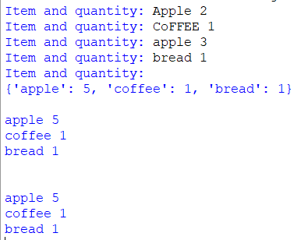
Elegant loop
Code | Code output
#Originally way for key in grocery: print(key, groceries[key]) print("\n") # 2 variables in for loop for key, value in groceries.items(): print(key, value)

Slide 17
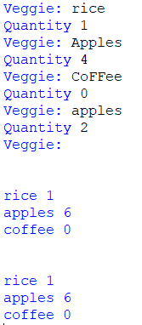
Definite loops and dictionaries
Code | Description
print("\n") for key in groceries: print(key.strip(), groceries[key]) print("\n") for key, value in groceries.items(): print(key.strip(), value)

Slide 18
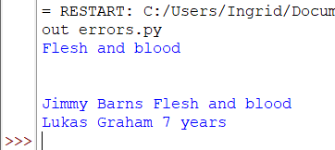
Revision Music Dictionary
Find the 3 mistakes
music_dictionary = []
music_dictionary[‘Jimmy Barnes’] = ‘Flesh & Blood’
music_dictionary[‘Lukas Graham’] = ‘7 years’
print(music_dictionary[‘Flesh and blood’])
print(‘\n’)
#print all records
for key, value in music_dictionary():
print(key, value)
Corrected Code
music_dictionary = {}
music_dictionary[‘Jimmy Barns’] = ‘Flesh & Blood’
music_dictionary[‘Lukas Graham’] = ‘7 years’
print(music_dictionary[‘Jimmy Barnes’])
print(‘\n’)
#print all records
for key, value in music_dictionary.items():
print(key, value)

Slide 19
Acknowledgements / Contributions
These slides are Copyright 2010- Charles R. Severance (www.dr-chuck.com) of the University of Michigan School of Information and open.umich.edu and made available under a Creative Commons Attribution 4.0 License. Please maintain this last slide in all copies of the document to comply with the attribution requirements of the license. If you make a change, feel free to add your name and organization to the list of contributors on this page as you republish the materials.
Initial Development: Charles Severance, University of Michigan School of Information
… Insert new Contributors or translation credits here
...

