Slide 1
Introductory Programming Techniques
North Metropolitan TAFE – Joondalup
Semester 2 - 2023
Courses:
Certificate III in Information Technology Certificate IV in IT (Programming) Certificate IV in IT (Networking) Certificate IV in IT (Cybersecurity) Certificate IV in IT (Web)

Slide 2
Files
Extending and Reusing Python Functionality
Reading and writing from Files
Lecturer: John Robertson
Session 6

Slide 3
Challenge 1
Activity 3
Download the starter code on Blackboard
String manipulation

Slide 4

Reading text files
Objectives
You will:
Determine the purpose of external data files
Read data from an external text file

Slide 5
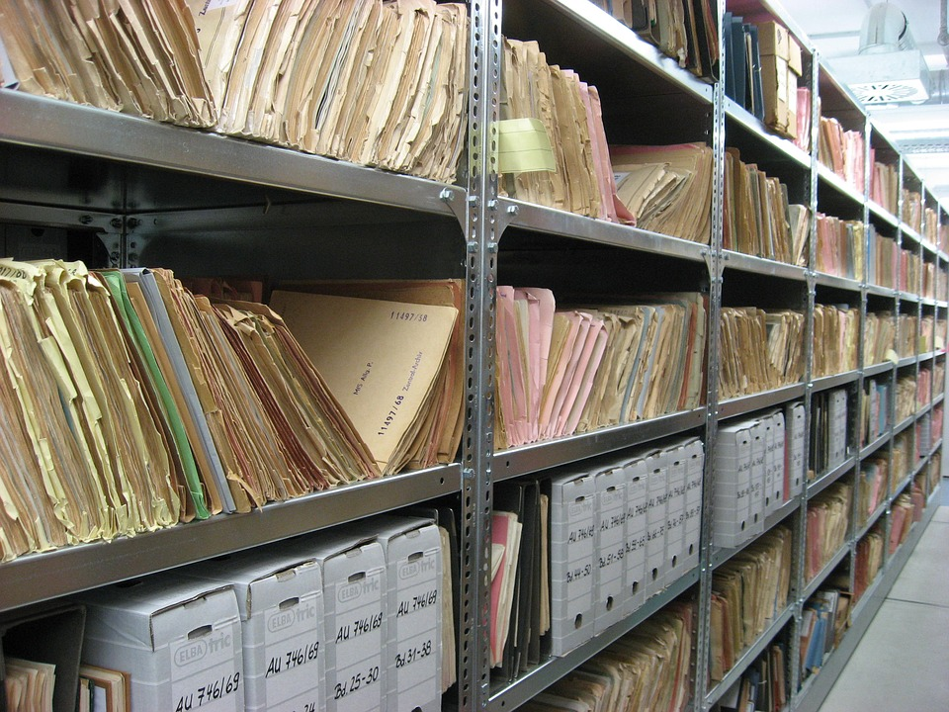
Files
Activity 1
A file is a term used to describe data that is held in storage on a computer.
They can often be used by other programs for different purposes.
Notes:
Image source: https://pixabay.com/photos/files-ddr-archive-1633406/

Slide 6
File handling
Activity 1
How do we keep any data generated once your code has been terminated?
How do we save program data to an external file?
Notes:
Image source: https://pixabay.com/photos/files-ddr-archive-1633406/

Slide 7
File handling
Activity 1
Question .
Can you think of examples of when file-handling techniques might be used?
Game progress
Test scores
Player names
Restaurant orders
Stock levels

Slide 8

File handling in Python
Activity 2
The key file-handling techniques that you need to be able to use are:
Open
Read
Close
Write
Append

Slide 9
Open a text file
Activity 2
Here is an instruction that will open a text file in read mode.
file = open("quick.txt","r")

Slide 10
Open a text file
Activity 2
file = open("quick.txt","r")
Here is an instruction that will open a text file in read mode.
Creates an identifier (also called a handle) for the file that is to be accessed.

Slide 11
Open a text file
Activity 2
file = open("quick.txt","r")
Here is an instruction that will open a text file in read mode.
Calls a function that returns a file object.

Slide 12
Open a text file
Activity 2
file = open("quick.txt","r")
Here is an instruction that will open a text file in read mode.
The first argument is the name of the text file to be opened.

Slide 13
Open a text file
Activity 2
file = open("quick.txt","r")
Here is an instruction that will open a text file in read mode.
The second argument is the mode that the file will be opened.

Slide 14

Open a text file: modes
Activity 2
file = open("quick.txt","r")
There are four modes for opening a file:
r for only reading files
w for only writing to files
a for adding to an existing file
r+ for reading and writing files
Opening a file in write mode will erase any existing file with the same name.

Slide 15
Read a text file
Activity 2
Once a file has been opened, it can then be read.
file = open("quick.txt","r")
quicktext = file.read()

Slide 16
Read a text file
Activity 2
file = open("quick.txt","r")
quicktext = file.read()
Once a file has been opened, it can then be read.
Creates a variable that will hold the contents of the text file.

Slide 17
Read a text file
Activity 2
file = open("quick.txt","r")
quicktext = file.read()
Once a file has been opened, it can then be read.
Is the identifier for the text file that has been opened.

Slide 18
Read a text file
Activity 2
file = open("quick.txt","r")
quicktext = file.read()
Once a file has been opened, it can then be read.
Is a method that is used to read the contents of the text file.

Slide 19
Read a text file
Activity 2
The text file must be saved in the same location as your Python file for the program to work.
file = open("quick.txt","r")
quicktext = file.read()
You must not use the same variable name as the file identifier in your program.

Slide 20
Reading lines from a text file
Activity 3
1 2 3 | file = open("quick.txt","r") print(file.readline())
The readline() method is used to read a single line.
The method will return the line with \n at the end of the string, adding a new line.
 | A >>>

Slide 21
Reading lines from a text file
Activity 3
1 2 3 4 | file = open("quick.txt","r") print(file.readline()) print(file.readline())
Each time the readline() method is called, the next line in the text file will be returned.
 | A quick >>>

Slide 22
Reading lines from a text file
Activity 3
1 2 3 4 | file = open("quick.txt","r") for line in file: print(line)
You can also iterate over a text file using a for loop.
Question
What do you think the output will be when this program is executed?

Slide 23
Reading lines from a text file
Activity 3
 | A quick brown fox jumps over the lazy dog >>>
Answer
For every line in the text file, it will print the line, along with a line space.

Slide 24
Reading lines from a text file
Activity 3
1 2 3 4 | file = open("quick.txt","r") for line in file: print(line.strip())
To remove the extra line space, the strip() method can be used.
 | A quick brown fox jumps over the lazy dog >>>

Slide 25
Reading lines from a text file
Activity 3
Another tool for reading lines is the readlines() method.
You can use this to place each line of the text file as an item in a list.
1 2 3 4 5 | file = open("quick.txt","r") quicklist = file.readlines() print(quicklist)
 | ['A\n', 'quick\n', 'brown\n', 'fox\n', 'jumps\n', 'over\n', 'the\n', 'lazy\n', 'dog'] >>>

Slide 26

Reading lines from a text file
Activity 3
1 2 3 4 5 | file = open("quick.txt","r") quicklist = file.readlines() print(quicklist)
The \n becomes more apparent when you see the data in this way.
 | ['A\n', 'quick\n', 'brown\n', 'fox\n', 'jumps\n', 'over\n', 'the\n', 'lazy\n', 'dog'] >>>
Note that \n is not added to the final line in the text file.

Slide 27
Reading lines from a text file
Activity 3
1 2 3 4 5 6 7 8 | file = open("quick.txt","r") quicklist = [] for line in file: quicklist.append(line.strip()) print(quicklist)
If you want to populate a list with lines from a text file but you don’t want \n included in the list,
you can write a for loop to populate the list instead.
 | ['A', 'quick', 'brown', 'fox', 'jumps', 'over', 'the', 'lazy', 'dog'] >>>

Slide 28

Default data type
1 2 3 4 5 6 7 8 | file = open("numbers.txt","r") numberlist = [] for line in file: numberlist.append(line.strip()) print(numberlist)
When the data is copied from a text file, it will automatically be held using the string data type.
 | ['1', '2', '3', '4', '5', '6', '7', '8', '9', '10'] >>>
Note the '' around each number in the list.

Slide 29
Default data type
1 2 3 4 5 6 7 8 | file = open("numbers.txt","r") numberlist = [] for line in file: numberlist.append(int(line.strip())) print(numberlist)
To change the data type, you will need to use casting.
This data should be held as an integer so you can cast it as an integer as you populate the list.
 | [1, 2, 3, 4, 5, 6, 7, 8, 9, 10] >>>
Note that there are no longer quotes around each number.

Slide 30
Closing a file
Activity 3
Once you have performed all the tasks that you need to with a file, it is important to close it.
This will free up system resources and protect the data.
1 2 3 4 5 6 7 | file = open("quick.txt","r") quicktext = file.read() file.close() print(quicktext)

Slide 31
Challenge 2
Activity 3
Download the started code for challenge 2 on blackboard
Read a file
Count the lines
Counts the words

Slide 32
Match the method to the description
Plenary
readline()
Removes the \n from the end of the string
readlines()
To be used when you are finished accessing the text file
strip()
Reads the entire text file
read()
Reads a single line from the text file
close()
Reads all of the lines and places them into a list

Slide 33
Match the method to the description
readline()
Removes the \n from the end of the string
readlines()
To be used when you are finished accessing the text file
strip()
Reads the entire text file
read()
Reads a single line from the text file
close()
Reads all of the lines and places them into a list

Slide 34
Make a prediction
Starter activity
1 2 3 4 5 6 | file = open("quick.txt", "r") quicktext = file.readline() file.close() quicktext = file.readlines() print(quicktext)
Question:
What will be the output of print, when this program is executed?
The first line from the text file will print
A list will be printed that contains each line from the text file as an item
The whole text will be printed with the first line repeated
An error will occur
▹
4

Slide 35
Make a prediction
Starter activity
1 2 3 4 5 6 | file = open("quick.txt", "r") quicktext = file.readline() file.close() quicktext = file.readlines() print(quicktext)
Question
What will be the output of print, when this program is executed?
The first line from the text file will print
A list will be printed that contains each line from the text file as an item
The whole text will be printed with the first line repeated
An error will occur
▹
4

Slide 36
Make a prediction
Starter activity
1 2 3 4 5 6 | file = open("quick.txt", "r") quicktext = file.readline() file.close() quicktext = file.readlines() print(quicktext)
Why? .
Once the file has been closed it can no longer be read.

Slide 37
Make a prediction
Starter activity
1 2 3 4 5 6 | file = open("quick.txt", "r") quicktext = file.readline() file.close() quicktext = file.readlines() print(quicktext)
Why? .
Once the file has been closed it can no longer be read.
An error will occur when the program tries to access a closed file.

Slide 38
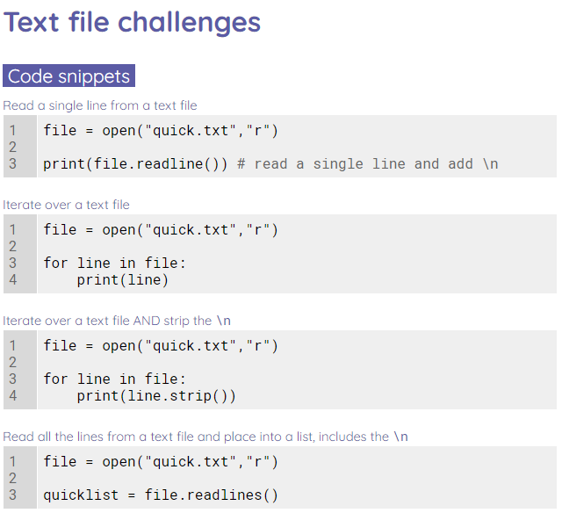
Text file challenges
Let’s run some more test cases in your local environment

Slide 39
Writing to text files
Objectives
Write to text files
Append to text files

Slide 40
Writing to a new text file
Activity 1
There are four modes for opening a file:
r for only reading files
w for only writing to files
a for adding to an existing file
r+ for reading and writing files
file = open("players.txt","w")

Slide 41
Writing to a new text file
Activity 1
file = open("players.txt","w")
When you open a file in write mode, it creates a new file with the specified file name.

Slide 42
Writing to a new text file
Activity 1
file = open("players.txt","w")
When you open a file in write mode, it creates a new file with the specified file name.
If that file already exists, then the file will be overwritten.

Slide 43

Writing to a new text file
Activity 1
file = open("players.txt","w")
Live coding

Slide 44
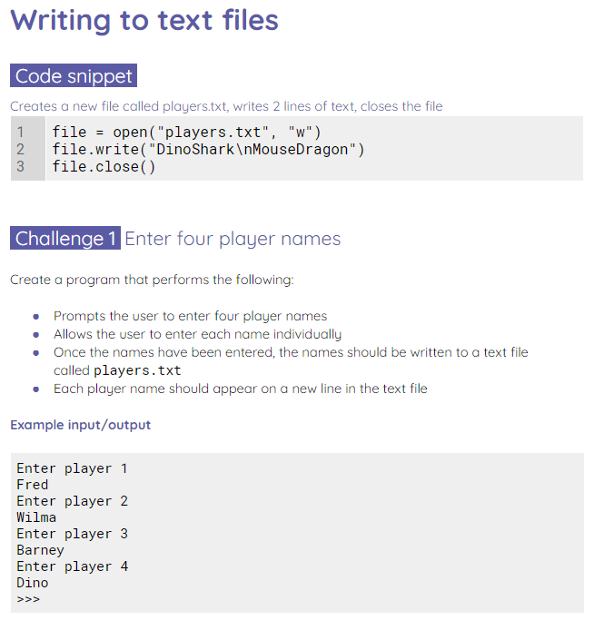
Writing to a new text file
Activity 1
Use the worksheet to try some mini challenges.

Slide 45
Appending to a text file
Activity 2
file = open("players.txt","a")
When you append to a file, you are adding new data to the end of the text file.
The mode character for appending to a file is an a.

Slide 46
Appending to a text file
Activity 2
file = open("players.txt","a")
file.write("DragonShark")
There is no append method for text files. The write() method is used to write and append files.

Slide 47
Appending to a text file
Activity 2
file = open("players.txt","a")
file.write("DragonShark")
Question .
What is missing from the program for it to work correctly?

Slide 48
Appending to a text file
Activity 2
Question .
What is missing from the program for it to work correctly?
Answer .
The file must be closed in order for the program to work as expected. The file will remain open and won’t be updated.
file = open("players.txt","a")
file.write("DragonShark")
file.close()

Slide 49
Appending to a text file
Activity 2
file = open("players.txt","a")
file.write("DragonShark")
file.close()
Live coding

Slide 50
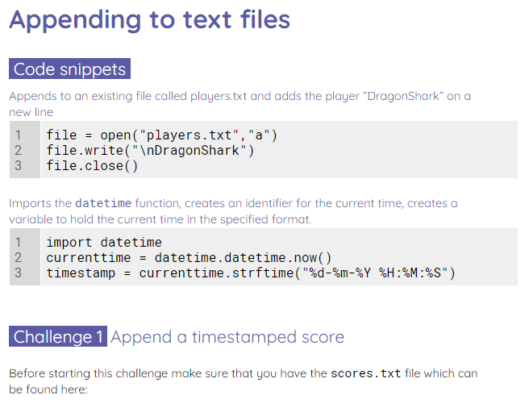
Appending to a text file
Activity 2
Use the worksheet to complete some append challenges.

Slide 51
Challenge 3
Activity 3
Download the started code for challenge 3 on blackboard

Slide 52
Summary
Secondary storage
Opening a file - file handle
File structure - newline character
Reading a file line by line with a for loop
Appending to a file
Searching for lines
Writing to a file

Slide 53


Acknowledgements / Contributions
Some of these slides are Copyright 2010- Charles R. Severance (www.dr-chuck.com) of the University of Michigan School of Information and made available under a Creative Commons Attribution 4.0 License. Please maintain this last slide in all copies of the document to comply with the attribution requirements of the license. If you make a change, feel free to add your name and organization to the list of contributors on this page as you republish the materials.
Initial Development: Charles Severance, University of Michigan School of Information
… Insert new Contributors and Translators here
...

