Slide 1
Introduction to Object-Oriented Programming
Various
ICT40220 – Cert IV of Information Technology
Cluster Intermediate IOT
Unit code | Unit title
ICTPRG430 | Apply introductory object-oriented language skills
ICTICT449 | Use version control systems in development environments

Slide 2
PREAMBLE: ICTPRG302 KEY REVISION
Part 0
Notes:
NOTE TO LECTURERS: Before talking about modularization in the form of classes/objects, ensure your class understands modularization in the form of functions and imports. You may have already covered these topics extensively in ICTPRG302, but if not sure, then this revision is recommended.

Slide 3
Overview: Modularity and Python
Revision on two key concepts: functions and modules
Ensure you understand the fundamentals of modularity before tackling the object-oriented approach to it

Slide 4
Functions: revision
Define a function with the ___ keyword
Inside the definition, we use round brackets to define the______ that the function accepts
A function definition is just that: a definition
To execute a function, we call it by referencing the name and then we use _____ brackets and include any arguments

Slide 5
Discussion: why write functions?

Slide 6
Why write functions?
… to reuse code, but why:
The least important reason is to write less code (copy/paste can do it more easily!)
Maintain less code is a better explanation
Fewer lines
Reuse in different contexts
Make one big problem into many small problems

Slide 7
The big problem with small problems
Making a big problem into small problems is harder than it sounds
One part is to do with how we think, reason, and decompose our big problem
The other part is to do with how we write functions

Slide 8
Pure functions
The ideal function only interacts with the outside world via arguments and return values
That means:
No referencing global variables
No creating global variables
A function that doesn’t affect the outside world in any other way but returning a value and that always produces the same output for the same input is called a pure function

Slide 9
Side effects
Anything a function does, that affects the world outside the function, except returning a value, is a side effect
Displaying/printing/emailing/actuating a motor/servo are all side effects
It is a bit odd, because if you think about it, the only reason to run a program is to affect something in the outside world (outside the CPU that is!)
Something, somewhere must cause a side effect

Slide 10
So why?
We encourage you to write pure functions and limit where in your program you create side effects to allow you to reason about functions independently of the rest of the code
If you take a big problem and create lots of small problems that interact with other parts of the code in complex or implicit ways, you now have an even bigger problem!
This problem: of how we breakdown big problems into smaller problems without creating even bigger problems is something we’ll revisit with OOP

Slide 11
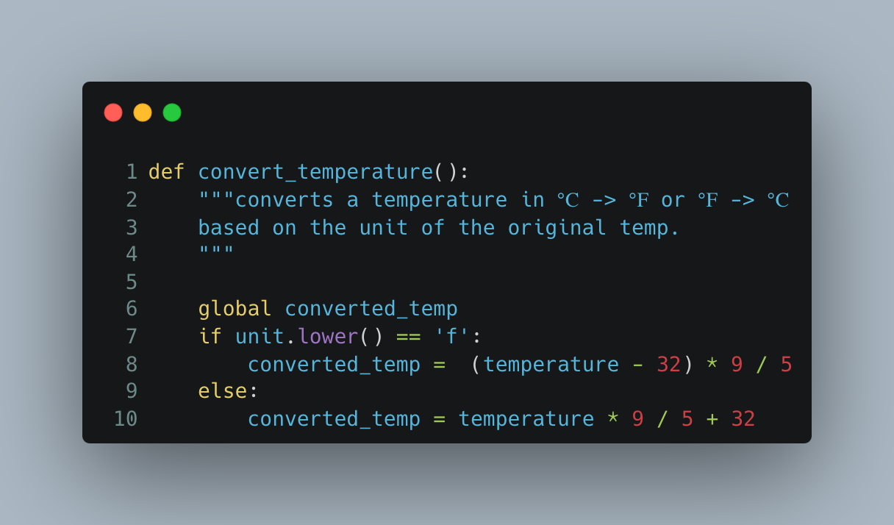
What’s wrong with this function?
Notes:
Key insights:
We don’t know if the function will work unless we see all points in the code that call it
If we change the name of the global we will break all code that uses the function
We need not only make sure that all variables are initialized correctly outside the function but that they have the expected value at the time the function is called
This function will probably make the code more complicated in the long term.
Also – there is a BUG with the conversion logic! But that was an accident ☺

Slide 12
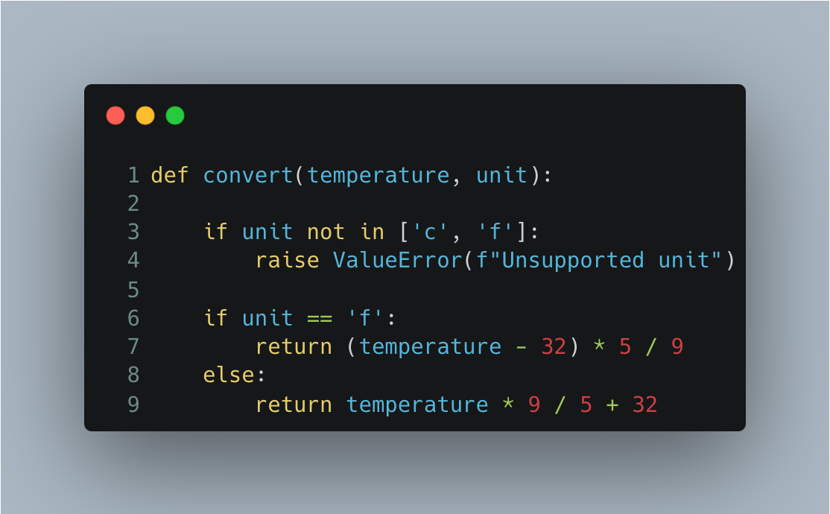
Compare to
Notes:
The key difference is that in the previous example, the correctness of the function cannot be determined without checking on the referenced code whereas in the modified version we can determine the correctness of the function independently of the rest of the code.

Slide 13
Python Modules
Any Python file can be treated as a module
A module is a collection of definitions that can be imported into another module or script
In Python a script is:
A python file that can be executed from the command line
A module is:
A collection of definitions that can be reused in multiple scripts
They might not have standalone value (e.g. can’t be executed as a script)
A package, btw, is a collection of modules, but we won’t look at this until next year/semester

Slide 14
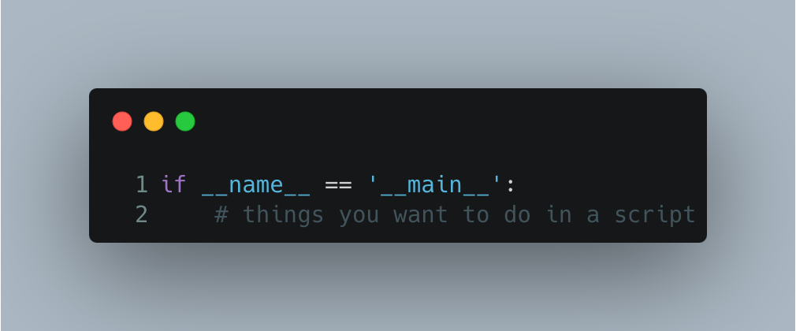
if/name/main allows one file to be both
A Python file can be both a script and a module using the if/name/main pattern
The __name__ variable is set to ‘__main__’ when executed as a script and set to the module name when imported

Slide 15
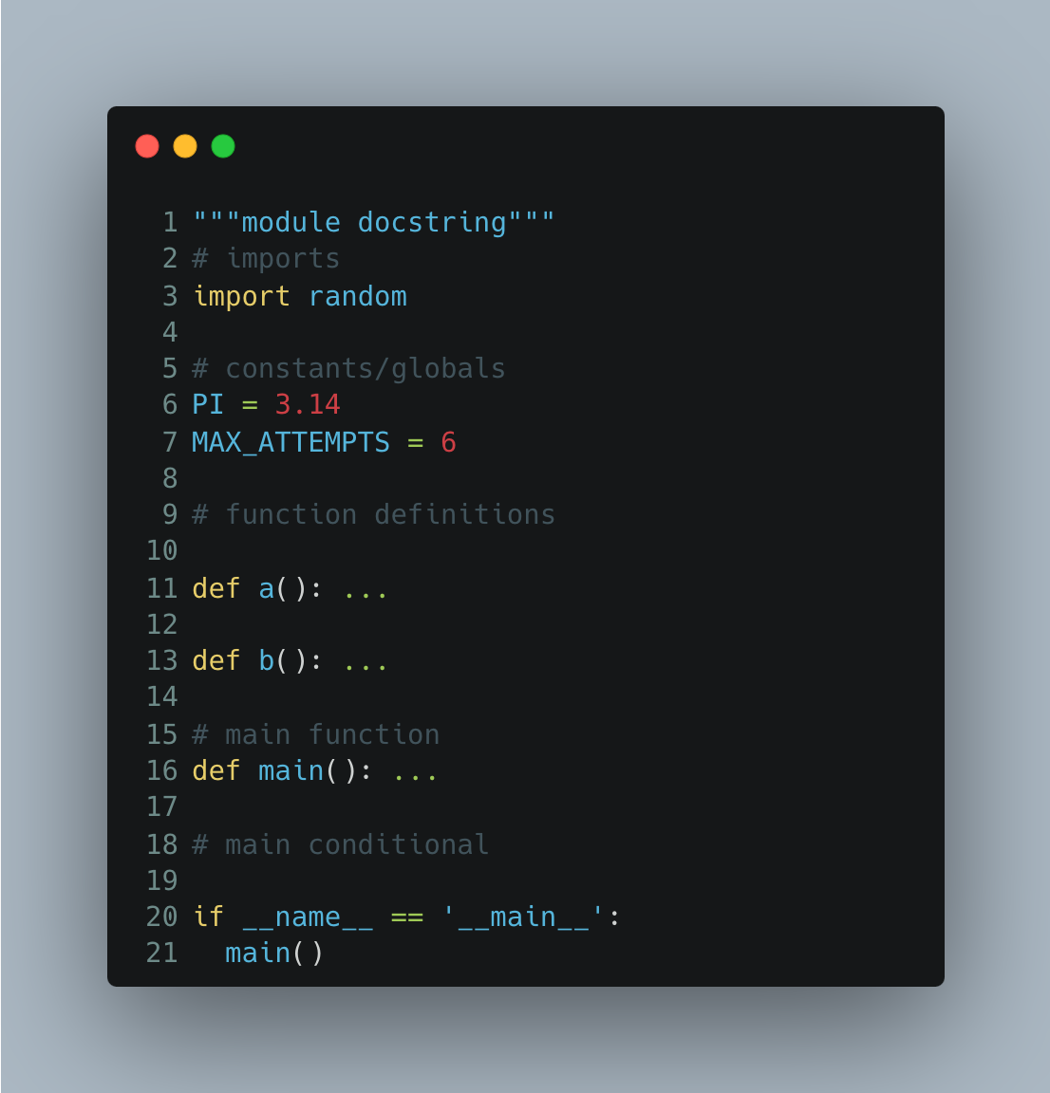
Structuring a python program
We define before we execute
We place if/name/main last
To avoid namespace contamination, we place the script logic in a main function

Slide 16
Namespaces
A namespace is a way of partitioning variable names into categories
In practice it just means we use a . (accessor) after a name to access the names associated with a given name
Folders are to files what namespaces are to names (variables)
Just like Documents/my_doc.txt is different from Desktop/my_doc.txt so too are namespaces

Slide 17
Namespace categories
Global: the global namespace is available to all parts of the program and may include additional qualifications (“explicit namespaces”)
Local: the local namespace is only available inside the scope of a function

Slide 18
Importing names from one module to another
To import a module, use import <module_name> where module_name is the filename minus .py
Importing a module causes its code to be executed!
By default, names/definitions in a module are imported into the module_name namespace
for example:
import random, imports the random module into a namespace called random
You can import from any .py file in the PYTHON_PATH or PATH
Notes:
Python imports are a bit unintuitive if you look to carefully into them. We are going to be slightly inaccurate in these slides for simplicity.

Slide 19
DEMO
See the current github repository for a demonstration of this

Slide 20
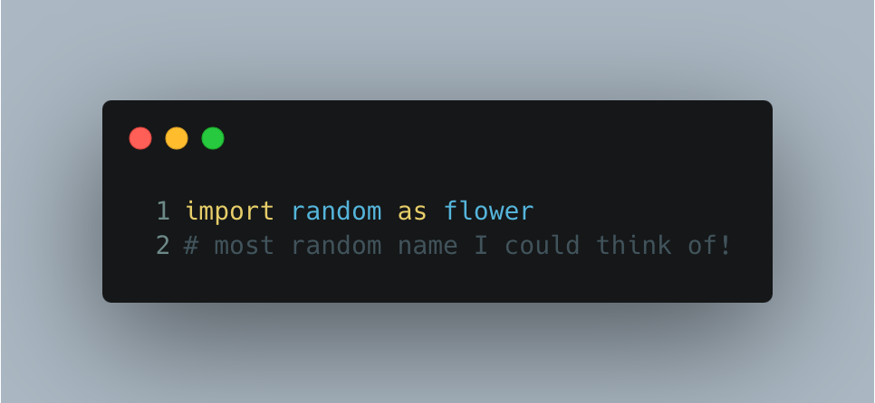
Importing into a custom namespace
Use the as keyword to import into a custom namespace
For example:

Slide 21
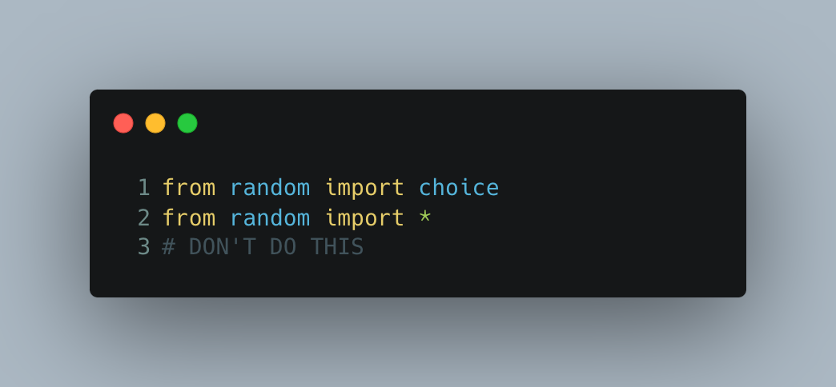
Importing into the global namespace
You can also import into the global/current namespace with from module

Slide 22
Summary
Functions and modules allow us to make our code reusable
They break down complex problems into simpler problems*
*But it depends on how we do it.
There are ways of decomposing problems that reduce complexity and there are ways that can increase complexity
Are there other ways to think of this problem of decomposition?

Slide 23
Self-test exercise
Note down all the reasons why you think it is important to be able to decompose (break down) big problems into discrete sub-problems
Think about it both from the point of view of problem solving in general and software development in particular
Consider what you know about version control and best practices in your notes

Slide 24
Introduction
Session 1

Slide 25
Object Oriented Programming
Programming Paradigms
What kind of problems is OOP trying to solve?
The challenges of learning OOP
Basic OOP in Python

Slide 26
Programming facts
Programming is complex
Programming is inventive
Programming is collaborative
Programming is combinatorial
The larger the program, the more apparent this becomes

Slide 27
Addressing the challenges
Since the origins of programming, programmers and scientists have tried to identify concepts and patterns to help address these challenges

Slide 28
Addressing the challenges
Modularity :
Identifying clear boundaries within an application with discrete responsibilities
Decomposition :
Making one big problem into lots of smaller problems
Reuse:
Finding multiple contexts and applications for the same code

Slide 29
Programming Paradigms*
Procedural
Functional
Object-Oriented
Event-Oriented
More…
*distinct set of organized concepts/thought patterns

Slide 30
Programming Paradigms
Procedural
Functional
Object-Oriented
Event-Oriented
More…
They are designed to help solve the problem of modularity, decomposition, and reuse. In other words, they are attempts at solving the problem of how to solve programming problems.

Slide 31
Hot (controversial) take
OOP is possibly the least intuitive of these patterns. But it was far and away the most dominant throughout most of the late 90’s and 2000’s and remains dominant to this day.
Notes:
Rafael says:
It is a hot take. Because it is actually the opposite of the core claims of OOP: that it is about “modelling real-world objects and interactions”. However, anecdotal and personal evidence, suggests otherwise.
The reason I emphasize this is because – while the mechanics of OOP are easy enough. I think one of its key pitfalls is that it is sold as intuitive and easy to model and this selling point is almost always backed by synthetic examples that seldom map to real world problems. What I have found in the past, is that students can become frustrated because the examples in OOP texts are usually easy to understand and follow but then as soon as you encounter an actual programming problem it can be a little disjointed how and in what way to approach the problem in an OOP fashion. Then, what most people do is enforce nouns on collections of behaviors (Helper/Manager/Collector/etc) – but now I am getting ahead of myself!

Slide 32
Object-Oriented
Focus on the things in your problem domain
Define their attributes and behaviors
A grouping of related attributes and behaviors is called an object
Objects interact with each other through clearly defined boundaries

Slide 33
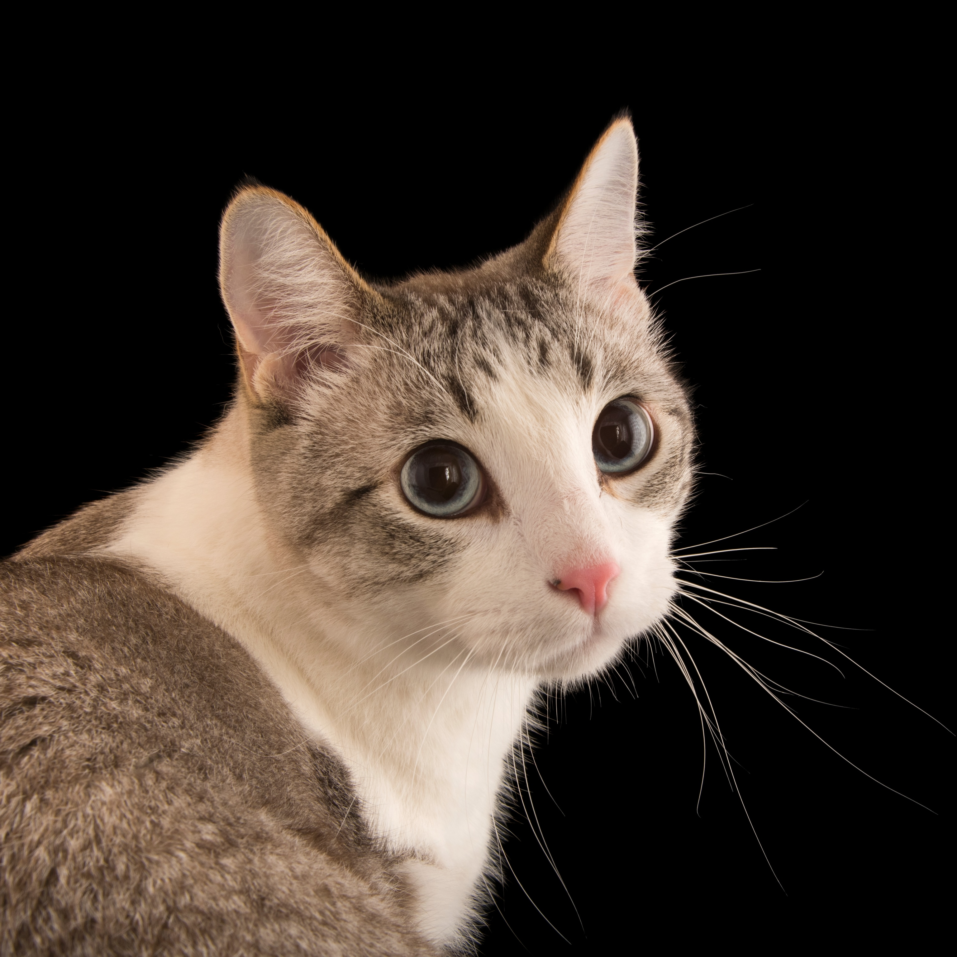
cat object
attributes
behaviors
a (very) cute cat that is 2 years old and has a tabby coat and nine lives
this cat can purr, meow, and eat

Slide 34
cat object
attributes
behaviors
- is_cute = True
- age = 2
coat = ‘tabby’
lives = 9
“purr!”
“meow!”
“Gobble, gobble”

Slide 35
Notice that the values change for each object, but we can say that all objects of a given type have these attributes and behaviors!

Slide 36
cat object
attributes
behaviors
- is_cute: bool
- age: int
- coat: str
+ purr()
+ meow()
+ eat()

Slide 37

attributes
behaviors
Cat
- is_cute: bool
- age: int
- coat: str
“meow!”
+ purr()
+ meow()
+ eat()

Slide 38
Class: a blueprint for an object
“That which is of type Cat shall have cuteness, age, and a coat pattern. It shall be able to purr, meow, and eat”
Cat
- is_cute: bool
- age: int
- coat: str
+ purr()
+ meow()
+ eat()

Slide 39

Object: an instance of a class
“this cat is a tabby, aged 2, that is definitely cute.
:cat

Slide 40
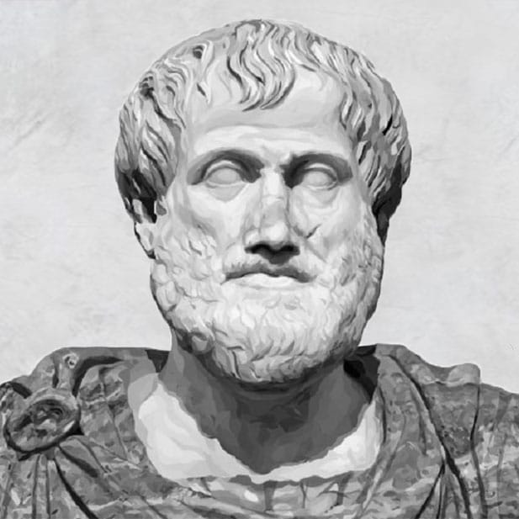
“A substance — that which is called a substance most strictly, primarily, and most of all — is that which is neither said of a subject nor in a subject (Aristotle, Categories 2a)
All objects are of a class, but the class is not the object

Slide 41
OOP in Python
Everything is an object in Python
Every object has a type (type = class)
What are the types of these objects:
“Hello”
42
42.0
True
None
print
def my_func(): …

Slide 42
Predict
type(print) -> builtin_function_or_method
type(str) -> ???

Slide 43
Type type
Everything is an object (meaning it is of type object), not everything is a class
A class is an object of type type
There are built in classes we can use to construct (make) objects of a particular type: int, bool, str, float are all such examples
Just like we can create our own functions with the def keyword, we can create our own type with the class keyword.

Slide 44
Demo
Create a simple Cat class and instantiate a cat
Assign attributes to an instance of a cat
Not much of a template!
Create an __init__ method and explain self
Create a new cat with at least a name and coat
Define a method
Notes:
Rafael’s exercises: https://github.com/NM-TAFE/civ-ipriot-in-class-demos/blob/2024/s1/raf/week11/lesson.md

Slide 45
A simple example
Let’s create a solution for greeting a person
This is called “Hello, World!”
What will the process look like?
Notes:
The “Hello, World” program is usually the first program anyone learns in any new language.

Slide 46
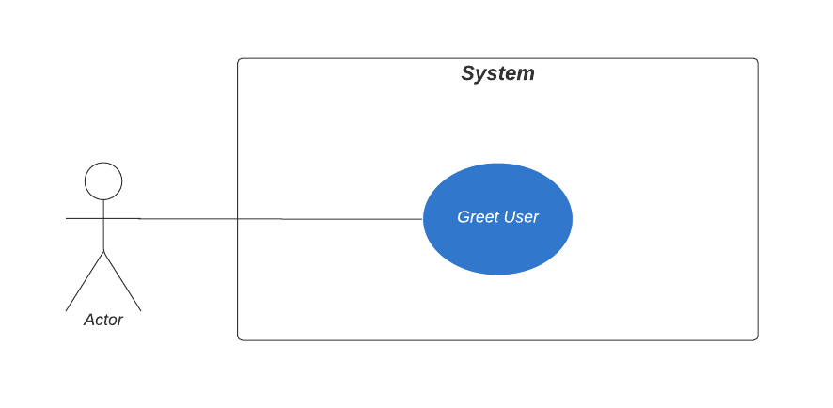
The requirement(s)
The program should greet a person.
Here is the Use Case Diagram:
Notes:
A Use Case Diagram shows interaction of users (or other systems) with a (software) system.
We’ll go into more detail later in the course.

Slide 47
The domain model
The Use Case is too simple to really warrant a domain model.
We can, however, say that we do need a “Greeter”:
Greeter
Notes:
The domain model shows the parts (objects) within a certain domain. For example, if you are building a Student management system, the domain might consist of objects like Student, Class, Course, Unit, Grades (results), etc. Think of domain objects in terms of nouns. If you can put “the” in front of, it’s a noun and you can consider it within the Domain model.
From the domain model (which shows relationships between objects), it’s relatively straightforward to create a Class Diagram.

Slide 48
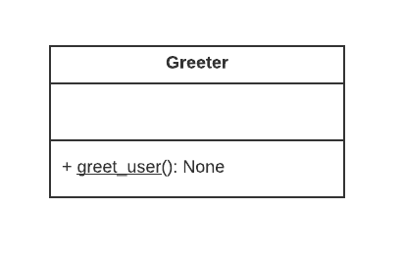
The Class Diagram
The Class Diagram is closely related to the Domain Model
The Class name
Attributes (fields, members, properties)
Methods
Notes:
We will go into more detail later in the course.
This example contains a single class. In more elaborate Class Diagrams, relationships between classes will be made more explicit.
Each Class is represented as a box. The name at the top is the name of the class. Sometimes, the name of an actual object is also shown.
The second part contains the Attributes. They are sometimes called fields, members, or properties.
The bottom part contains the Methods. These are functions that pertain to the class. Some methods pertain to the class as a whole (for example, static methods like in this example, which is underlined, or class methods). Other methods only pertain to the data in an instance. These are called instance methods.

Slide 49
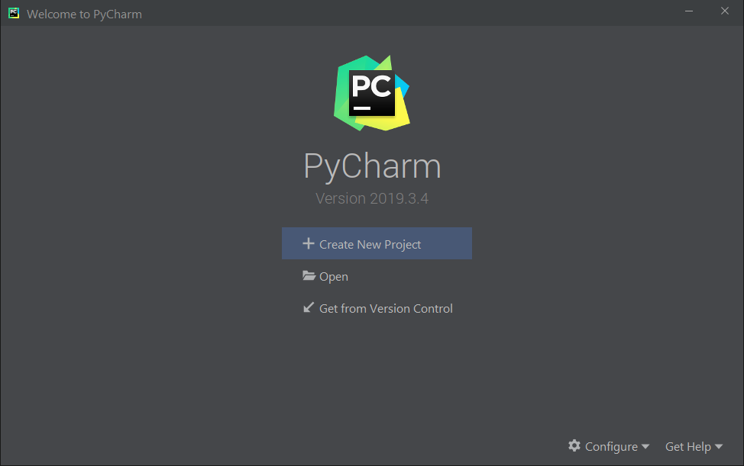
Let’s create our Greeter program
We’ll be using PyCharm throughout this course
Notes:
Create a new project

Slide 50
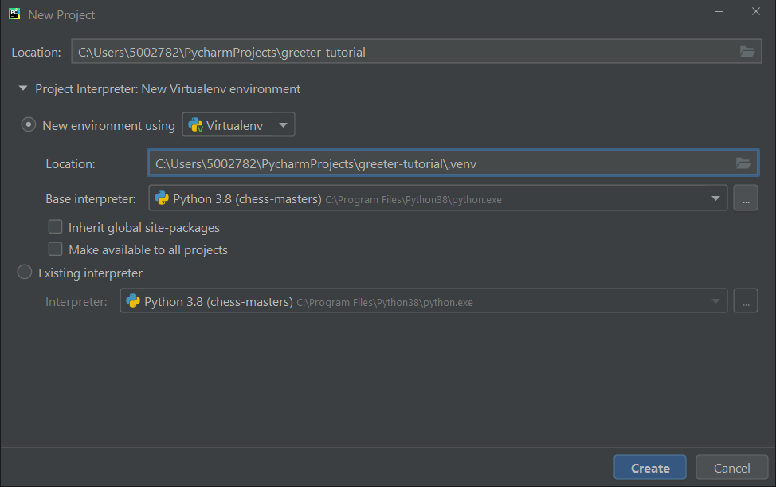
Let’s create our Greeter program
Notes:
Give the project a name, for example, ‘greeter-tutorial’.
The Location of the virtual environment will be create for you.
You can consider renaming the actual folder to read ‘.venv’ to indicate it’s a “special” folder.
You can leave everything else the same.
Click Create.

Slide 51
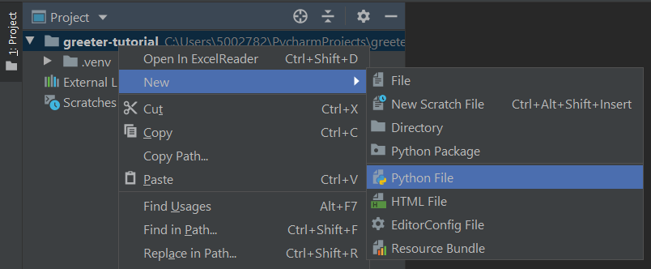
Let’s create our Greeter program
Notes:
Create a new Python file by right-clicking the project name “greeter-tutorial”.
Select New | Python File

Slide 52
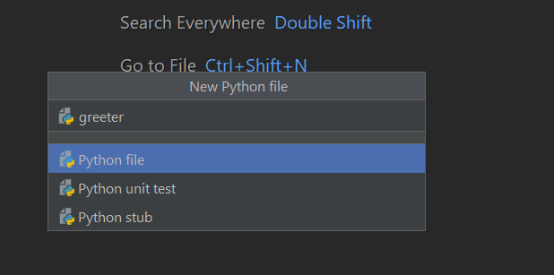
Let’s create our Greeter program
Notes:
Type the name greeter.
You do not have to provide the extension .py as that will be done by PyCharm. ONLY when you create a “New Python file”, though.
Press enter to have PyCharm create the file.

Slide 53
Let’s create our Greeter program
class Greeter: @staticmethod def greet_user(): print('Hello, world!') if __name__ == '__main__': Greeter.greet_user()
Notes:
Please note that we do not need to instantiate an object if we use a static method.
class Greeter: @staticmethod def greet_user(): print('Hello, world!') if __name__ == '__main__': Greeter.greet_user()

Slide 54
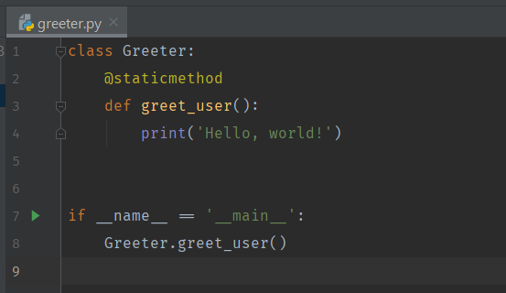
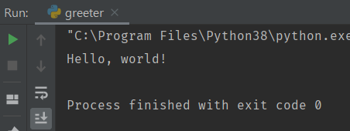
Let’s run our Greeter program
Static method…
Start the program
Review the output
Notes:
The output is shown at the bottom of the screen.

Slide 55
What is IoT?
Session 01

Slide 56
What is IoT?
Internet of Things
Ecosystem
Things
physical items
communicate with each other & people
Notes:
IoT is an ecosystem of parts that work together. Devices, servers, websites, etc.
Things are physical items that communicate with each other & people (but mostly with each other).
Computers that communicate with people (PC’s, laptops, etc.) are usually not considered part of IoT ecosystem.
However, mobile phones may be the exception: e.g., they communicate with Apple/Google so their mapping software know, for instance, where a traffic jam is. Also: keep track of busy times at shops. This does not need human interaction, so this can be considered machine-to-machine communication.

Slide 57
What is IoT?
Thing + Controller
Read/write data
Transfer data to and from the Internet
Smart Device
Internet
User
Bulb
Controller
Notes:
When you combine a thing with a controller, you gain the ability to read/write and transfer data to and from the Internet.
In the case of a light bulb, it can only be turned on/off (dimming might be an option). The controller simply forms the interface with the outside world (normally, this would be a simple on/off-switch or a dimmer switch). Example: Light bulb +------------------------+ | <== | <== <== | bulb(s) controller | Internet User(s) | ==> | ==> ==> +----- smart device -----+

Slide 58
Exercise: IoT where?
In groups of 2 or 3
(unless COVID restrictions are in place)
Are you able to identify
Some common IoT devices (products / prototyping solutions)
How IoT could be used?
How could IoT benefit us?
Notes:
Give them approx. 20 minutes. After that, collate any findings on the whiteboard.

Slide 59
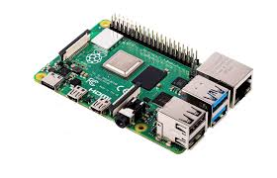
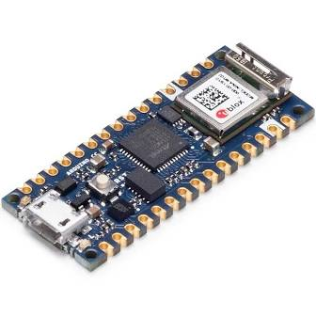
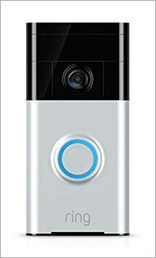
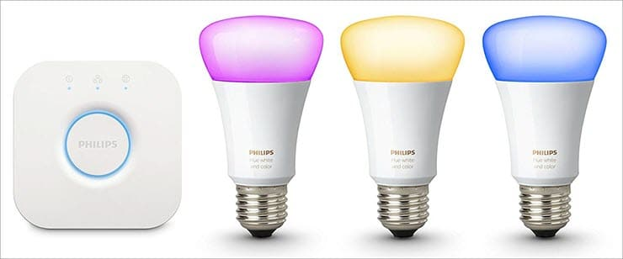
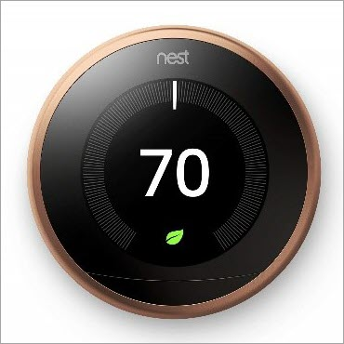
IoT Where?
Notes:
ESP32
Raspberry Pi
NEST thermostat
Philips Hue lights
Nest doorbell

Slide 60
Sensors vs Actuators
Session 01

Slide 61
Sensors
Input data
Examples:
IR (infrared)
Switch / button
Touch / pressure
Temperature
Atmospheric pressure
Light
Humidity
RFID
Notes:
- Sensors input data from the environment. Examples of different types of sensor include: - IR - Switch / button - touch / pressure - temperature - atmospheric pressure - light - humidity - RFID

Slide 62
Actuators
Output data
Change state of environment
Examples:
Bulb (LED)
Motor
Monitor
Buzzer / loudspeaker
Relay
Notes:
- bulb - motor - monitor - buzzer - RFID - relay

Slide 63
Architecture
Session 01

Slide 64
Architecture
End to end architecture
sensors / actuators
servers
communication channel
applications consume the data and present to users

Slide 65
Communications Channels
Cellular 3G/4G/5G
WiFi
Ethernet
Bluetooth
Zig-Bee
LoRaWAN

Slide 66
Communications Protocols
HTTP(S)
MQTT
WebSockets
SOAP
JSON
const socket = new WebSocket('ws://game.example.com:12010/updates'); socket.onopen = function () {
setInterval(function() {
if (socket.bufferedAmount == 0)
socket.send(getUpdateData());
}, 50);
};
Notes:
MQTT = Message Queuing Telemetry Transport
WebSocket = communications protocol, which provides full-duplex communication channels over a single TCP connection. It is distinct from HTTP, but compatible with it.
SOAP and JSON are more “data wrappers” than protocols.

Slide 67
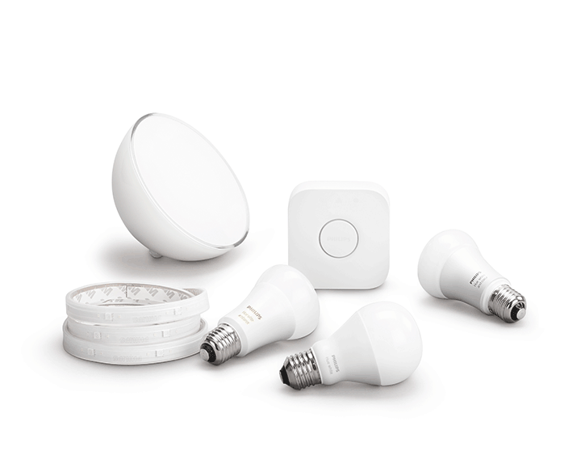
Communications Channels
IoT often has a hub that may be:
Cloud servers, or
Local server, or
a combination.
Notes:
Philips Hue: the lights connect to the local server, which itself connects to the internet.
Image from: https://www.philips-hue.com/en-au

Slide 68
Raspberry Pi
Session 01

Slide 69
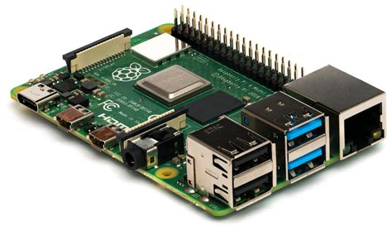
Raspberry Pi 3B/4B
The Raspberry Pi is a SBC
Single-Board Computer
The CPU is contained in an SoC
System-on-a-chip

Slide 70
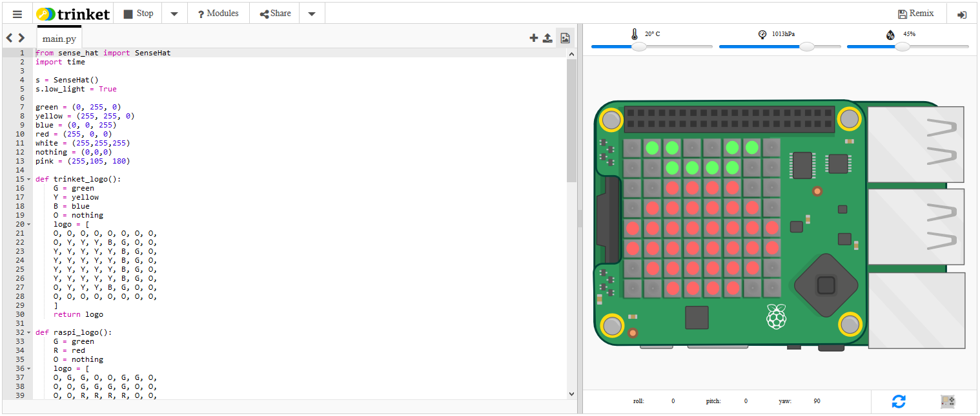
Raspberry Pi SenseHat Simulator
Notes:
The simulator can be found in the Simulators folder in Blackboard’s Learning Materials.
You can find the SenseHat simulator documentation: https://sense-emu.readthedocs.io/en/v1.0/api.html

Slide 71
The requirement(s): revisited
The program should greet a person using a Raspberry Pi SenseHat.
Here is the Use Case Diagram again:
Notes:
A Use Case Diagram shows interaction of users (or other systems) with a (software) system. The system, in this case, is a Raspberry Pi.

Slide 72
The domain model
We can still say that we do need a “Greeter”, but now we know we also need a “SenseHat”:
Greeter
SenseHat

Slide 73
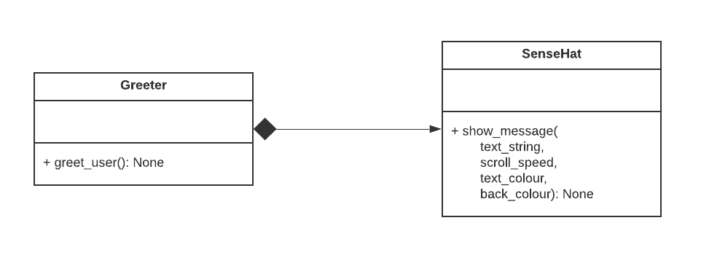
The Class Diagram
Notes:
We keep the Greeter class, but now it uses a SenseHat. The closed diamond shape means that the SenseHat is “owned” by the Greeter.
Please note that the greet_user method is no longer underlined, so it is not a static method any more. This also means that we need to actually instantiate an object of class Greeter.
We’ll dive into more detail later in the course.

Slide 74
Let’s update our Greeter program
from sense_hat import SenseHat class Greeter: def __init__(self): self.sense_hat = SenseHat() def greet_user(self): self.sense_hat.show_message('Hello, world!', scroll_speed=0.05) if __name__ == '__main__': # Instantiate a Greeter object greeter = Greeter() # Call the instance method {greet_user} greeter.greet_user()
Notes:
from sense_hat import SenseHat class Greeter: def __init__(self): self.sense_hat = SenseHat() def greet_user(self): self.sense_hat.show_message('Hello, world!', scroll_speed=0.05) if __name__ == '__main__': # Instantiate a Greeter object greeter = Greeter() # Call the instance method {greet_user} greeter.greet_user()

Slide 75
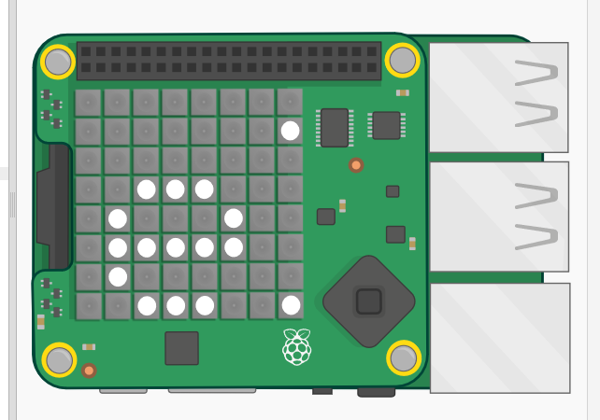
Try it in the simulator
The ‘e’ from ‘Hello world!’
Notes:
from sense_hat import SenseHat class Greeter: def __init__(self): self.sense_hat = SenseHat() def greet_user(self): self.sense_hat.show_message('Hello, world!', scroll_speed=0.05) if __name__ == '__main__': # Instantiate a Greeter object greeter = Greeter() # Call the instance method {greet_user} greeter.greet_user()

Slide 76
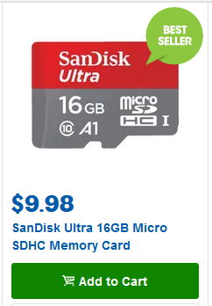
Raspberry Pi
In the future, we will be doing this stuff on actual Raspberry Pi’s
As a reminder: please get a ≥16GB micro SD card (class 10 or better)
Example from OfficeWorks

Slide 77
END
Session 1

