Slide 1
UML, remote deployment, and smiley assessment (POR) guidelines
Various
ICT40120 – Cert IV of Information Technology
IP4RIoT
Unit code | Unit title
ICTPRG430 | Apply introductory object-oriented language skills
ICTICT449 | Use version control systems in development environments

Slide 2
Agenda
Optional (SSH and remote deployment)
Basics of UML
Representing relationships between classes
Key relationships
UML Tools:
Generating topologies from source
Mermaid
Other…
Portfolio overview

Slide 3
Note: Remote Deployment
Remote deployment in general and the use of the Raspberri Pi and SenseHAT in particular is now an optional part of this cluster.
Your lecturer may choose to skip these slides and focus on guiding you on a local installation of the project files.

Slide 4
Unified Modelling Language (UML)
Standard for representing different facets of software design
Popular in the 2000’s
Scaled back in the context of agile
Beginner: learn to **read** the basic diagram types
More advanced: learn to loosely write the basic diagram types

Slide 5
Key types
Class (now)
Sequence (later)
Use Case (briefly now)
Activity (~flowchart)
There are 10 more diagram types, ~800 pages of specification; managed by OMG!!
Notes:
OMG: This is true! Object Management Group ☺

Slide 6
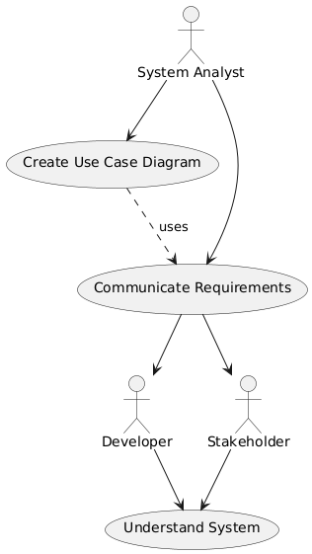
Use Case Diagram
A system analyst shall create use case diagrams to use them to communicate requirements to developers and stakeholders so that they understand the system.
If you can understand this diagram says the same thing, you understand the use case for use case diagrams!
Notes:
Or, in a bit more detail (generate by ChatGPT o1 Mini; intended mostly for humor and a little bit for education):
Use Case: Create Use Case Diagram
1. Use Case Overview
• Use Case Name: Create Use Case Diagram
• Actor(s): System Analyst
• Secondary Actor(s): Developer, Stakeholder
• Scope: System Design and Requirements Communication
• Level: User Goal
• Preconditions:
• The System Analyst has access to the system requirements.
• Necessary tools for diagram creation (e.g., PlantUML, drawing software) are available.
• Postconditions:
• A use case diagram is created and documented.
• The diagram is ready to be communicated to Developers and Stakeholders.
2. Description
The System Analyst creates a Use Case Diagram to visually represent the system’s functionalities and interactions between actors and use cases. This diagram serves as a tool to communicate system requirements effectively to both Developers and Stakeholders, facilitating a common understanding of the system’s operations and objectives.
3. Actors
• Primary Actor:
• System Analyst
• Role: Responsible for analyzing system requirements and designing use case diagrams to represent system functionalities.
• Secondary Actors:
• Developer
• Role: Receives communicated requirements to implement system functionalities.
• Stakeholder
• Role: Receives communicated requirements to provide feedback and ensure the system meets business needs.
4. Main Flow (Basic Flow)
1. Initiate Diagram Creation:
• The System Analyst begins the process of creating a use case diagram based on gathered system requirements.
2. Identify Actors and Use Cases:
• The analyst identifies the key actors (e.g., Developers, Stakeholders) and use cases (e.g., Communicate Requirements, Understand System) involved in the system.
3. Design Diagram:
• Using appropriate tools, the System Analyst designs the use case diagram, placing actors and use cases in their respective positions and establishing relationships between them.
4. Review Diagram:
• The analyst reviews the diagram for accuracy, ensuring all relevant interactions and functionalities are represented correctly.
5. Finalize Diagram:
• Upon verification, the System Analyst finalizes the use case diagram, preparing it for communication.
6. Communicate Requirements:
• The System Analyst shares the use case diagram with Developers and Stakeholders to convey the system’s functionalities and requirements.
7. Developers and Stakeholders Understand System:
• Developers use the diagram to guide the development process.
• Stakeholders use the diagram to understand how the system will meet business needs.
5. Alternative Flows
• A1: Missing Requirements Identified
• During the Review Diagram step, the System Analyst identifies missing requirements.
• System Analyst revisits the requirements gathering phase to obtain the necessary information.
• Returns to Identify Actors and Use Cases step.
• A2: Tool Unavailability
• If the necessary diagramming tools are unavailable during Design Diagram, the System Analyst seeks alternative tools or resolves access issues.
• Once tools are available, proceeds with Design Diagram.
6. Exceptions
• E1: Incomplete Requirements Documentation
• If system requirements are incomplete, the System Analyst cannot create an accurate use case diagram.
• The analyst must collaborate with stakeholders to gather complete requirements before proceeding.
• E2: Miscommunication with Stakeholders
• If Developers or Stakeholders misunderstand the use case diagram, additional meetings or revisions may be necessary to clarify requirements.
7. Extensions
• Ext1: Update Diagram Based on Feedback
• After communicating the diagram, feedback from Developers or Stakeholders may necessitate updates to the use case diagram.
• The System Analyst revises the diagram accordingly and re-communicates the updated version.
8. Special Requirements
• Consistency: The use case diagram should adhere to UML standards for clarity and consistency.
• Clarity: All actors and use cases should be clearly labeled and accurately represent their roles and functionalities.
• Accessibility: The final diagram should be accessible to all relevant parties, possibly through shared repositories or documentation platforms.
9. Assumptions
• System Analyst Competence: It is assumed that the System Analyst possesses the necessary skills to create accurate and effective use case diagrams.
• Stakeholder Availability: Developers and Stakeholders are available to receive and review the communicated requirements.
10. Frequency of Use
• This use case is performed once during the initial phases of system design and may be repeated if significant changes to requirements occur.
11. Related Use Cases
• Communicate Requirements: The process of sharing the use case diagram with Developers and Stakeholders.
• Understand System: The subsequent actions taken by Developers and Stakeholders to comprehend the system based on the diagram.
Summary
This use case outlines the process by which a System Analyst creates a Use Case Diagram to represent system functionalities and interactions. The diagram serves as a crucial tool for communicating requirements to Developers and Stakeholders, ensuring a shared understanding of the system’s goals and operations. The use case includes steps for initiating, designing, reviewing, finalizing, and communicating the diagram, along with handling alternative flows and exceptions to maintain accuracy and clarity.

Slide 7
Class Diagram
We have already seen…
Recall what each section means
Recall what the +/- means
Cat
- is_cute: bool
- age: int
- coat: str
+ purr()
+ meow()
+ eat()

Slide 8
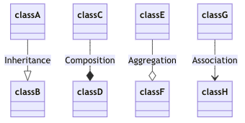

Relationships
Association
Directional
Cardinality
Generalization (inheritance)
Realization (interface implementation)
Aggregation
Composition
Notes:
Images from: https://mermaid.js.org/syntax/classDiagram.html

Slide 9
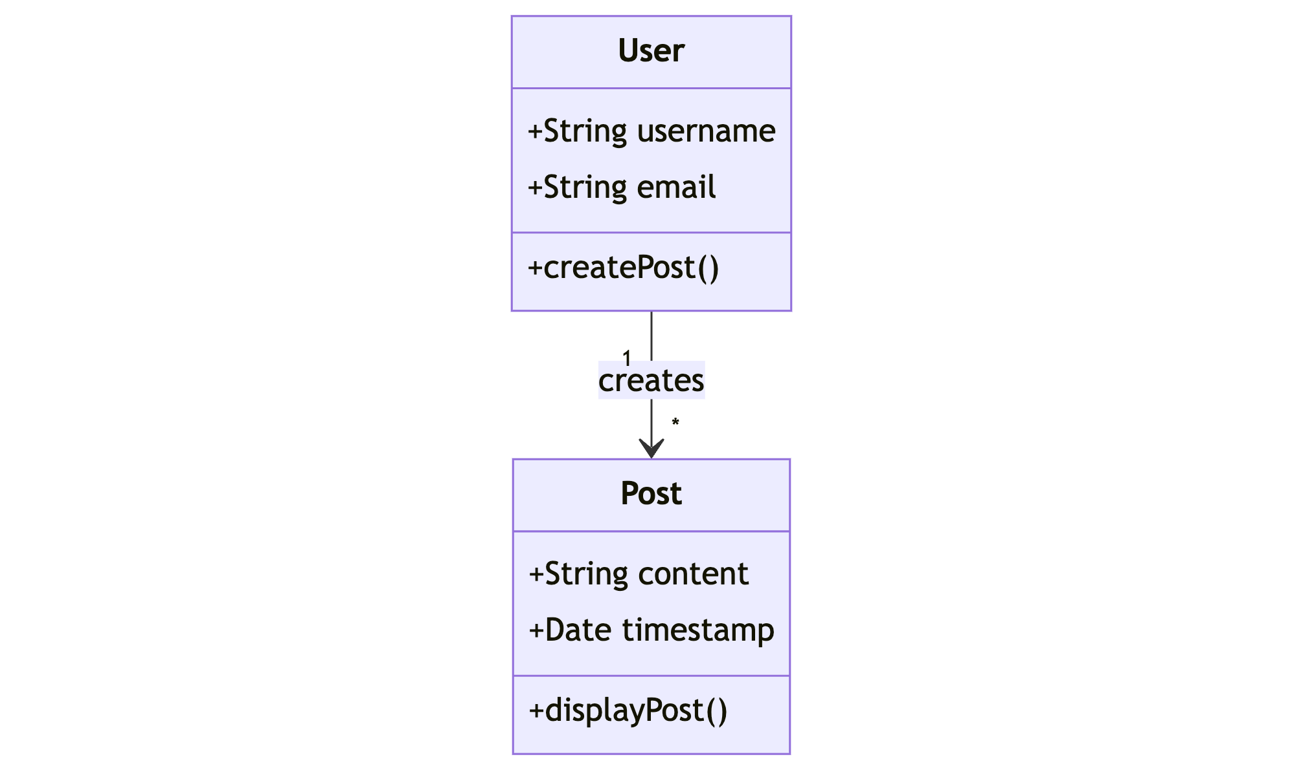
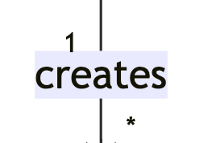
Association

Slide 10
Cardinality
1 Only 1
0..1 Zero or One
1..* One or more
* Many
n n (where n>1)
0..n zero to n (where n>1)
1..n one to n (where n>1)
Notes:
From https://mermaid.js.org/syntax/classDiagram.html

Slide 11
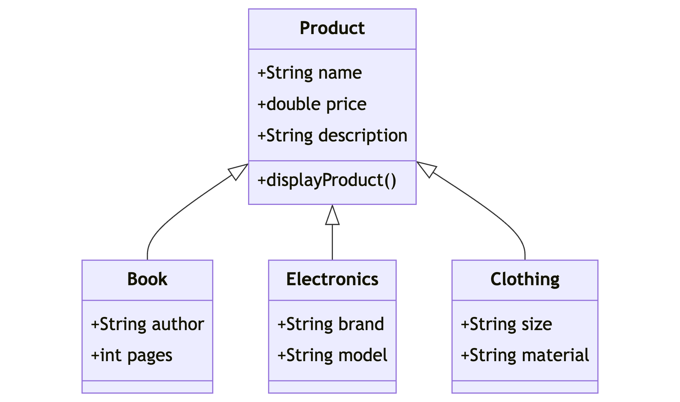
Generalization (inheritance)
Notes:
From https://mermaid.js.org/syntax/classDiagram.html

Slide 12
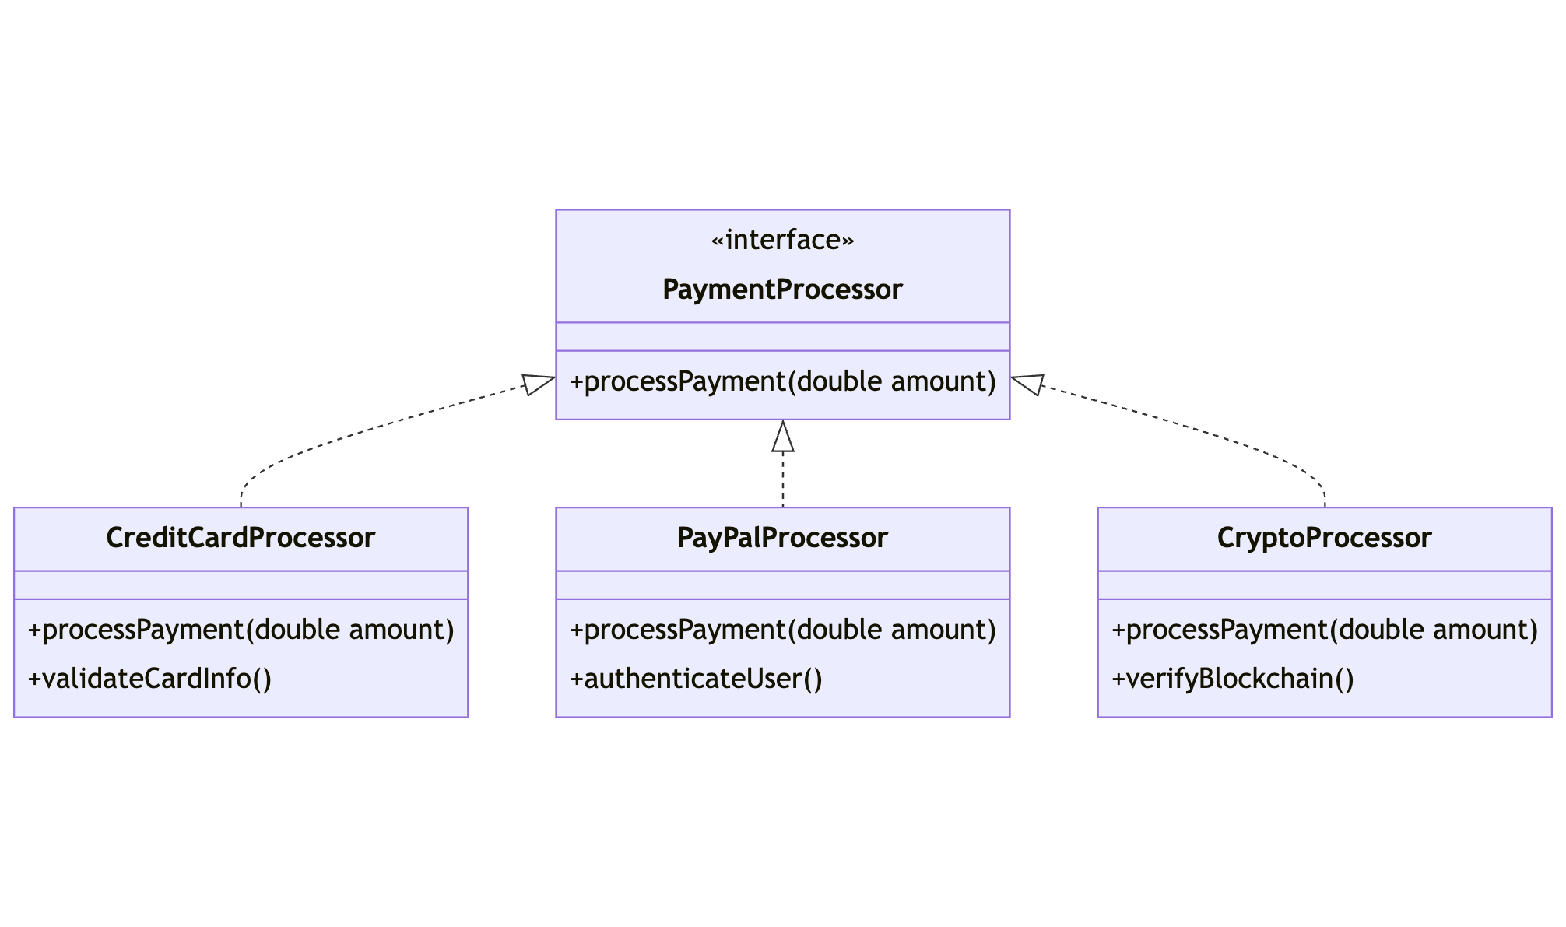
Realization
Notes:
From https://mermaid.js.org/syntax/classDiagram.html

Slide 13
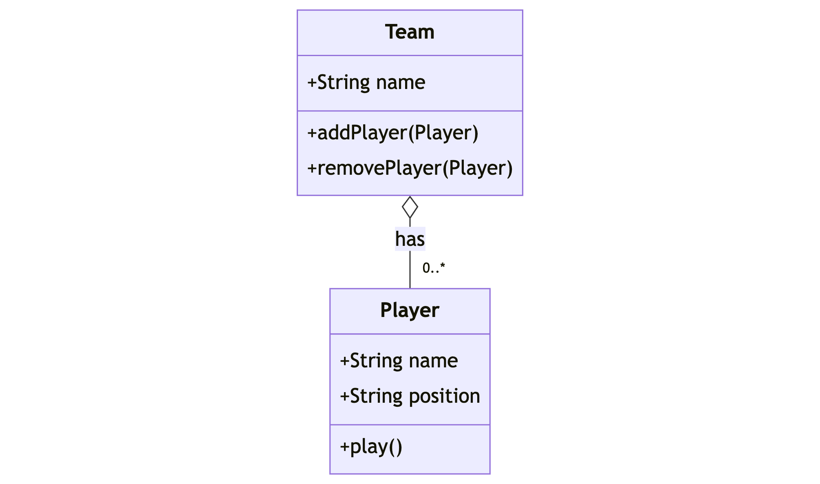
Aggregation

Slide 14
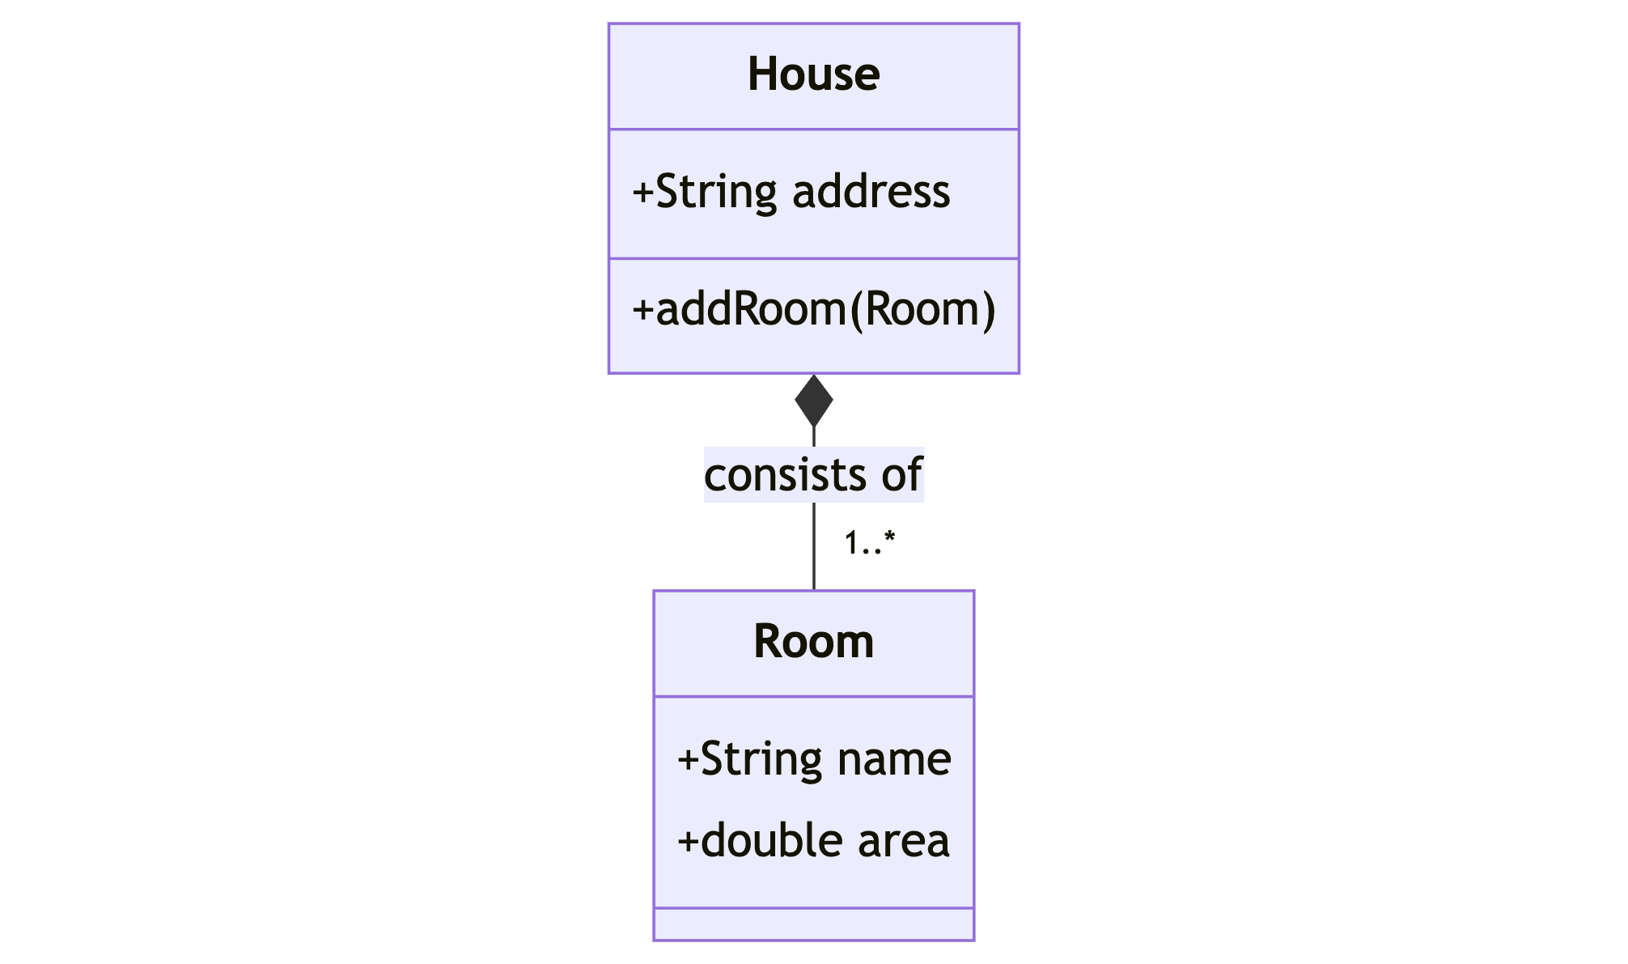
Composition

Slide 15
Composition vs. Aggregation
MYTH: Aggregation is about cardinality
TRUTH: The difference is about the object lifecycle!
>> Can the part live without the whole? <<

Slide 16
Optional exercise
Implement the example classes
Use float instead of double
Use snake_case
Add an if/name/main to add relationships that are established at runtime

Slide 17
Tooling
Many IDEs can generate class diagrams from source but they don’t generally model relationships other than generalization/realization
Plenty of UML tools out there
Personal favorite: Mermaid
JavaScript only
Markdown friendly
Implemented in GitHub, PyCharm, vscode, and more.

Slide 18
What is remote deployment
If you develop code on machine A but run the code on machine B, this is remote deployment.
Machine B can be:
A different physical computer
An IoT device
A cloud service
A virtual machine or container*

Slide 19
Why it matters
(1) IoT devices seldom offer an IDE and a complete development environment
(2) Almost all cloud runs on VMs and containers running on remote machines
(3) The target execution platform is not always the platform you develop on:
E.g. mobile, Linux->Windows, Windows->Linux, OSX -> Windows, etc….

Slide 20
SSH and Remote Deployment
SSH = Secure SHell
Protocol for providing a command line on a remote computer
Most common way to connect to a remote *NIX based machine (physical or virtual)
Doesn’t require a GUI on the remote machine – suitable for stripped down environments
Secure
SSH has been part of *NIX for a long time and more recently is available by default on most Windows distributions

Slide 21
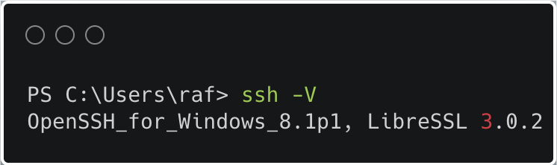
Run commands remotely: SSH
Check if ssh is installed:
ssh -V

Slide 22

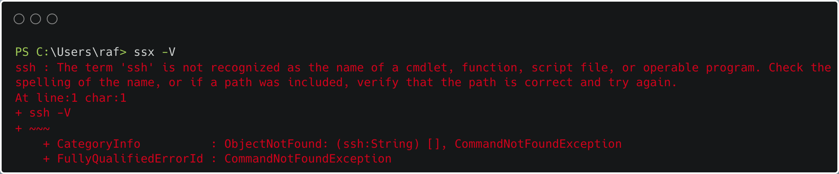

Command line SSH
Check if ssh is installed:
ssh -V

Slide 23
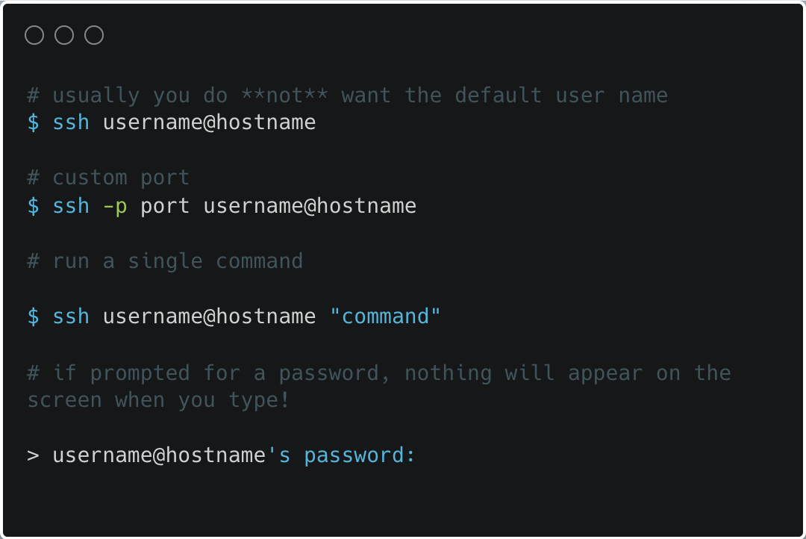
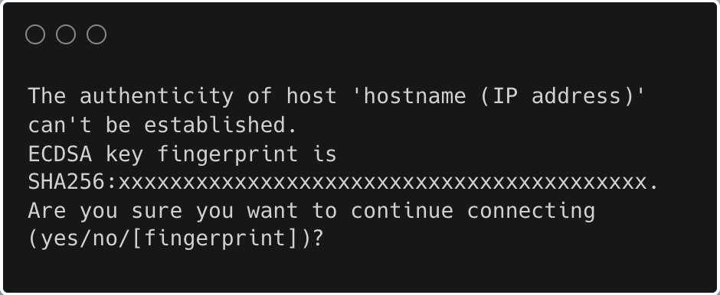
Command line SSH
Connect to a remote with the correct user
ssh –l your_user hostname
or ssh your_user@hostname
hostname
:– ip addr or name
Notes:
To initiate an SSH connection, the basic syntax you will use is username@hostname. Here, username represents the user account you're logging into on the remote server, and hostname represents the address of that server.
Another variant you might encounter is ssh –l username hostname.
2. Understanding the SSH Password Prompt:
After entering the SSH command, you might be prompted to enter your password with username@hostname's password:. When typing your password, it's important to remember that no characters will appear on the screen—this is a security feature to prevent shoulder surfing – but can be disorienting to new users
3. The Authenticity Warning Prompt:
If it's your first time connecting to a server, or if the server's public key doesn't match your records, SSH will display an authenticity warning. This looks like: The authenticity of host 'hostname (IP address)' can't be established. ECDSA key fingerprint is SHA256:xxxxxxxxxxxxxxxxxxxxxxxxxxxxxxxxxxxxxxxxx. Are you sure you want to continue connecting (yes/no/[fingerprint])?
This prompt is crucial for your security. It helps prevent man-in-the-middle attacks by ensuring that the server you're connecting to is indeed the one you intend to connect with. Responding 'yes' will add the host to your known hosts file, confirming you trust this server.

Slide 24
Transfer files securely: SCP
scp – Secure Copy Protocol: used to copy files between systems, securely
Command format: scp username@remotehost:/remote/file.txt /local/dir/
Copying directories recursively: scp -r username@remotehost:/remote/dir/ /local/dir/
Notes:
basic syntax of the SCP command is quite straightforward. You specify the source file, followed by the destination file. The destination can be on a local machine or a remote server. For example, to copy a local file named 'localfile.txt' to a remote server, you would use the command shown on the screen. Here, 'username' is your user account on the remote server, 'remotehost' is the server's address, and '/remote/dir/' is the directory where you want to place the file
To copy files from a remote server to your local machine, simply reverse the source and destination in the command.
To copy entire directories instead of single files, use the '-r' option for recursive copying. If the remote server uses a non-standard SSH port, you can specify it with the '-P' option.

Slide 25
SSH/SCP/SFTP in PyCharm Professional
Note: requires PyCharm Professional, not Community
Features:
Remote terminal (ssh)
Automated file synchronization over scp/sftp
Remote interpreter (ssh)

Slide 26
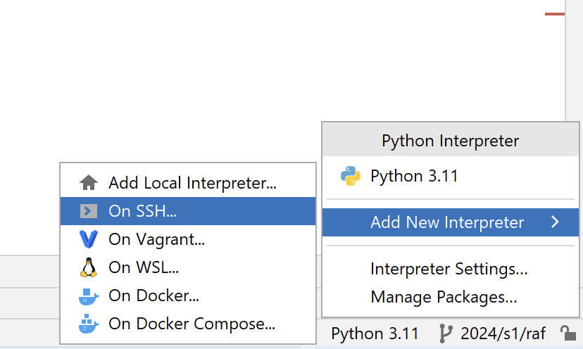
Get started: existing
Important: ensure you do not have a venv currently defined in a project
In an existing, select Add new interpreter… > On SSH

Slide 27
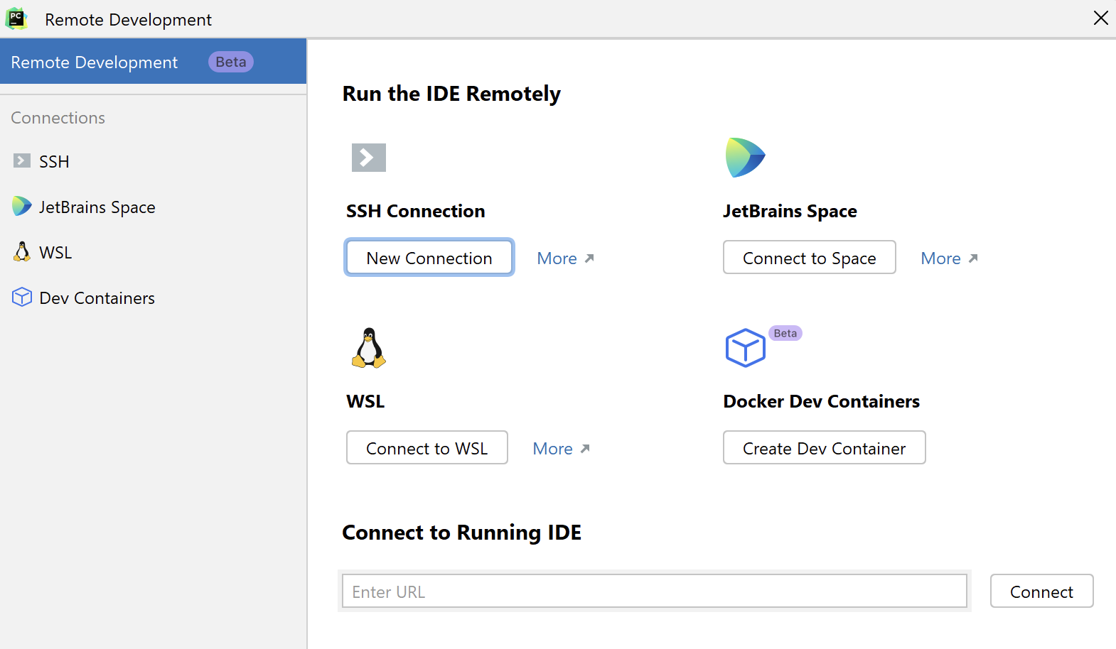
Get started new
Select File > Remote Development > SSH Connection
Note: beta feature we have not worked with yet

Slide 28
Smiley project
Instructions in Blackboard under Assessments (as usual)
Source in github:
https://github.com/NM-TAFE/civ-ipriot-smiley/blob/main/README.md
You can request a GitHub-only version of this assessment (at your lecturer’s discretion)

Slide 29
Mock sense_hat.py
The source includes a mock sense_hat – if you cannot or don’t want to do remote deployment – keep this file – it will simulate the behavior of the SenseHAT LED
If you can do remote deployment and have a Pi with SenseHAT you must delete this file before you sync
The requirements remain the same, but you do not need to prove remotely deployment only that the mock SenseHAT GUI, runs

