Slide 1
General Dev Skills
Command Line Basics

Slide 2
Background
General Dev Skills – Command Line Basics

Slide 3
Background
Command Line
CLI
Command Prompt (MS-DOS style)
Linux Shell (BASH, FISH, ZSH et al)
PowerShell

Slide 4
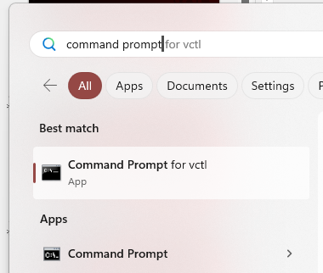
Background
Starting the Command Line
Option 1:
Start Menu
Type “command prompt”
click on required option
Option 2:
Window + R
type in “cmd”

Slide 5
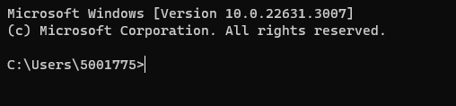
What it looks like
Basic – text only
Display shows:
Introduction (Microsoft Windows…)
The prompt
C:\Users\USER_NAME\

Slide 6
What it looks like
The prompt
C:\ Drive letter
Users The computer account folder
USER_NAME Your user folder

Slide 7
Spaces and Sensitivity
General Dev Skills – Command Line Basics

Slide 8
Command Case Sensitivity
The command line in the DOS prompt is
NOT CASE SENSITIVE
So, all of the following are the same:
CD abc
cd abc
Cd abc
cD abc

Slide 9
Command Line and Spaces
The SPACE is a command delimiter
It separates the various parts of the command
For example:
Copy /v a.txt b.txt
copy is the command
/v is a switch
a.txt is the source
b.txt the destination

Slide 10
Command Switches
General Dev Skills – Command Line Basics

Slide 11
Command Switches
Commands may have switches
Tells command to perform optional action
Usually (in DOS) / followed by switch
Examples:
/v
/r
/w

Slide 12
Command Line and Spaces
The SPACE is a command delimiter
It separates the various parts of the command
For example:
Copy /v a.txt b.txt
copy is the command
/v is a switch
a.txt is the source
b.txt the destination

Slide 13
Folders and Files
General Dev Skills – Command Line Basics

Slide 14
Folders and Files
Folders hold collections of (related) files
Files contain text, pictures, video, audio, source code and many other possibilities

Slide 15
Folder and File Names
Files and folders may use the . (full-stop) zero or more times.
Generally:
File-names have a full-stop
Folder names do not
Usually, file names:
Contain two parts
Name and Extension
Separated by a .
Folder names usually:
Have just a name
🦆

Slide 16
Folders and Files
Text Files
Human readable content
Example extensions:
.py
.txt
.php
.js
.html
.md

Slide 17
Folders and Files
Binary Files
Computer readable only
Usually require special applications
Or are executable
Common extensions include:
.jpg
.avi
.bin
.xlsx
.com
.exe

Slide 18
Folder and Directories
General Dev Skills – Command Line Basics

Slide 19
Folders and Directories
They are the same thing
Windows calls them folders
Generally, we call them directories when using command prompts

Slide 20
Files and Folders
Naming Files & Folders
Only use:
a – z
0 – 9
- (minus)
_ (underscore)
. (dot/full-stop)
If you use other characters, including the space, you will need to wrap the name in quotes.
For example:
mkdir “Do Not Use Spaces”
🦆

Slide 21
Case Sensitivity
WARNING
Windows is usually NOT case sensitive
Other operating systems usually are
Recommend:
Use only LOWER CASE for all Files and Folders

Slide 22
Listing Files and Folders
General Dev Skills – Command Line Basics

Slide 23
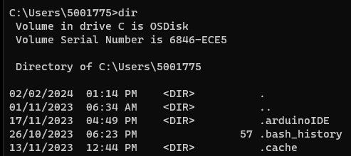
Listing Files and Folders
Command:
DIR
List all files/folders “long” format
Date, time, type (<DIR> or blank), size, name

Slide 24
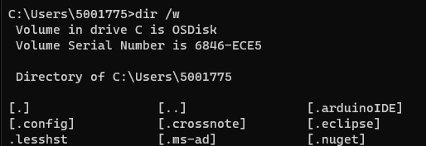
Listing Files and Folders
Command:
DIR /W
List all files/folders “wide format”
The /W is known as a switch
Folders in [ … ]

Slide 25
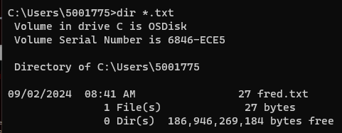
Listing Files and Folders
Command:
DIR *.txt
List all files with the extension of .txt

Slide 26
Creating Empty Files
General Dev Skills – Command Line Basics

Slide 27
Creating Empty Files
Command:
copy nul > FILENAME.EXTENSION
Creates an empty file called:
FILENAME.EXTENSION

Slide 28
Creating Empty Files
Example:
copy nul > ReadMe.md
COPY nul > .keep
Copy nul > data.csv

Slide 29
Creating Folders
General Dev Skills – Command Line Basics

Slide 30

Creating Folders
Command:
MKDIR Folder_Name
Creates a new folder called “Folder_Name”

Slide 31
Creating Multiple Folders
Command:
MKDIR Folder_1 Folder_2 Folder_3
For example:
mkdir alpha bravo charlie

Slide 32

Creating Nested Folders
Command:
MKDIR Parent_Folder\Child_Folder
For example:
Mkdir Practice\Demo_Folder

Slide 33
Changing Folders
General Dev Skills – Command Line Basics

Slide 34

Changing Folders
Command:
CD Folder_Name
Changes into the folder called Folder_Name
For example:
CD Practice

Slide 35
Changing Folders
Changing into a Parent and Child Folder in one step:
cd Parent_Folder\Child_Folder
For example:
Mkdir Practice\Demo_Folder
Changes into the folder called Demo_Folder inside the Practice folder

Slide 36
HOME or USER ROOT
General Dev Skills – Command Line Basics

Slide 37
To User’s Home Folder
Called:
HOME
USER HOME
USER ROOT
Location is:
C:\Users\YOUR_USER_NAME

Slide 38
To User’s Home Folder
Quick way to go back to “HOME”:
cd %userprofile%

Slide 39
Drive Root Folder
General Dev Skills – Command Line Basics

Slide 40
Drive Root Folder
Location is:
DRIVE_LETTER:\
Where DRIVE_LETTER is one of A, B, C, … Z
C:\ is the most common “Root”
Usually houses the operating system

Slide 41
Change to a Drive
Use just the letter and a colon
Example:
D:
Will change to the D: drive
C:
Will change to the C: drive
Then use CD \ to go to the root of the drive
In general, DO NOT use the Root of the “Windows” Drive (eg C:\)
🦆

Slide 42
Exercise
General Dev Skills – Command Line Basics

Slide 43
Exercise 1
Open the command line prompt
WIN + R
Type cmd and press Enter
This usually opens your user folder

Slide 44
Exercise 2
Ensure you are in:
C:\Users\YOUR_USER_NAME
If not use:
cd %userprofile%

Slide 45
Exercise 3
Create a new folder Practice in your User Home:
Mkdir Practice
Change into the Practice folder
cd Practice

Slide 46
Exercise 4
Create two new folders:
bird
fish
in the current (practice) folder

Slide 47
Exercise 5
Create two new folders using ONE mkdir command called:
animal
mineral
in the current (practice) folder

Slide 48
Exercise 6
Create a ReadMe.md file in the Practice folder
Create a .keep file in the animal, bird and mineral folders

Slide 49
Copying Folders & Files
General Dev Skills – Command Line Basics

Slide 50
Copying Folders & Files
Command:
copy SOURCE DESTINATION
This command:
Duplicates SOURCE

Slide 51
Copying Folders & Files
Command:
copy SOURCE DESTINATION
Copies the source file/folder to the destination file/folder

Slide 52
Copying Folders & Files
SOURCE | DESTINATION | RESULT
file | new-file | Copy file into new-file
folder | new-folder | Copy folder into new-folder
file | folder | Copy file into the folder
file | folder/new-file | Copy file in the folder, naming the copy new-file
folder | file | NOT POSSIBLE

Slide 53

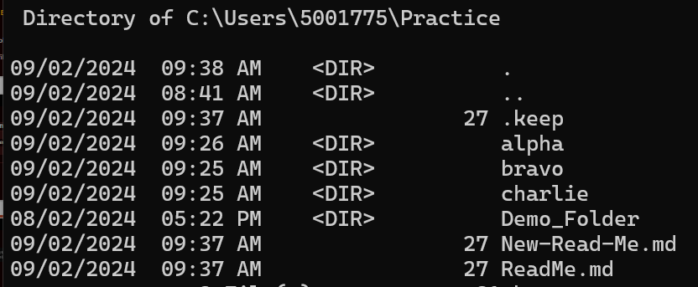
Copying Folders & Files

Slide 54
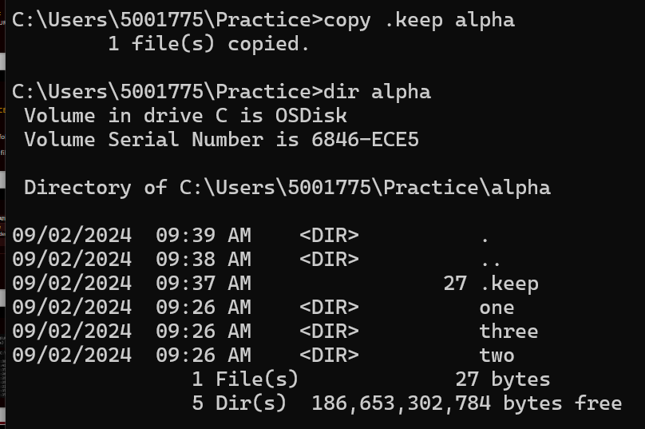
Copying Folders & Files

Slide 55
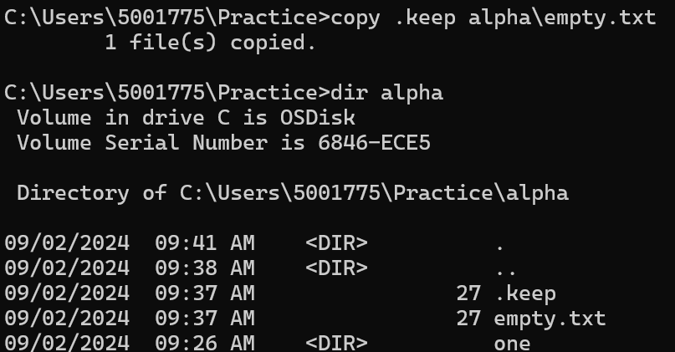
Copying Folders & Files

Slide 56
Moving Folders & Files
General Dev Skills – Command Line Basics

Slide 57
Moving Folders & Files
Command:
move SOURCE DESTINATION
This command:
Moves the SOURCE to the Destination

Slide 58
Moving Folders & Files
Examples
Move ReadMe.md rEADmE.txt
Renames Readme.md to rEADmE.txt
MOVE ReadMe.md alpha
Moves the ReadMe.md into the alpha folder

Slide 59
Moving Folders & Files
SOURCE | DESTINATION | RESULT
file | new-file | move file to new-file (Rename)
folder | new-folder | move folder into new-folder (Rename)
file | folder | move file into the folder
file | folder/new-file | Move file in the folder, renaming file to new-file
folder | file | NOT POSSIBLE

Slide 60

Moving Folders & Files
Move demo.md into Demo.md
Move Demo.md into demo.txt

Slide 61

Moving Folders & Files
Move demo.txt file into the charlie folder
Move demo.txt in the Charlie folder into he demo.md file in the same folder

Slide 62
Renaming Folders & Files
General Dev Skills – Command Line Basics

Slide 63
Renaming Folders & Files
Command:
rename SOURCE DESTINATION
This command:
renames SOURCE to DESTINATION

Slide 64
Exercises II
General Dev Skills – Command Line Basics

Slide 65
Exercises II - 0
More exercises to be added to this presentation

Slide 66
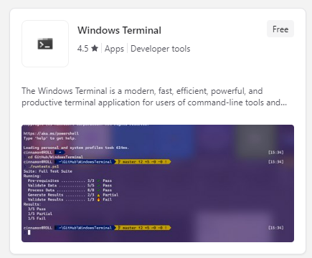
Microsoft Terminal
Microsoft Terminal
More versatile than plain CMD prompt
Install from the Microsoft Store
Search for Terminal
Install full version (see picture)

Slide 67
🦆

