Slide 1
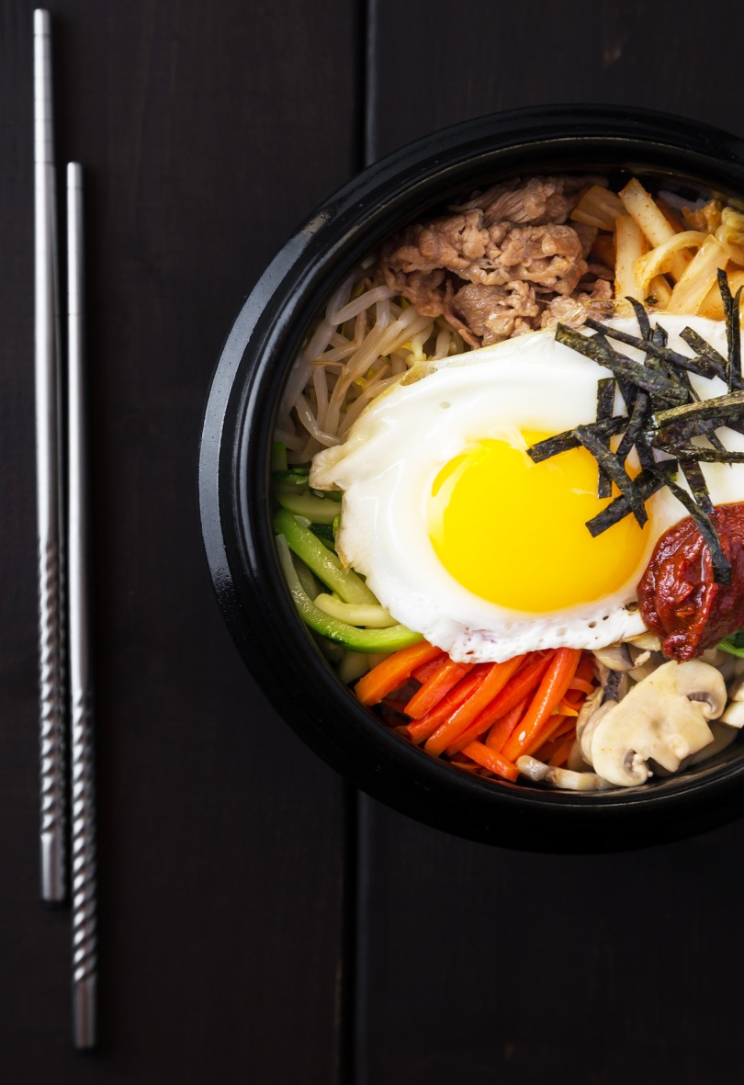
The Korean national cuisine

Slide 2
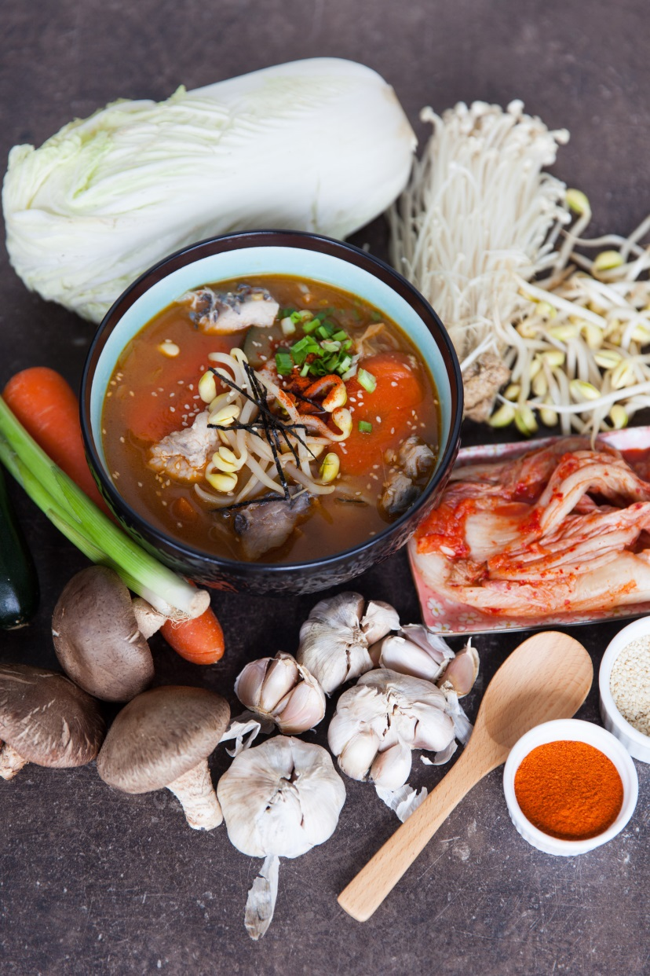
History
Korean cuisine in the form in which it is now, finally formed during the war with Japan. The Japanese brought new fruits and vegetables to Korea, the main one being red pepper. It is thanks to him that most Korean dishes can be described as "hot and spicy".

Slide 3
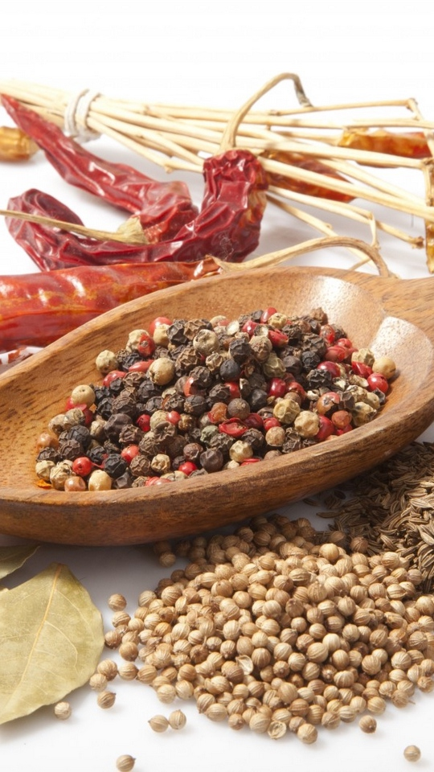

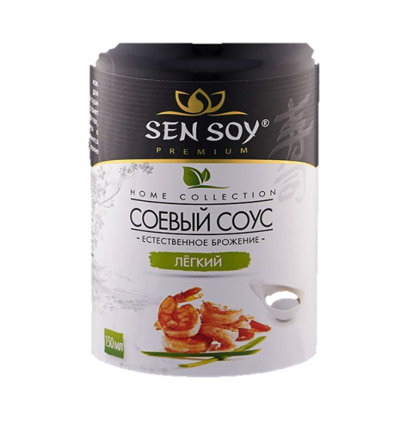
Difference
red and black pepper
Korean cuisine has a wide variety of fermented and fermented foods: vegetables, roots, fish and seafood. An important element are flavoring additives - red and black pepper, soy sauce, sesame oil. For foreigners, many dishes seem burning, but you can not show their discontent. Because it would be considered disrespectful.
sesame oil
soy sauce

Slide 4
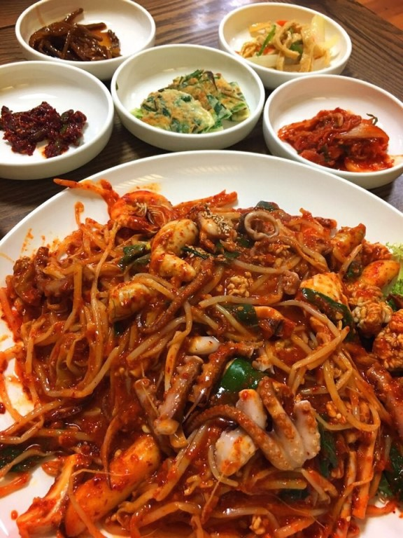
Menu
Feature Korean menu – a set of snacks to any position: when you order a main dish you will bring 5-6 appetizers (panchanan), a side of rice and a small bowl of soup. All this diversity is included in the price. Snacks can be updated if something is over. Koreans don't eat everything. The Koreans decided to order a lot of food, but try a little from each dish, leaving some of the food on the plates.
Panchanan

Slide 5
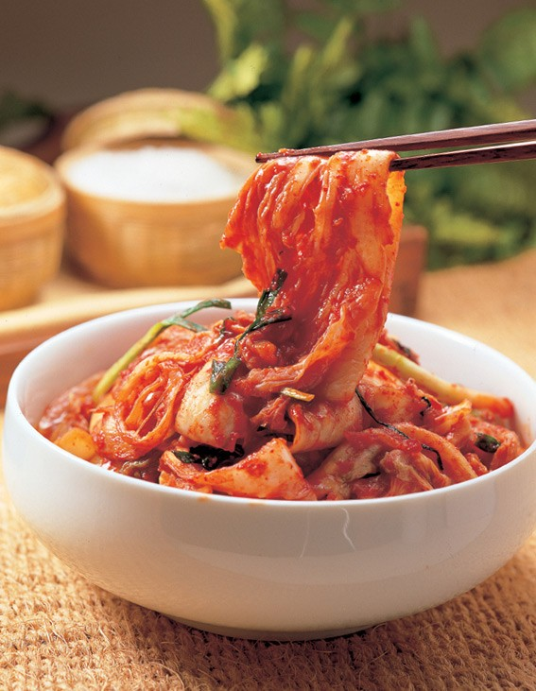
Kimchi
No Korean table can be imagined without kimchi. In recent years, it has increasingly attracted the attention of the world community and is becoming more familiar and consumed dish. The most famous kimchi is sauerkraut in hot red pepper, but in fact there are quite a lot of types of kimchi.
Kimchi

Slide 6
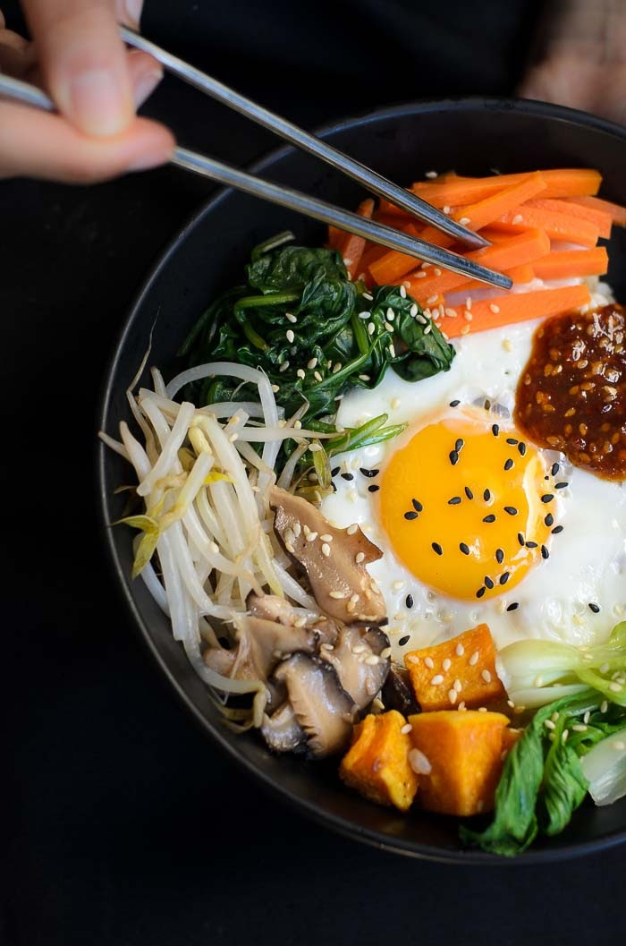
Pibimbap
Pibimbap is a big bowl of rice mixed with vegetables, egg and various herbs (and sometimes kimchi) and added to sauces.
Pibimbap

Slide 7
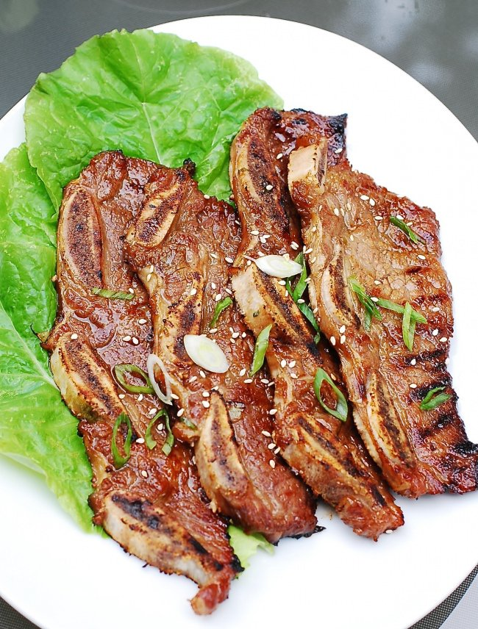
Kalbi
Kalbi is one of the most favorite dishes of Koreans, which is prepared from beef (less often-pork). Carefully cut pieces of marinated meat are fried in a sauce and eaten with seasonings.
Kalbi

Slide 8
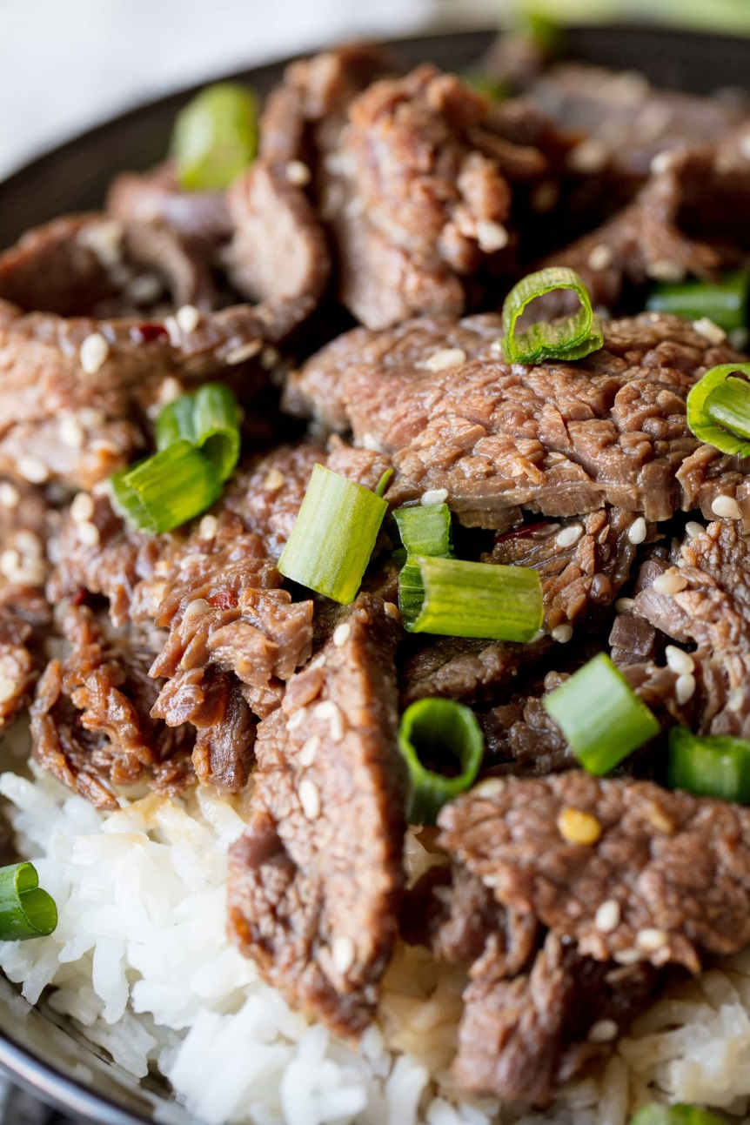
Pulkogi
Pulkogi is sweet meat fried in a sauce and served with various seasonings. Due to its sweet taste of the pulgogi is very fond of children. Cooking it is very simple, so Koreans often make pulkogi at home.
Pulkogi

Slide 9
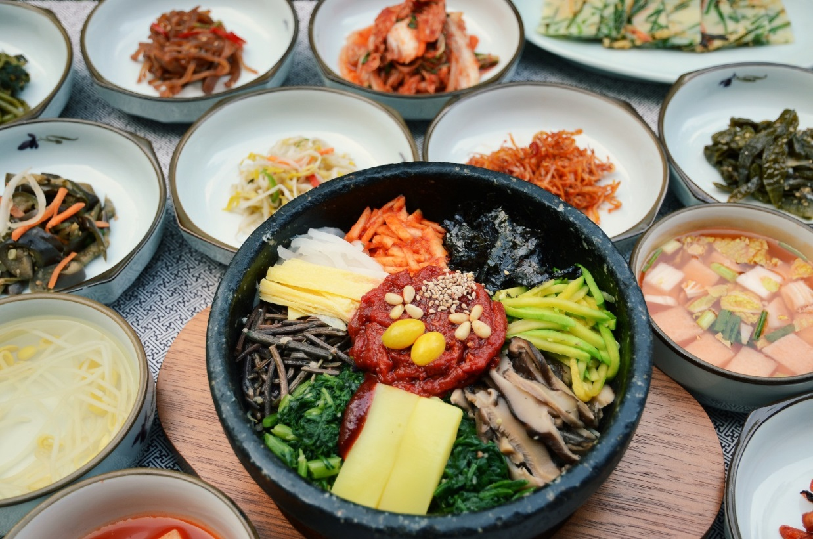
Conclusion
Korean cuisine is one of the most useful and healthy because it uses products with minimal processing.Today it is becoming more and more popular, Korean restaurants are opening not only in China or Japan, but also in Europe.

