Slide 1
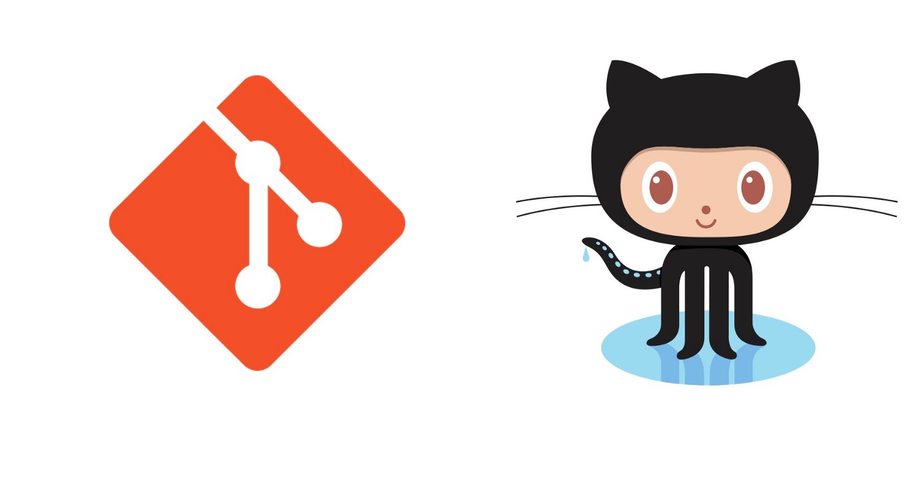
A quick tour of Git and Github
(for researchers)
Serena Defina

Slide 2
Overview of this talk
What is Git and what is it for?
What is GitHub and what is it for?
The big 5 (basic commands you should know)
Mini demo

Slide 3
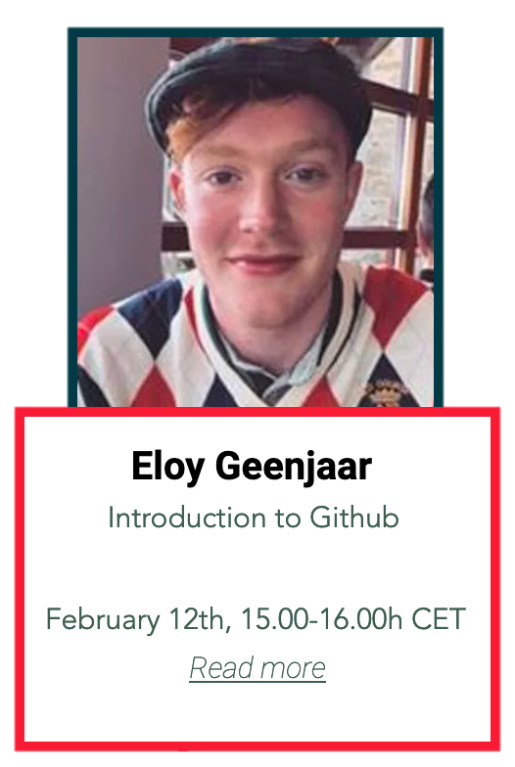
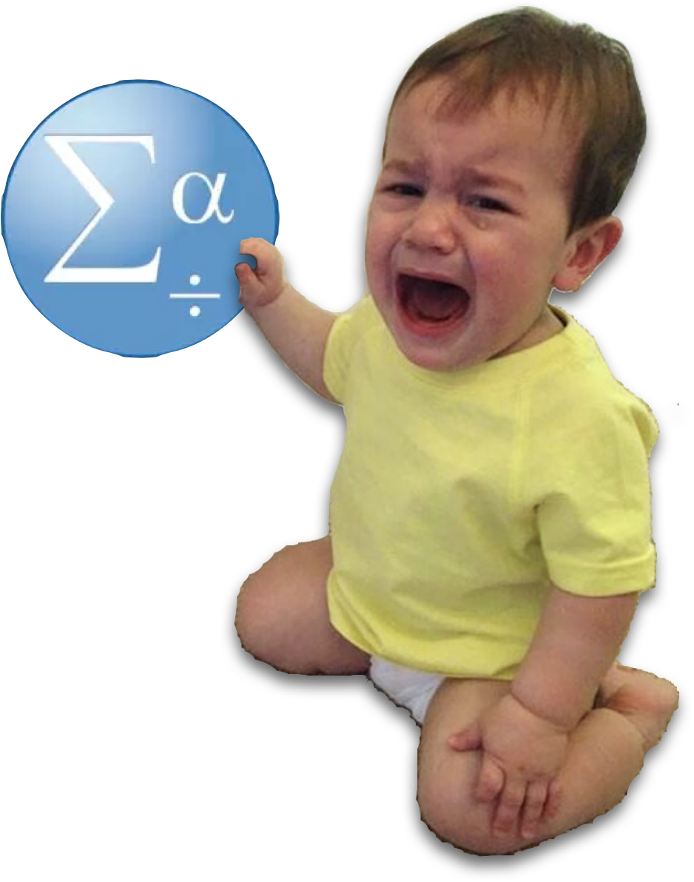
Disclaimer
I am a baby!

Slide 4
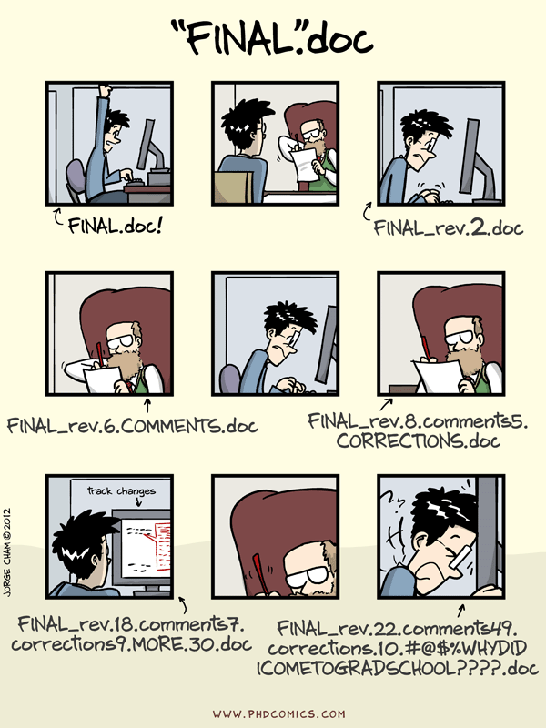
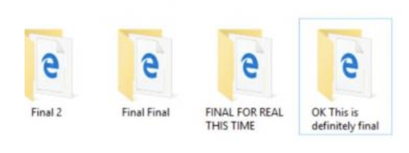
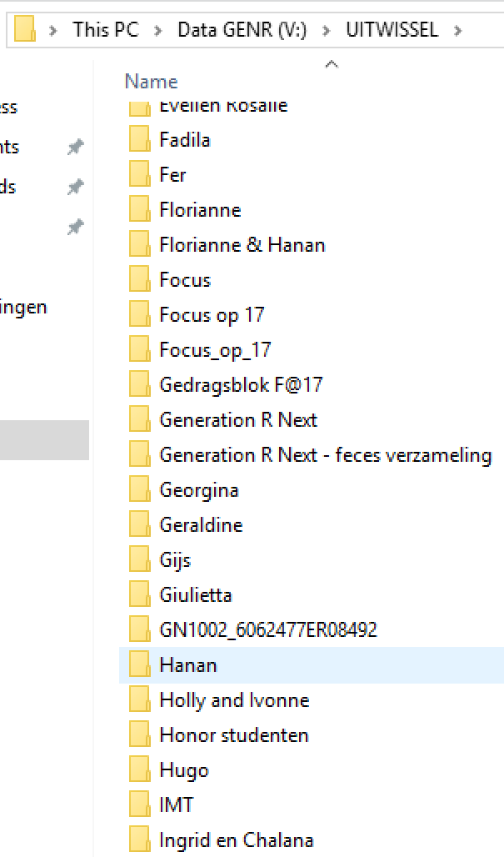
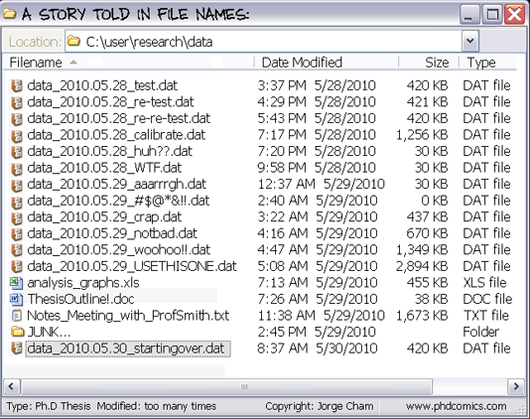
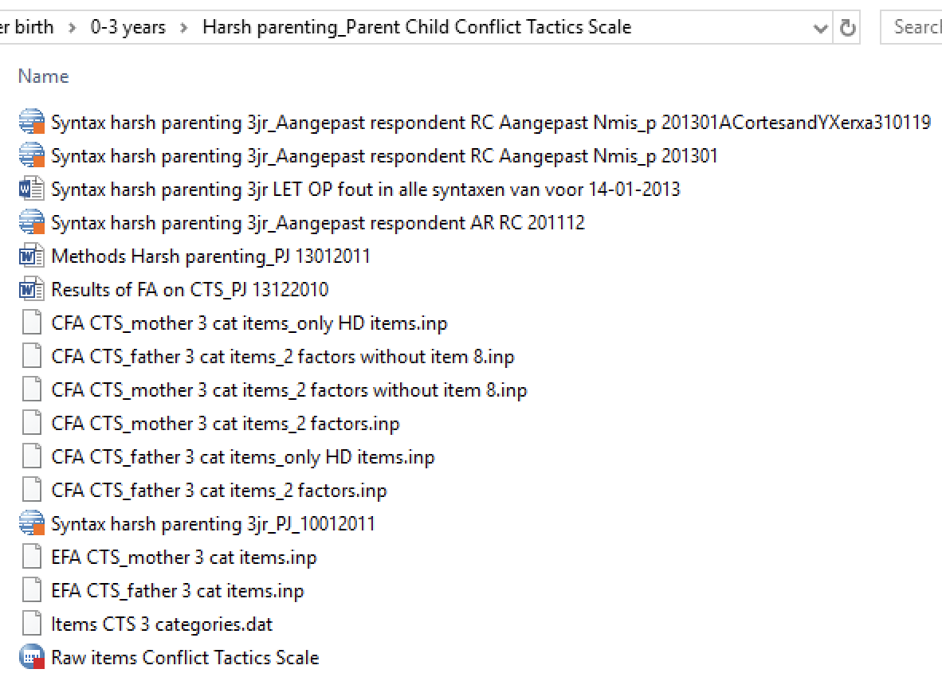
A world without version control…
Notes:
What is the problem we are trying to solve?
When I started the PhD, I thought you run analyses once.
Especially when you collaborate with other people:
- you take turns, so each one will spend a lot of time waiting for the other to finish, OR each work on their own copies and email changes back and forth
> things will be lost, overwritten, or duplicated

Slide 5
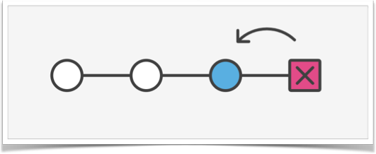
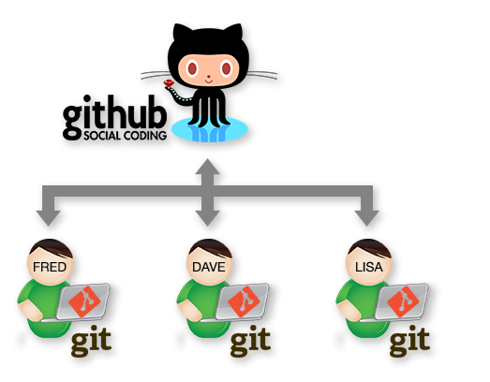
What is Git?
Git is a version control software: it tracks the evolution and merges changes in your files.
What is it for?
Primarily (?) software development (code), but… not only:
Dissertation: https://github.com/blahah/phd
CV: https://github.com/smythp/cv
What is GitHub?
GitHub is a web-based collaboration tool.
Tutorials: https://github.com/SereDef/GenR-run-GWAS
Websites: https://seredef.github.io/
Notes:
track the evolution of a project
Git is a program that works in the background, making it easy for you to keep track of changes in your work. So that you only see one version of a file/folder, but all the history of changes are available.
Version control allows you to track files in different states, combine different versions, identify a particular version of a file, and revert changes.
And it isn’t just for software: Version control is helpful for anything that changes over time or needs to be shared, such as code and data but also books, papers, and anything that changes over time or needs to be shared

Slide 6


Why bother with all of this?
Open and reproducible science (!)
Easy collaborations
Sanity
Notes:
A project without version control is like cooking without a recipe - it'll be difficult to remember how to produce the same results again.
Version control is like an unlimited ‘undo’ button…that also allows many people to work in parallel
Keeping a record of what was changed, when, and why is extremely useful for all researchers if they ever need to come back to the project later on (e.g., a year later, when memory has faded).

Slide 7
Interacting with git and Github
The command line (the “classic” way)
The “clicky-clacky” way, e.g:
Github web or Desktop
Rstudio / Vscode / Pycharm

Slide 8
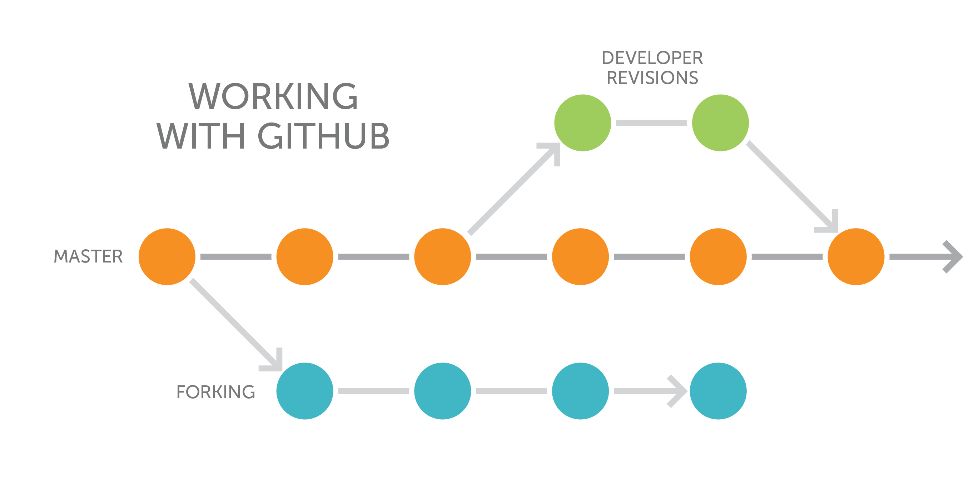
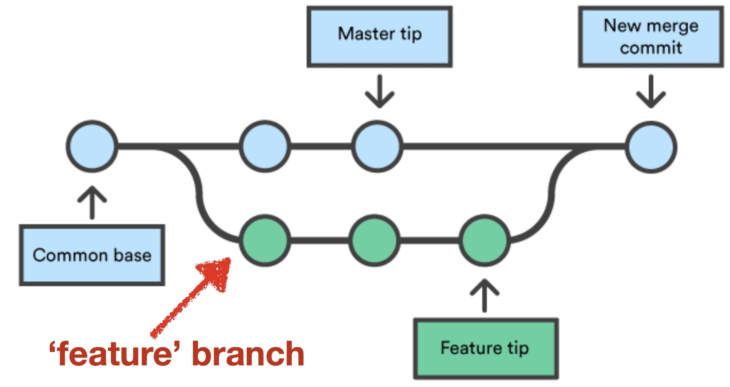
Git(hub) basic lingo
commit
repository
README & .gitignore
Fork & clone
Branch
Collaborator / Contributor
Issues
Notes:
A version control system keeps track of changes for us. Effectively it creates different versions of our files, and keeps useful metadata about them.
Each record of these changes is called a commit
The complete history of commits for a particular project and their metadata make up a repository.
A repo is a directory consisting of two parts
the files and sub-directories that we create and edit.
the extra information that Git records about the project's history (stored in a .git directory)
Note: Git expects this information to be laid out in a particular way, so we should not edit or delete .git.
Repositories can be kept in sync across different computers, facilitating collaboration among different people.
The README is a markdown file (automatically rendered when you visit a repo)
This sheet has everything you need to know about writing in markdown: https://github.com/adam-p/markdown-here/wiki/Markdown-Cheatsheet
When you Fork a repository, you make your own copy that lives online on your GitHub account.
When you Clone, you are copying the version controlled files to your computer.
Changes you make won’t affect the original in either case.
When you fork you copy someone else’s project / repo with the intention to build on it/improve it and contribute back changes using “pull requests” - You are not a collaborator, but you may become a contributor.
Create, assign & manage Issues by clicking on the Issue tab
Your default branch is the Main - but you can switch or add branches here
Notice when we create a branch - we can jump back and forth between our “READMEs” and see the different content. - <<quick demo! >> You decide you like what you’ve done and want to merge those changes into your master branch.
Use different branches: makes merging of code explicit
Way of sharing code, using branches make sure you don’t get in each other’s way
If your collaborators suggest changes, as we will all do later, their changes go onto a new Branch until you accept them and
Merge their changes into the Main.
Collaborators have permission to make changes to files in your repository without your approval (they are the inner circle).
Anyone can be a Contributor via Pull Requests (though you don’t need to accept their contributions).
Issues are your “to-do’s” - they are the tasks you need to perform, the bugs you need to fix, and things you want to accomplish.
You can “label” issues and “assign” them to collaborators (or yourself)

Slide 9



The big five
A little bash (before we start)
pwd
ls
cd
git clone (or git init)
git status
git add
git commit –m “I changed something”
git push
Or… clicky clacky …
Notes:
When you add a file to your work, you have to add it to the repository git add
When you’ve changed files, and want to be able to go back to this point, you commit your changes git commit
We've set up our repo. In this video, we will build a workflow for updating and tracking our files using Git.
Git add adds the file to the staging area (you put it in an envelope)

Slide 10
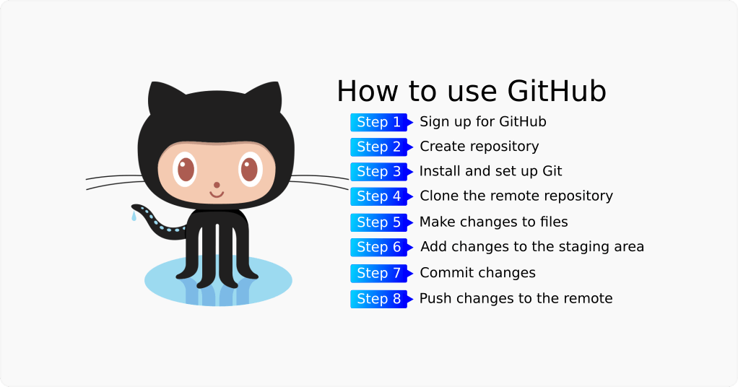
Summing up
Takes a bit of practice to learn Git’s workflow …
… buuut you will get:
Automated backups
Easy sharing of code with collaborators
An open science badge of honour
You can roll back if you mess up
Looks good on your resume
Thank your past self in 4 years
*And you don’t have to learn command line tools.

