Slide 1

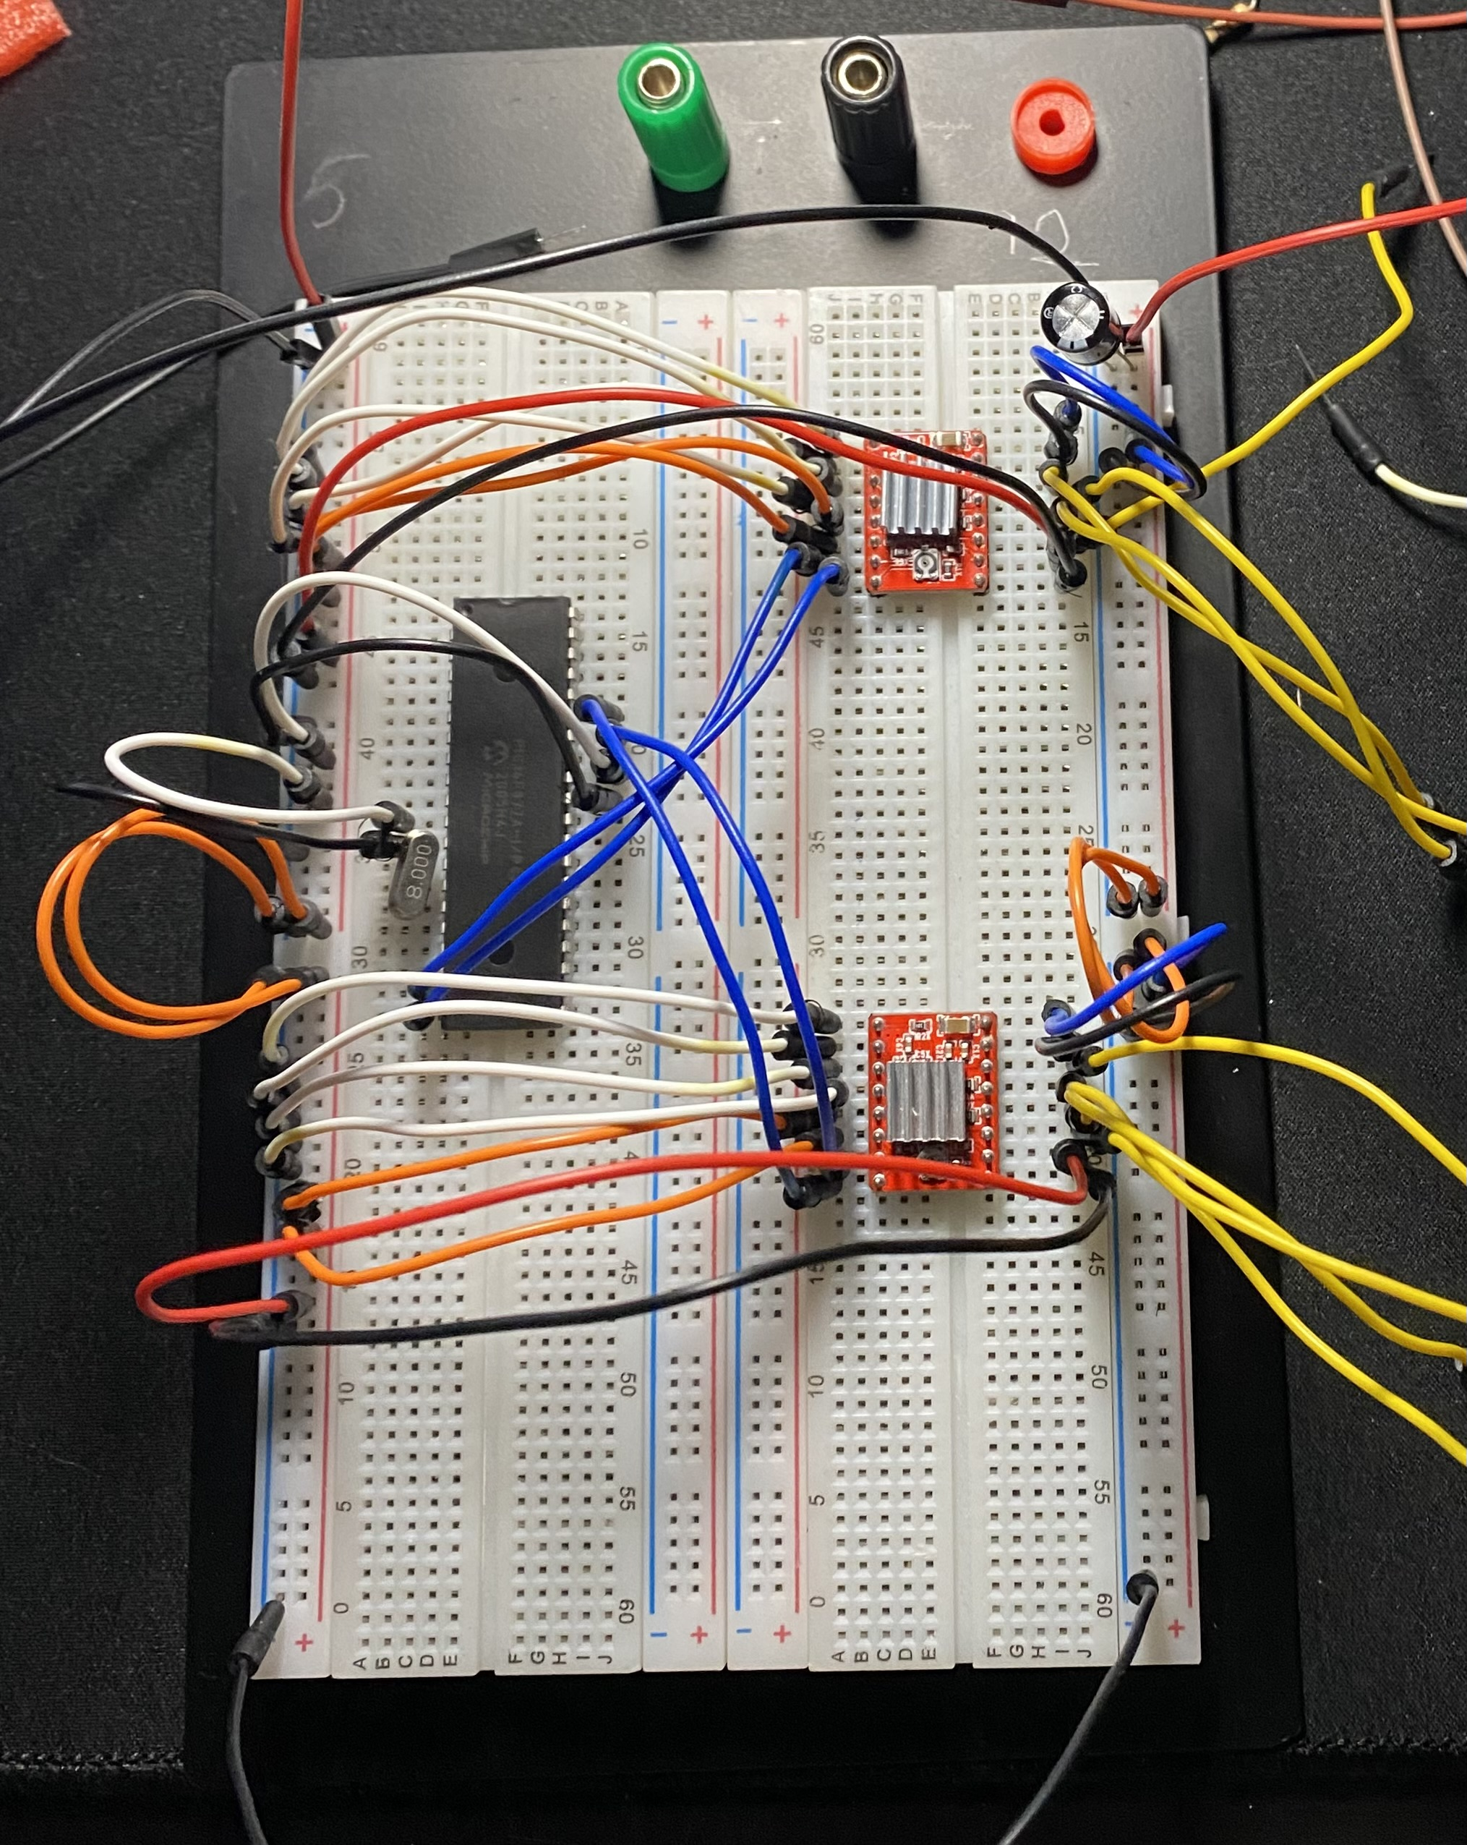
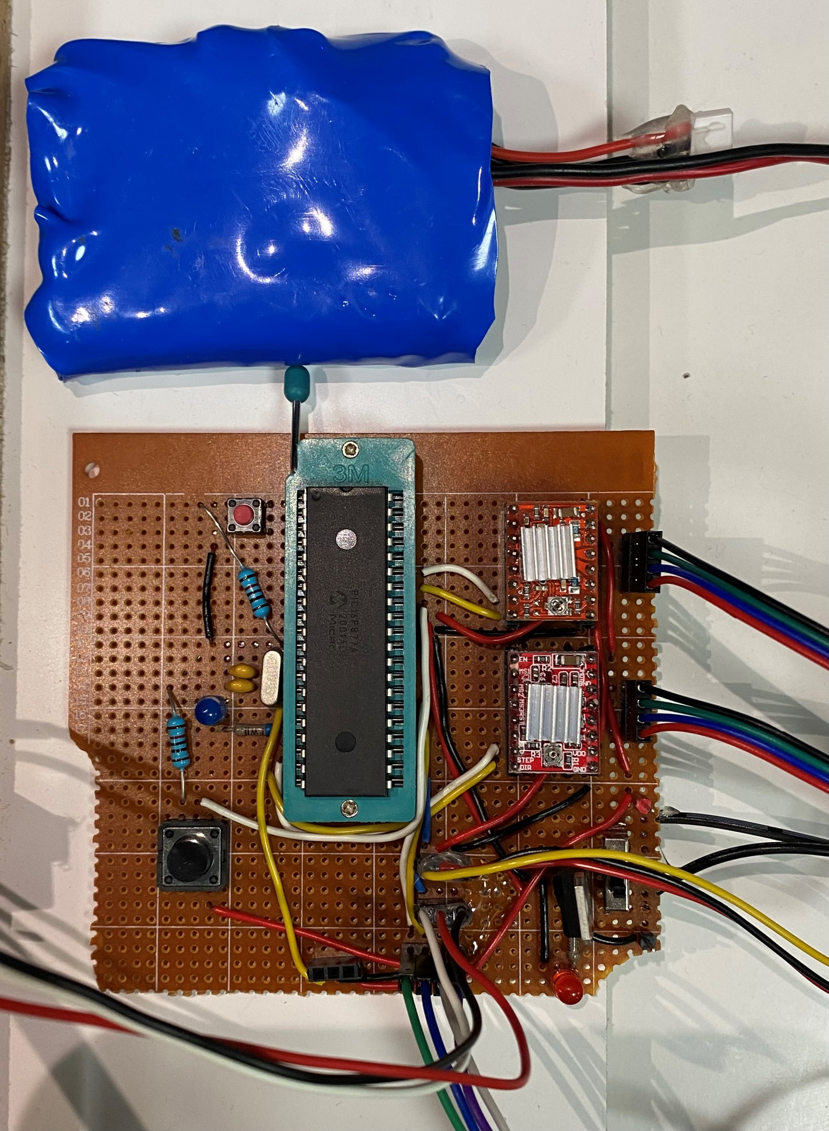
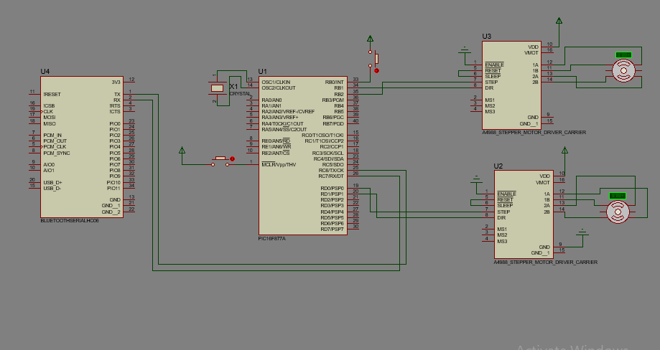
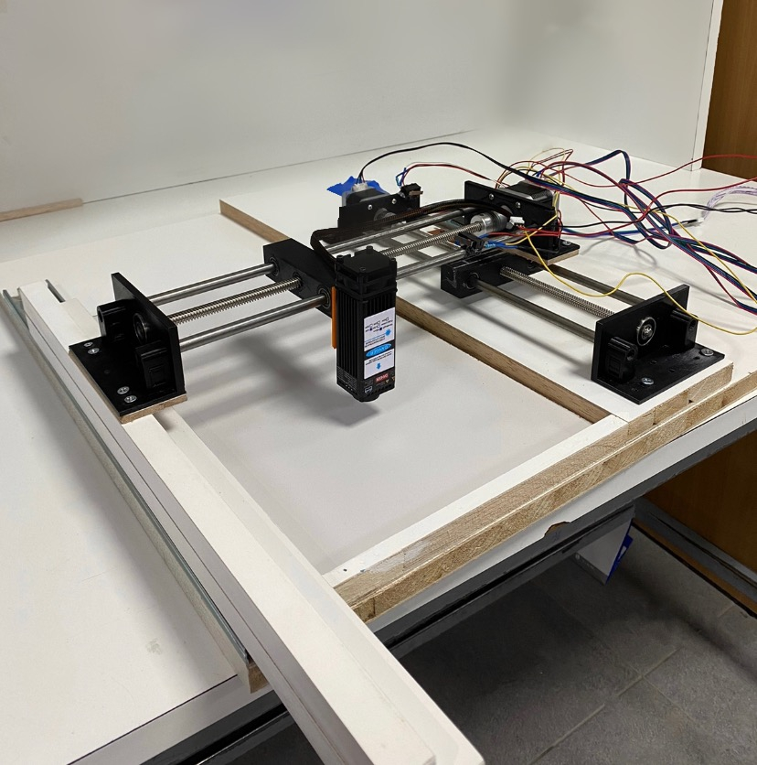
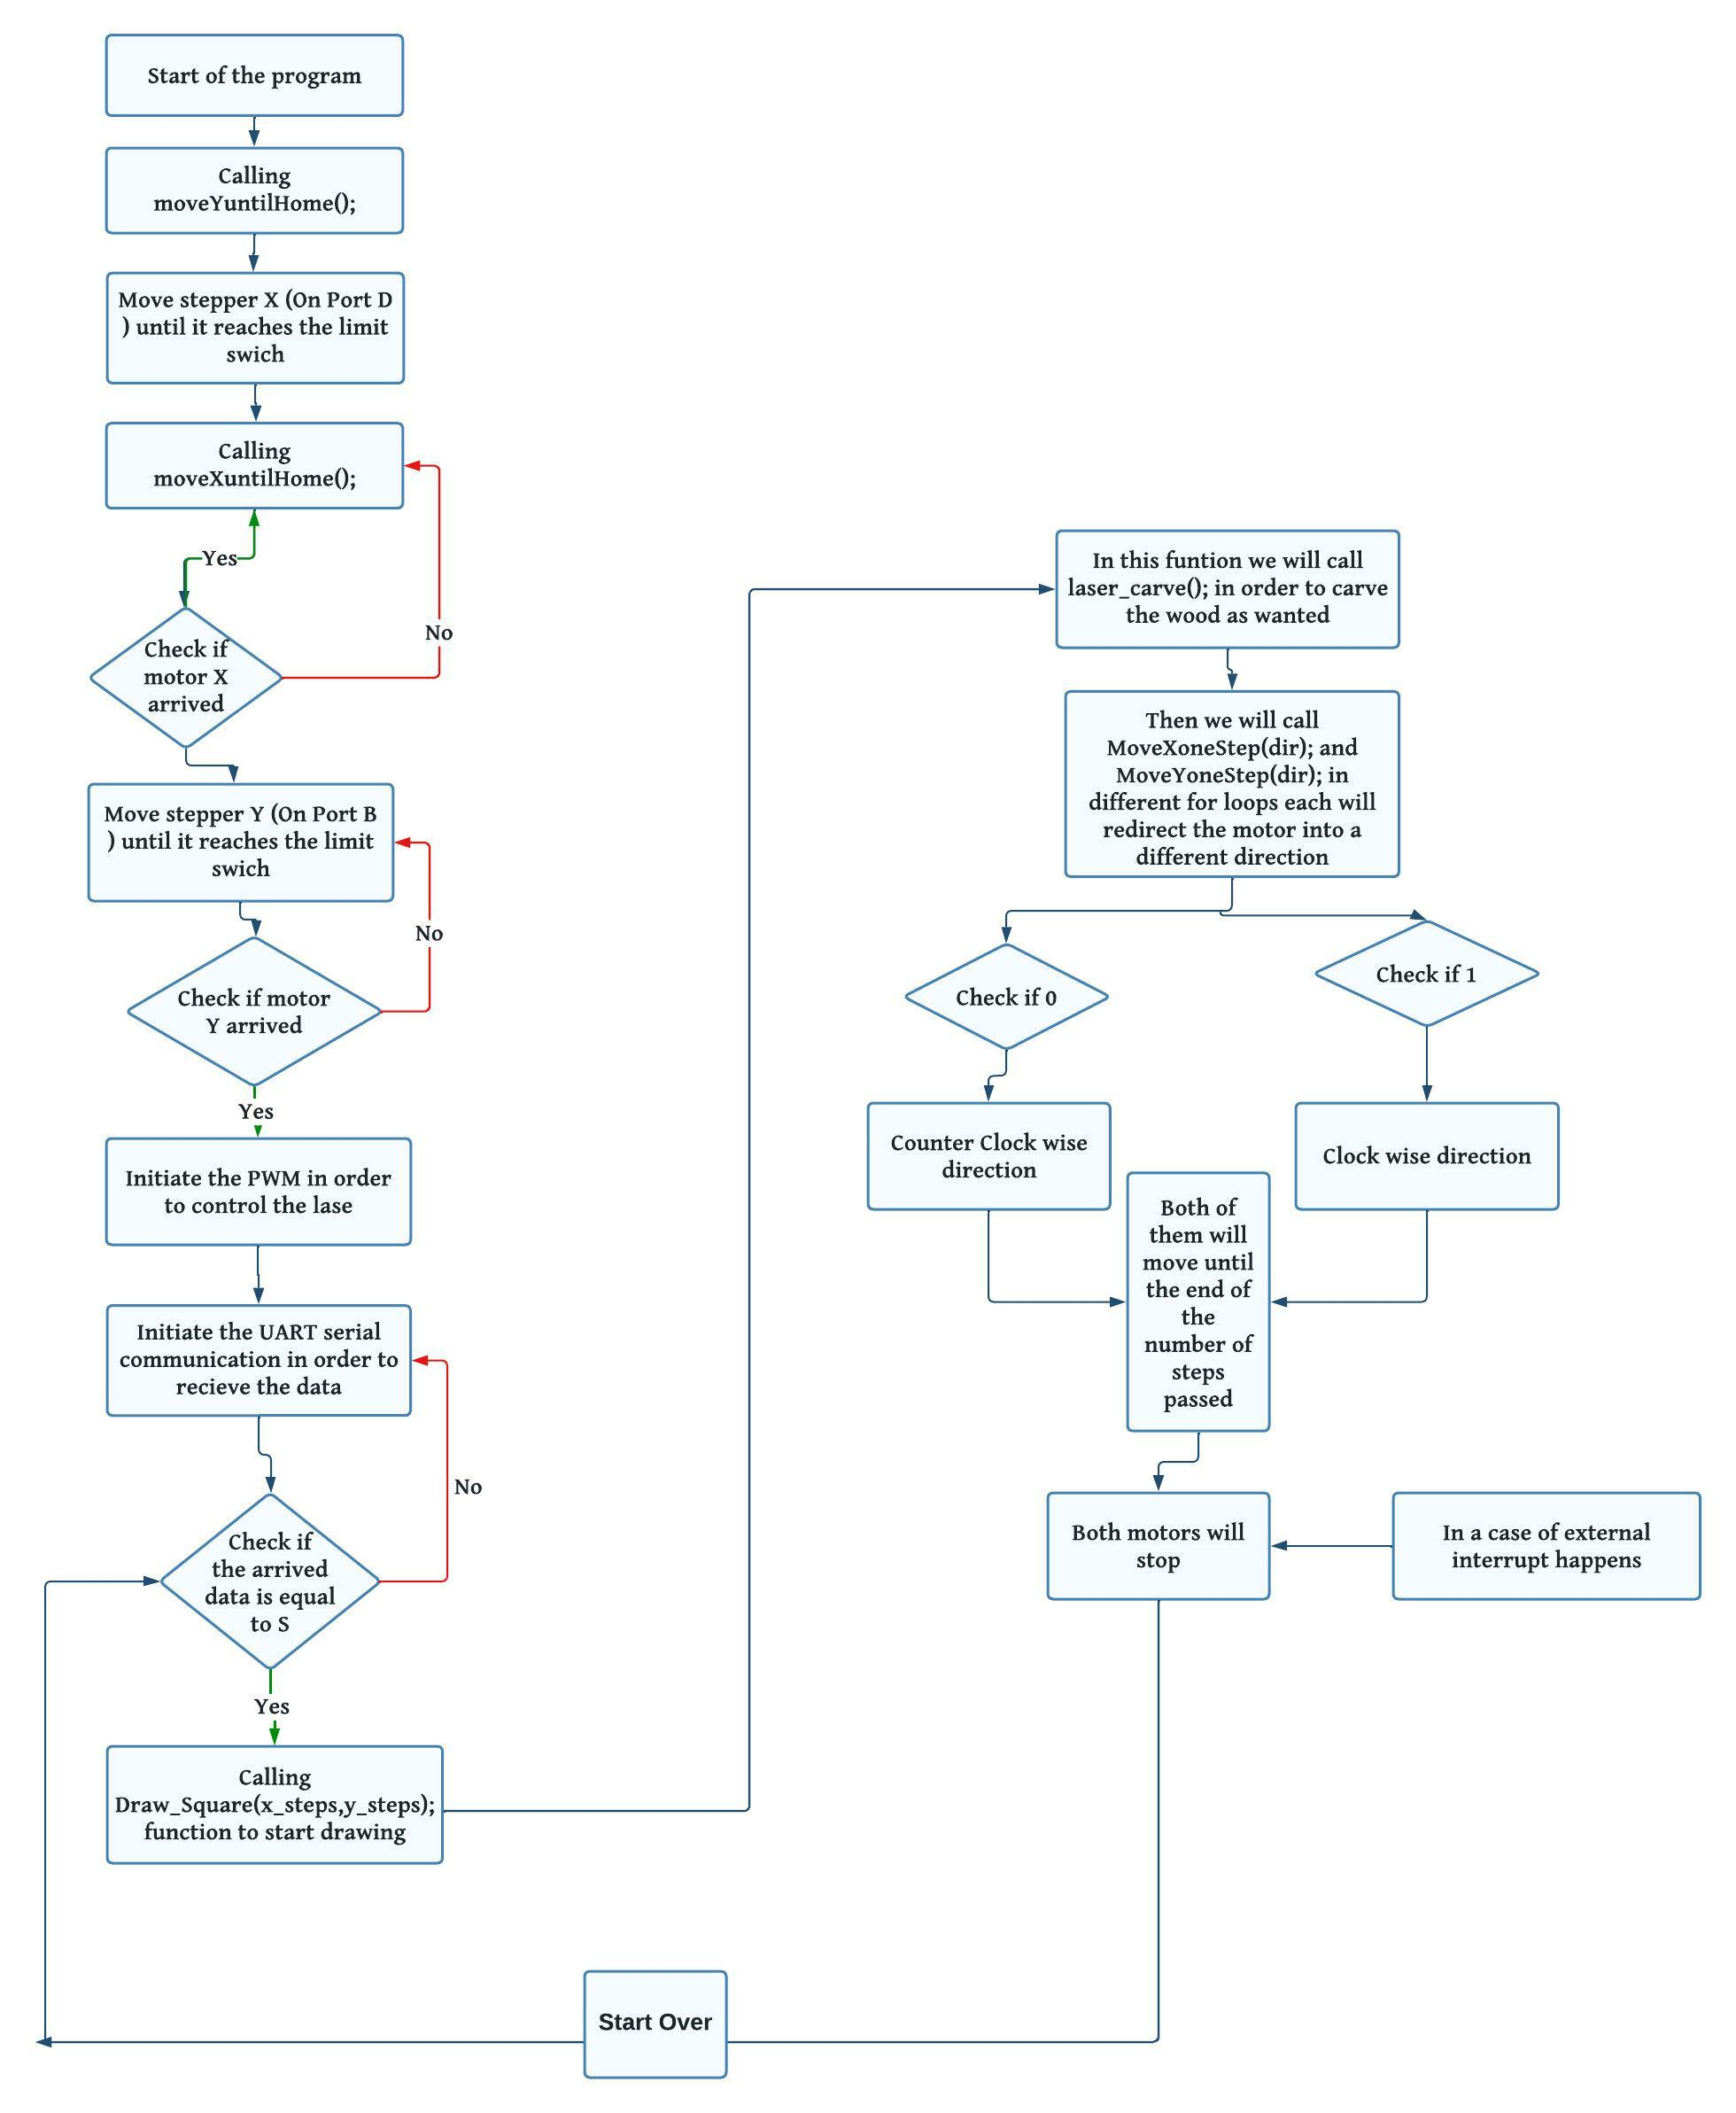
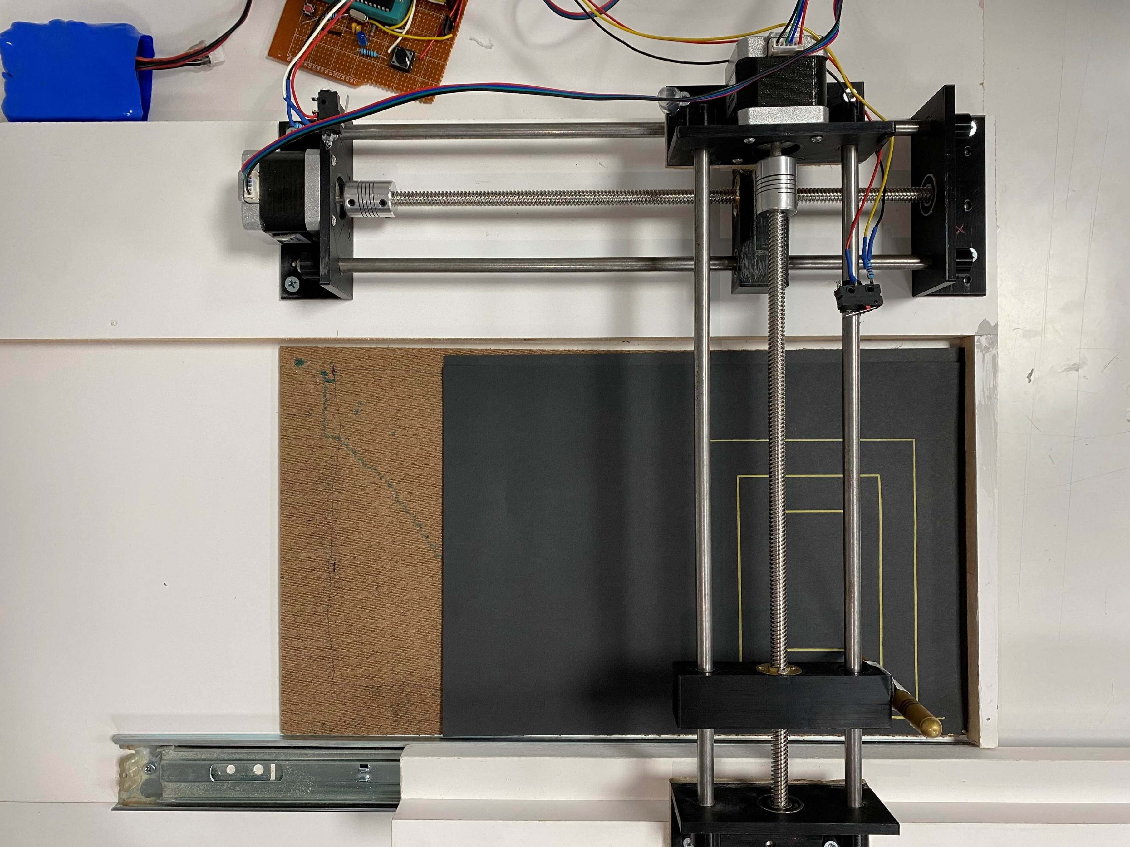

Laser Engraver
S. Salah, S. Abdallah, and A. AlZoul
Supervisor: Dr. Belal Sababha Embedded Systems Final Design Project, Fall 2022 King Abdullah II School of Engineering
Princess Sumaya University for Technology
Introduction A laser engraver is a machine that uses a laser to etch designs and patterns onto various materials, such as wood, metal, and plastic. This poster will provide an overview of the hardware and software components used to build a laser engraver using the PIC16F877A microcontroller and stepper motors. The PIC16F877A will be used to control the stepper motors, .This poster will explain how the PIC used to control the movement of the stepper motors and the laser, taking orders from a serial Bluetooth, resulting in high-quality engravings.
Results
PIC16F877A were able to take orders from the Bluetooth Arduino application through a serial Bluetooth module to control the stepper motors, And draw squares.
Design
Figure 1: Electrical Circuit Diagram
Figure 2: Software Diagram
Figure 3: Circuit on bread Board
Figure 4: Circuit after Soldering
Figure 5: Final Design
Figure 6: Drawing Squares
Figure 7: Final Results
Conclusion
In conclusion, this poster has provided an overview of the hardware and software components used to build a laser engraver using the PIC16F877A microcontroller, stepper motors, and stepper drivers. The PIC16F877A is used to control the stepper motors and stepper drivers, which are responsible for moving the laser in the x and y-axis, and providing the necessary current and voltage to drive the stepper motors. HC-05 Bluetooth module used to read, which contains the information about the image to be engraved on the material. Orders will be sent to the PIC16F877A via serial communication, which is used to control the movement of the stepper motors and the laser. The combination of the PIC16F877A, stepper motors, stepper drivers and Bluetooth module allows for precise control of the laser engraver, resulting in high-quality engravings. This poster has provided a detailed explanation of how these components work together to create a functional laser engraver.

