Slide 1
Operating systems –Lecture3
Saidalavi Kalady
Office: CSE 203B
Contact Numbers:0495 2286809
9895495333
Email: said@nitc.ac.n
Text Book :
Modern Operating Systems
Andrew S Tanenbaum and Herbert Bos
Operating System Concepts
Avi Silberschatz, Peter Baer Galvin, Greg Gagne

Slide 2
Operating systems –introduction
…….. fd=open(“file name”, mode);
a=10; ……….
b=20; int read(fd, buffer, n);
c=a+b; ……….
………… int write(fd, buffer, size);
………… ……….
printf(“%d”, c);
………

Slide 3
Introduction
Hardware interface: ISA of the machine
OS interface: system calls
Application program
Application program
OS interface
Operating systems
H/W interface
ISA
Hardware
Hardware

Slide 4
What is an OS
An OS is a program that acts an intermediary between the user of a computer and computer hardware.
Operating system goals:
Execute user programs and make solving user problems easier
Make the computer system convenient to use
Use the computer hardware in an efficient manner
Major cost of general purpose computing is software.
OS simplifies and manages the complexity of running application programs efficiently.

Slide 5
Computer System Structure
Computer system can be divided into four components
Hardware – provides basic computing resources
CPU, memory, I/O devices
Operating system
Controls and coordinates use of hardware among various applications and users
Application programs – define the ways in which the system resources are used to solve the computing problems of the users
Word processors, compilers, web browsers, database systems, video games
Users
People, machines, other computers

Slide 6
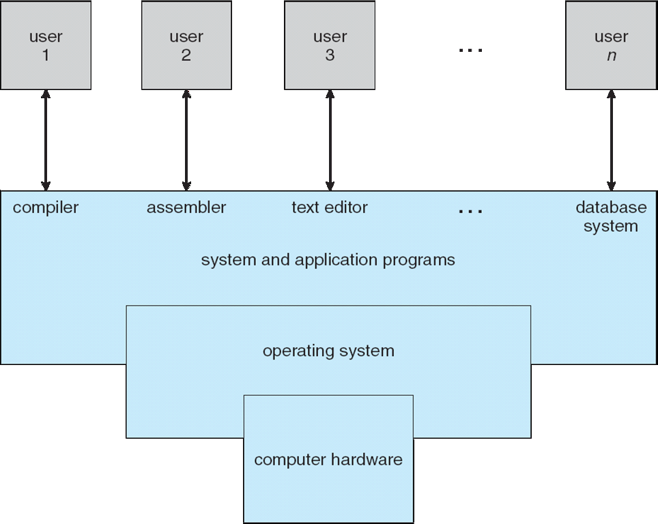
Computer System Structure

Slide 7
Operating System Definition
OS is a resource allocator
Manages all resources
Decides between conflicting requests for efficient and fair resource use
OS is a control program
Controls execution of programs to prevent errors and improper use of the computer
No universally accepted definition
“Everything a vendor ships when you order an operating system” is good approximation
But varies wildly
“The one program running at all times on the computer” is the kernel. Everything else is either a system program (ships with the operating system) or an application program

