Slide 1


Multi-functional Cane An assistive device for the visually impaired
Embedded Design
Submitted By:
Ali Yazbeck- 94764
Serena Haidar - 90457
Zein Attar -94266
Approved By:
Dr. Mohamad Shreif

Slide 2
Outline
Introduction
Project Objective
Required Components
Circuit Design
Implementation
Conclusion

Slide 3
Project Objective
Measure the temperature in a specific medium.
Show measurement range between -40C and +125C.
Light up RGB LEDs differently according to the corresponding temperature.

Slide 4

Problem : Challenges Faced by the Visually Impaired
Detecting obstacles
Navigating unfamiliar environments
Lack of access to affordable smart devices
Safety risks at night or in emergencies

Slide 5
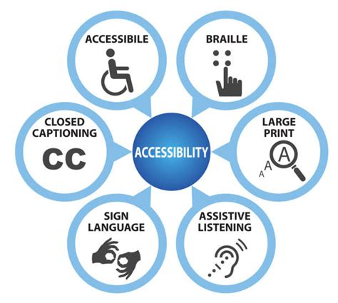
OUR MOTIVATION
Help blind people navigate their environment in a safer way
Applying embedded systems for social impact
Desire to build practical, accessible solutions

Slide 6
EXISTING SYSTEMS
Project Name | Object Detection | Audio Feedback | GPS / SMS | Light Safety | Notes
SmartCane (IIT Delhi) | Ultrasonic sensors | Vibration alerts | No | No | Widely adopted; lacks GPS or AI features
Batcane (Leeds University) | Sonar-based echolocation | Vibration alerts | No | No | Detects obstacles in multiple directions; no GPS/audio
XploR Cane (Birmingham City U.) | Facial recognition | Bone-conduction audio | Yes | No | Enhances social interaction; limited recognition range
Chest Camera + Wristbands (US) | Computer vision (obstacles) | Vibrating wristbands | No | No | Effective in crowds; lacks GPS and audio
Our Project | Ultrasonic sensors | MP3 audio alerts | Yes | Yes | Includes water hazard detection, lighting, and emergency SMS

Slide 7
PROPOSED SOLUTION: MULTI-FUNCTIONAL CANE
SOLUTION
GOALS
Combine sensors with embedded systems for real-time feedback
Add GPS and emergency functions
Affordable and easy to maintain
Obstacle detection for safer navigation
Light up in the dark for safety
Compass orientation and direction guidance
Ensuring a safer navigation
Assisting in the case of emergencies
Enhancing mobility and independence

Slide 8
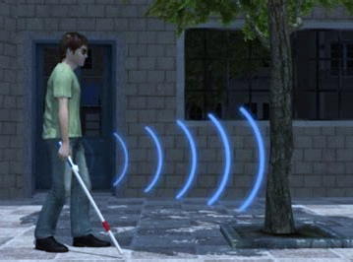

FUNCTIONALITY
Obstacle Detection
Voice-Assisted Navigation
Automatic Nighttime Lighting
Emergency Button + Location Sharing
Water Detection

Slide 9
Required Components

Slide 10
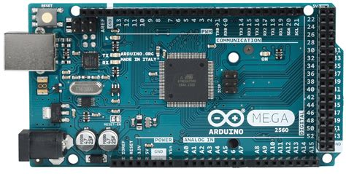
ARDUINO MEGA 2560 : OVERVIEW
Low-cost and low-power System on a Chip (SoC) microcontroller
Developed by Espressif Systems.
Designed for mobile devices, wearable electronics and Internet of Things (IoT) applications
Wireless Connectivity: Wi-Fi and Bluetooth
Processor speed : 240 MHz
Memory: 520 KiB SRAM and 448 KiB ROM
Supports external flash and PSRAM

Slide 11
ESP32 : FEATURES
Peripheral interfaces:
34 programmable GPIOs
12-bit SAR ADC, DAC, SPI, UART, PWM and more
Clocks and timers:
2 Internal oscillators (8 MHz and RC) with calibration
2 External crystal oscillator : 2 MHz ~ 60 (40 MHz only for Wi-Fi/Bluetooth functionality) and 32 kHz for RTC with calibration
Power Management: 5 power modes, including deep sleep(10 μA.) and Hibernation for energy efficient operation.

Slide 12
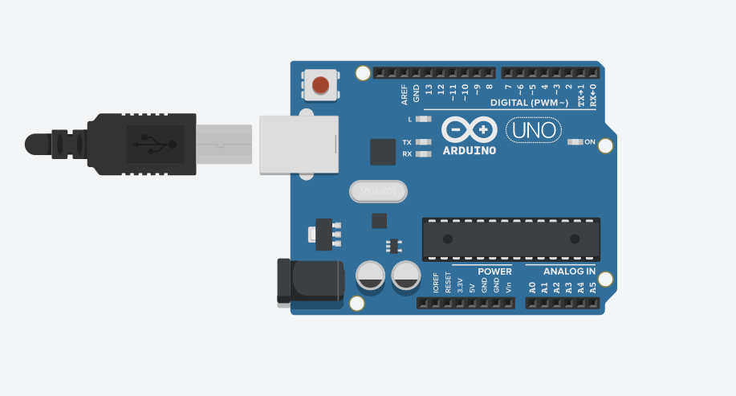
Arduino UNO
The Arduino Uno is an open-source microcontroller board based on the Microchip ATmega328P microcontroller and developed by Arduino.cc. The board is equipped with sets of digital and analog input/output pins that may be interfaced to various expansion boards and other circuits.

Slide 13
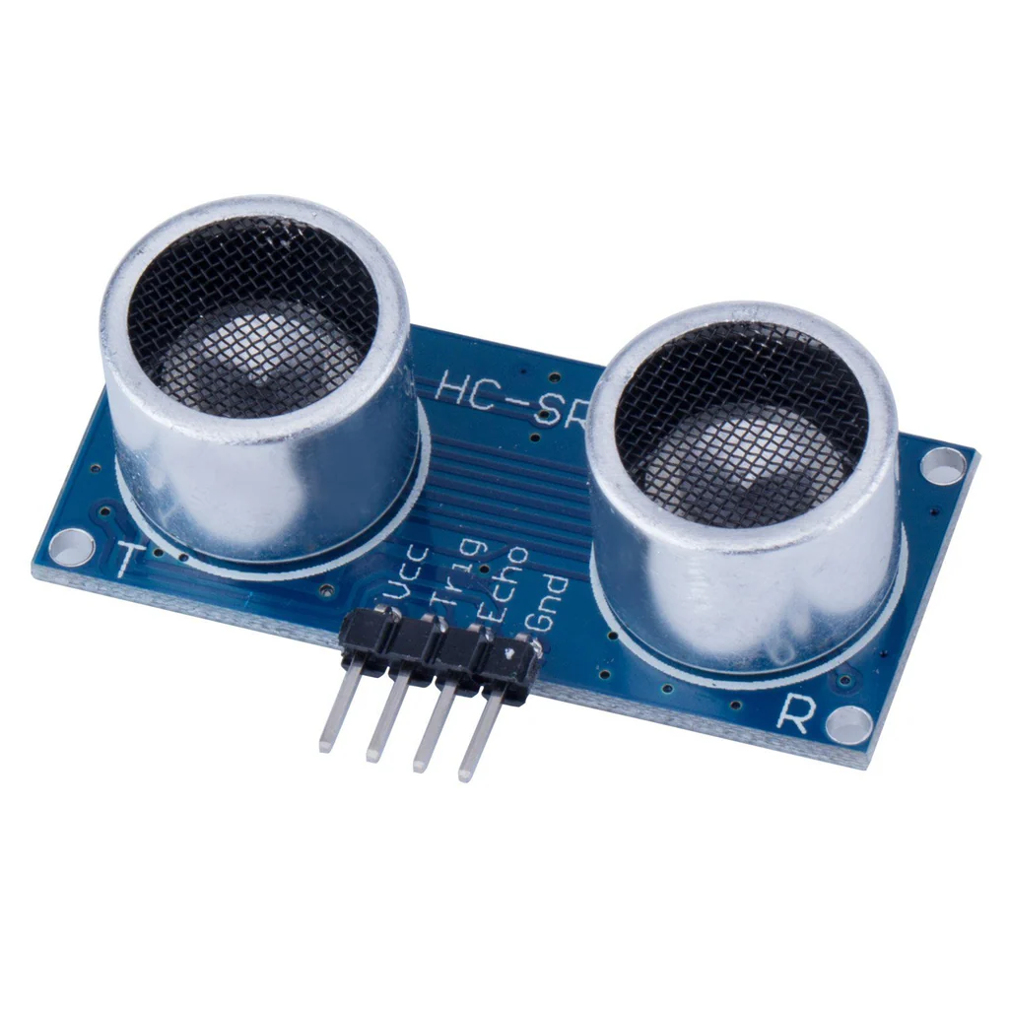
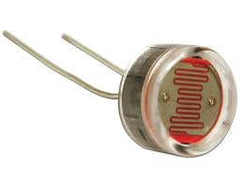

MAIN COMPONENTS
DFPlayer
SIM Card + Speaker
Ultrasonic sensor

Slide 14
MAIN COMPONENTS
LDR + LED
Water sensor
Sensors: Ultrasonic + voice feedback

Slide 15
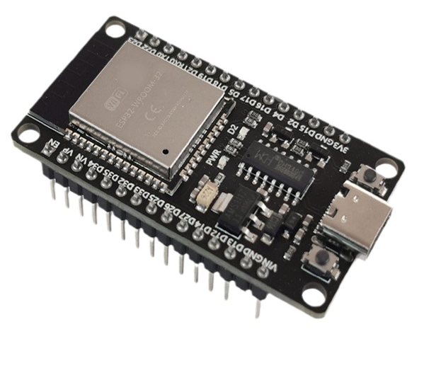
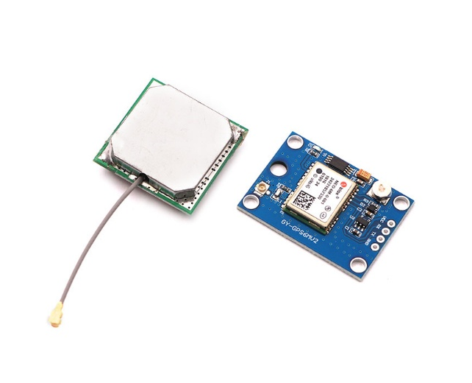
COMPONENTS: COMMUNICATION AND LOCATION MODULES
ESP32
NEO-6M GPS Module
Emergency Button

Slide 16
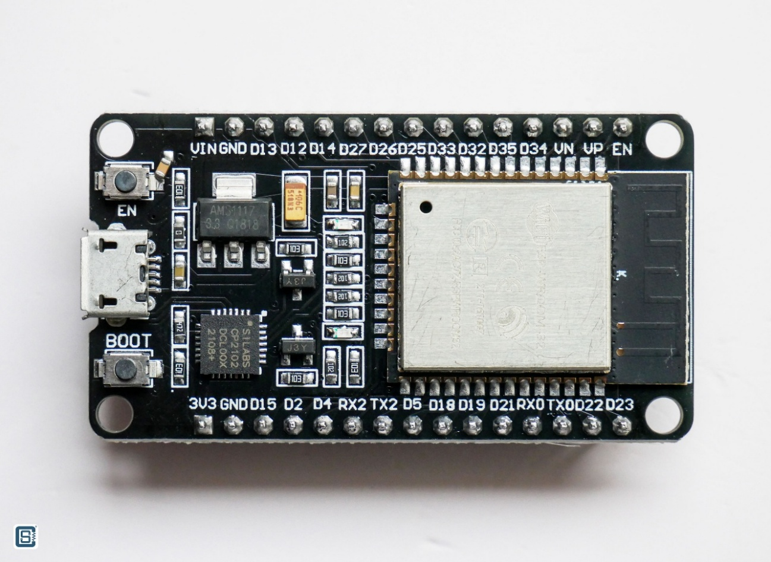
ESP32 : OVERVIEW
Low-cost and low-power System on a Chip (SoC) microcontroller
Developed by Espressif Systems.
Designed for mobile devices, wearable electronics and Internet of Things (IoT) applications
Wireless Connectivity: Wi-Fi and Bluetooth
Processor speed : 240 MHz
Memory: 520 KiB SRAM and 448 KiB ROM
Supports external flash and PSRAM
Clocks and timers:
2 Internal oscillators (8 MHz and RC) with calibration
2 External crystal oscillator : 2 MHz ~ 60 (40 MHz only for Wi-Fi/Bluetooth functionality) and 32 kHz for RTC with calibration

Slide 17
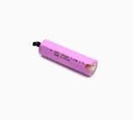
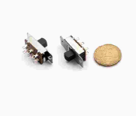
COMPONENTS: POWER MANAGEMENT
18650 Li-ion Rechargeable Batteries
TP4056 Battery Charging Module
Slide Switch

Slide 18
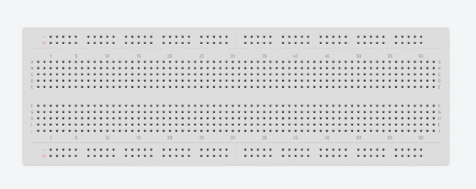
COMPONENTS: ADDITIONAL
Breadboard
Jumper Wires
Resistors
Cane and Box

Slide 19
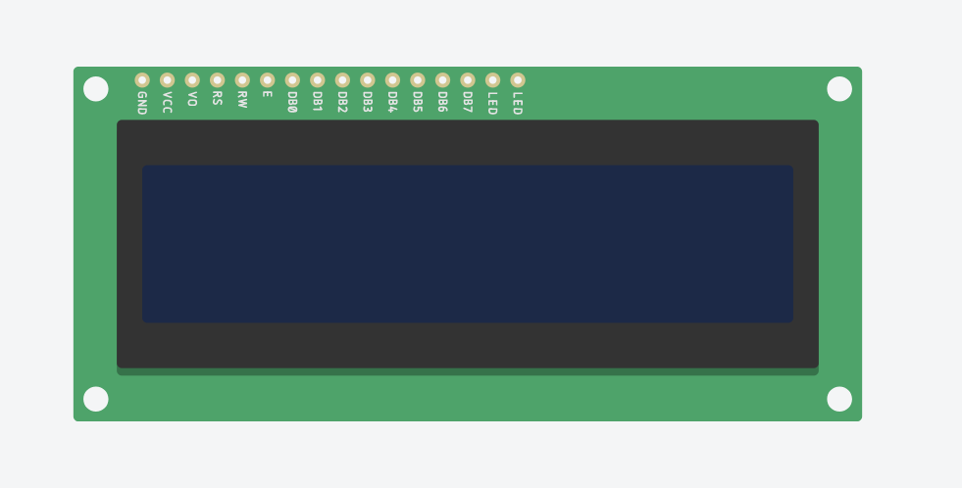
16*2 LCD
An LCD is an electronic display module which uses liquid crystal to produce a visible image. The 16×2 LCD display is a very basic module commonly used in DIYs(Do It Yourself) and circuits. The 16×2 translates a display 16 characters per line in 2 such lines. In this LCD each character is displayed in a 5×7 pixel matrix.

Slide 20

Temperature Sensor [TMP36]
The TMP36 is a low voltage, precision centigrade temperature sensor. It provides a voltage output that is linearly proportional to the Celsius temperature. It also doesn't require any external calibration to provide typical accuracies of ±1°C at +25°C and ±2°C over the −40°C to +125°C temperature range.

Slide 23
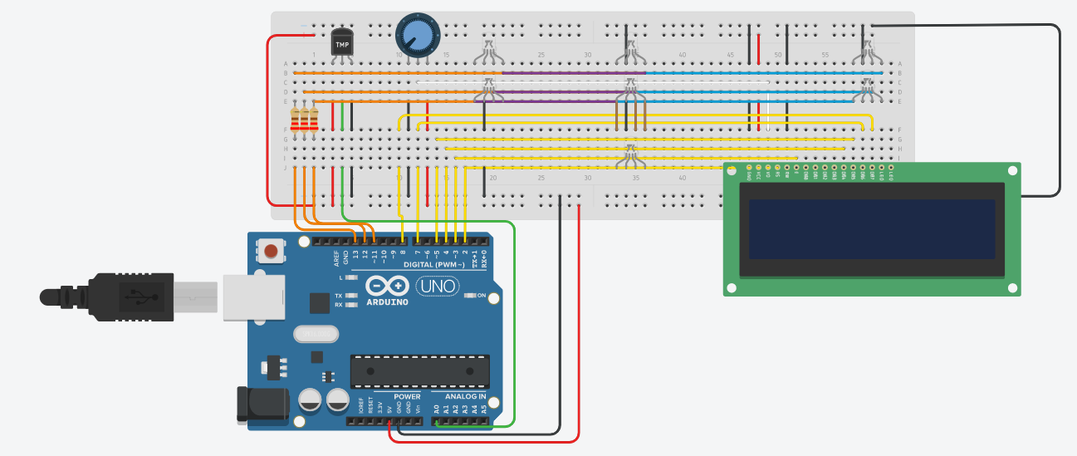
Circuit Design

Slide 24
Operation
This Device gives the temperature of a certain medium by displaying it on the 16*2 LCD .
The RGB LEDs light correspondingly to the temperature value.

Slide 25
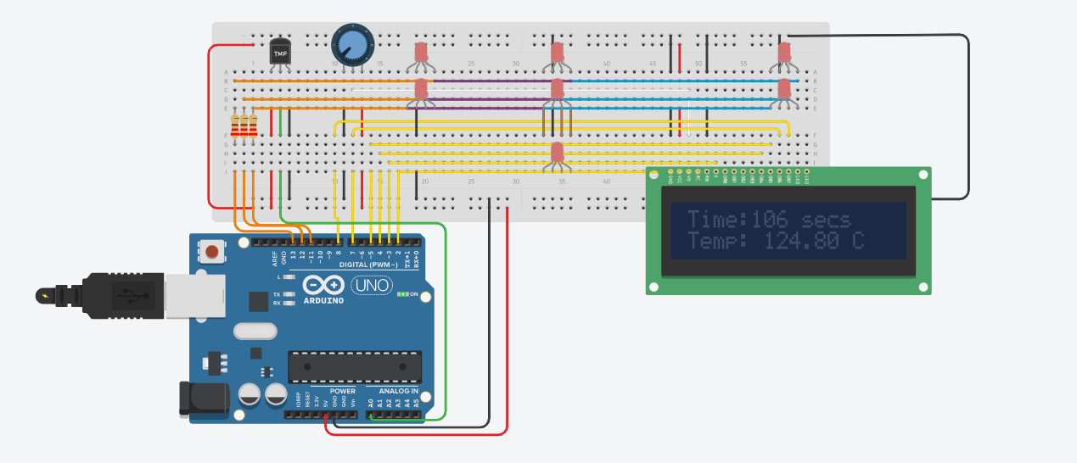
Implementation

Slide 26
Code Sample
if(temp<-15.82)
rgbcolor(255,255,255);//when the temperature is less than -15.82 the RGB LED lights pink
else if(temp>82.813)
rgbcolor(255,0,0);//when the temperature is above 82.813 the RGB LED lights red

Slide 27
Conclusion
This device makes our life easier, safer and more practical by displaying not only the temperature as numerical value, but also a lightning color that corresponds to a specific temperature.
We learned how to apply engineering to create a prototype for a specific system.

Slide 28
Tinkercad link
https://.....

Slide 29
Thank you
We are ready to answer your questions

