Slide 1


Explainable Sequential Anomaly Detection via Prototypes
He Cheng¹ Depeng Xu² Shuhan Yuan¹
¹Utah State University
²University of North Carolina at Charlotte
This work was supported in part by NSF 2103829

Slide 2
Introduction
Deep sequential anomaly detection, explainable anomaly detection

Slide 3
Sequential Anomaly Detection
Sequential data is ubiquitous in various applications.
Sequential anomaly detection is critical to build robust and reliable systems.

Slide 4
Deep Sequential Anomaly Detection
Deep learning-based methods perform better than traditional methods.
Deep sequential anomaly detection models are black-boxed.
Detecting anomalies with explanations is more trustworthy.

Slide 5
Detecting Anomalies with Explanations
Anomalies in sequential data can be explained by prototypes.
Anomaly in a single sequence can be explained by instantiated prototype.
Anomalies in the whole dataset can be explained by diverse prototypes.

Slide 6
Methodology
Explainable Sequential Anomaly Detection via Prototypes(GLEAD)

Slide 7
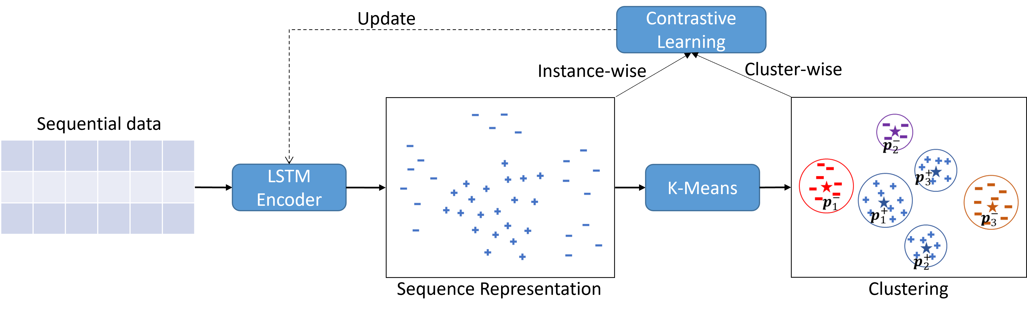
Overview
We propose an Explainable Sequential Anomaly Detection (ESAD) framework.
ESAD adopts contrastive learning and k-means technique.
ESAD can derive multiple normal and abnormal prototypes.
ESAD can detect and explain abnormal sequences by learned prototypes.

Slide 8
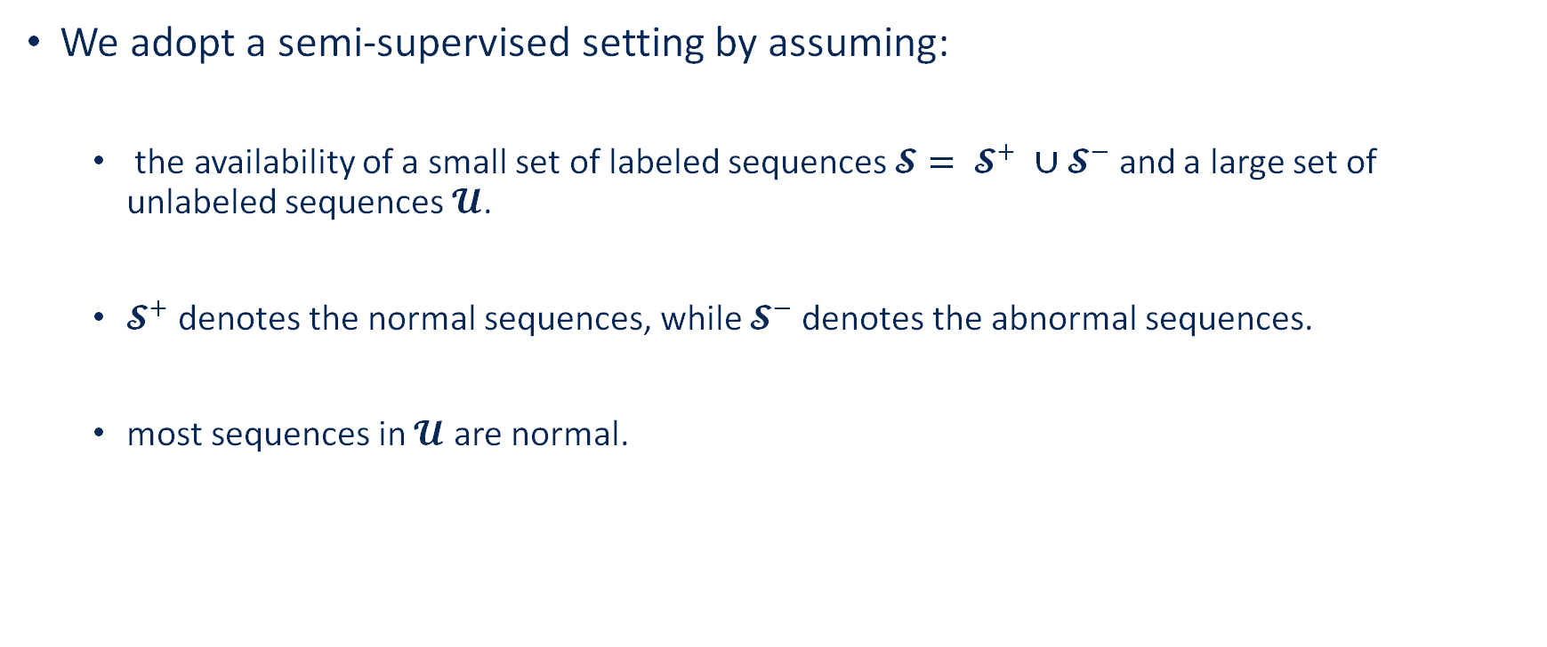
Setup
We adopt a semi-supervised setting by assuming:
the availability of a small set of labeled sequences $\text{𝓢}= {\text{𝓢}}^{+} ∪{\text{𝓢}}^{−}$ and a large set of unlabeled sequences$\text{𝓤}$.
${\text{𝓢}}^{+}$ denotes the normal sequences, while ${\text{𝓢}}^{−}$denotes the abnormal sequences.
most sequences in $\text{𝓤}$ are normal.

Slide 9
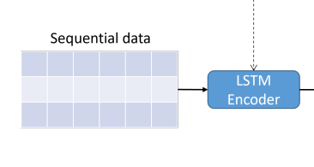
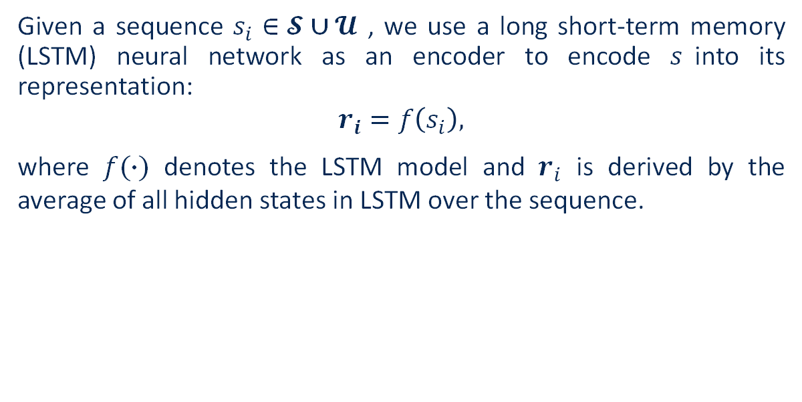
Sequence Representation
Given a sequence $s_{i}∈\text{𝓢}∪\text{𝓤}$ , we use a long short-term memory (LSTM) neural network as an encoder to encode $s$into its representation:
$$r_{i}=f\left(s_{i}\right),$$
where $f(∙)$ denotes the LSTM model and $r_{i}$ is derived by the average of all hidden states in LSTM over the sequence.

Slide 10
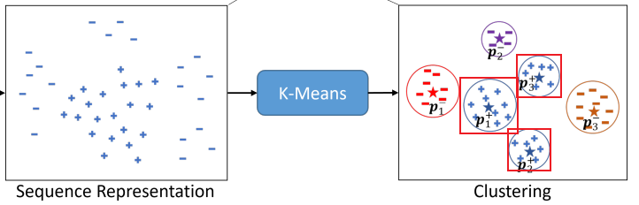
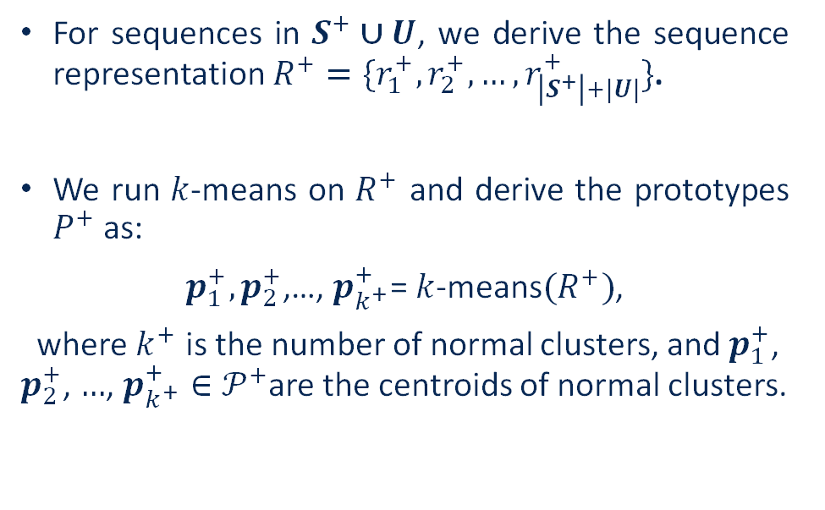
Prototype Representation
For sequences in $S^{+}∪U$, we derive the sequence representation $R^{+}=\{r_{1}^{+},r_{2}^{+},…,r_{\left|S^{+}\right|+|U|}^{+}\}$.
We run $k$-means on $R^{+}$ and derive the prototypes $P^{+}$ as:
$p_{1}^{+},p_{2}^{+}$,…, $p_{k^{+}}^{+}$= $k$-means$(R^{+})$,
where $k^{+}$ is the number of normal clusters, and $p_{1}^{+}$, $p_{2}^{+}$, $…$, $p_{k^{+}}^{+}∈𝒫^{+}$are the centroids of normal clusters.

Slide 11
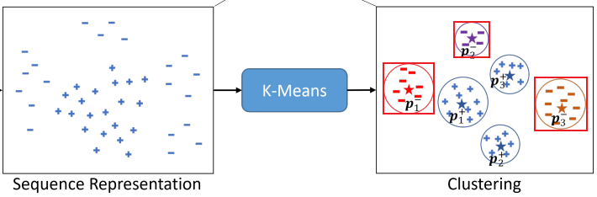
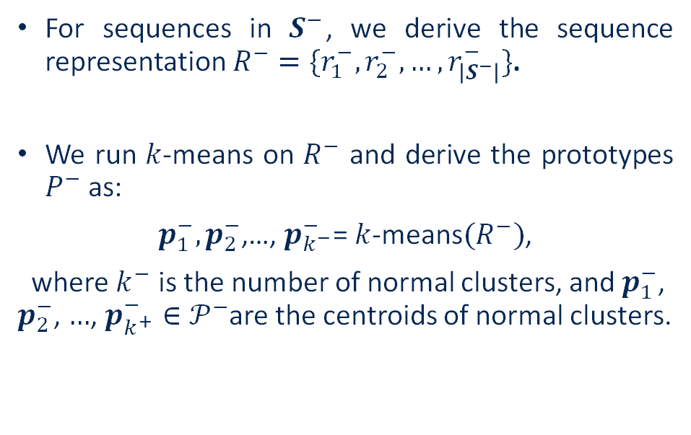
Prototype Representation
For sequences in $S^{−}$, we derive the sequence representation $R^{−}=\{r_{1}^{−},r_{2}^{−},…,r_{\left|S^{−}\right|}^{−}\}$.
We run $k$-means on $R^{−}$ and derive the prototypes $P^{−}$ as:
$p_{1}^{−},p_{2}^{−}$,…, $p_{k^{−}}^{−}$= $k$-means$(R^{−})$,
where $k^{−}$ is the number of normal clusters, and $p_{1}^{−}$, $p_{2}^{−}$, $…$, $p_{k^{+}}^{−}∈𝒫^{−}$are the centroids of normal clusters.

Slide 12
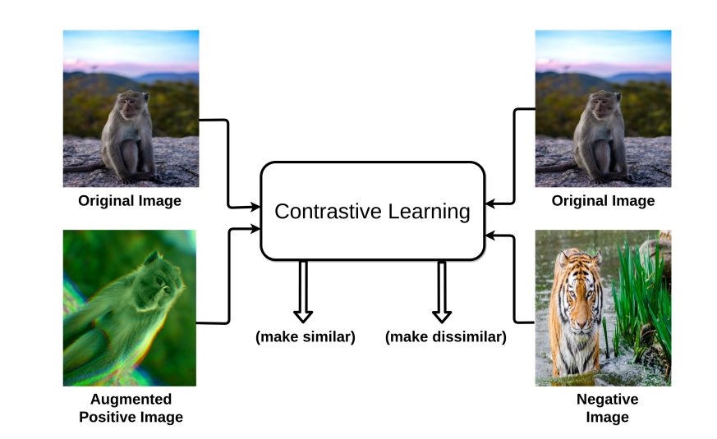
Learning Objectives
contrastive learning
Contrastive Learning is an unsupervised representation learning technique.
The goal is to learn a representation space where similar samples are close together while dissimilar samples are far apart.
https://arxiv.org/abs/2011.00362

Slide 13
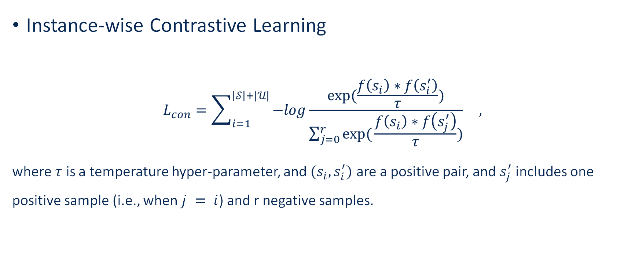
Learning Objectives
Instance-wise Contrastive Learning
$$L_{con}=\sum_{i=1}^{\left|𝒮\right|+|𝒰|}{−log\frac{exp⁡(\frac{f\left(s_{i}\right)∗f\left(s_{i}^{′}\right)}{τ})}{\sum_{j=0}^{r}{exp⁡(}\frac{f\left(s_{i}\right)∗f\left(s_{j}^{′}\right)}{τ})}} ,$$
where $τ$ is a temperature hyper-parameter, and $(s_{i}, s_{i}^{′})$ are a positive pair, and $s_{j}^{′}$ includes one positive sample (i.e., when $j = i$) and r negative samples.

Slide 14
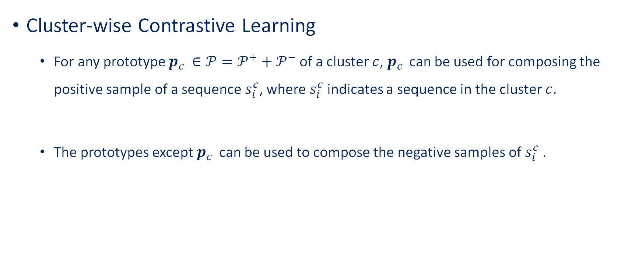
Learning Objectives
Cluster-wise Contrastive Learning
For any prototype $p_{c }∈𝒫=𝒫^{+}+𝒫^{−}$of a cluster $c$, $p_{c }$can be used for composing the positive sample of a sequence $s_{i}^{c}$, where $s_{i}^{c}$indicates a sequence in the cluster $c$.
The prototypes except $p_{c }$ can be used to compose the negative samples of $s_{i}^{c}$.

Slide 15
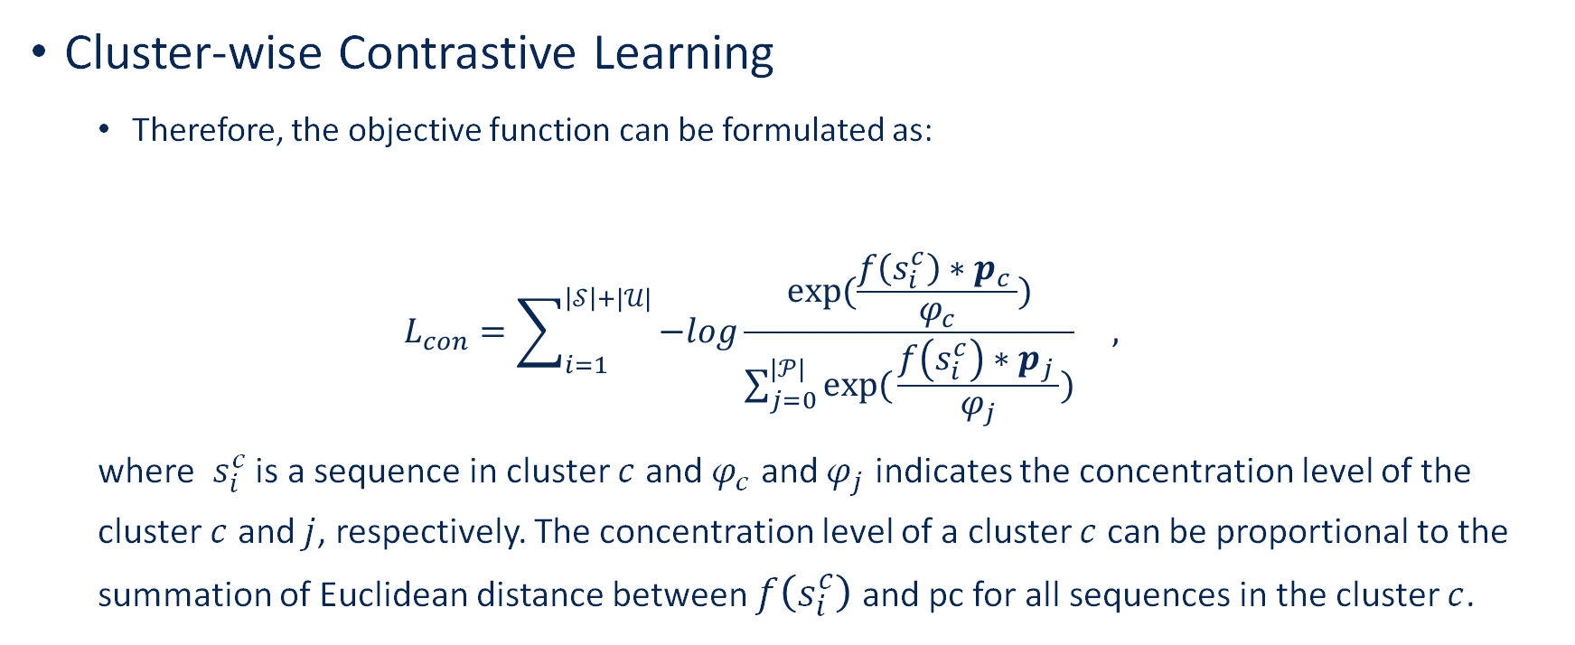
Learning Objectives
Cluster-wise Contrastive Learning
Therefore, the objective function can be formulated as:
$$L_{con}=\sum_{i=1}^{\left|𝒮\right|+|𝒰|}{−log\frac{exp⁡(\frac{f\left(s_{i}^{c}\right)∗p_{c }}{φ_{c}})}{\sum_{j=0}^{|𝒫|}{exp⁡(}\frac{f\left(s_{i}^{c}\right)∗p_{j }}{φ_{j}})}} ,$$
where $s_{i}^{c}$ is a sequence in cluster $c$ and $φ_{c}$ and $φ_{j}$ indicates the concentration level of the cluster $c$ and $j$, respectively. The concentration level of a cluster $c$ can be proportional to the summation of Euclidean distance between $f\left(s_{i}^{c}\right)$and pc for all sequences in the cluster $c$.

Slide 16

Learning Objectives
By combining the instance-wise and cluster-wise contrastive learning objectives, our final learning objective can be expressed as:
$ℒ=ℒ_{con}+λ∗ℒ_{pro}$ ,
where $λ$is a hyper-parameter to balance these two objectives.

Slide 17
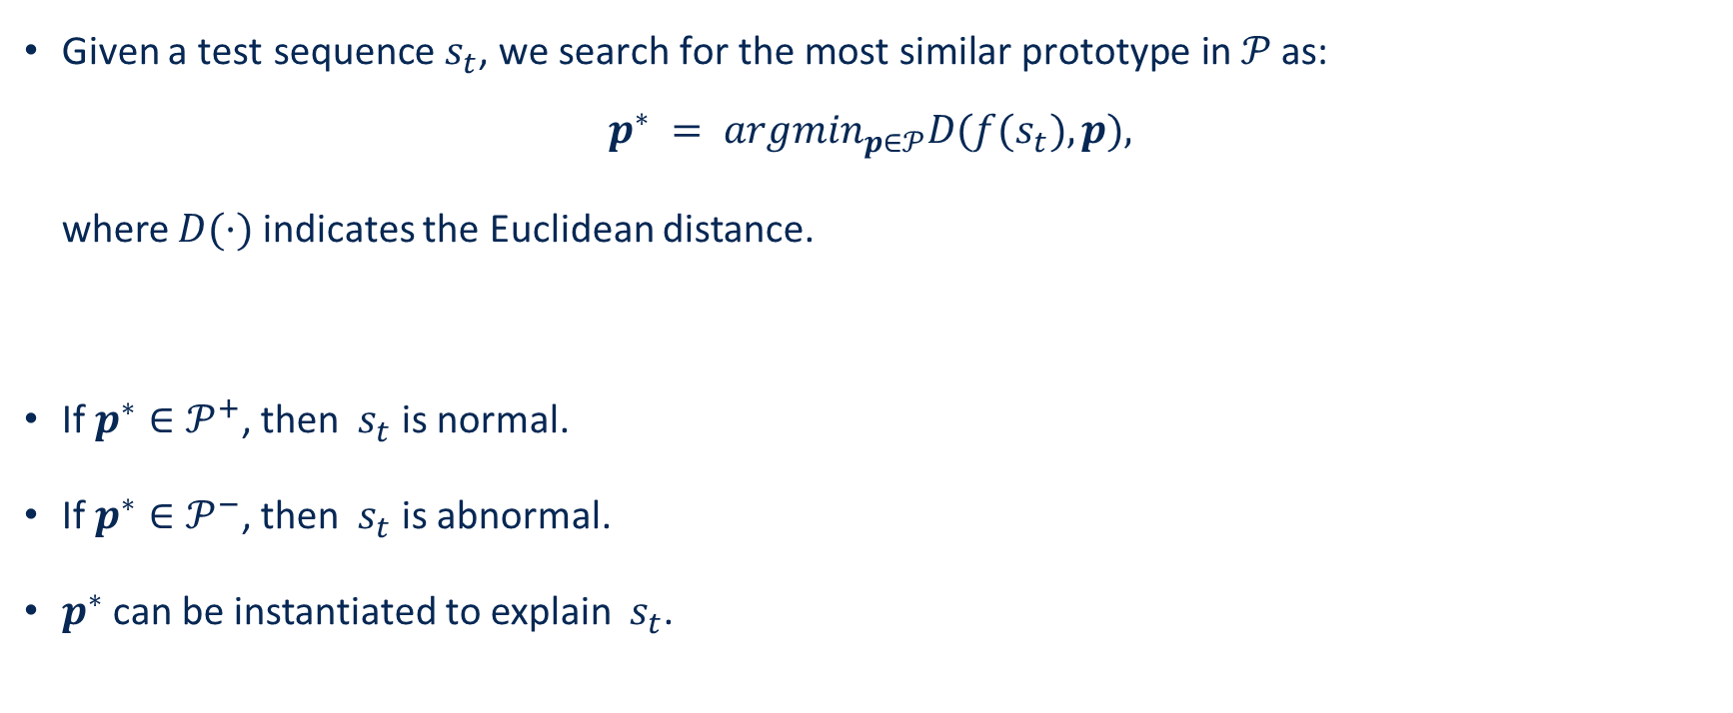
Abnormal Sequence Detection and explanation
Given a $\text{test} \text{sequence}{ s}_{t}\text{, }\text{we} \text{search} \text{for} \text{the} \text{most} \text{similar} \text{prototype} \text{in} 𝒫 \text{as}\text{: }$
$$p^{∗} = {argmin}_{p∈𝒫}D(f(s_{t}), p),$$
where $D(·)$indicates the Euclidean distance.
If $p^{∗}∈𝒫^{+}$, then ${ s}_{t}$ is normal.
If $p^{∗}∈𝒫^{−}$, then ${ s}_{t}$ is abnormal.
$p^{∗}$ can be instantiated to explain ${ s}_{t}$.

Slide 18
Experiments
Abnormal sequence detection, visualization, clustering analysis, and case study

Slide 19
Datasets
BlueGene/L (BGL) is a log dataset containing alert and non-alert log messages collected from a BlueGene/L supercomputer system at Lawrence Livermore National Labs.
Reuters is a text dataset consisting of 90 categories from 7769 training documents and 3019 testing documents.
20 Newsgroups is another text dataset containing about 18000 newsgroups posts from 20 different topics.

Slide 20
Statistics of Training set
Dataset |  | BGL | Reuters | 20 Newsgroups
Training | Normal | 100 | 200 | 200
 | Abnormal | 100 | 200 | 200
 | Unlabeled | 900 | 800 | 800
Test | Normal | 10000 | 1000 | 1000
 | Abnormal | 1000 | 200 | 200

Slide 21
Baselines (Abnormal Sequence Detection)
Isolation Forest (iForest) is an unsupervised outlier detection algorithm that recursively partitions the observations based on decision trees.
One Class Support Vector Machine (OCSVM) is a one-class novelty detection method that learns the pattern of observations and recognizes samples whose behaviors deviate from the learned pattern .
DeepSAD is a state-of-the-art semi-supervised anomaly detection approach that takes advantage of the labeled anomalies as well as the unlabeled samples to achieve good performance on anomaly detection.

Slide 22
Results (Sequential Anomaly Detection)
Dataset | Metric | iForest | OCSVM | DeepSAD | ESAD
BGL | Precision | 21.92±5.74 | 20.27±10.20 | 85.43±11.81 | 90.88±4.81
 | Recall | 49.65±13.94 | 60.05±18.50 | 97.46±2.52 | 97.49±2.05
 | F-1 score | 30.40±8.13 | 29.95±13.36 | 90.63±7.13 | 93.99±2.51
 | AUC | 57.28±7.67 | 53.47±16.37 | 97.79±1.54 | 98.24±0.96
Reuters | Precision | 41.80±2.61 | 42.67±1.91 | 76.86±8.14 | 86.03±3.28
 | Recall | 58.15±4.49 | 41.15±3.58 | 88.90±12.80 | 94.85±1.16
 | F-1 score | 48.59±2.97 | 41.85±2.55 | 82.25±9.67 | 90.19±1.89
 | AUC | 70.97±2.21 | 65.05±1.60 | 91.79±6.79 | 95.87±0.70
20 Newsgroups | Precision | 27.40±1.65 | 26.50±2.21 | 72.92±13.98 | 71.53±10.29
 | Recall | 41.30±3.03 | 35.60±3.05 | 85.35±11.18 | 87.10±5.63
 | F-1 score | 32.91±1.90 | 30.38±2.55 | 77.19±7.20 | 77.82±5.26
 | AUC | 59.69±1.42 | 57.93±1.79 | 88.91±4.11 | 89.71±1.65

Slide 23
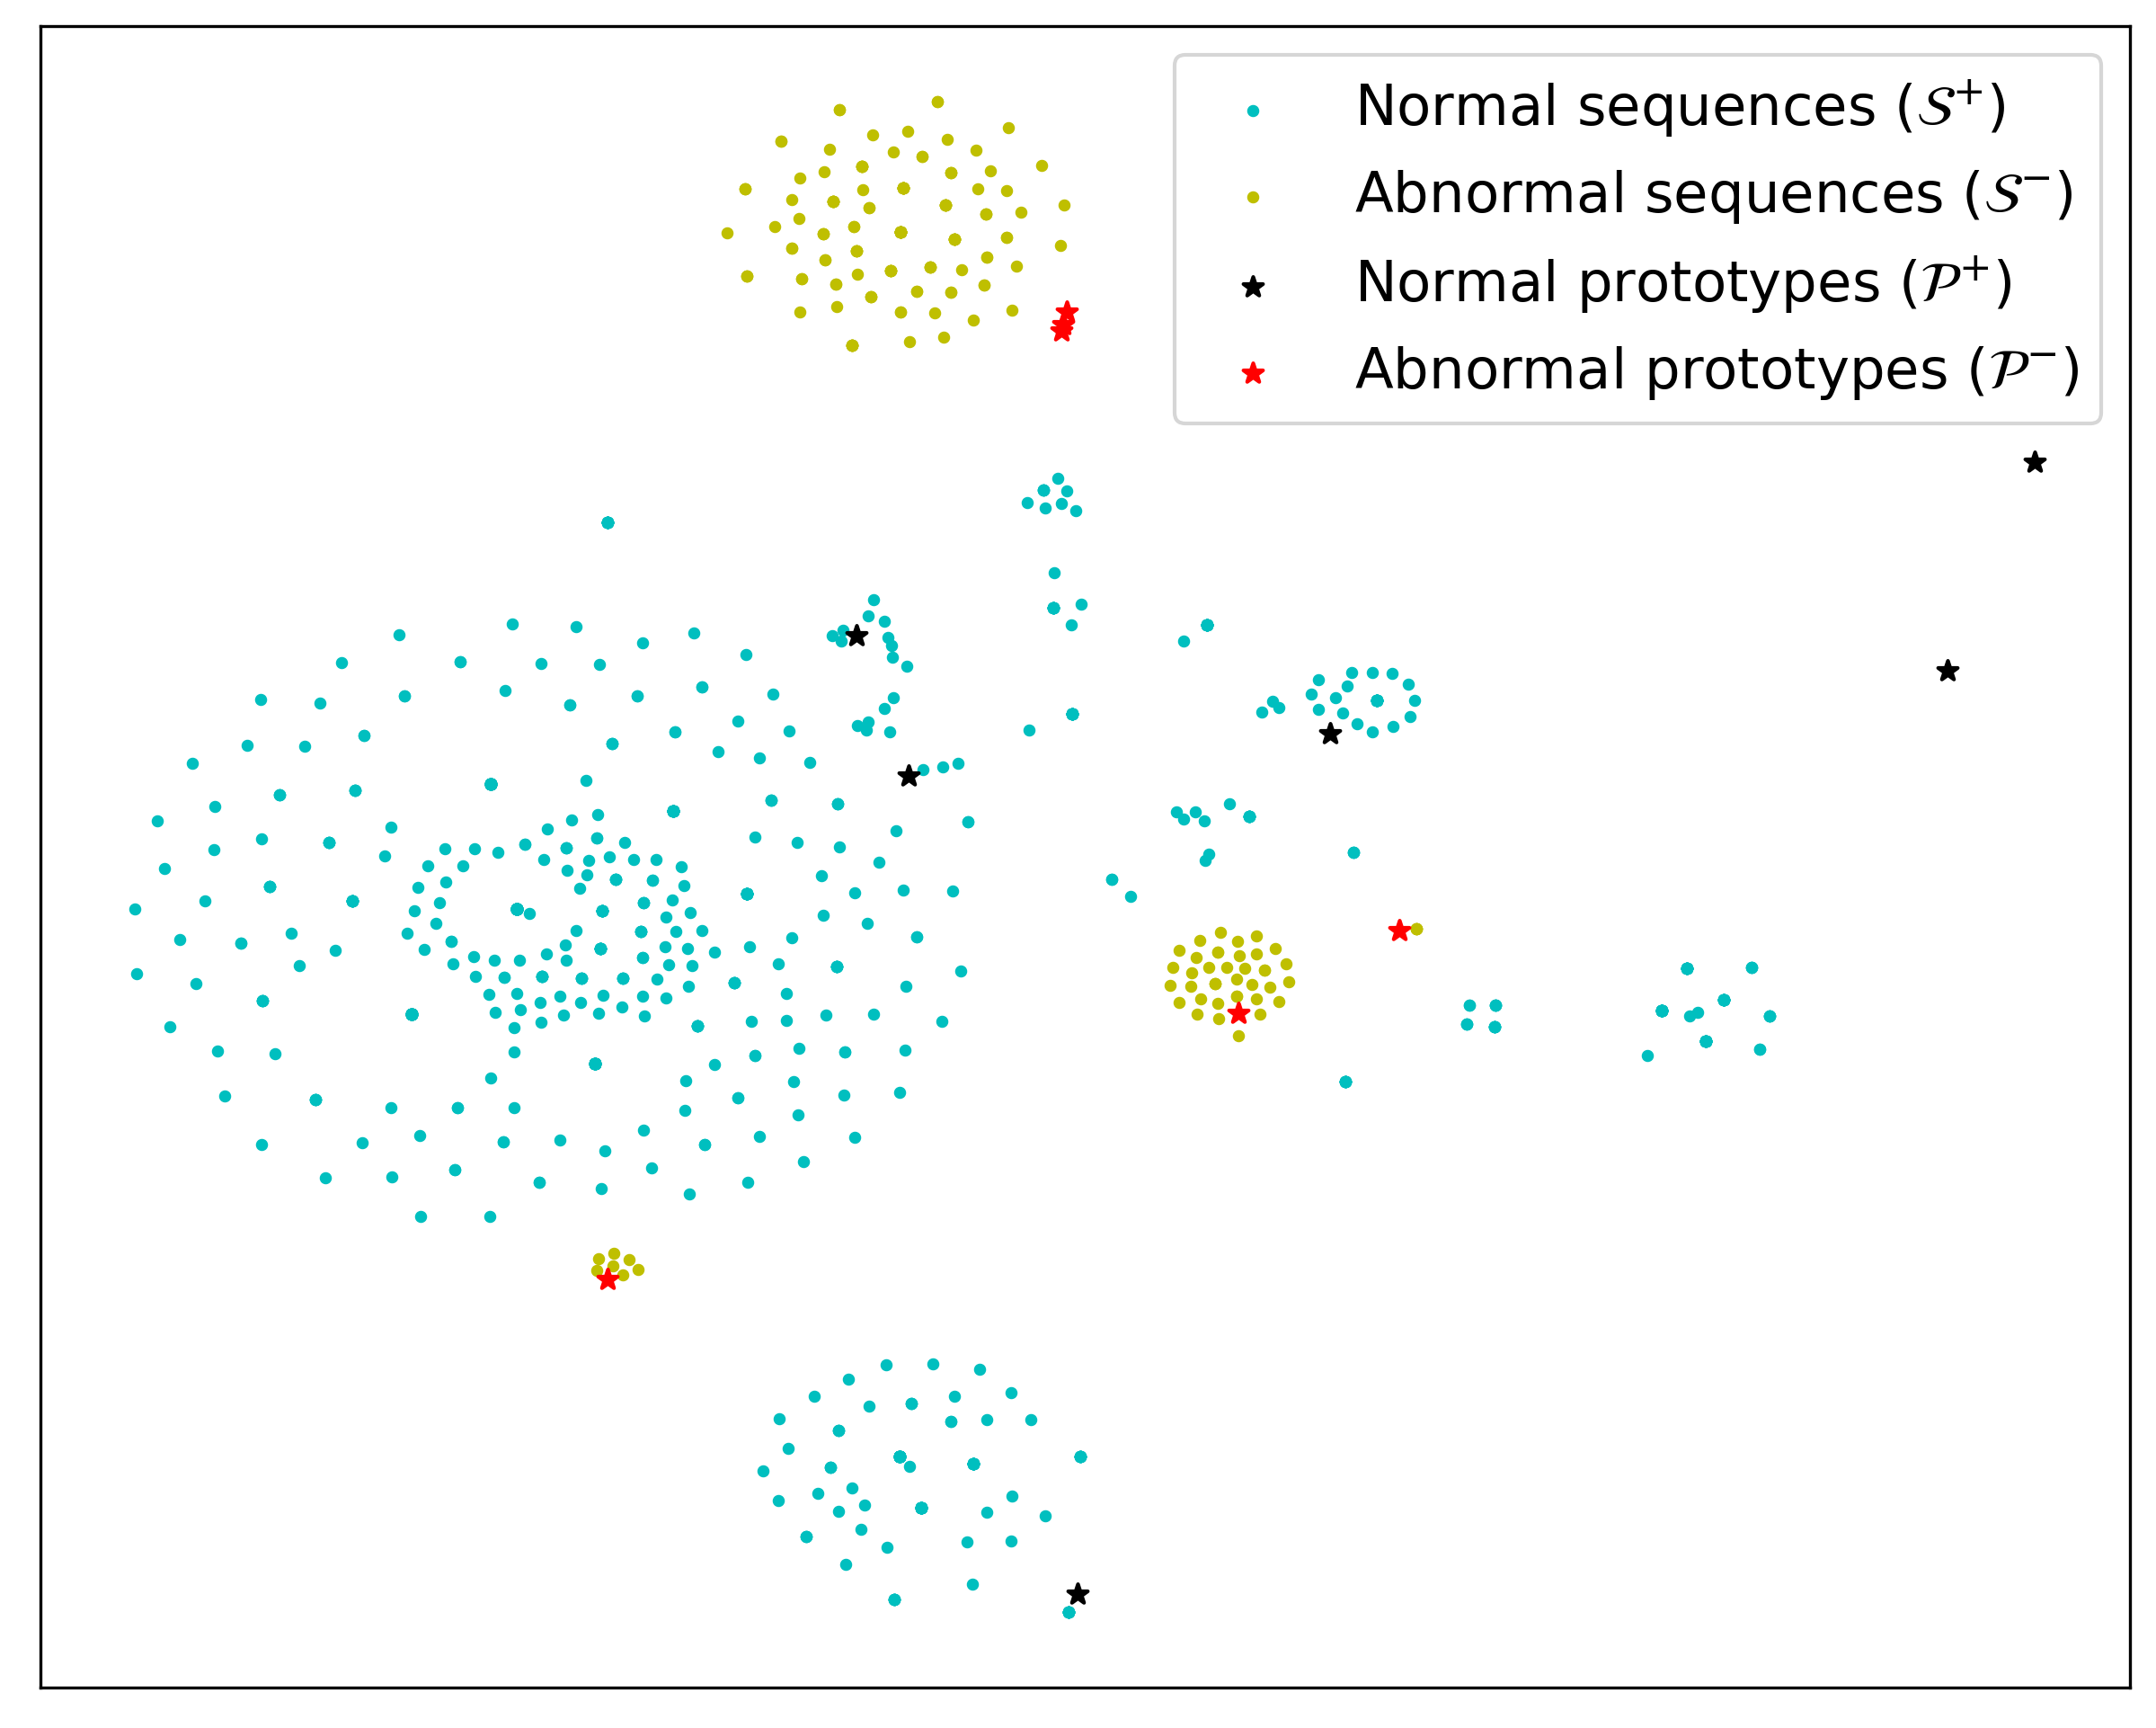
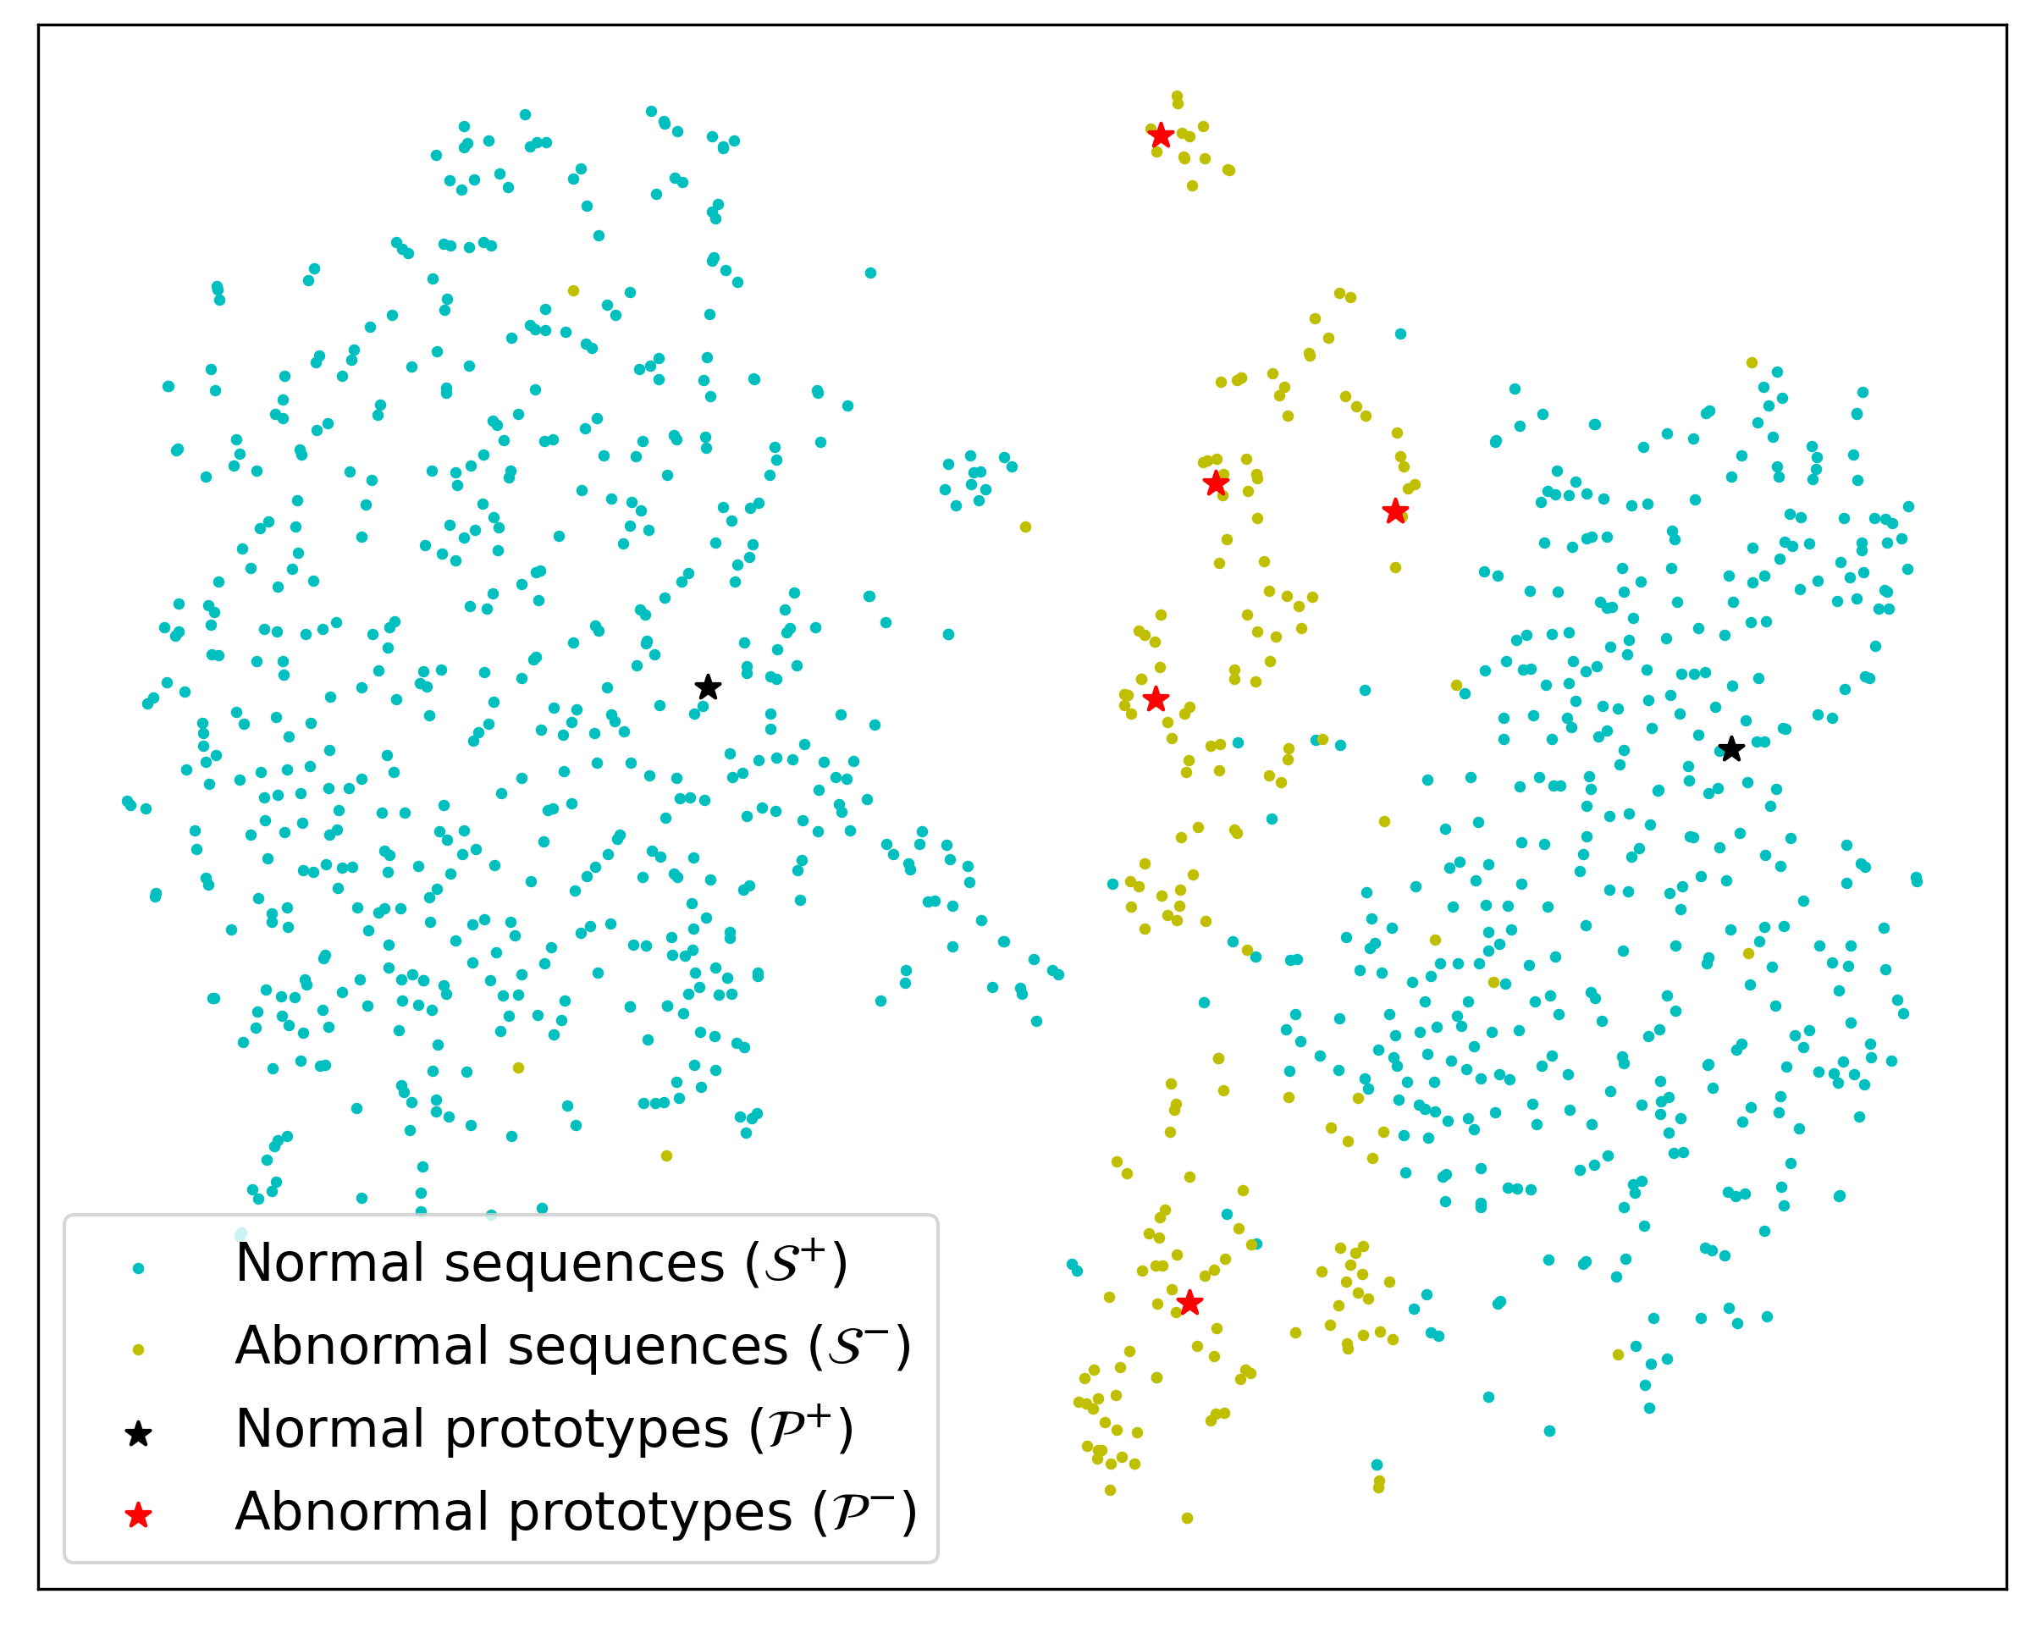
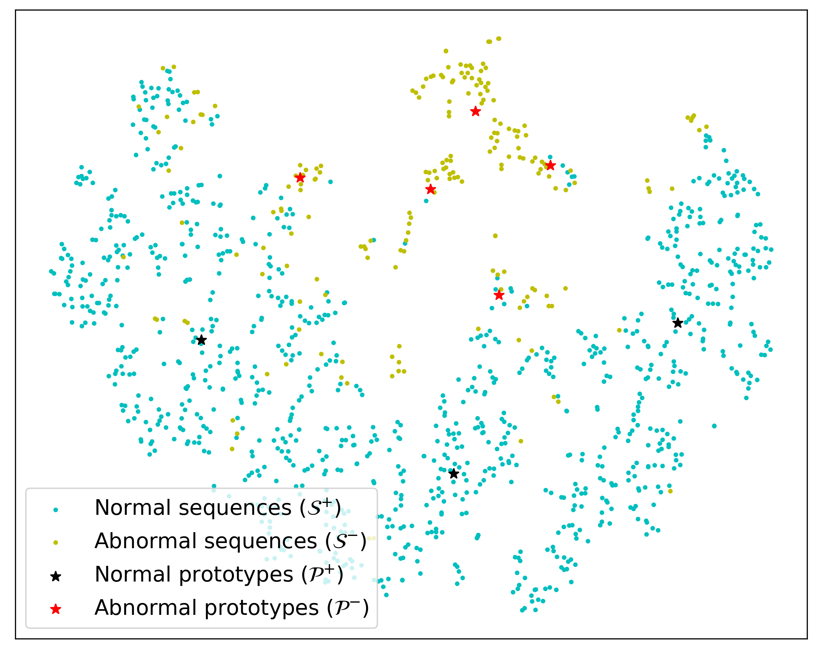
Results (Visualization)
BGL
Reuters
20 Newsgroups

Slide 24
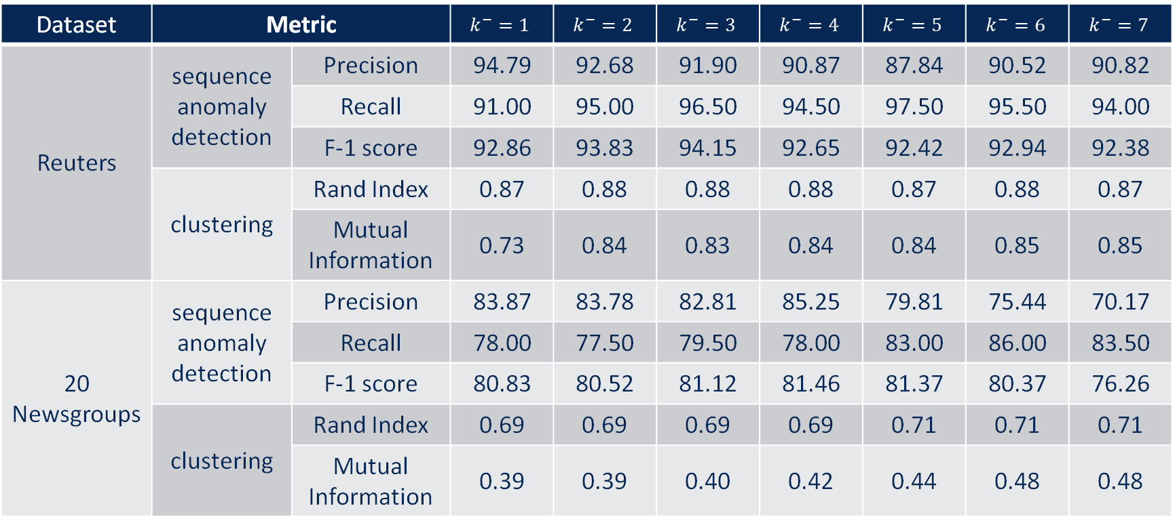
Results (Clustering Analysis)
Dataset | Metric |  | $$k^{−}=1$$ | $$k^{−}=2$$ | $$k^{−}=3$$ | $$k^{−}=4$$ | $$k^{−}=5$$ | $$k^{−}=6$$ | $$k^{−}=7$$
Reuters | sequence anomaly detection | Precision | 94.79 | 92.68 | 91.90 | 90.87 | 87.84 | 90.52 | 90.82
 |  | Recall | 91.00 | 95.00 | 96.50 | 94.50 | 97.50 | 95.50 | 94.00
 |  | F-1 score | 92.86 | 93.83 | 94.15 | 92.65 | 92.42 | 92.94 | 92.38
 | clustering | Rand Index | 0.87 | 0.88 | 0.88 | 0.88 | 0.87 | 0.88 | 0.87
 |  | Mutual Information | 0.73 | 0.84 | 0.83 | 0.84 | 0.84 | 0.85 | 0.85
20 Newsgroups | sequence anomaly detection | Precision | 83.87 | 83.78 | 82.81 | 85.25 | 79.81 | 75.44 | 70.17
 |  | Recall | 78.00 | 77.50 | 79.50 | 78.00 | 83.00 | 86.00 | 83.50
 |  | F-1 score | 80.83 | 80.52 | 81.12 | 81.46 | 81.37 | 80.37 | 76.26
 | clustering | Rand Index | 0.69 | 0.69 | 0.69 | 0.69 | 0.71 | 0.71 | 0.71
 |  | Mutual Information | 0.39 | 0.39 | 0.40 | 0.42 | 0.44 | 0.48 | 0.48

Slide 25
Results (Case Study)
Reuters
Query I | U.K. MONEY MARKET GIVEN FURTHER 166 MLN STG HELP The Bank of England said it provided the market with further help totalling 166 mln stg . . .
Prototype | U.K. MONEY MARKET RECEIVES 205 MLN STG LATE HELP The Bank of England said it has provided around 205 mln stg late assistance to the market . . .
Query II | SRI LANKA GETS USDA APPROVAL FOR WHEAT PRICE Food Department officials said the U.S. Department of Agriculture approved the Continental Grain Co sale of 52,500 tonnes of soft wheat at 89 U.S. Dlrs a tonne C and F from Pacific Northwest to Colombo . . .
Prototype | CHINA BUYS U.S. HARD AND SOFT WHEAT Private exporters said China bought a total of 550,000 tonnes of U.S. wheat under the export enhancement program U.S. Department of Agriculture of the subsidies still awaited ...

Slide 26
Results (Case Study)
20 Newsgroups
Query I | They beat Ford to the market with the Camaro/Firebird, but really only in words. Production of these vehicles will be limited until the end of the year, keeping selling prices above MSRP for the most part since there are so many twitching Camaro fans out there . . .
Prototype | On BOTH cars, the rubber seals around the window and door fell off. . . . The panel gaps were large and non-uniform between the 2 cars I saw - the kind of thing you expect and accept on a Mustang, but not from Chrysler’s savior . . .
Query II | Public revelation, which is the basis of Catholic doctrine, ended with the death of St John, the last Apostle. Nothing new can be added. Every so often, the Pope declares that some departed Christian is now in Heaven, and may be invoked in the public rites of the Church . . .
Prototype | If it were a sin to violate Sunday no one could ever be forgiven for that for Jesus never kept Sunday holy. He only recognized one day of the seven as holy. Jesus also recognized other holy days, like the Passover. Acts 15 says that no more should be layed on the Gentiles than . . .

Slide 27
Conclusion

Slide 28
Conclusion
We have developed ESAD, a sequential anomaly detection framework that can identify diverse anomalies in sequential data based on contrastive learning and clustering technique.
ESAD can learn diverse prototypes for normal and abnormal sequences.
ESAD can detect and explain abnormal sequences using learned prototypes.

Slide 29
Q&A
Email: he.cheng@usu.edu

