Slide 1


Sequential Anomaly Detection with Local and Global Explanations
He Cheng¹ Depeng Xu² Shuhan Yuan¹
¹Utah State University
²University of North Carolina at Charlotte
This work was supported in part by NSF 2103829

Slide 2
Introduction
Deep sequential anomaly detection, explainable anomaly detection

Slide 3
Sequential Anomaly Detection
Sequential data is ubiquitous in the real world and has various applications such as log data.
Sequential anomaly detection is critical to build robust and reliable systems.
Anomaly detection in sequential data (consisting of a set of entries) is to identify abnormal entries.

Slide 4
Deep Sequential Anomaly Detection
Deep learning-based methods outperform traditional methods.
Deep sequential anomaly detection methods are black-box models.
Detecting anomalies without explanations is not trustworthy.

Slide 5
Detecting Anomalies with Explanations
Explanations for anomalies can be conducted at global level and local level.
Global explanation generalize the abnormal patterns over the whole dataset.
Local explanation focuses on each individual sequence and aims to highlight the abnormal entries in the abnormal sequence.

Slide 6
Methodology
Globally and Locally Explainable Anomaly Detection (GLEAD)

Slide 7
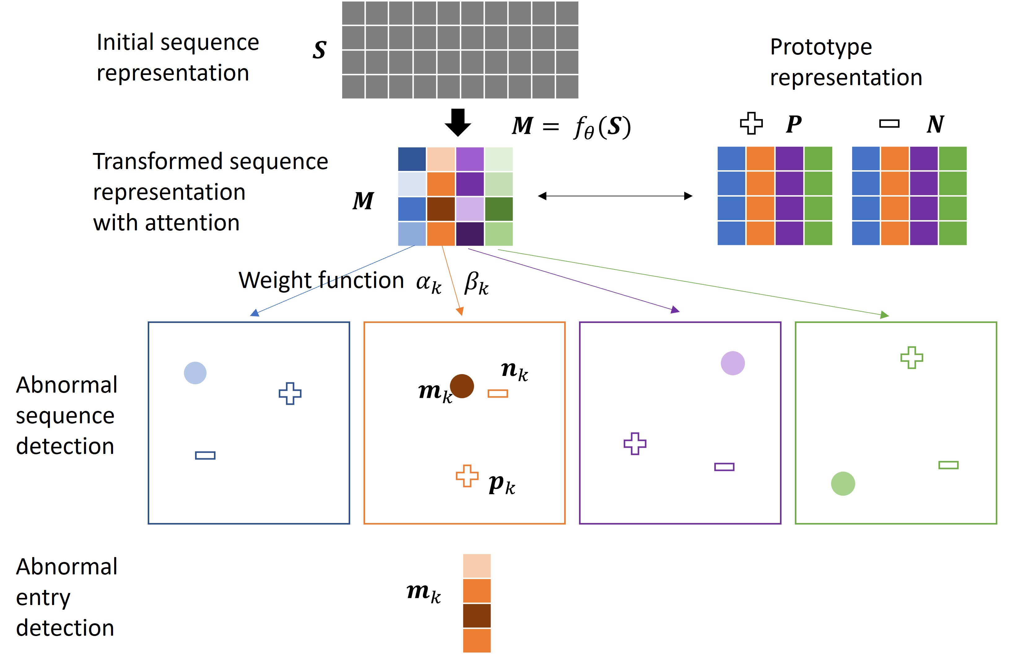
Overview
We propose a Globally and Locally Explainable Anomaly Detection (GLEAD) framework.
GLEAD adopts the multi-head self-attention technique.
GLEAD can identify abnormal entries from an abnormal sequence.
GLEAD can capture the different normal and abnormal patterns over the whole dataset.

Slide 8
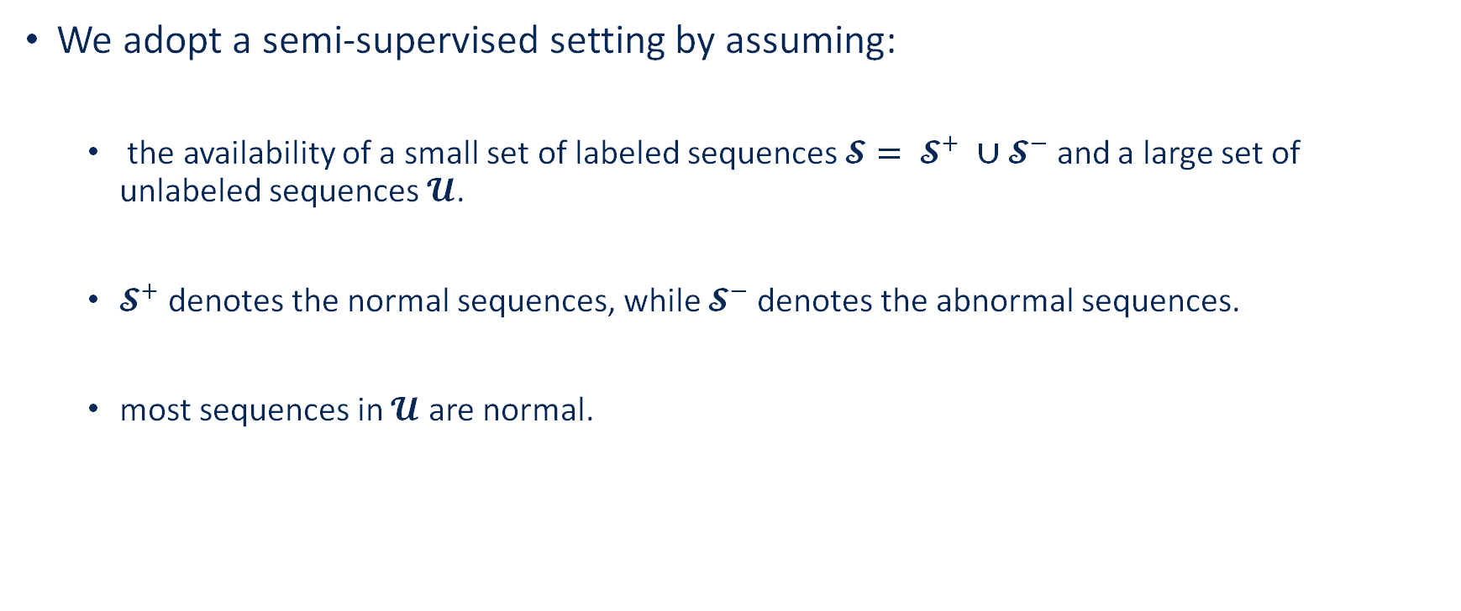
Setup
We adopt a semi-supervised setting by assuming:
the availability of a small set of labeled sequences $\text{𝓢}= {\text{𝓢}}^{+} ∪{\text{𝓢}}^{−}$ and a large set of unlabeled sequences$\text{𝓤}$.
${\text{𝓢}}^{+}$ denotes the normal sequences, while ${\text{𝓢}}^{−}$denotes the abnormal sequences.
most sequences in $\text{𝓤}$ are normal.

Slide 9



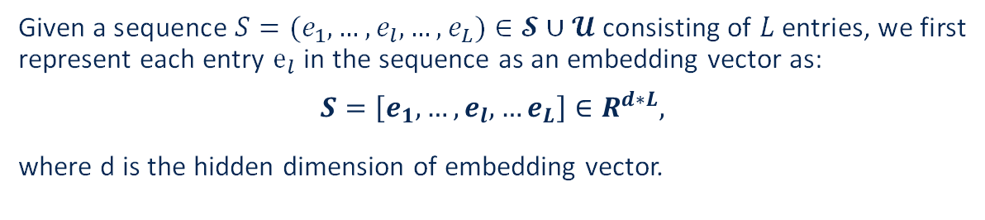

Initial Sequence Representation
Given a sequence $S=(e_{1}, …,e_{l},…,e_{L})∈\text{𝓢}∪\text{𝓤}$ consisting of $L$ entries, we first represent each entry $e_{l}$ in the sequence as an embedding vector as:
$$S=\left[e_{1},…,e_{l},…e_{L}\right]∈R^{d∗L},$$
where d is the hidden dimension of embedding vector.
initial sequence representation
original sequence
$$d$$
$$L$$
$S=(e_{1}, …,e_{l},…,e_{L})$ $∈R^{1∗L}$
$$L$$
$S=\left[e_{1},…,e_{l},…e_{L}\right]$ $∈R^{d∗L}$

Slide 10





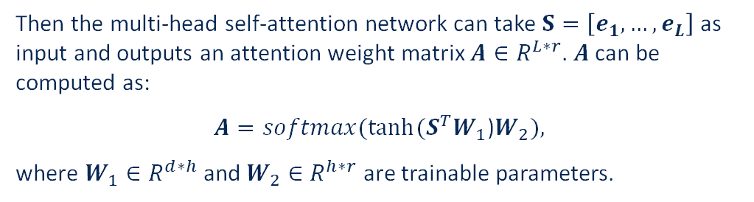


Transformed Sequence Representation
Then the multi-head self-attention network can take $S=\left[e_{1},…,e_{L}\right]$ as input and outputs an attention weight matrix $A∈R^{L∗r}$. $A$can be computed as:
$A=softmax(tanh⁡(S^{T}W_{1}$)$W_{2}),$
where $W_{1}∈R^{d∗h}$ and $W_{2}∈$ $R^{h∗r}$ are trainable parameters.
Sum up to 1
T
.
.
$$=⁡⁡$$
$$softmax⁡⁡$$
tanh$⁡⁡$
$${A∈R}^{L∗r}$$
$${S∈R}^{d∗L}$$
$${W_{1}∈R}^{d∗h}$$
$${W_{2}∈R}^{h∗r}$$

Slide 11


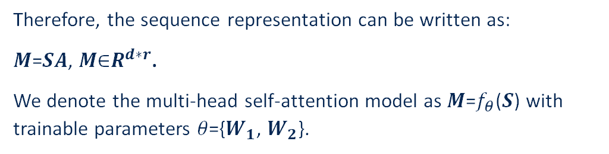


Transformed Sequence Representation
Therefore, the sequence representation can be written as:
𝑴=𝑺𝑨, 𝑴∈$R^{d∗r}$.
We denote the multi-head self-attention model as 𝑴=$f_{θ}$(𝑺) with trainable parameters 𝜃={$W_{1}$, $W_{2}$}.
one sequence representation
initial sequence representation
a group of attention weight
.
$$=⁡⁡$$
$${M∈R}^{d∗r}$$
$${S∈R}^{d∗L}$$
$${A∈R}^{L∗r}$$

Slide 12



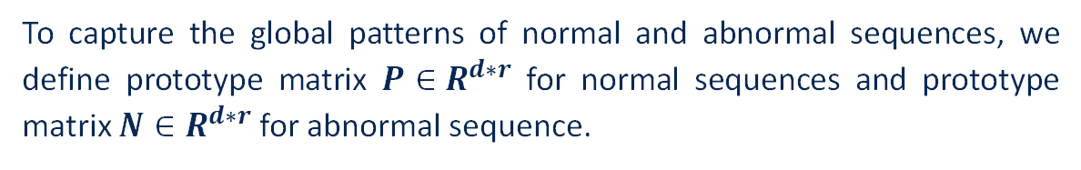


Prototype Matrices
To capture the global patterns of normal and abnormal sequences, we define prototype matrix $P∈R^{d∗r}$ for normal sequences and prototype matrix $N∈R^{d∗r}$ for abnormal sequence.
prototype vectors
capture one abnormal pattern
$$M^{+}$$
$$M^{−}$$
$$P∈R^{d∗r}$$
$$M∈R^{d∗r}$$
$$N∈R^{d∗r}$$

Slide 13
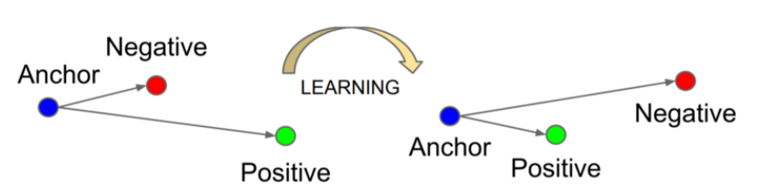
Objective Functions
Weighted triplet loss
Background: Triplet loss
The triplet loss minimizes the distance from an anchor to a positive sample and maximizes the distance from the anchor to a negative sample:
$$L(a,p,n)=max⁡\{d(a_{i},p_{i}​)−d(a_{i}​,n_{i}​)+margin,0\}$$

Slide 14

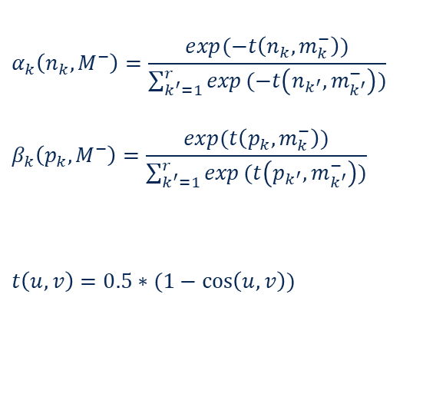

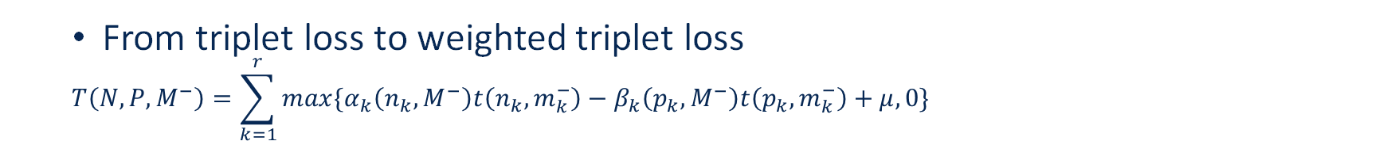





Objective Functions
From triplet loss to weighted triplet loss
$$T\left(N,P,M^{−}\right)=\sum_{k=1}^{r}{max\{α_{k}\left(n_{k},M^{−}\right)t\left(n_{k},m_{k}^{−}\right)−β_{k}\left(p_{k},M^{−}\right)t\left(p_{k},m_{k}^{−}\right)+μ,0\}}$$
lower t value -> lower weight
lower t value -> higher weight
$$α_{k}\left(n_{k},M^{−}\right)=\frac{exp(−t\left(n_{k},m_{k}^{−}\right))}{\sum_{k^{′}=1}^{r}{exp}(−t\left(n_{k^{′}},m_{k^{′}}^{−}\right))}$$
$$β_{k}\left(p_{k},M^{−}\right)=\frac{exp(t\left(p_{k},m_{k}^{−}\right))}{\sum_{k^{′}=1}^{r}{exp}(t\left(p_{k^{′}},m_{k^{′}}^{−}\right))}$$
$$t\left(u,v\right)=0.5∗(1−\cos\left(u,v\right))$$
$$t(m_{1}^{−},p_{1})$$
$$t(m_{3}^{−},p_{3})$$
$$t(m_{1}^{−},n_{1})$$
$$t(m_{3}^{−},n_{3})$$
dissimilar
similar
$$P∈R^{d∗r}$$
$$M^{−}∈R^{d∗r}$$
$$N∈R^{d∗r}$$
maximize
minimize

Slide 15
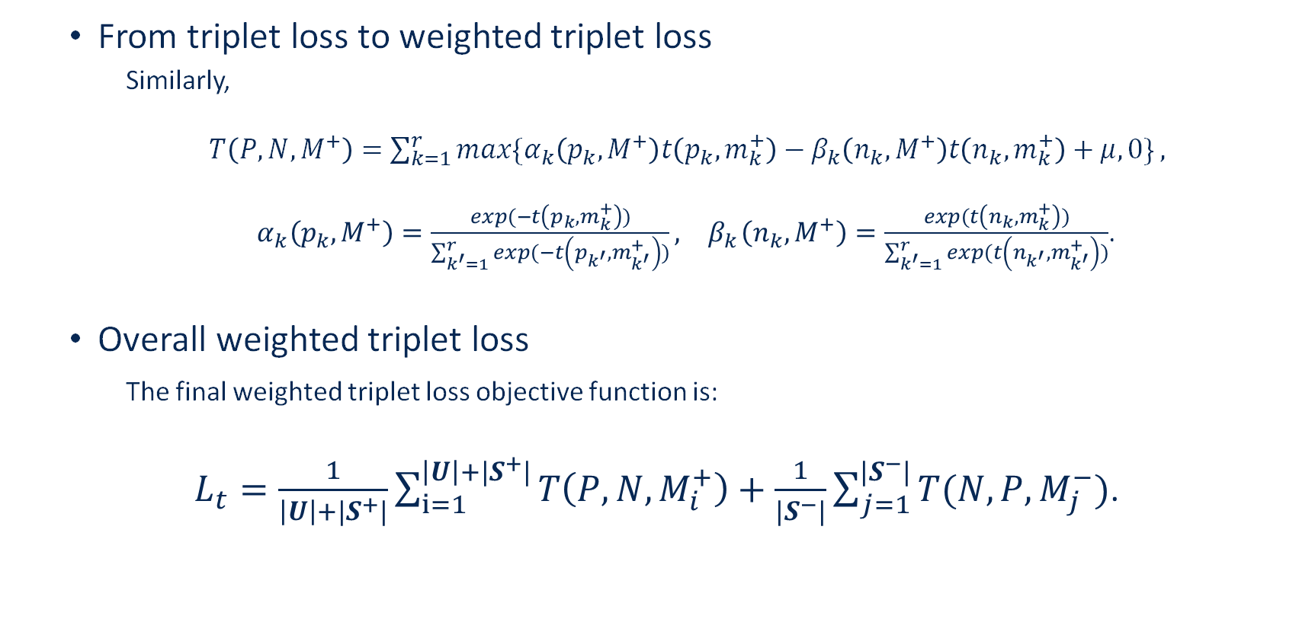
Objective Functions
From triplet loss to weighted triplet loss
Similarly,
$T\left(P,N,M^{+}\right)=\sum_{k=1}^{r}{max\{α_{k}\left(p_{k},M^{+}\right)t\left(p_{k},m_{k}^{+}\right)−β_{k}\left(n_{k},M^{+}\right)t\left(n_{k},m_{k}^{+}\right)+μ,0\}},$
$α_{k}\left(p_{k},M^{+}\right)=\frac{exp⁡(−t\left(p_{k},m_{k}^{+}\right))}{\sum_{k^{′}=1}^{r}{exp}(−t\left(p_{k^{′}},m_{k^{′}}^{+}\right))}, { β}_{k}\left(n_{k},M^{+}\right)=\frac{exp⁡(t\left(n_{k},m_{k}^{+}\right))}{\sum_{k^{′}=1}^{r}{exp}(t\left(n_{k^{′}},m_{k^{′}}^{+}\right))}$.
Overall weighted triplet loss
The final weighted triplet loss objective function is:
$L_{t}=\frac{1}{\left|U\right|+|S^{+}|}\sum_{i=1}^{\left|U\right|+|S^{+}|}{T\left(P,N,M_{i}^{+}\right)+\frac{1}{|S^{−}|}\sum_{j=1}^{|S^{−}|}{T(N,P,}M_{j}^{−})}$.

Slide 16
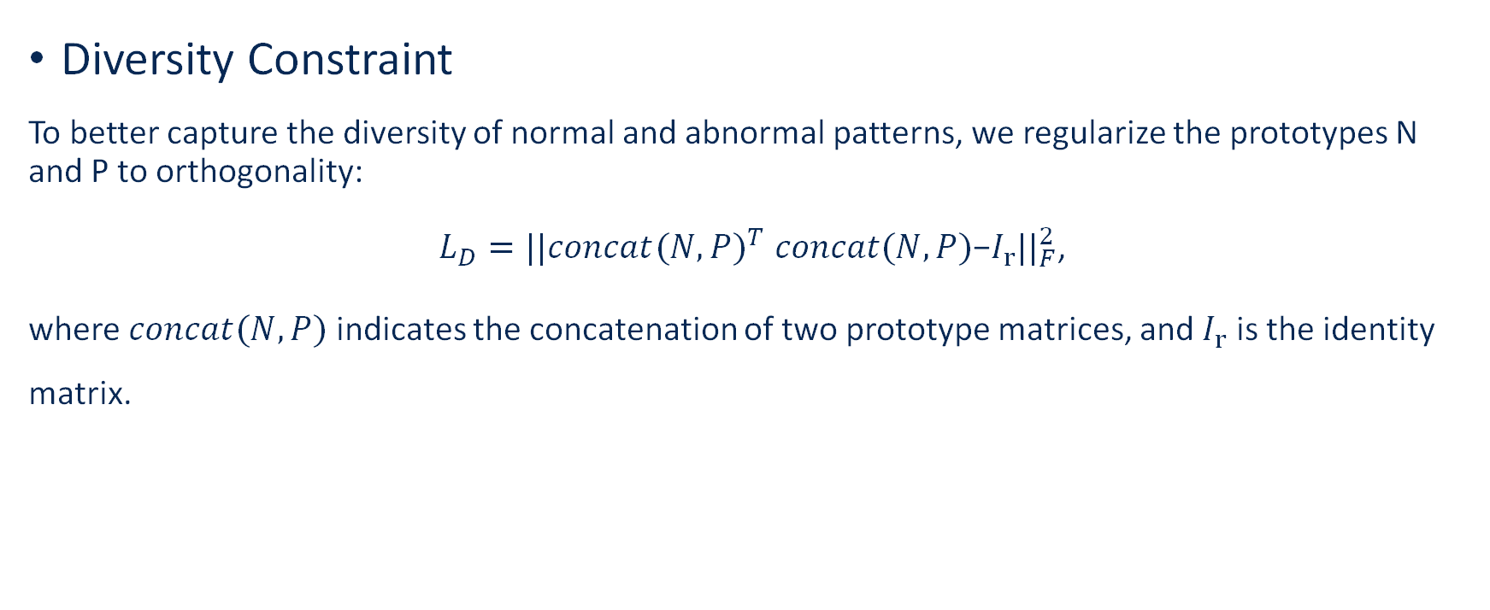
Training Objectives
Diversity Constraint
To better capture the diversity of normal and abnormal patterns, we regularize the prototypes N and P to orthogonality:
$L_{D}=||{{concat(N,P)}^{T} concat(N,P)\text{−}I_{r}||}_{F}^{2}$,
where $concat(N,P)$indicates the concatenation of two prototype matrices, and $I_{r}$ is the identity matrix.

Slide 17

Training Objectives
Overall training objective
By combining the weighted triplet loss and diversity constraint, our overall objective can be written as:
$L=L_{t}+λ∗L_{D}$,
where $λ$is a hyperparameter.

Slide 18

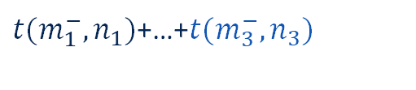
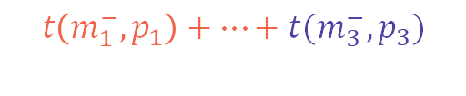
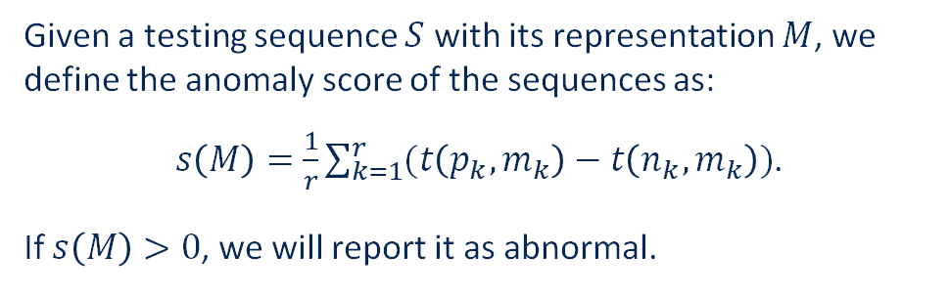

Abnormal Sequence Detection
Given a testing sequence $S$ with its representation $M$, we define the anomaly score of the sequences as:
$s\left(M\right)=\frac{1}{r}\sum_{k=1}^{r}{(t\left(p_{k},m_{k}\right)−t\left(n_{k},m_{k}\right))}$.
If $s\left(M\right)>0$, we will report it as abnormal.
$$t\left(m_{1}^{−},p_{1}\right)+…+t(m_{3}^{−},p_{3})$$
$t(m_{1}^{−},n_{1})$+…+$t(m_{3}^{−},n_{3})$
compare
similar?
similar?
$$P∈R^{d∗r}$$
$$M∈R^{d∗r}$$
$$N∈R^{d∗r}$$

Slide 19
Explanation
Our model can provide local and global explanations.
(Abnormal Entry Detection) Local explanation focuses on selecting abnormal entries from sequences.
Global explanation aims to capture general normal and abnormal patterns over the whole dataset.

Slide 20

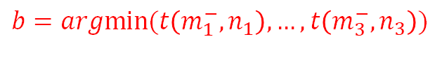

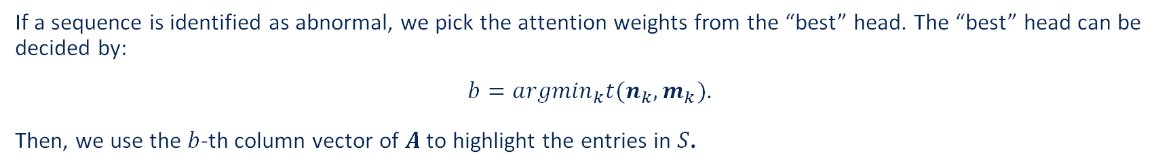

Local Explanation/Abnormal Entry Detection
If a sequence is identified as abnormal, we pick the attention weights from the “best” head. The “best” head can be decided by:
$b={argmin}_{k}t(n_{k},m_{k})$.
Then, we use the $b$-th column vector of $A$ to highlight the entries in $S$.
$$b=argmin⁡⁡(t\left(m_{1}^{−},n_{1}\right),…, t\left(m_{3}^{−},n_{3}\right))$$
$b$-th column
$b$-th column
abnormal entries
$$M∈R^{d∗r}$$
$$N∈R^{d∗r}$$
$${A∈R}^{L∗r}$$
$$a_{b}{∈R}^{1∗L}$$
original sequence

Slide 21



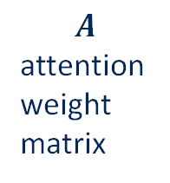
Global Explanation
Abnormal sequences share the same “best” head index can be clustered together.
$$A$$
attention weight matrix
sequences
sequences closest to $n_{1}$
sequences closest to $n_{2}$
sequences closest to $n_{3}$

Slide 22

Global Explanation
Global explanation aims to not only group abnormal sequences but learn their abnormal patterns.
Given all abnormal sequences closest to $n_{k}$, we pick top-$z$ entries with the highest attention weights in $a_{k}$. By combining these entries, we can derive a list of the high-frequency entries with high attention weights, which decodes the hidden pattern of abnormal sequences in $n_{k}$.

Slide 23
Experiments
Abnormal sequence detection, local and Global Explanations

Slide 24
Datasets
BlueGene/L (BGL) is a dataset of logs collected from a BlueGene/L supercomputer system at Lawrence Livermore National Labs (LLNL). This log dataset includes alert and non-alert messages as well as their alert category tags.
Thunderbird is a dataset of logs collected from a Thunderbird supercomputer system. This log dataset also includes alert messages, non-alert messages, and their alert category tags.

Slide 25
Statistics of Training set
Dataset |  | BGL | Thunderbird
Training | Normal | 20 | 20
 | Abnormal | 20 | 20
 | Unlabeled | 2000 | 2000
Validation | Normal | 200 | 200
 | Abnormal | 20 | 20
Test | Normal | 20000 | 20000
 | Abnormal | 2000 | 2000

Slide 26
Baselines (Abnormal Sequence Detection)
Isolation Forest (iForest) is an unsupervised anomaly detection algorithm that is built using decision trees.
One Class Support Vector Machine (OCSVM) is a one-class novelty detection algorithm that focuses on learning the pattern of known normal data samples.
LSTM with Attention (LSTM-Attention). We train an LSTM model with an attention layer using labeled sequences in a supervised manner.
DeepSAD is a semi-supervised anomaly detection method that leverages both labeled and unlabeled samples to improve the performance of anomaly detection.

Slide 27
Results (Abnormal Sequence Detection)
Dataset | Metric | iForest | OCSVM | LSTM-Attention | DeepSAD | GLEAD
BGL | Precision | 31.09±6.63 | 24.68±13.35 | 75.00±28.52 | 99.28±0.45 | 97.86±2.67
 | Recall | 77.84±11.62 | 94.44±0.60 | 93.21±1.47 | 93.87±4.20 | 94.08±2.99
 | F-1 score | 44.30±8.52 | 37.44±16.91 | 79.52±22.64 | 96.45±2.26 | 95.91±2.39
 | AUC | 80.03±7.08 | 75.42±16.00 | 92.87±6.12 | 96.90±2.10 | 96.93±1.55
Thunderbird | Precision | 12.69±6.22 | 8.79±0.08 | 53.16±19.11 | 97.31±2.47 | 96.96±1.01
 | Recall | 36.59±18.5 | 76.58±1.35 | 82.46±23.58 | 91.81±5.92 | 97.83±2.27
 | F-1 score | 18.84±9.3 | 15.77±0.15 | 63.17±20.02 | 94.36±3.17 | 97.38±1.11
 | AUC | 55.95±9.58 | 48.56±0.40 | 87.15±11.91 | 95.77±2.92 | 98.76±1.12

Slide 28
Baselines (Abnormal Entry Detection)
iForest and OCSVM. We use iForest and OCSVM for abnormal entry detection. The input to both models for abnormal entry detection is the count vector derived from the log message, where each dimension indicates a unique word, and the value indicates the word frequency.
LSTM-Attention. After training the LSTM with the attention model, we also use the attention weights to predict abnormal entries.
Shapley is widely used to explain individual predictions. Shapley values are calculated as contributions that features make for predictions. As a post-hoc explanation model, we train an LSTM for sequential anomaly detection and use Shapley to identify abnormal entries.

Slide 29
Results (Abnormal Entry Detection)
Dataset | Metric | iForest | OCSVM | LSTM-Attention | Shapley | GLEAD
BGL | Precision | 18.39±6.48 | 21.66±0.55 | 75.50±27.85 | 98.24±1.13 | 97.62±2.96
 | Recall | 75.33±28.33 | 99.19±0.57 | 76.89±2.10 | 89.87±4.66 | 96.71±1.90
 | F-1 score | 29.55±10.52 | 35.56±0.74 | 72.98±19.48 | 93.79±2.26 | 97.14±1.96
 | AUC | 71.36±14.16 | 81.65±0.61 | 85.72±5.29 | 94.86±2.29 | 98.25±0.99
Thunderbird | Precision | 79.87±42.09 | 16.21±1.42 | 10.46±6.14 | 37.92±12.04 | 98.06±1.20
 | Recall | 79.92±42.12 | 100.00±0.02 | 26.26±19.13 | 83.92±16.32 | 98.71±1.32
 | F-1 score | 79.89±42.11 | 27.88±2.09 | 14.42±9.16 | 51.62±12.87 | 98.37±0.54
 | AUC | 89.90±21.17 | 73.96±2.61 | 61.77±9.37 | 91.09±8.18 | 99.34±0.66

Slide 30
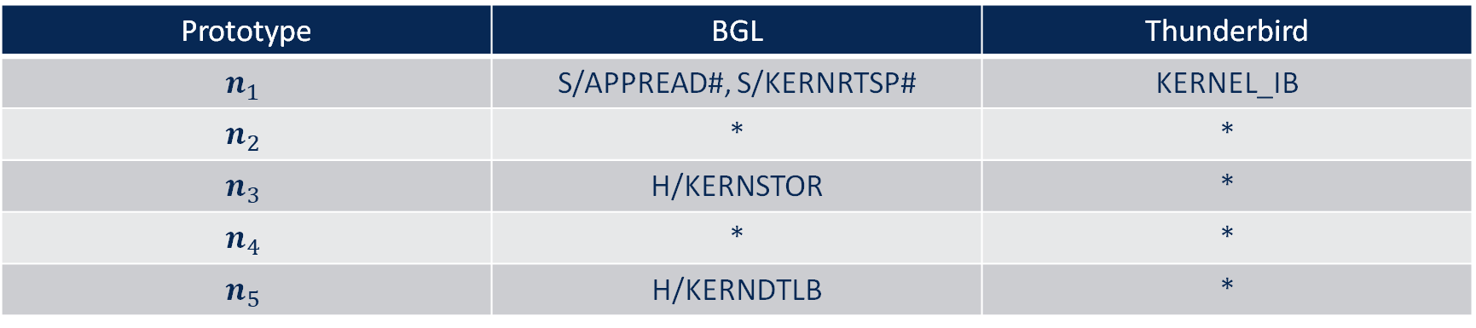
Global Explanation
Dataset | Representative abnormal entries for each abnormal type
BGL | H/KERNDTLB: data TLB error interrupt
 | H/KERNSTOR: data storage interrupt
 | S/APPREAD#: ciod: failed to read message prefix on control stream
 | S/KERNRTSP#: rts panic! - stopping execution
Thunderbird | KERNEL_IB: Fatal error (Local Catastrophic Error)
Prototype | BGL | Thunderbird
$$n_{1}$$ | S/APPREAD#, S/KERNRTSP# | KERNEL_IB
$$n_{2}$$ | * | *
$$n_{3}$$ | H/KERNSTOR | *
$$n_{4}$$ | * | *
$$n_{5}$$ | H/KERNDTLB | *

Slide 31
Conclusion

Slide 32
Conclusion
We have developed GLEAD, a sequential anomaly detection model that can achieve local and global explanations in a semi-supervised setting.
The local explanation, which aims to detect abnormal entries in the abnormal sequences.
Two prototype matrices are developed to encode the global patterns of normal and abnormal sequences.

Slide 33
Q&A
Email: he.cheng@usu.edu

