Slide 1
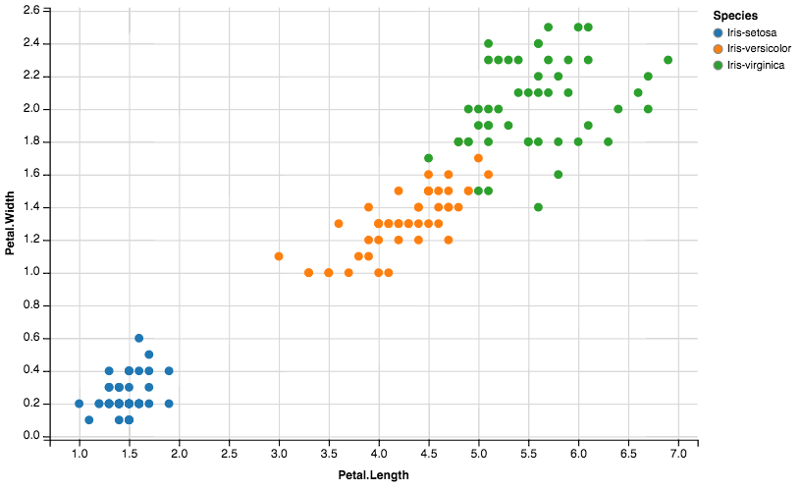
1. Three plant species from the Iris family, Iris setosa, Iris versicolor and Iris virginica, can be distinguished by the petal length and petal width.
Write a function that, when given a petal length and width, predicts the Iris species.
Example:
predict(1.4, 0.2)
>>> ‘Iris setosa

Slide 2
1. Three plant species from the Iris family, Iris setosa, Iris versicolor and Iris virginica, can be distinguished by the petal length and petal width.

Slide 3
1. Three plant species from the Iris family, Iris setosa, Iris versicolor and Iris virginica, can be distinguished by the petal length and petal width.
def predict(length, width):
prediction = ''
if 0.8>width>0:
if 2>length>0.9:
prediction +='Iris setosa '
if 1.8>width>0.8:
if 5.5>length>2.5:
prediction +='Iris versicolor '
if 2.6>width>1.2:
if 7>length>4:
prediction +='Iris virginica'
return prediction

Slide 4
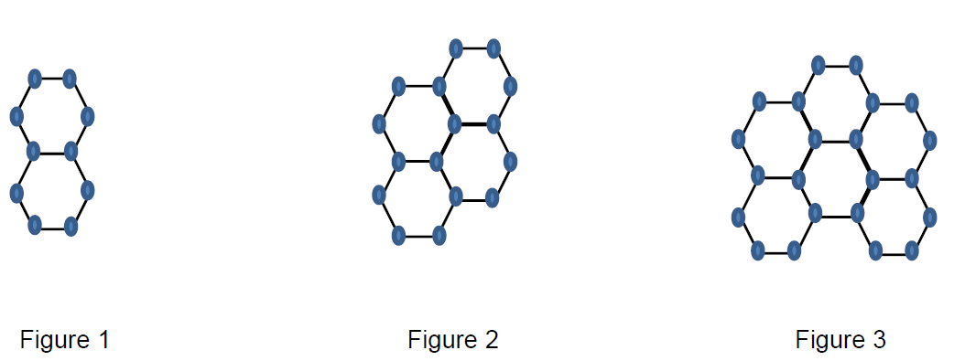
2. Study the dot number in these figures to arrive at a general expression of the dot number. For example, how many dots would Figure 30 contain? Write a function that accepts the figure number and returns the number of dots.

Slide 5
2. Study the dot number in these figures to arrive at a general expression of the dot number. For example, how many dots would Figure 30 contain? Write a function that accepts the figure number and returns the number of dots.
Figure | Number of dots | Pattern
1 | 10 | -
2 | 16 | 10 + 6
3 | 22 | 10 + 6 + 6
4 | 28 | 10 + 6 + 6 + 6
… | .. | …
General expression: 10 + (n - 1) * 6

Slide 6
2. Study the dot number in these figures to arrive at a general expression of the dot number. For example, how many dots would Figure 30 contain? Write a function that accepts the figure number and returns the number of dots.
Figure | Number of dots | Pattern
1 | 10 | -
2 | 16 | 10 + 6
3 | 22 | 10 + 6 + 6
4 | 28 | 10 + 6 + 6 + 6
… | .. | …
General expression: 10 + (n - 1) * 6
def dotNum(figure):
return(10 + (figure - 1) * 6)

