Slide 1
Pies required today… Please take one on your way to your seat ☺
Please sit in your project groups. You should have one by now.

Slide 2
A quick summary on key concepts

Slide 3
What are the die-die must know things?
Notes:
Pseudocode
Flowcharts
The concept of an algorithm

Slide 4
What are the die-die must know things?
Boolean data types --- only 2 outcomes (True or False)
Relational operators can come in many different forms --- (equality ==, inequality !=, …)
Boolean data types can be compared and controlled using AND, NOT, OR
Flow control (for branching and looping) --- using conditional statements e.g. IF
Programming Statements
Commenting (using # in python)
Dealing with interpreter error messages
Basic Python syntax
The use of indentation and colon to mark out blocks of code controlled by some conditional statement
Nesting
Some Python quirks (e.g. the input into command line is always a string first)
Notes:
Pseudocode
Flowcharts
The concept of an algorithm

Slide 5
Boolean logic
Named after George Boole
Boolean logic (aka Boolean algebra) is the branch of algebra in which the values of the variables are the truth values true and false, usually denoted 1 and 0 respectively
When 1 and 0, we only need 1 bit to represent this!

Slide 6
Boolean logic
We can explore logical relationships via
Conjunction (AND)
Disjunction (OR)
Negation (NOT)
Just as you can do things with numbers in numerical operations (plus, minus, divide).
You can also do things with Boolean variables via the operators (AND, OR, NOT)

Slide 7
Boolean logic (evaluation)
1 is equals to 1 evaluates to TRUE
1 is equals to 0 evaluates to FALSE

Slide 8
Boolean logic (negation)
1 is NOT EQUALS to 0 evaluates to TRUE
1 is NOT EQUALS to 1 evaluates to FALSE

Slide 9
Boolean logic (conjunction)
1 is equals to 1 AND 0 is equals to 0 evaluates to TRUE
0 is equals to 0 AND 1 is equals to 1 evaluates to TRUE

Slide 10
Boolean logic (conjunction)
1 is equals to 0 AND 0 is equals to 0 evaluates to FALSE
1 is equals to 0 AND 0 is equals to 1 Evaluates to FALSE

Slide 11
Boolean logic (disjunction)
1 is equals to 1 OR 0 is equals to 0 evaluates to TRUE
1 is equals to 0 OR 0 is equals to 0 evaluates to TRUE

Slide 12
Boolean logic (disjunction)
1 is equals to 1 OR 1 is equals to 0 evaluates to TRUE
1 is equals to 0 OR 0 is equals to 1 evaluates to FALSE

Slide 13
Boolean logic (condensation and precedence rules)
1 is equals to 0 and 0 is not equals to 1 or 1 is equals to 0
FALSE and TRUE or FALSE
(FALSE and TRUE) or FALSE
FALSE or FALSE
FALSE

Slide 14
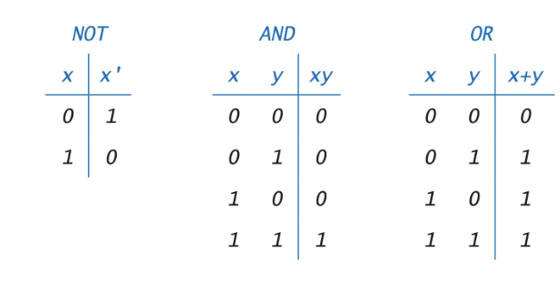
Boolean logic truth table

Slide 15
Flow control
Boolean logic is the bedrock of computing
It is used for controlling how code works
This is encapsulated in the ”if…else” statements
If (statement evaluates to TRUE)… {do this}
Else … {do that}
When the “if statement evaluates to false”, another branch will be activated automatically

Slide 16
Flow control (example)
grade = 5
If (grade > 5) {“you got an A”} else {“you did not get an A”}
If (grade > 5) {“you got an A”} evaluates to FALSE
And so, the code outputs {“you did not get an A”}

Slide 17
Nesting
Multiple “if” and/or “if-else” statements can be embedded within each other
This creates a logical chain where an inner statement is dependent on the logical statement of the outer statement

Slide 18
Nesting (using if)
If (today is sunny)
if (today is not cloudy)
if (today is a holiday)
{go out to play}
If (TRUE)
if (TRUE)
if (TRUE)
{go out to play}
‘today is not cloudy’ is nested under ‘today is sunny’
Suppose if ‘today is not sunny’, then {go out to play} will not execute
Suppose if ‘today is sunny’ AND ‘today is cloudy’, {go out to play} will also not execute (you do not need to consider if ‘today is a holiday’)

Slide 19
Nesting (using if)
Notice that
If (TRUE)
if (TRUE)
if (TRUE)
{go out to play}
Can be condensed to
If (TRUE) AND (TRUE) AND (TRUE)
{go out to play}
But note that this is not nesting as all three statements are evaluated simultaneously.

Slide 20
Nesting (using if-else)
If (TRUE)
if (TRUE)
if (TRUE)
{go out to play}
else
{snack}
else
{wait}
else
{sleep}
Here, given various scenarios, there is a different outcome:
If TRUE, TRUE, FALSE, {snack}
If FALSE, {sleep}
If TRUE, FALSE, {wait}
Note that in nesting, should the outermost loop evaluate to FALSE, it goes directly to the else condition that is paired with it.
In this case, to {sleep}.
All the other statements associated with TRUE will not run

Slide 21

Week 5 – Boolean data types, relational operators and selection basics
Introduction to Computational Thinking
Wilson Goh
Marek Mutwil

Slide 22
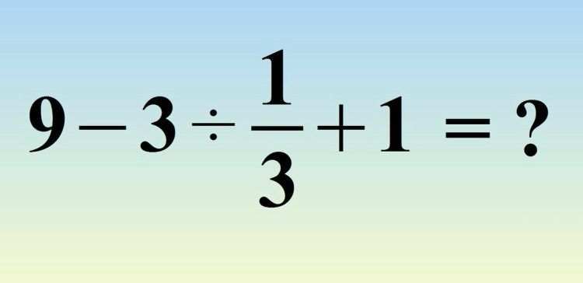

1. Write a Python script functions.py to compute the following expressions, assuming that the angles are in radian. By importing the math package, you have access to many math-related methods or attributes, such as math.sqrt() for square root, math.pi for pi value, math.e for e value, math.log() for logarithm, math.cos(), math.sin(), math.tan() for trigonometric functions, etc.)
Solve if you are a genius!
Notes:
Intro 5

Slide 23
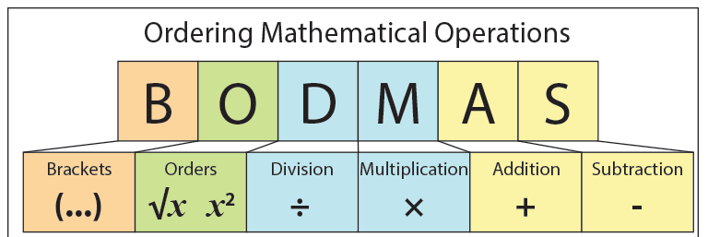
1. Write a Python script functions.py to compute the following expressions, assuming that the angles are in radian. By importing the math package, you have access to many math-related methods or attributes, such as math.sqrt() for square root, math.pi for pi value, math.e for e value, math.log() for logarithm, math.cos(), math.sin(), math.tan() for trigonometric functions, etc.)
Solve if you are a genius!

Slide 24
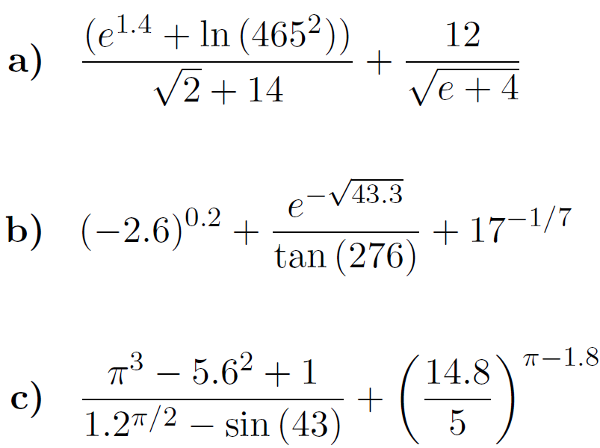
1. Write a Python script functions.py to compute the following expressions, assuming that the angles are in radian. By importing the math package, you have access to many math-related methods or attributes, such as math.sqrt() for square root, math.pi for pi value, math.e for e value, math.log() for logarithm, math.cos(), math.sin(), math.tan() for trigonometric functions, etc.)
Notes:
Self solve a), 5 mins

Slide 25
1. Write a Python script functions.py to compute the following expressions, assuming that the angles are in radian. By importing the math package, you have access to many math-related methods or attributes, such as math.sqrt() for square root, math.pi for pi value, math.e for e value, math.log() for logarithm, math.cos(), math.sin(), math.tan() for trigonometric functions, etc.)

Slide 26
1. Write a Python script functions.py to compute the following expressions, assuming that the angles are in radian. By importing the math package, you have access to many math-related methods or attributes, such as math.sqrt() for square root, math.pi for pi value, math.e for e value, math.log() for logarithm, math.cos(), math.sin(), math.tan() for trigonometric functions, etc.)
(math.e**1.4+ math.log(465**2)) / (math.sqrt(2)+14) + 12/math.sqrt(math.e+4) = 5.689705917…

Slide 27
1. Write a Python script functions.py to compute the following expressions, assuming that the angles are in radian. By importing the math package, you have access to many math-related methods or attributes, such as math.sqrt() for square root, math.pi for pi value, math.e for e value, math.log() for logarithm, math.cos(), math.sin(), math.tan() for trigonometric functions, etc.)
(math.e**1.4+ math.log(465**2)) / (math.sqrt(2)+14) + 12/math.sqrt(math.e+4) = 5.689705917…
1.64373+0.7115629957j
256.9957j
-15.342+0.65j
Notes:
Ask students to solve b) 3 mins + 2 mins go over

Slide 28
1. Write a Python script functions.py to compute the following expressions, assuming that the angles are in radian. By importing the math package, you have access to many math-related methods or attributes, such as math.sqrt() for square root, math.pi for pi value, math.e for e value, math.log() for logarithm, math.cos(), math.sin(), math.tan() for trigonometric functions, etc.)
(math.e**1.4+ math.log(465**2)) / (math.sqrt(2)+14) + 12/math.sqrt(math.e+4) = 5.689705917…
(-2.6)**0.2 + (math.e**-math.sqrt(43.3) /math.tan(276)) + 17**(-1/7) = 1.64373+0.7115629957j
156.112392j
0.112824965
4.5869976425131735
Notes:
Ask students to solve c) 3 mins, go over 2 mins

Slide 29
1. Write a Python script functions.py to compute the following expressions, assuming that the angles are in radian. By importing the math package, you have access to many math-related methods or attributes, such as math.sqrt() for square root, math.pi for pi value, math.e for e value, math.log() for logarithm, math.cos(), math.sin(), math.tan() for trigonometric functions, etc.)
(math.e**1.4+ math.log(465**2)) / (math.sqrt(2)+14) + 12/math.sqrt(math.e+4) = 5.689705917…
(-2.6)**0.2 + (math.e**-math.sqrt(43.3) /math.tan(276)) + 17**(-1/7) = 1.64373+0.7115629957j
(math.pi**3 - 5.6**2 + 1) /(1.2**(math.pi/2) - math.sin(43)) + (14.8/5)**(math.pi-1.8) = 4.58699
Notes:
Ask students to solve c) 3 mins, go over 2 mins

Slide 30
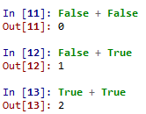
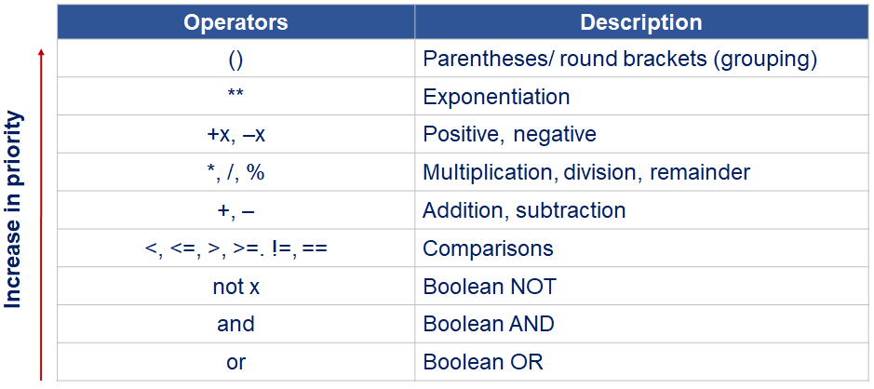
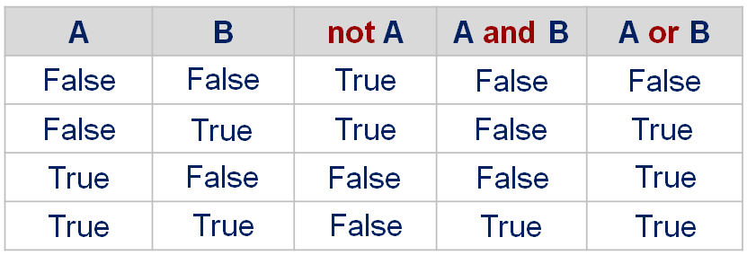
2. What would be the result of the following expressions?
3 == 2 + 1
3 == 3
True
(b) (3 == 2) + 1
False + 1
True
(c) 5 < 6 or 8 > 4
True or True
True
(d) 5 < 10 > 4
(5 < 10) and (10 > 4)
True and True
True
(e) False and True and True or False or True and False
(False and True) and (True or False) or (True and False)
False and True or False
False or False
False
Notes:
Remind students of prority rules 2 mins + 3 mins to solve a)

Slide 31
2. What would be the result of the following expressions?
3 == 2 + 1
3 == 3
True
(b) (3 == 2) + 1
False + 1
True
(c) 5 < 6 or 8 > 4
True or True
True
(d) 5 < 10 > 4
(5 < 10) and (10 > 4)
True and True
True
(e) False and True and True or False or True and False
(False and True) and (True or False) or (True and False)
False and True or False
False or False
False
Notes:
3 mins to solve b

Slide 32
2. What would be the result of the following expressions?
3 == 2 + 1
3 == 3
True
(b) (3 == 2) + 1
False + 1
True
(c) 5 < 6 or 8 > 4
True or True
True
(d) 5 < 10 > 4
(5 < 10) and (10 > 4)
True and True
True
(e) False and True and True or False or True and False
(False and True) and (True or False) or (True and False)
False and True or False
False or False
False
Notes:
3 mins to solve c

Slide 33
2. What would be the result of the following expressions?
3 == 2 + 1
3 == 3
True
(b) (3 == 2) + 1
False + 1
True
(c) 5 < 6 or 8 > 4
True or True
True
(d) 5 < 10 > 4
(5 < 10) and (10 > 4)
True and True
True
(e) False and True and True or False or True and False
(False and True) and (True or False) or (True and False)
False and True or False
False or False
False
Notes:
3 mins to solve d

Slide 34
2. What would be the result of the following expressions?
3 == 2 + 1
3 == 3
True
(b) (3 == 2) + 1
False + 1
True
(c) 5 < 6 or 8 > 4
True or True
True
(d) 5 < 10 > 4
(5 < 10) and (10 > 4)
True and True
True
(e) False and True and True or False or True and False
(False and True) and (True or False) or (True and False)
False and True or False
False or False
False
Notes:
3 mins to solve e

Slide 35
2. What would be the result of the following expressions?
3 == 2 + 1
3 == 3
True
(b) (3 == 2) + 1
False + 1
True
(c) 5 < 6 or 8 > 4
True or True
True
(d) 5 < 10 > 4
(5 < 10) and (10 > 4)
True and True
True
(e) False and True and True or False or True and False
(False and True) and (True or False) or (True and False)
False and True or False
False or False
False
Notes:
The preliminary pair does not work --- always check using L to R.

Slide 36
3. Write a script that tests whether the user can follow instructions. It prompts the user to enter the character ‘x’. If the user enters anything other than an ‘x’, it prints an error message - otherwise, the script does nothing.
Notes:
5 mins to solve

Slide 37
3. Write a script that tests whether the user can follow instructions. It prompts the user to enter the character ‘x’. If the user enters anything other than an ‘x’, it prints an error message - otherwise, the script does nothing.
What do we know?
A command line prompt requires the use of an <input> function and an assignment of the results of the input to some variable
The requirement is to check for non-equality to the letter ‘x’. If true, print a message. Where we are looking for non-equality, we use the ‘!=‘ operator
The requirement says to do nothing if the input is equals to x. In other words, we do not have to link the ‘if’ condition with an ‘else’ statement
Try doing this in your groups. Otherwise discuss your solutions for the next 5 minutes

Slide 38
3. Write a script that tests whether the user can follow instructions. It prompts the user to enter the character ‘x’. If the user enters anything other than an ‘x’, it prints an error message - otherwise, the script does nothing.
# Can the user follow instructions ?? inx = input('Enter an x: ') if inx != 'x':
print("That was no 'x'!")

Slide 39
4. Write a script to calculate the volume of a pyramid (square base), which is 1/3 * base * height, where the base is length * width. Prompt the user to enter values for the length, width, and height, and then calculate the volume of the pyramid. When the user enters each value, she will then also be prompted for either `i' for inches or `c' for centimeters (2.54 cm = 1 inch). The script should print the volume in cubic inches. As an example, the output format can be:
This program will calculate the volume of a pyramid. Enter the length of the base: 50 Is that i or c? i Enter the width of the base: 6.3
Is that i or c? c Enter the height: 4 Is that i or c? i The volume of the pyramid is 165.3543307086614 cubic inches.
Notes:
10 mins to solve

Slide 40
4. Write a script to calculate the volume of a pyramid (square base), which is 1/3 * base * height, where the base is length * width. Prompt the user to enter values for the length, width, and height, and then calculate the volume of the pyramid. When the user enters each value, she will then also be prompted for either `i' for inches or `c' for centimeters (2.54 cm = 1 inch). The script should print the volume in cubic inches. As an example, the output format can be:
What do we know?
Use 3 sets of inputs (length, width and height)
For each input, check if inch or cm. Since we want the output in inches, we convert whenever we get cm. This has to be repeated 3 times.
We also do not need to store the results in cm, and can write over the original variable storing the results in cm.
There is no need for deep nesting or branching since the 3 inputs are treated independent of each other.
Try doing this in your groups. Otherwise discuss your solutions for the next 10 minutes

Slide 41
4. Write a script to calculate the volume of a pyramid (square base), which is 1/3 * base * height, where the base is length * width. Prompt the user to enter values for the length, width, and height, and then calculate the volume of the pyramid. When the user enters each value, she will then also be prompted for either `i' for inches or `c' for centimeters (2.54 cm = 1 inch). The script should print the volume in cubic inches. As an example, the output format can be:
Notes:
Note that single quotes can also be used to denote strings. Different languages may treat single and double quotes differently.

Slide 42
5. In chemistry, the pH of an aqueous solution is a measure of its acidity. The pH scale ranges from 0 to 14, inclusive. A solution with a pH of 7 is said to be neutral, a solution with a pH greater than 7 is basic, and a solution with a pH less than 7 is acidic. Write a script that will prompt the user for the pH of a solution, and will print whether it is neutral, basic, or acidic. If the user enters an invalid pH, an error message will be printed.
Notes:
10 mins to solve

Slide 43
5. In chemistry, the pH of an aqueous solution is a measure of its acidity. The pH scale ranges from 0 to 14, inclusive. A solution with a pH of 7 is said to be neutral, a solution with a pH greater than 7 is basic, and a solution with a pH less than 7 is acidic. Write a script that will prompt the user for the pH of a solution, and will print whether it is neutral, basic, or acidic. If the user enters an invalid pH, an error message will be printed.
What do we know?
Only 1 input to be evaluated against some conditions
Since pH should be bound between 0 to 14 , any input beyond this range should give an error message --- you may use an “or” control operator e.g. X < 0 or X > 14. Conversely, you can also use “and” e.g. X >= 0 and X <= 14
An input may be non-numeric, would you want to check for this?
If the input is numeric and in correct range, there are 3 possible splits of the pH, acidic, basic and neutral. There is some flexibility here..
Try doing this in your groups. Otherwise discuss your solutions for the next 10 minutes

Slide 44
5. In chemistry, the pH of an aqueous solution is a measure of its acidity. The pH scale ranges from 0 to 14, inclusive. A solution with a pH of 7 is said to be neutral, a solution with a pH greater than 7 is basic, and a solution with a pH less than 7 is acidic. Write a script that will prompt the user for the pH of a solution, and will print whether it is neutral, basic, or acidic. If the user enters an invalid pH, an error message will be printed.
# Prompts the user for the pH of a solution and prints # whether it is basic , acidic , or neutral ph = float(input('Enter the pH of the solution : ')) if ph < 0 or ph > 14:
print('Error in pH!') elif ph < 7:
print('It is acidic') elif ph > 7:
print('It is basic') else:
print('It is neutral') # no need to write " elif ph ==7"
The final situation is implicit hence no need to specify it explicitly as ph==7

Slide 45
6. Write a script that will first prompt the user for a distance in kilometers, with error check that the input distance can't be negative. Then, the script will print the cost of the travel by walking, by motorcycle, by car and by plane, knowing that:
walking, motorcycle, car and plane travel cost 0, 0.22, 0.26 and 0.78 SGD per kilometer, respectively;
walking can't be done for more than 20 kilometers, motorcycle travel can't be done for more than 200 kilometers, car travel can't be done for more than 800 kilometers, plane travel can't be done for less than 100 kilometers.
For example, the output will look like this: Enter the distance in kilometer: 12 The cost by walking is free! The cost by motorcycle is 2.6 SGD The cost by car is 3.1 SGD You travel is too short to be done by plane
Notes:
10 mins to solve

Slide 46
6. Write a script that will first prompt the user for a distance in kilometers, with error check that the input distance can't be negative. Then, the script will print the cost of the travel by walking, by motorcycle, by car and by plane, knowing that:
walking, motorcycle, car and plane travel cost 0, 0.22, 0.26 and 0.78 SGD per kilometer, respectively;
walking can't be done for more than 20 kilometers, motorcycle travel can't be done for more than 200 kilometers, car travel can't be done for more than 800 kilometers, plane travel can't be done for less than 100 kilometers.
What do we know?
To catch a negative value, we only need to check if the distance is less than 0, if true, we return an error, else we continue running the code.
Although it is possible to simply calculate the cost of any given distance for all 3 travel modes, we need to input a condition that determines the limits of each mode e.g. if X > 20, we do not consider walking a feasible option and thus return a message indicating this.
The price of each travel mode and its respective limitations can be determine independently of each other (no nesting and branching required).
Try doing this in your groups. Otherwise discuss your solutions for the next 10 minutes

Slide 47
6. Write a script that will first prompt the user for a distance in kilometers, with error check that the input distance can't be negative. Then, the script will print the cost of the travel by walking, by motorcycle, by car and by plane, knowing that:
walking, motorcycle, car and plane travel cost 0, 0.22, 0.26 and 0.78 SGD per kilometer, respectively;
walking can't be done for more than 20 kilometers, motorcycle travel can't be done for more than 200 kilometers, car travel can't be done for more than 800 kilometers, plane travel can't be done for less than 100 kilometers.
distance = float(input('Enter the distance in kilometers:')) if distance <0: print('Error, your distance is lower than 0!')
else: if distance <= 20: # travel by walking print('The cost by walking is free!') else: print('Your travel is too long to be done by walking') if distance <= 200: # travel by motorcycle cost = distance * 0.22 print('The cost by motorcycle is ',cost ,'SGD') else: print('Your travel is too long for the motorcycle')
if distance <= 800: # travel by car cost = distance * 0.26 print('The cost by car is ',cost ,'SGD') else: print('Your travel is too long to be done by car') # travel by plane if distance >= 100: cost = distance * 0.78 print('The cost by plane is ',cost ,'SGD') else: print('Your travel is too short to be done by plane')

Slide 48
7. Write a script that will prompt the user for an amount in Singapore Dollars, and then to which foreign currency he would like to convert this amount ('E' for Euros, 'U' for US Dollars, 'J' for Japanese Yen). The script will then print the original amount and the converted amount. The output can look like this:
Enter the amount in Singapore Dollars: 29.340 Do you want to convert this amount in Euros (E), US Dollars (U) or Japanese Yen (J)? U 29.34 Singapore Dollars equals 21.603042 US Dollars
The program must check that the user didn't enter a negative amount. You can check online for the latest currency rates.
Notes:
10 mins to solve

Slide 49
7. Write a script that will prompt the user for an amount in Singapore Dollars, and then to which foreign currency he would like to convert this amount ('E' for Euros, 'U' for US Dollars, 'J' for Japanese Yen). The script will then print the original amount and the converted amount. The output can look like this:
What do we know?
To catch a negative value, we only need to check if the distance is less than 0, if true, we return an error, else continue running.
The input amount is always assumed to start in SGD, to be converted to something else.
The option to select E, U or J, will independently create 3 code blocks that will each do its own conversion and return an output.
Currency is a float variable (can have cents). Do not set input to integer.
Try doing this in your groups. Otherwise discuss your solutions for the next 10 minutes

Slide 50
7. Write a script that will prompt the user for an amount in Singapore Dollars, and then to which foreign currency he would like to convert this amount ('E' for Euros, 'U' for US Dollars, 'J' for Japanese Yen). The script will then print the original amount and the converted amount. The output can look like this:
Enter the amount in Singapore Dollars: 29.340 Do you want to convert this amount in Euros (E), US Dollars (U) or Japanese Yen (J)? U 29.34 Singapore Dollars equals 21.603042 US Dollars
The program must check that the user didn't enter a negative amount. You can check online for the latest currency rates.
amount = float(input('Enter the amount in Singapore Dollars: ')) if amount <0: # error check
print('Error, the amount is negative ') else: # if no error when inputting the amount choice = input('Convert to Euros(E), US Dollars(U) or Japanese Yens(J)?') # conversion to Euros if choice == 'E': converted_amount = amount * 0.6716 print(amount, 'Singapore Dollars equals ', converted_amount, ' Euros ') # conversion in US Dollars

Slide 51
8. Write a script that will print a list consisting of “cylinder”, “circle”, and “rectangle”. It prompts the user to choose one, prompts the user for the appropriate quantities (e.g., the radius of the circle) and then prints its area. If the user enters an invalid choice, the script simply prints an error message. By importing the math package, you have access to the value of pi via math.pi. The script should use a nested if-else statement to accomplish this. Here are two examples of running it (units are assumed to be inches).
Menu 1. Cylinder 2. Circle 3. Rectangle Please choose one: 2 Enter the radius of the circle: 4.1 The area is 52.81017250684441
Menu 1. Cylinder
2. Circle 3. Rectangle Please choose one: 3 Enter the length: 4 Enter the width: 6 The area is 24.0
Notes:
SKiP

Slide 52
8. Write a script that will print a list consisting of “cylinder”, “circle”, and “rectangle”. It prompts the user to choose one, prompts the user for the appropriate quantities (e.g., the radius of the circle) and then prints its area. If the user enters an invalid choice, the script simply prints an error message. By importing the math package, you have access to the value of pi via math.pi. The script should use a nested if-else statement to accomplish this. Here are two examples of running it (units are assumed to be inches).
What do we know?
If you call in a library using import, accessing its methods/attributes requires using the form <library name>.<method name> e.g. math.pi will access the value of pi stored in the math library.
Different shape have different quantities for calculating area
The choice of what type of shape can be evaluated via the if-elif-else control statements.
The ordering of the shapes do not matter.
Try doing this in your groups. Otherwise discuss your solutions for the next 10 minutes

Slide 53
8. Write a script that will print a list consisting of “cylinder”, “circle”, and “rectangle”. It prompts the user to choose one, prompts the user for the appropriate quantities (e.g., the radius of the circle) and then prints its area. If the user enters an invalid choice, the script simply prints an error message. By importing the math package, you have access to the value of pi via math.pi. The script should use a nested if-else statement to accomplish this. Here are two examples of running it (units are assumed to be inches).
Notes:
Notice that there is no need to convert the input to an integer. We can simply do a string comparison here. This is why the equality comparator uses single quotes on 1.

Slide 54
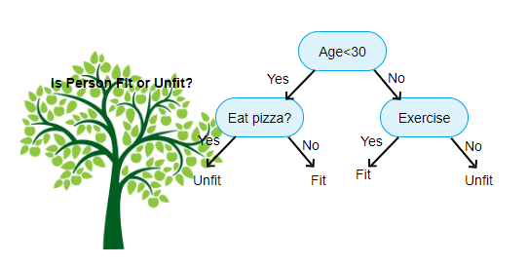
Wilson’s challenge
The decision tree is one of the most simple yet most useful (explainable) machine learning models.
If (Age < 30):
If (eat pizza == Yes):
<Unfit>
else:
<Fit>
else:
if (exercise == Yes):
<Fit>
else:
<Unfit>

Slide 55
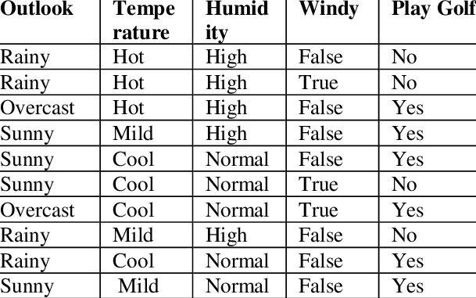
Wilson’s challenge
Looking at the outlook, temperate, humidity and windiness, derive a set of relationships that allows you to decide whether or not to play golf
You will need to use nested “if-else” statements

Slide 56
One way is to write it all manually
…..
If (outlook == ‘Sunny’):
< no golf >
else:
if (outlook == ‘Overcast’):
<play golf>
else:
if (windy == True):
<no golf>
else:
<play golf>
…..

Slide 57
Another way is to establish rules
Using rules is not perfect but it is elegant

Slide 58
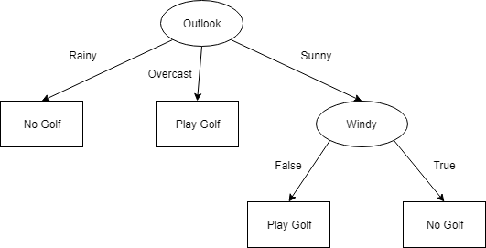
Wilson’s challenge
If (outlook == ‘Sunny’):
< no golf >
else:
if (outlook == ‘Overcast’):
<play golf>
else:
if (windy == True):
<no golf>
else:
<play golf>

Slide 59
You may leave once you complete the items. Or stick around and chat/discuss
Please take out your RPIs, and enjoy today’s practical

