Slide 1

Improving Mental Health: A Fun Buy and Interact Game for Jose Maria College Students”
Meow!

Slide 2

Contents
1 - Introduction
1.1- Background of the Study
1.2 - Statement of Goals and Objectives
1.3 - System Prototyping
2 - Review of Related Literature
3. END

Slide 3

INTRODUCTION
1.1 BACKGROUND OF THE STUDY
Mental health of the students plays a pivotal role in influencing their efficiency, effectiveness, and overall productivity in academic pursuits. The influences of Mental Health can also affect the student’s mood and choices. These challenges posed by academic demands can often lead to heightened stress levels, contributing to exhaustion that will lead to poor habits and choices, worsening the overall well-being of a student. In response to these concerns, the creation of a simple game involving the purchase and interaction with virtual pet cats aims to alleviate stress and provides enjoyment to improve mental health that will also improve the overall well-being of the student.

Slide 4

INTRODUCTION
According to Centers for Disease Control and Prevention. (n.d).” Mental health includes our emotional, psychological, and social well-being. It affects how we think, feel, and act.” This in turn affects our choices, habits, and thought. Coping mechanism is a common approach in relieving and improving the mental health of a person, however it does not actually solve the problem but makes it worse. One approach that is considered to be healthy in relieving and improving the mental health of a person is through pets.
1.1 BACKGROUND OF THE STUDY

Slide 5
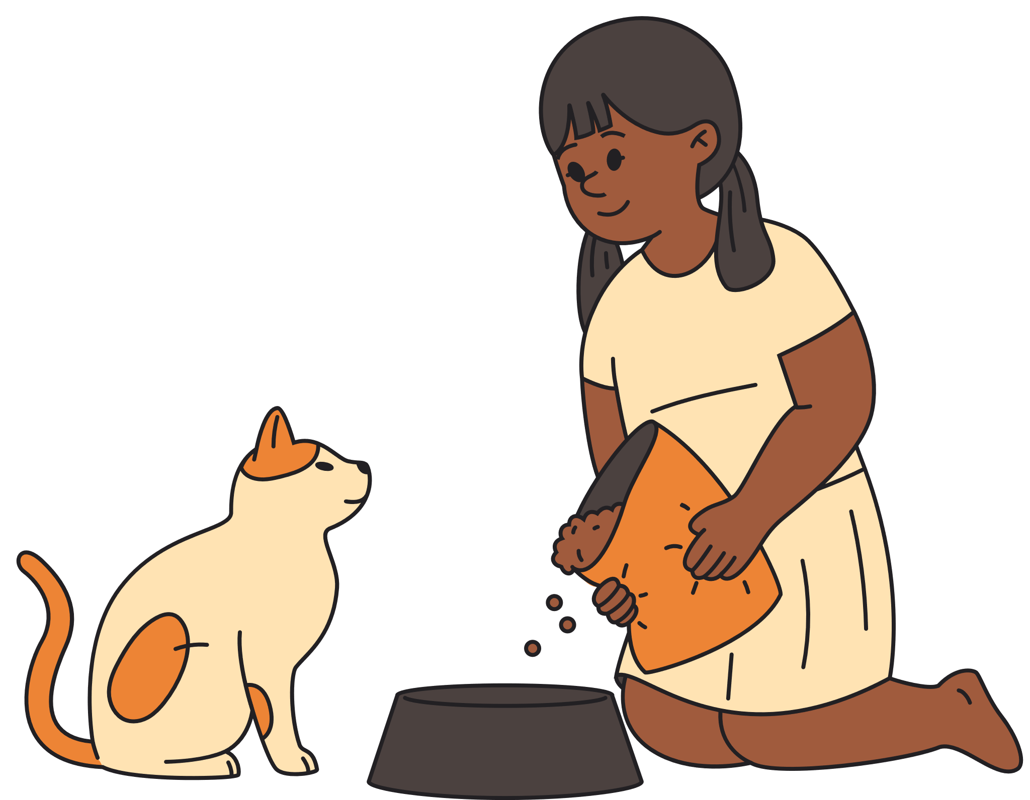
INTRODUCTION
1.1 BACKGROUND OF THE STUDY
According to Wikipedia (n.d). “Pets or companion animal, is an animal kept primarily for a person’s company or entertainment rather than as working animal, livestock, or laboratory animal” (“Pet”, para. 1). Pets such as dogs and cats can improve the mental health of a students that are currently exhausted or stressed because of tasks. Pets provide company, entertainment, and motivation to a student. This inspired the creation of the game; it improves the student’s mental health even without cats in their household or simply seek to improve their mental health.

Slide 6

THIS STUDY SPECIFICALLY AIMS TO:
01.
Create a program that will improve the student’s mental health that will lead to productivity and effectiveness in doing academic tasks.
02.
Provide enjoyment and alleviate stress to students that are exhausted.

Slide 7
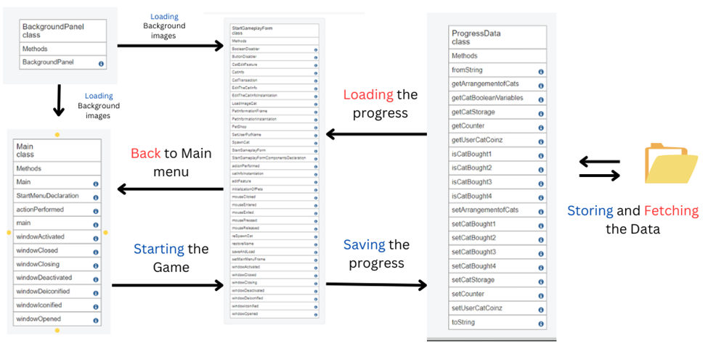
UML DIAGRAM

Slide 8
1.2 STATEMENT OF GOALS AND OBJECTIVES
This project is entitled “Improving Mental Health: A Fun Buy and Interact Game for Jose Maria College Students”. This project is a stand-alone desktop application which will be created with the help of JAVA programming language that can be played offline. This is to provide the user’s enjoyment without requiring internet connection and setups that are too complicated. The tools that were used in developing this Program are as follows:

Slide 9



JAVA SDK VERSION 21
JAVA LANGUAGE LEVEL 20
INTELLIj
NOTEPAD

Slide 10
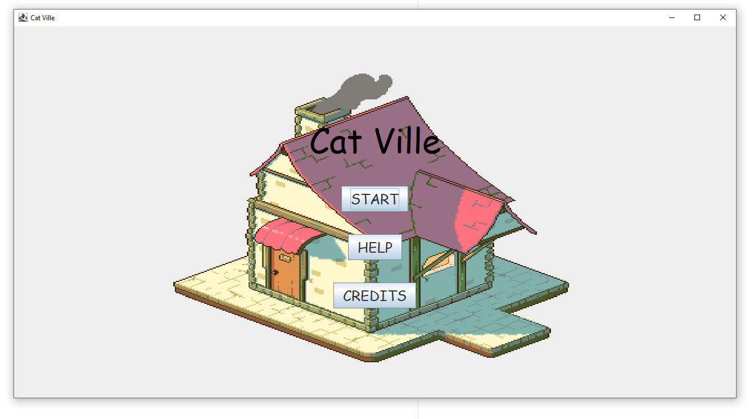


1.3 SYSTEM AND PROTOTYPING
MAIN MENU FRAME

Slide 11
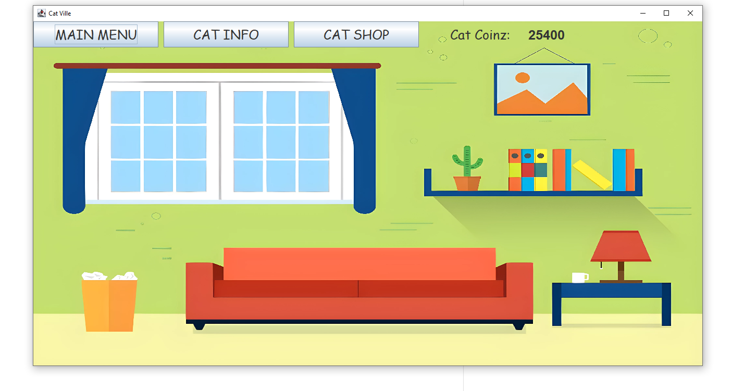
1.3 SYSTEM AND PROTOTYPING
START GAMEPLAYFORM

Slide 12
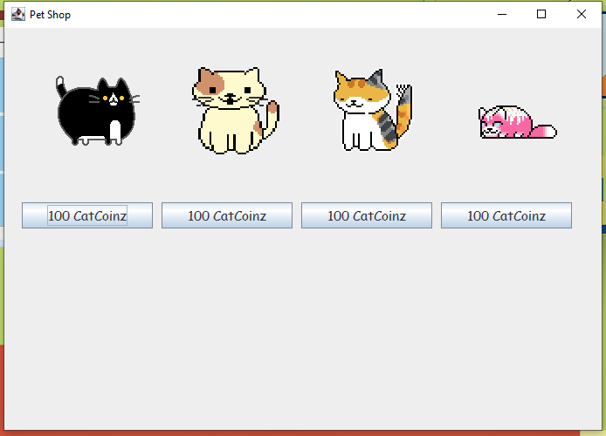
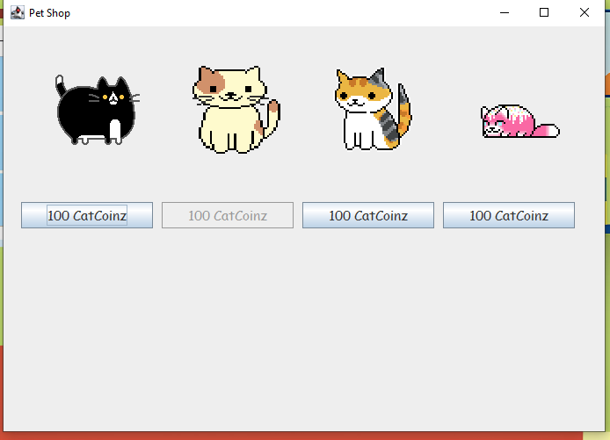
1.3 SYSTEM AND PROTOTYPING
PETSHOP
BEFORE:
AFTER:

Slide 13
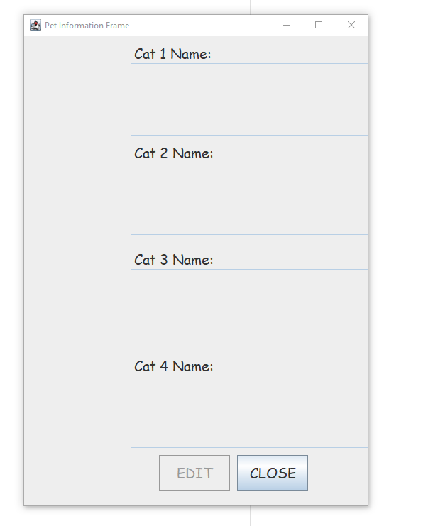
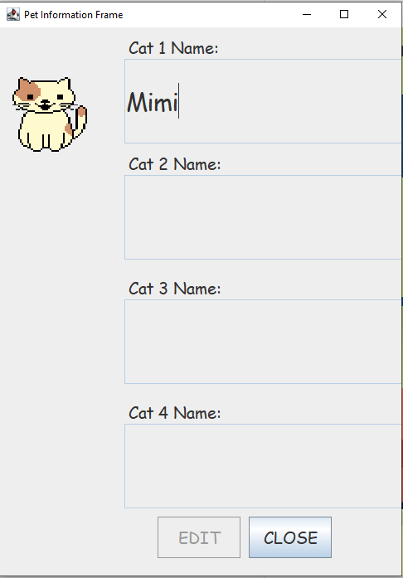
1.3 SYSTEM AND PROTOTYPING
CAT INFORMATION
BEFORE:
AFTER:

Slide 14
OTHER FEATURES:
01.
02.
03.
SYNCHRONIZED OF LOADING AND SAVING THE PROGRESS OF THE USER USING A TXTFILE
HAS BACKGROUND MUSIC TO ENJOY
CAN UPDATE/EDIT CAT’S NAME

Slide 15

FEATURES IN THE FUTURE:
1.Add a Delete Feature that can sync properly with load and save feature.
2.Add more variety of cats and objects available in the Pet Shop.
3.Add an increase and decrease loop currency mechanism.
4.Cats and objects are no longer placed in fix location and can be placed depending on the user’s preference.
5.More options to interact with cats.
6.Background has variety.
7.More Background Music.

Slide 16
REVIEW OF RELATED LITERATURE
https://www.cdc.gov/mentalhealth/learn/index.htm
https://www.ncbi.nlm.nih.gov/books/NBK559031/
https://en.wikipedia.org/wiki/Pet
https://psychcentral.com/health/pets-and-mental-health#1.-They-help-us-feel-loved
https://www.psychologytoday.com/us/blog/evidence-based-living/202102/pet-could-boost-your-mental-health

Slide 17

MEOW!

