Slide 1




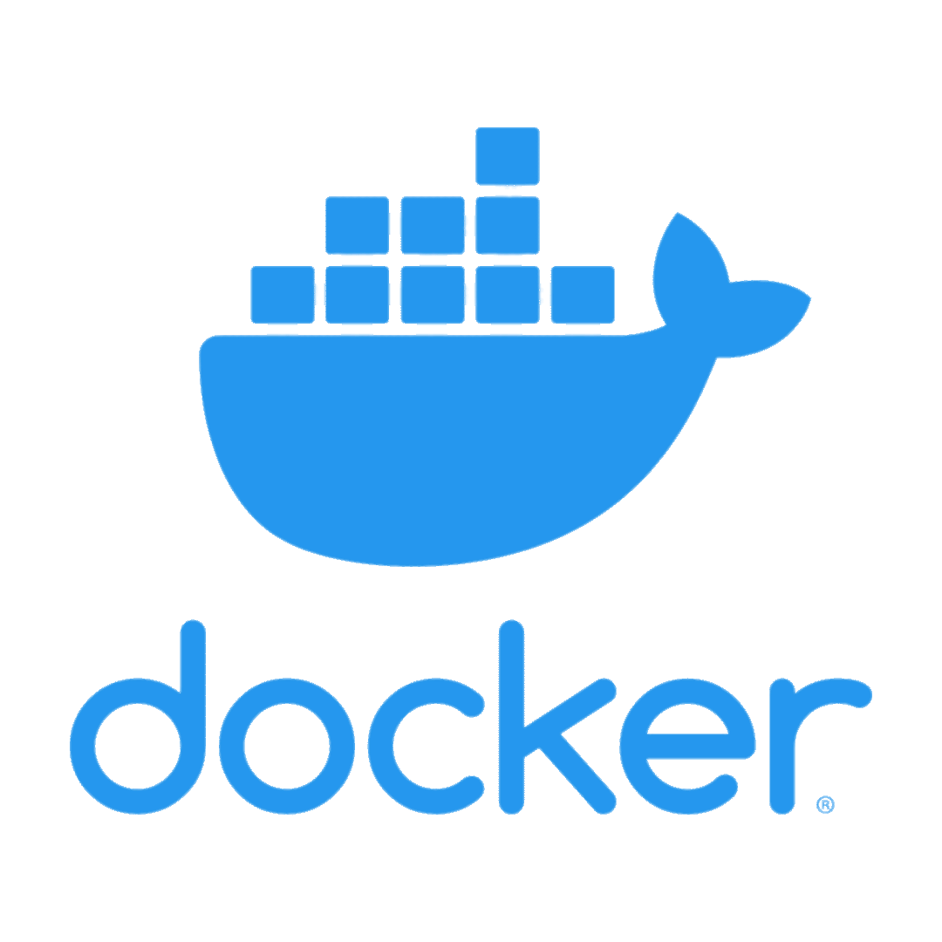





Uniform and Automated Deployment in SCVU
Bootc for Air-Gapped, Reproducible Builds
By SCT Benson Teo
Problem
How do you ensure uniform software deployment across machines in an air-gapped environment without spending hours configuring each one?
Value Proposition
Reproducible (same system, every time)
Offline-capable (ideal for SCVU)
Fast Deployment
Customizable (add/change in Containerfile)
Reduced support (uniform and standard)
Problem
How do you ensure uniform software deployment across machines in an air-gapped environment without spending hours configuring each one?
Solution
Bootc (Bootable Containers)
Bootc combines OS + Applications + Configs into 1 image that can be atomically deployed to any workstation.
Stack Breakdown
Stack(s) | Application(s)
Core OS & Desktop | Fedora 43 & KDE
Development | Python, Git, Docker
Graphics & Design | CUDA, Blender
Windows Emulation | Wine
Office | LibreOffice
File Sharing | Samba, Avahi
Cloud & Containers | Openshift, Kubernetes
JS/Frontend | React, Vue, Typescript
Limitations
Large ISO file size
Certain hardware (read: old) may have issues.
Immutable Root = Rebuild for changes
Offline packages become stale
Linux/Container learning curve
Key Features
Immutable Root Filesystem
Container-based builds (OCI)
Rollback and Updates
Fast and Reproducible Deployments
Next Steps
Pilot with incoming trainees
Image Variants
Repository upgrades
Prep for unit wide deployment
Workflow
Build Image
Export to OCI/ISO
Upload to Registry
Deploy to Machine
Post-install Config
Conclusion
Using Bootc allows us to deploy systems quicker, more consistently and more efficiently.
Download & Install package
Time-intensive
Upgrade and Install OS
Image Registry for upgrading
Flash to Machine
Initial Install
Run scripts for verification

