Slide 1


AirBooking
Kovalchuk Serhii

Slide 2




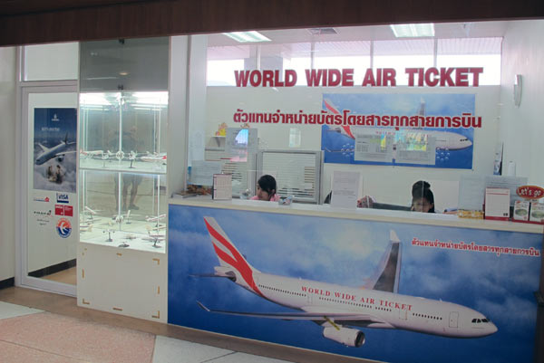


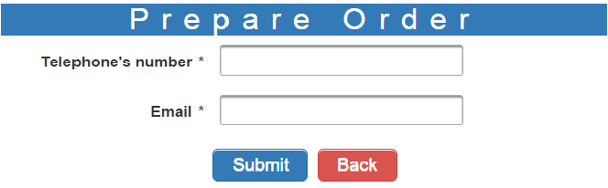


Slide 3
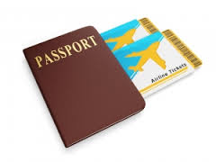
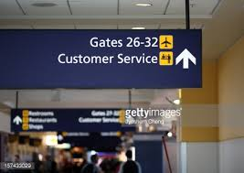

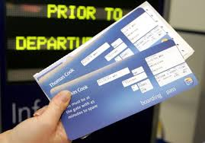
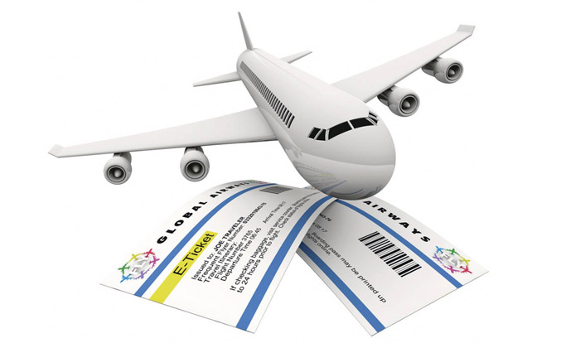

Add and remove tickets from a cart
Have an account on
the Website
Customer
Book available
tickets without registration
Search tickets
See total price of selected tickets

Slide 4




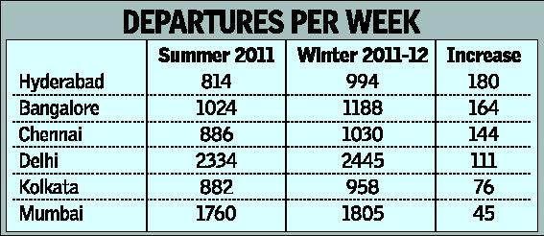

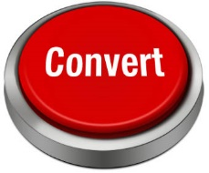
I can edit a
timetable
Have an
account on the
website
I can remove
flights
I can add
flights
Change status all booked
tickets more than three days ago

Slide 5



Change status
Create different staff
Have an account on the Website
See list of all booked orders
See reports on tickets count, total sum and data by date or destination places
Edit staff’s list
Have an account on the Website

Slide 6















Slide 7
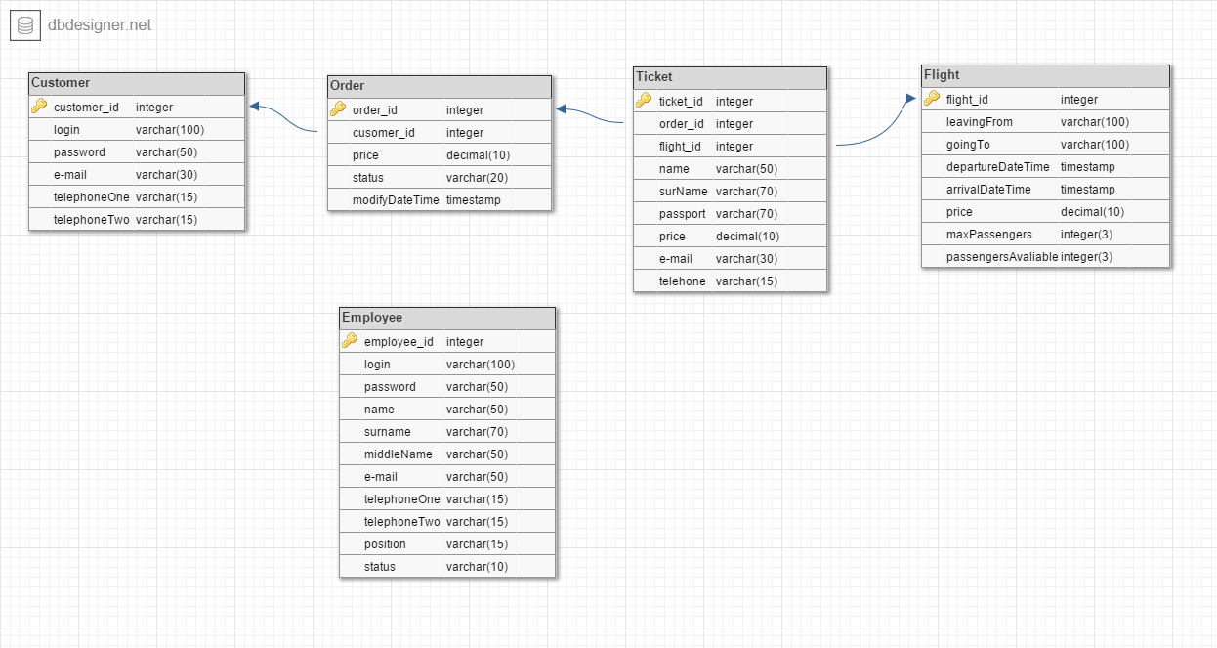


Slide 8
Questions?

