Slide 1
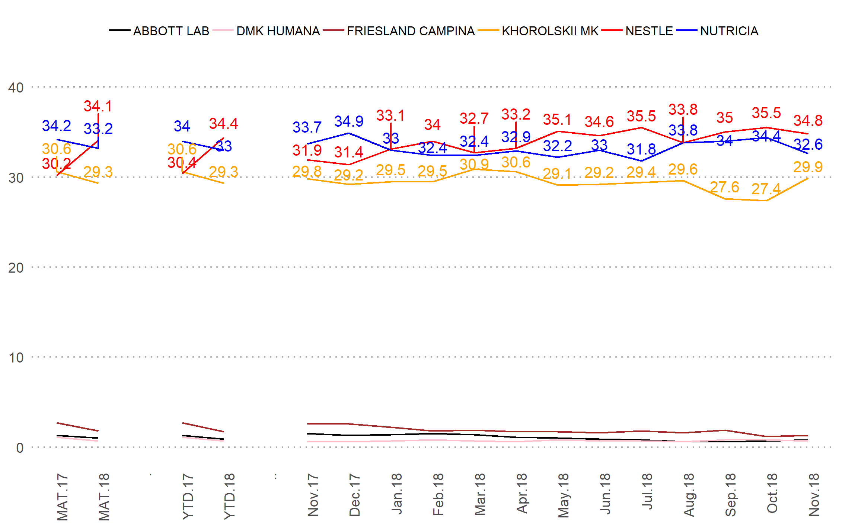
Solution 1:
Labels do not overlap
Custom colors
Ukraine
Brand |  | Nov-18 | vs PP |  | YTD 18 | vs YTD17 |  | MAT 18 | vs MAT17
AGUSHA |  | 11.7 | 0.2 |  | 11.8 | -2.8 |  | 11.9 | -2.6
MALYUTKA KH |  | 11.4 | 0.3 |  | 10.9 | -0.5 |  | 10.9 | -0.6
MILUPA |  | 9.8 | -0.4 |  | 9.3 | 1.1 |  | 9.3 | 1.1
YAGOTYNSKE DLYADITEI |  | 8.9 | 0.6 |  | 8.6 | 1.3 |  | 8.6 | 1.3
MALYSH KH |  | 7.9 | 0.0 |  | 7.9 | -0.8 |  | 8.0 | -0.9
CHUDO-CHADO |  | 6.7 | -0.6 |  | 7.3 | 1.1 |  | 7.2 | 1.2
NUTRILON |  | 7.5 | 0.2 |  | 6.5 | 0.6 |  | 6.5 | 0.6
NESTOGEN |  | 6.6 | 0.1 |  | 6.1 | 1.0 |  | 6.1 | 1.0
GERBER |  | 4.7 | 0.1 |  | 5.7 | 1.5 |  | 5.6 | 1.5
KARAPUZ |  | 4.2 | -0.2 |  | 5.7 | -0.9 |  | 5.6 | -0.9
HIPP |  | 4.5 | -0.1 |  | 4.3 | 0.5 |  | 4.3 | 0.5
* The table presents market shares and differences vs previous period or the same period last year.

Slide 2
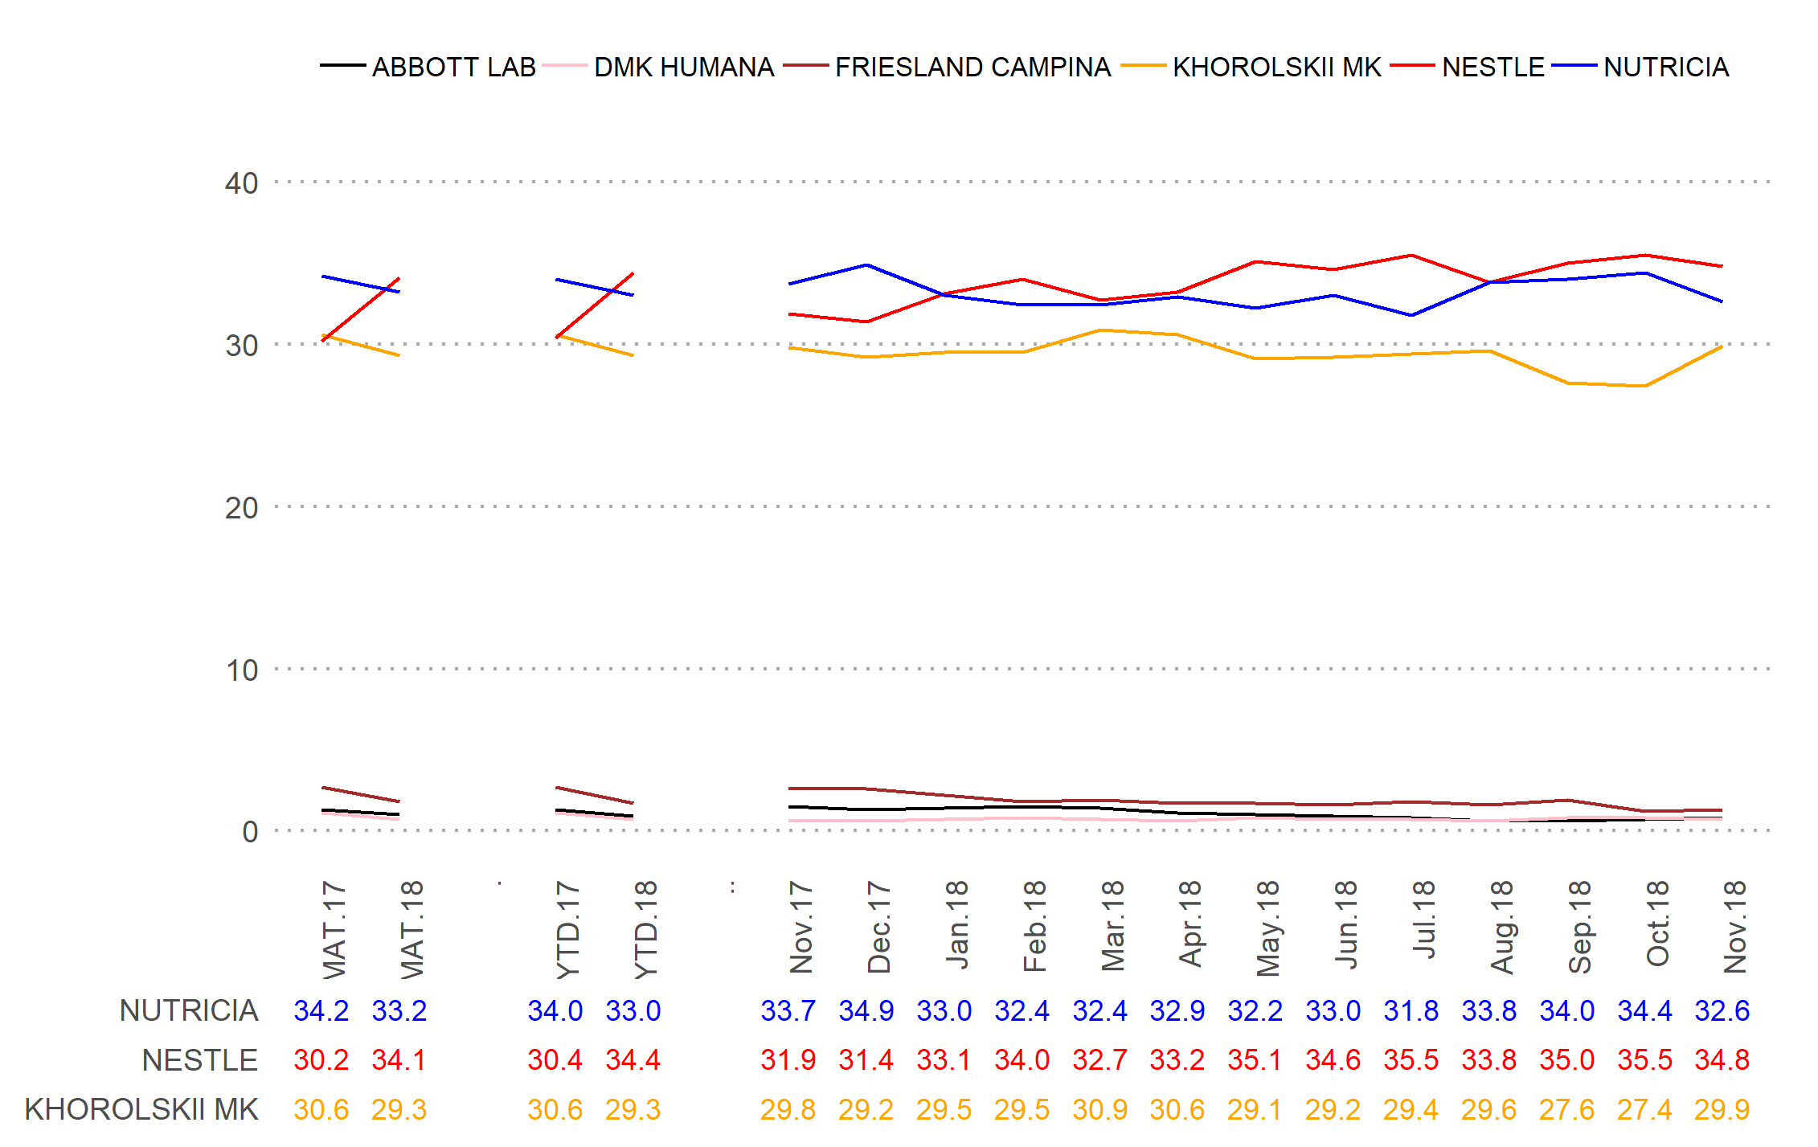
Solution 2:
No labels
Labels are in the table below the chart, color of labels is similar to color of lines
Custom colors
Brand |  | Nov-18 | vs PP |  | YTD 18 | vs YTD17 |  | MAT 18 | vs MAT17
AGUSHA |  | 11.7 | 0.2 |  | 11.8 | -2.8 |  | 11.9 | -2.6
MALYUTKA KH |  | 11.4 | 0.3 |  | 10.9 | -0.5 |  | 10.9 | -0.6
MILUPA |  | 9.8 | -0.4 |  | 9.3 | 1.1 |  | 9.3 | 1.1
YAGOTYNSKE DLYADITEI |  | 8.9 | 0.6 |  | 8.6 | 1.3 |  | 8.6 | 1.3
MALYSH KH |  | 7.9 | 0.0 |  | 7.9 | -0.8 |  | 8.0 | -0.9
CHUDO-CHADO |  | 6.7 | -0.6 |  | 7.3 | 1.1 |  | 7.2 | 1.2
NUTRILON |  | 7.5 | 0.2 |  | 6.5 | 0.6 |  | 6.5 | 0.6
NESTOGEN |  | 6.6 | 0.1 |  | 6.1 | 1.0 |  | 6.1 | 1.0
GERBER |  | 4.7 | 0.1 |  | 5.7 | 1.5 |  | 5.6 | 1.5
KARAPUZ |  | 4.2 | -0.2 |  | 5.7 | -0.9 |  | 5.6 | -0.9
HIPP |  | 4.5 | -0.1 |  | 4.3 | 0.5 |  | 4.3 | 0.5
* The table presents market shares and differences vs previous period or the same period last year.

Slide 3
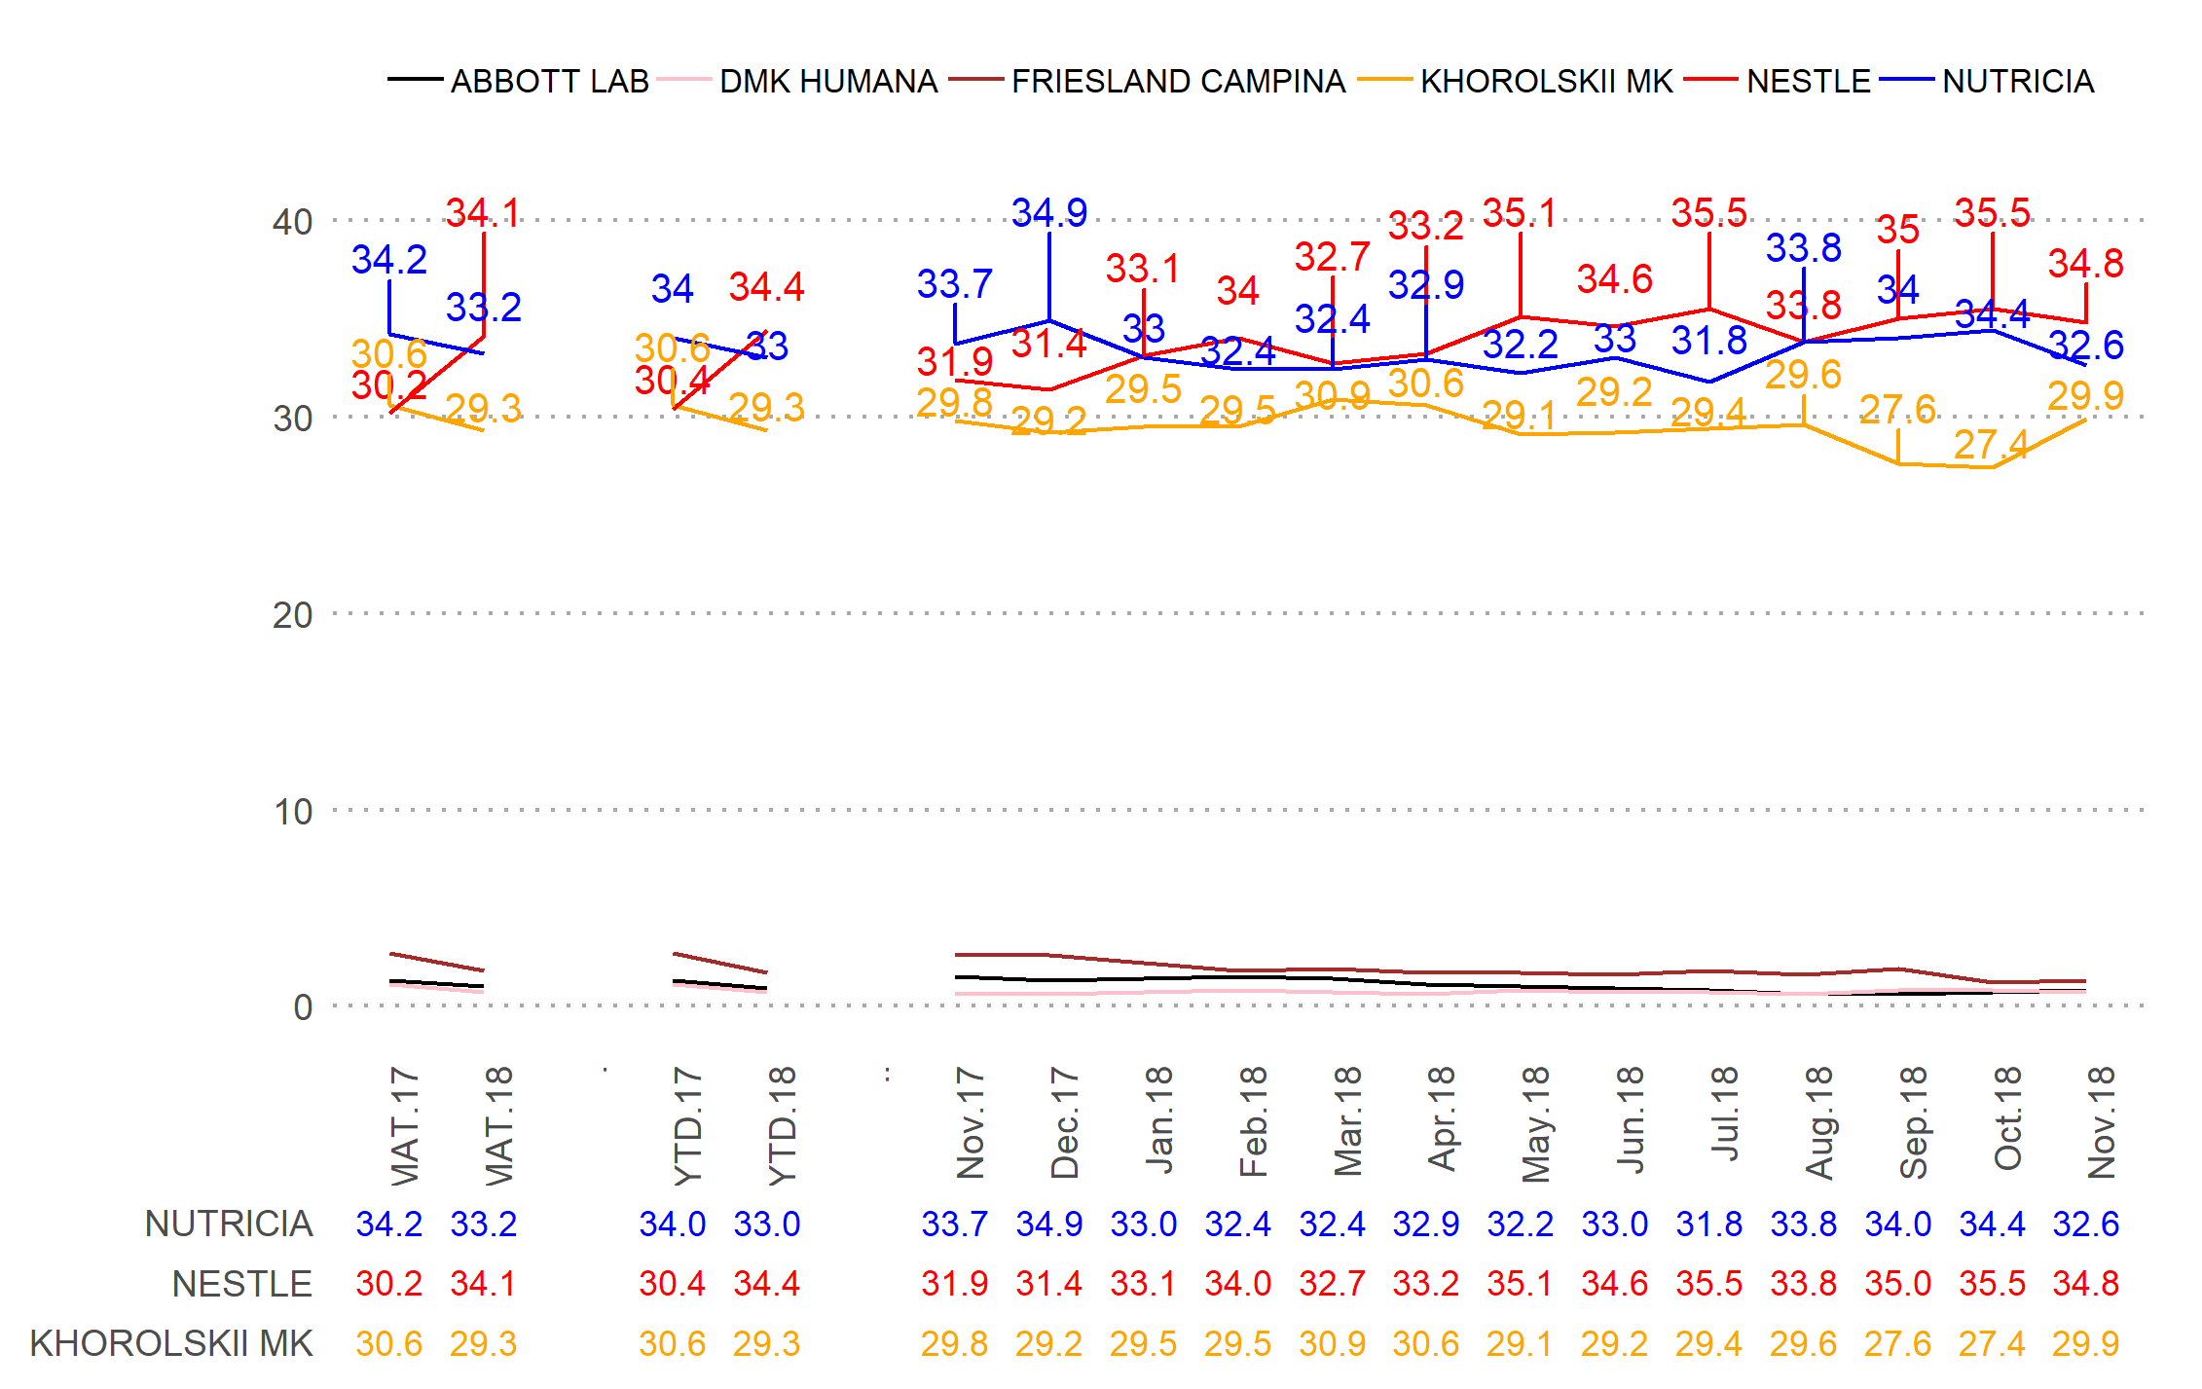
Solution 3:
Labels do not overlap
Labels are in the table below the chart, color of labels is similar to color of lines
Custom colors
Brand |  | Nov-18 | vs PP |  | YTD 18 | vs YTD17 |  | MAT 18 | vs MAT17
AGUSHA |  | 11.7 | 0.2 |  | 11.8 | -2.8 |  | 11.9 | -2.6
MALYUTKA KH |  | 11.4 | 0.3 |  | 10.9 | -0.5 |  | 10.9 | -0.6
MILUPA |  | 9.8 | -0.4 |  | 9.3 | 1.1 |  | 9.3 | 1.1
YAGOTYNSKE DLYADITEI |  | 8.9 | 0.6 |  | 8.6 | 1.3 |  | 8.6 | 1.3
MALYSH KH |  | 7.9 | 0.0 |  | 7.9 | -0.8 |  | 8.0 | -0.9
CHUDO-CHADO |  | 6.7 | -0.6 |  | 7.3 | 1.1 |  | 7.2 | 1.2
NUTRILON |  | 7.5 | 0.2 |  | 6.5 | 0.6 |  | 6.5 | 0.6
NESTOGEN |  | 6.6 | 0.1 |  | 6.1 | 1.0 |  | 6.1 | 1.0
GERBER |  | 4.7 | 0.1 |  | 5.7 | 1.5 |  | 5.6 | 1.5
KARAPUZ |  | 4.2 | -0.2 |  | 5.7 | -0.9 |  | 5.6 | -0.9
HIPP |  | 4.5 | -0.1 |  | 4.3 | 0.5 |  | 4.3 | 0.5
* The table presents market shares and differences vs previous period or the same period last year.

Slide 4
Solution 4:
The same as Solution 3, but each element of the chart is independent (can be moved, re-colored etc.)
(this is flexible option, but its flexibility is the biggest drawback)
ABBOTT LAB
DMK HUMANA
FRIESLAND CAMPINA
KHOROLSKII MK
NESTLE
NUTRICIA
Brand |  | Nov-18 | vs PP |  | YTD 18 | vs YTD17 |  | MAT 18 | vs MAT17
AGUSHA |  | 11.7 | 0.2 |  | 11.8 | -2.8 |  | 11.9 | -2.6
MALYUTKA KH |  | 11.4 | 0.3 |  | 10.9 | -0.5 |  | 10.9 | -0.6
MILUPA |  | 9.8 | -0.4 |  | 9.3 | 1.1 |  | 9.3 | 1.1
YAGOTYNSKE DLYADITEI |  | 8.9 | 0.6 |  | 8.6 | 1.3 |  | 8.6 | 1.3
MALYSH KH |  | 7.9 | 0.0 |  | 7.9 | -0.8 |  | 8.0 | -0.9
CHUDO-CHADO |  | 6.7 | -0.6 |  | 7.3 | 1.1 |  | 7.2 | 1.2
NUTRILON |  | 7.5 | 0.2 |  | 6.5 | 0.6 |  | 6.5 | 0.6
NESTOGEN |  | 6.6 | 0.1 |  | 6.1 | 1.0 |  | 6.1 | 1.0
GERBER |  | 4.7 | 0.1 |  | 5.7 | 1.5 |  | 5.6 | 1.5
KARAPUZ |  | 4.2 | -0.2 |  | 5.7 | -0.9 |  | 5.6 | -0.9
HIPP |  | 4.5 | -0.1 |  | 4.3 | 0.5 |  | 4.3 | 0.5
* The table presents market shares and differences vs previous period or the same period last year.
40
30
20
10
0
.
..
Nov.17
Dec.17
Jan.18
Feb.18
Mar.18
Apr.18
May.18
Jun.18
Jul.18
Aug.18
Sep.18
Oct.18
Nov.18
MAT.17
MAT.18
YTD.17
YTD.18
NUTRICIA
34.2
33.2
34.0
33.0
33.7
34.9
33.0
32.4
32.4
32.9
32.2
33.0
31.8
33.8
34.0
34.4
32.6
NESTLE
30.2
34.1
30.4
34.4
31.9
31.4
33.1
34.0
32.7
33.2
35.1
34.6
35.5
33.8
35.0
35.5
34.8
KHOROLSKII MK
30.6
29.3
30.6
29.3
29.8
29.2
29.5
29.5
30.9
30.6
29.1
29.2
29.4
29.6
27.6
27.4
29.9

Slide 5
Main Baby Food Producers Performance

