Slide 1
Cybersecurity Threat Detection & Anomaly Analysis Dashboard
Capstone Project Presentation
Mupenzi Serge
25181

Slide 2
Introduction & Problem Statement
Cybersecurity threats are increasing in complexity, making detection and prevention critical. Organizations need tools to identify anomalies and attacks quickly in large network traffic datasets. This project addresses this by combining machine learning with interactive dashboards in Power BI.
Dataset Link
GitHub Repo Link
PowerBI Link

Slide 3
Dataset Overview
Dataset: Refined cybersecurity dataset enhanced with anomaly detection using Isolation Forest.
- Records: Multiple days of simulated network traffic
- Fields: src_bytes, dst_bytes, protocol, flag, label, anomaly_label, anomaly_score, Actual_Label, Predicted_Label
- Source: Synthetic dataset for cybersecurity analytics.
Dataset Link
GitHub Repo Link
PowerBI Link

Slide 4
Methodology
1. Data Collection & Cleaning: Removed duplicates, handled missing values, encoded categories.
2. Feature Engineering: Added anomaly detection features using Isolation Forest.
3. Dashboard Design: Created interactive Power BI dashboards to visualize network traffic and detection results.
Dataset Link
GitHub Repo Link
PowerBI Link

Slide 5
Dashboard 1: Traffic Overview
Shows total records, benign traffic, and detected attacks.
Includes donut chart for anomaly distribution and slicers for protocol, flag, and predicted label.
Dataset Link
GitHub Repo Link
PowerBI Link

Slide 6
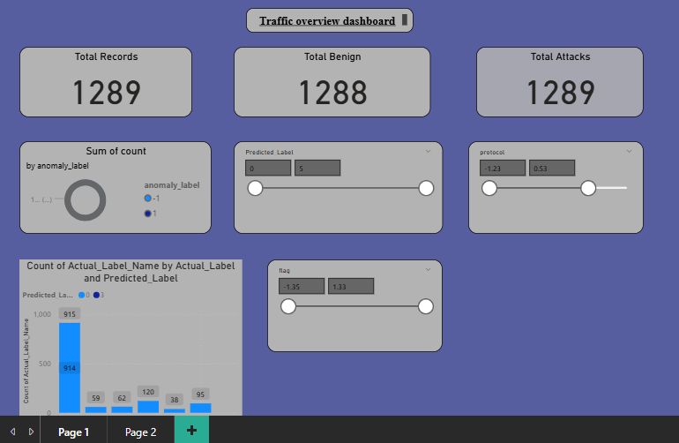
GitHub Repository: https://github.com/Serge731/CyberSecurityBigDataAnalytics

Slide 7
Dashboard 2: Anomaly Detection & Model Evaluation
Displays anomalies detected, anomaly rate and model accuracy.
Includes scatter plot, bar charts, and confusion matrix.
Dataset Link
GitHub Repo Link
PowerBI Link

Slide 8
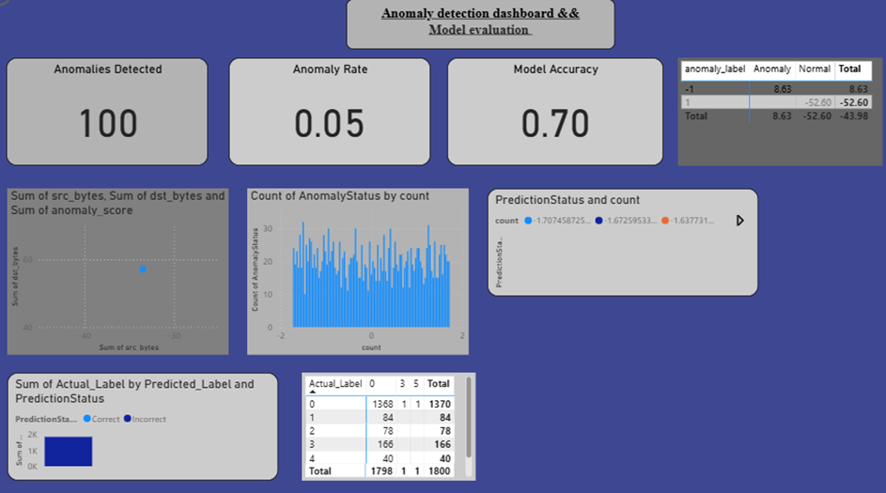
GitHub Repository: https://github.com/Serge731/CyberSecurityBigDataAnalytics

Slide 9
Key KPIs & Measures
- TotalRecords: Count of all traffic entries
- TotalAttacks: Count of malicious traffic records
- TotalBenign: Count of normal traffic records
- AnomaliesDetected: Total anomalies from Isolation Forest
- AnomalyRate: % of anomalies in dataset
- ModelAccuracy: % of correct predictions
Dataset Link
GitHub Repo Link
PowerBI Link

Slide 10
Recommendations
1. Integrate dashboards with real-time streaming data.
2. Use advanced ML models (XGBoost, PyCaret) to improve classification.
3. Automate anomaly alerts in Power BI.
4. Provide executive summary reports with monthly trends.
Dataset Link
GitHub Repo Link
PowerBI Link

Slide 11
Future Work
1. Expand dataset with real-world traffic logs.
2. Deploy dashboards in Power BI Service for organization-wide access.
3. Enhance visual storytelling with AI-driven insights.
4. Integrate with SIEM systems for proactive threat response.
Dataset Link
GitHub Repo Link
PowerBI Link

Slide 12
Closing Summary
This project demonstrates how combining machine learning with interactive visual analytics can empower organizations to detect threats more effectively.
The Power BI dashboard provides a clear, actionable view of network anomalies and model performance.
Dataset Link
GitHub Repo Link
PowerBI Link

Slide 13
Thank you for your time and consideration.
GitHub Repository: https://github.com/Serge731/CyberSecurityBigDataAnalytics

