Slide 1
Energy Saving in O-RAN with Reinforcement Learning
A digital-twin study: learning to sleep 5G cells without hurting service quality
ns-3 mmWave O-RAN
imitation + PPO
energy-vs-QoS tradeoff
ns-O-RAN digital-twin study · imitation + reinforcement learning

Slide 2
CONTEXT
The problem & the goal
▪ 5G base stations (gNBs) draw ~600 W even when almost idle — a large, avoidable energy cost.
▪ Idea: an intelligent controller that puts unused gNBs to sleep, waking them when demand returns.
▪ The tension: sleep too aggressively and you drop calls / lose throughput (QoS).
▪ Company goal: a reinforcement-learning (RL) controller that beats the hand-coded heuristic on the energy-vs-QoS tradeoff — more energy saved without hurting throughput or reliability.
Energy-Saving RL · ns-O-RAN digital twin
02 / 13

Slide 3
SYSTEM
The digital twin (what we simulate)
▪ ns-3 mmWave O-RAN simulator, scenario-three: 1 LTE anchor cell + 7 mmWave gNBs (can sleep), 6 users.
▪ Traffic redesigned to 3 sharp bursts per episode (+ an always-on baseline user) — so the controller must adapt in real time (sleep in the lulls, wake for the bursts).
▪ Energy model: each ON gNB = 600 W static + 400 W x utilisation; a sleeping gNB ~ 0 W.
▪ Key constraint: the simulator runs ~15-20 s per 100 ms control step (CPU-bound) — this shapes everything.
Energy-Saving RL · ns-O-RAN digital twin
03 / 13

Slide 4
SYSTEM
How it works — real-time closed-loop control
▪ Every 100 ms, a handshake over shared memory (files + semaphores):
– ns-3 emits per-cell KPMs (load, throughput, dropped calls) -> a 61-number observation.
– the controller picks a 7-bit ON/OFF action (one bit per gNB; anchor always ON).
– the action is written back; ns-3 applies it and advances 100 ms.
▪ Reward the RL optimises: throughput(Mbps) - energy(kW) - 2 x dropped-calls(RLF).
▪ The controller plays the role of an O-RAN 'xApp'; we drive the sim directly (no live RIC needed).
Energy-Saving RL · ns-O-RAN digital twin
04 / 13

Slide 5
METHOD
The controllers we compared
▪ Heuristic (TwinHeuristic) - the company baseline: load-adaptive, sleeps idle cells, wakes on neighbour load.
▪ Behaviour Cloning (BC) - a neural net trained to copy the heuristic (reached 100% match).
▪ PPO (reinforcement learning) - warm-started from BC, then fine-tuned on the reward. The one that can surpass.
▪ Pruning controller - an aggressive energy-saver with a tunable 'grace' dial (energy-vs-reliability).
▪ (ns-3's own built-in heuristic is quota-driven and can't adapt to load - hence the custom one.)
Energy-Saving RL · ns-O-RAN digital twin
05 / 13

Slide 6
METHOD
The learning pipeline
▪ 1) Collect expert demonstrations - run the heuristic on the twin, log (observation, action) pairs.
▪ 2) Behaviour Cloning (+ critic warm-up) - clone the heuristic into the policy AND pre-train its value estimator; the warm-up fixes a classic BC->PPO collapse we hit and diagnosed.
▪ 3) PPO fine-tune (~4 h, live ns-3 rollouts) - improve on the true reward.
▪ 4) Evaluate deterministically vs the heuristic across 4 seeds; score energy / throughput / RLF.
▪ All reproducible; trained model + demos committed to the repo.
Energy-Saving RL · ns-O-RAN digital twin
06 / 13

Slide 7
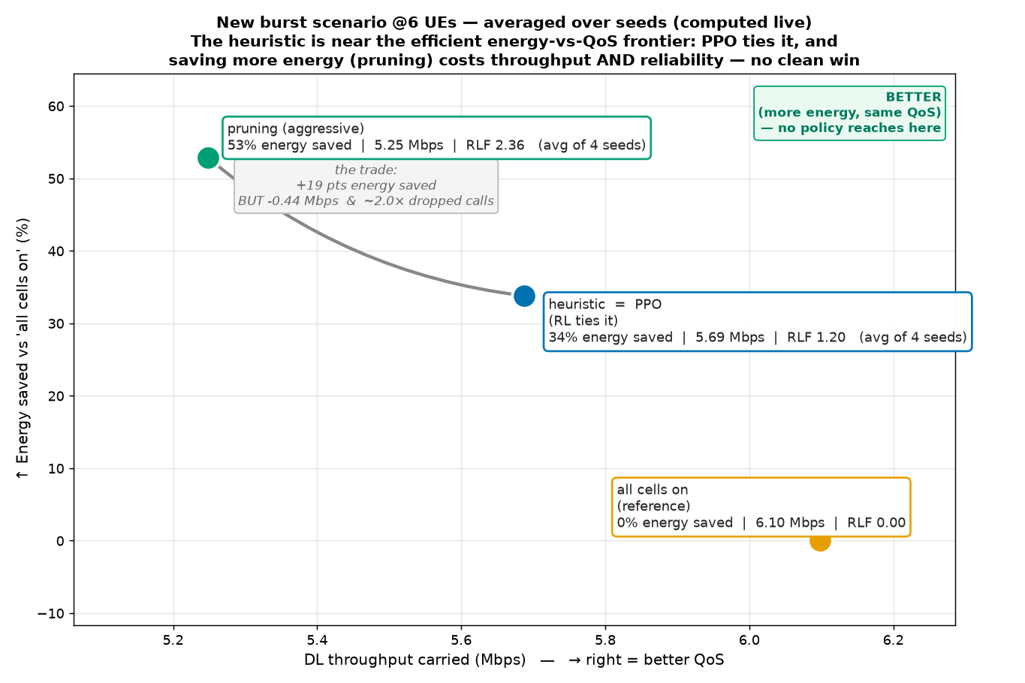
RESULTS
Result 1 — the energy-vs-QoS tradeoff
Heuristic sits near the efficient frontier; plain-reward PPO ties it byte-for-byte
4-seed averages. PPO reproduces the heuristic (a tie). Aggressive pruning saves more energy but costs reliability.
Energy-Saving RL · ns-O-RAN digital twin
07 / 13

Slide 8
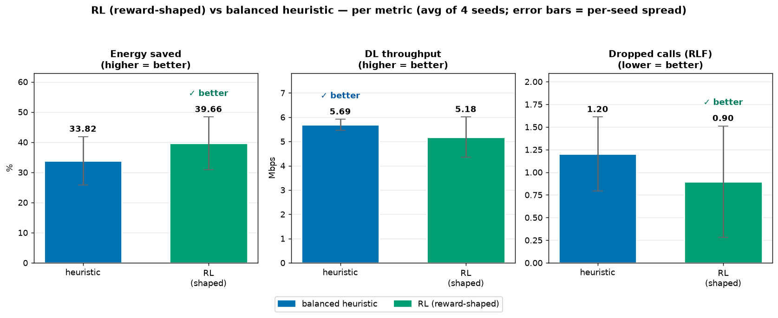
RESULTS
Result 2 — an improved reward moved RL off the tie
Potential-based reward shaping -> a distinct, greener + more-reliable policy
Shaped-reward RL vs balanced heuristic (4-seed avg): +6 pts energy AND ~25% fewer dropped calls, ~9% less throughput.
Energy-Saving RL · ns-O-RAN digital twin
08 / 13

Slide 9
ANALYSIS
Why RL doesn't strictly dominate (the key insight)
▪ The heuristic is genuinely near-optimal here - it's hard to beat because it's already good.
▪ RL is sample-starved: the slow sim affords only ~640 trial-steps, and random on/off exploration sleeps idle AND busy cells together -> can't isolate 'sleeping THIS idle cell was the good move'.
▪ The 43% 'idle-but-powered' waste is real in hindsight, but NOT free to reclaim: sleeping a momentarily-idle cell that's needed next causes a dropped call. The heuristic's caution is justified.
▪ So it's a favourable TRADEOFF (greener + more reliable, slightly less throughput), not a clean sweep.
Energy-Saving RL · ns-O-RAN digital twin
09 / 13

Slide 10
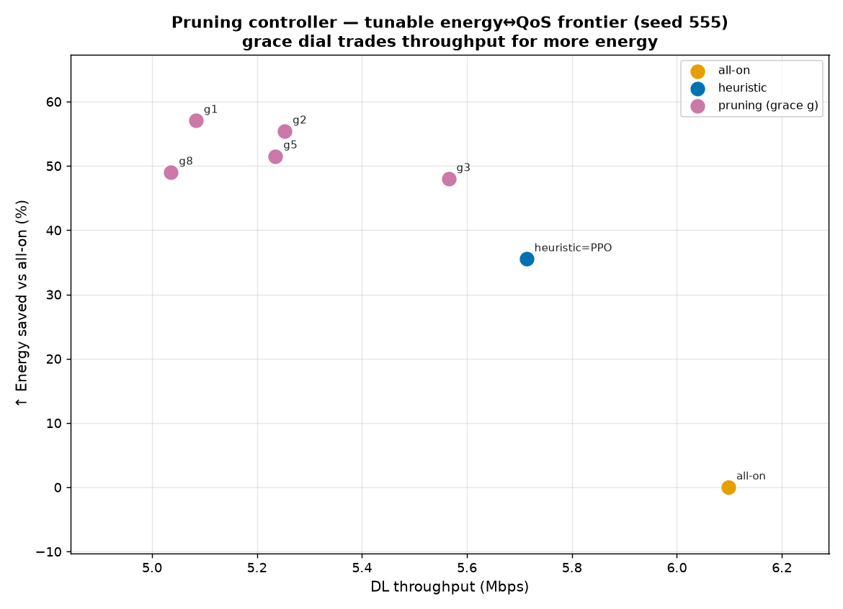
RESULTS
Operational value — a tunable energy/QoS frontier
One dial lets an operator choose the operating point; the heuristic is a single fixed point
Pruning 'grace' dial: from the heuristic's point up to ~57% energy saved, trading throughput as you go.
Energy-Saving RL · ns-O-RAN digital twin
10 / 13

Slide 11
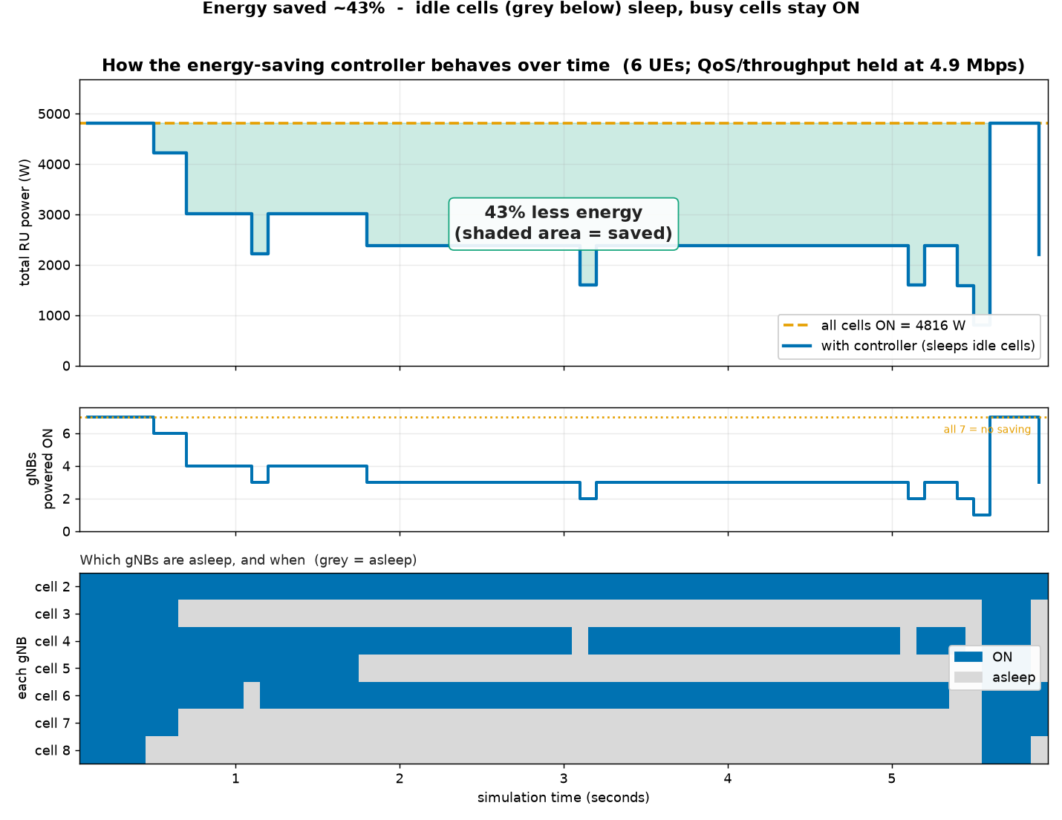
RESULTS
What the controller does over time
Cells sleep through the lulls and wake for the bursts
One shaped-RL run (seed 999, ~43% saved). RL's 4-seed AVERAGE is ~40% energy saved; per-seed it varies 25-46%. Idle cells sleep; busy cells stay on.
Energy-Saving RL · ns-O-RAN digital twin
11 / 13

Slide 12
SUMMARY
Bottom line & next steps
▪ Delivered: a realistic bursty twin, a working imitation+RL pipeline (BC 100% match, stable PPO), a rigorous energy-vs-QoS tradeoff, and a tunable energy-saving controller.
▪ RL result: with reward shaping, RL learns a greener + more-reliable operating point than the heuristic - better on energy AND dropped-calls, slightly lower throughput: a favourable, honest tradeoff.
▪ It does not STRICTLY beat a strong heuristic on all three axes - the real blocker is the slow simulator's tiny sample budget (~640 RL trial-steps), too little to out-tune a good heuristic.
▪ Next steps: (1) sample-efficient RL - offline RL on logged data, or a fast learned surrogate of the sim - to escape that budget; (2) richer / larger network scenarios; (3) ship the tunable controller.
Energy-Saving RL · ns-O-RAN digital twin
12 / 13

Slide 13
DELIVERABLES
Reproducibility & deliverables
▪ Two git repos: ns-3-mmwave-oran (the twin) + ns-o-ran-gym (gym / RL / analysis).
▪ Committed: trained model + demos + obs-stats; all scripts; figures computed live from run folders.
▪ Docs (self-contained): OVERVIEW.md (how it all works), RESULTS.md (findings & numbers), REPRODUCE.md (build & run from scratch), CONTEXT.md (full-journey primer).
▪ Figures: energy-vs-QoS tradeoff, per-metric comparison, pruning frontier, controller-over-time.
Energy-Saving RL · ns-O-RAN digital twin
13 / 13

