Slide 1
Diploma
Variant 1
Sergei Larin 2022
CONFIDENTIAL © 2022 EPAM Systems, Inc.

Slide 2
Task
Variant 1.
Using API https://affiliate.itunes.apple.com/resources/documentation/itunes-store-web-service-search-api/ get all data about “Pink Floyd" and store it into your DB:
kind,
collectionName,
trackName,
collectionPrice,
trackPrice,
primaryGenreName,
trackCount,
trackNumber,
releaseDate.
Output the data for the year of releaseDate (the year is set) in form of a table and sort them by trackPrice in descending order.

Slide 3
Solution
Frontend + Backend: Python + Flask
Database: RDS PostgresSQL
SCM: GitHub
Tests: Linter check
Quality Gate: SonarQube
IaC: Terraform
Cloud: AWS at own account
Orchestration: EKS
CI/CD: Jenkins Logging + Monitoring: CloudWatch
Scalability: Horizontal Pod Autoscaling(HPA)

Slide 4
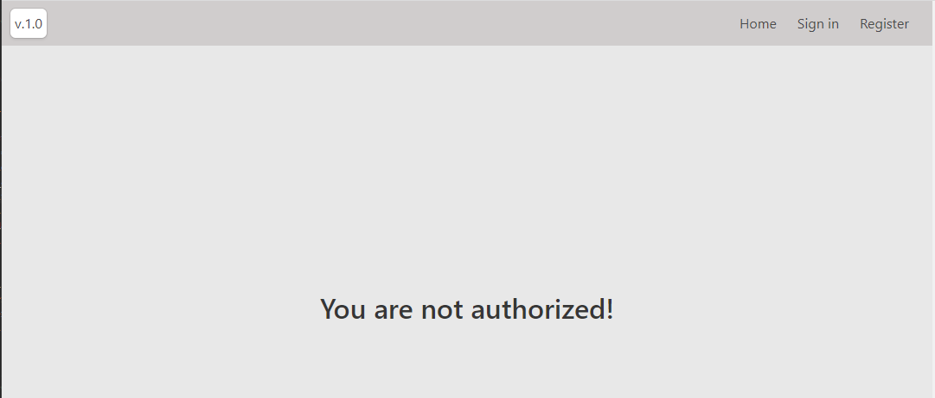
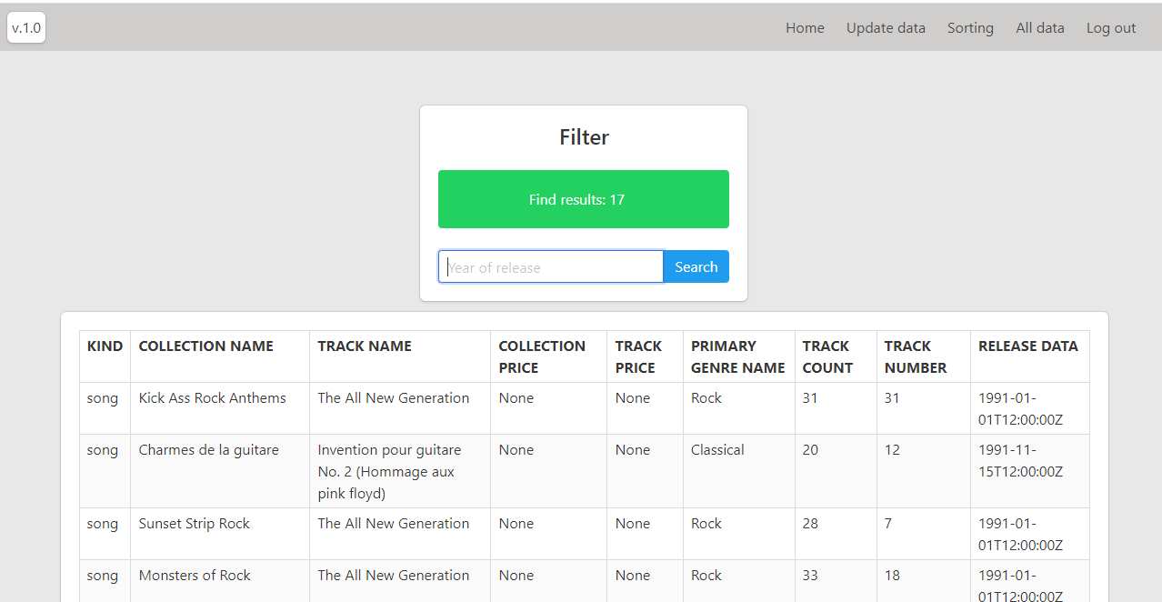
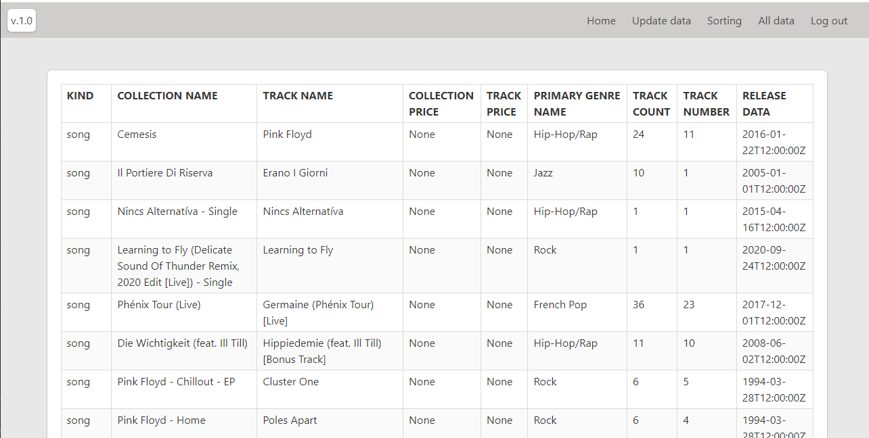
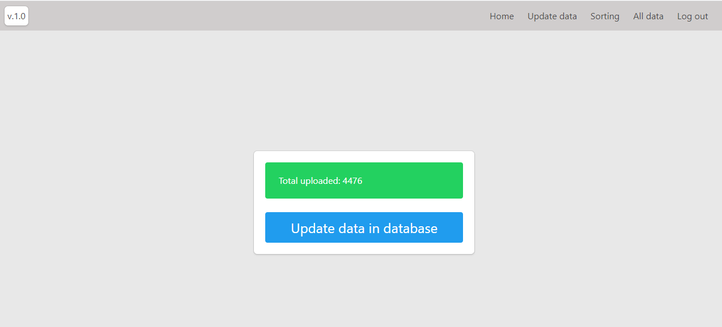
Application view

Slide 5
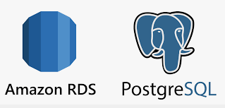
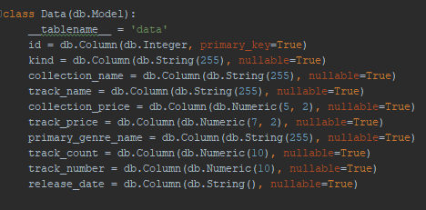

Database
Manage DB
python manage.py db migrate
python manage.py db upgrade

Slide 6

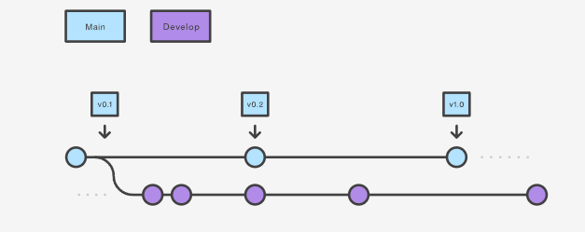
SCM
Source code: https://github.com/Sergei-Larin/diploma.git

Slide 7
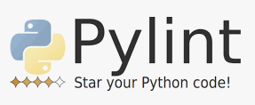

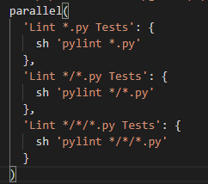
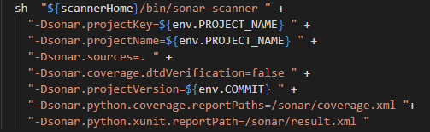
Tests + Quality Gate

Slide 8

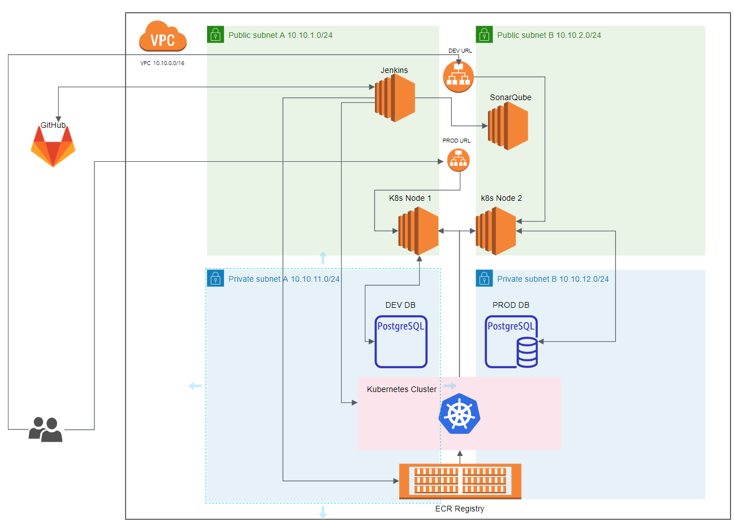
IaC
Jenkins automatically integrated with all services when started
VPC
Subnets
Ec2 instance
ECR
EKS
RDS PostgreSQL
LoadBalancers
Security Groups
SMM (store RDS credentials)

Slide 9


Orchestration
Used one parametrized manifest.yaml for run application in dev and prod environments
Used entities:
ConfigMap
Deployment
Service (LoadBalancer)
HorizontalPodAutoscaler
HPA starts when:
Cpu Utilization above then 60%
Plugins:
metrics-server

Slide 10
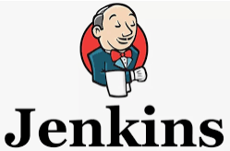
CI / CD
Used: Multibranch Pipeline
Pipeline: declarative Jenkinsfile in GitHub
Worker Nodes: Run at kubernetes by agent.yaml file
Triggered by: web hook from GitHub
Pipeline Stages
Preparations (Initialize parameters as environment JENKINS-41929)
Test pylint (run parallel)
SonarQube
Build image
Deploy to dev (when branch dev)
Deploy to prod (when new tag created)
Branch filter for run pipeline:
Include: dev* release* v.*
Excludes: feature* , fix*, test*

Slide 11
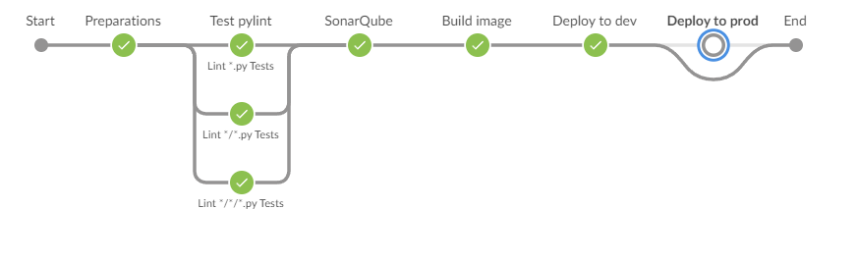
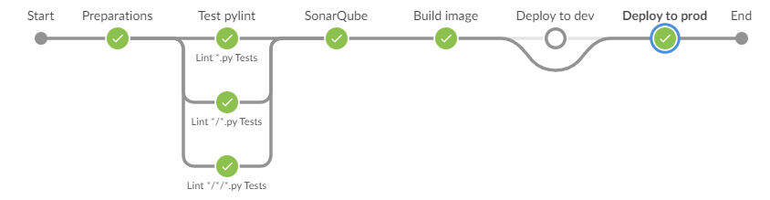
CI / CD
Web hook events to starts pipeline:
Pull requests
Pushes
Branch or tag creation
Branch or tag deletion
Dev pipeline
Prod pipeline

Slide 12

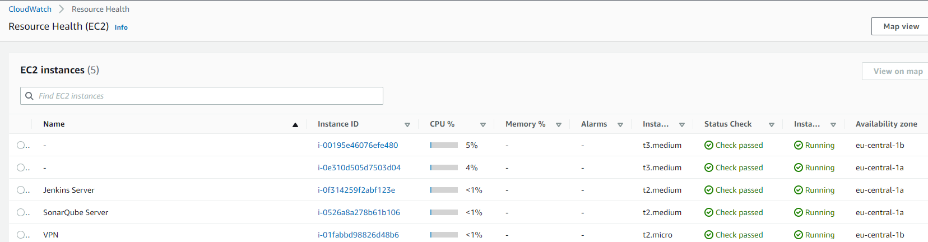
Monitoring

Slide 13
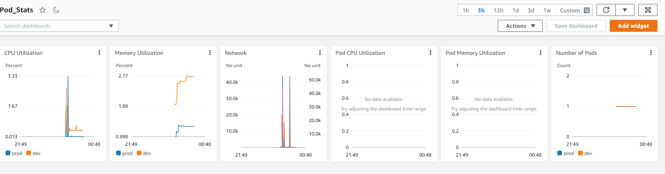
Monitoring

Slide 14
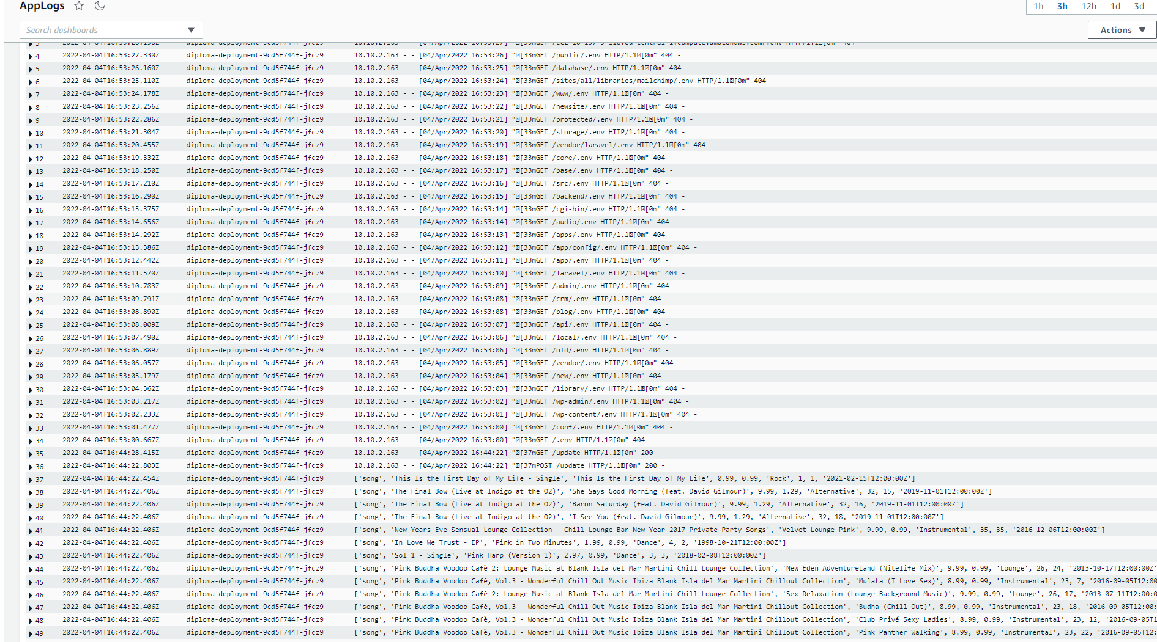
Logs from APP

Slide 15
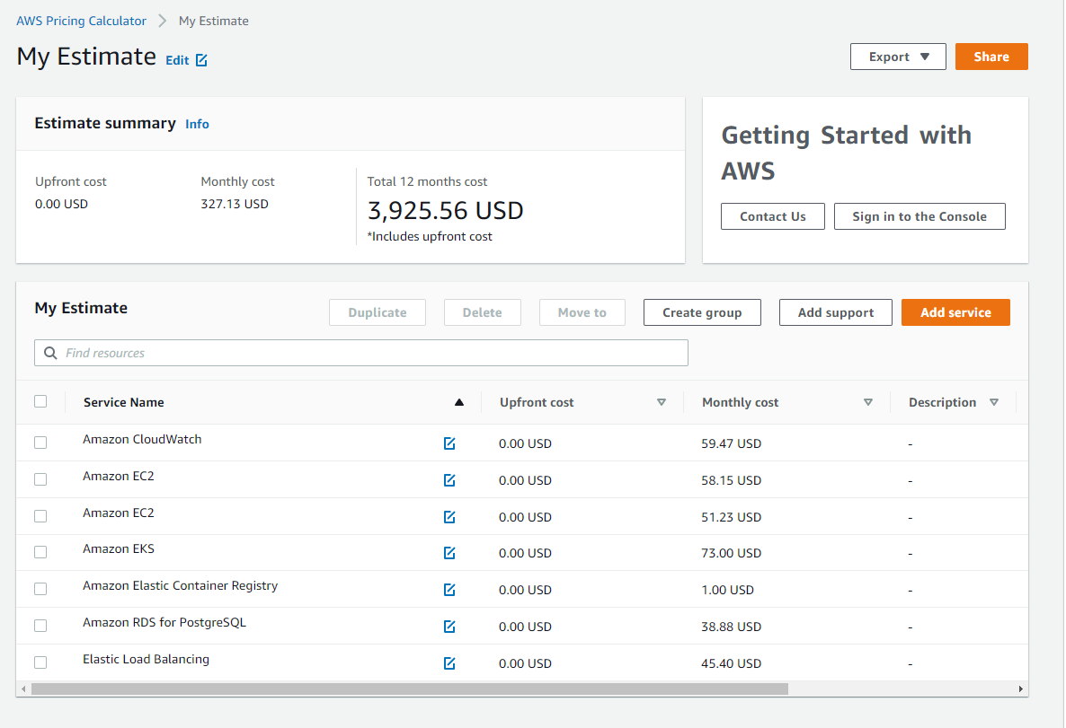
Project cost in AWS
Monthly cost: 327.13 USD
Total 12 months cost: 3,925.56 USD

Slide 16
Thank you!

