Slide 1

Version control system Azure Devops, Git
Siarhei Tsikhan
14 december 2021

Slide 2
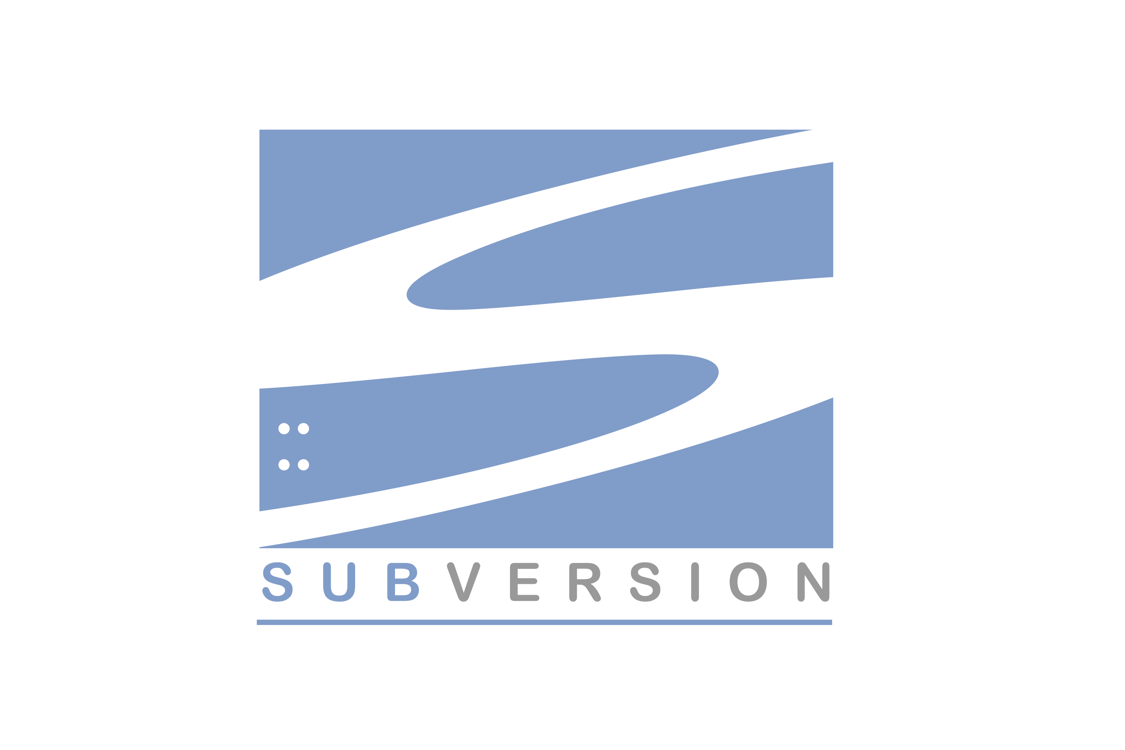
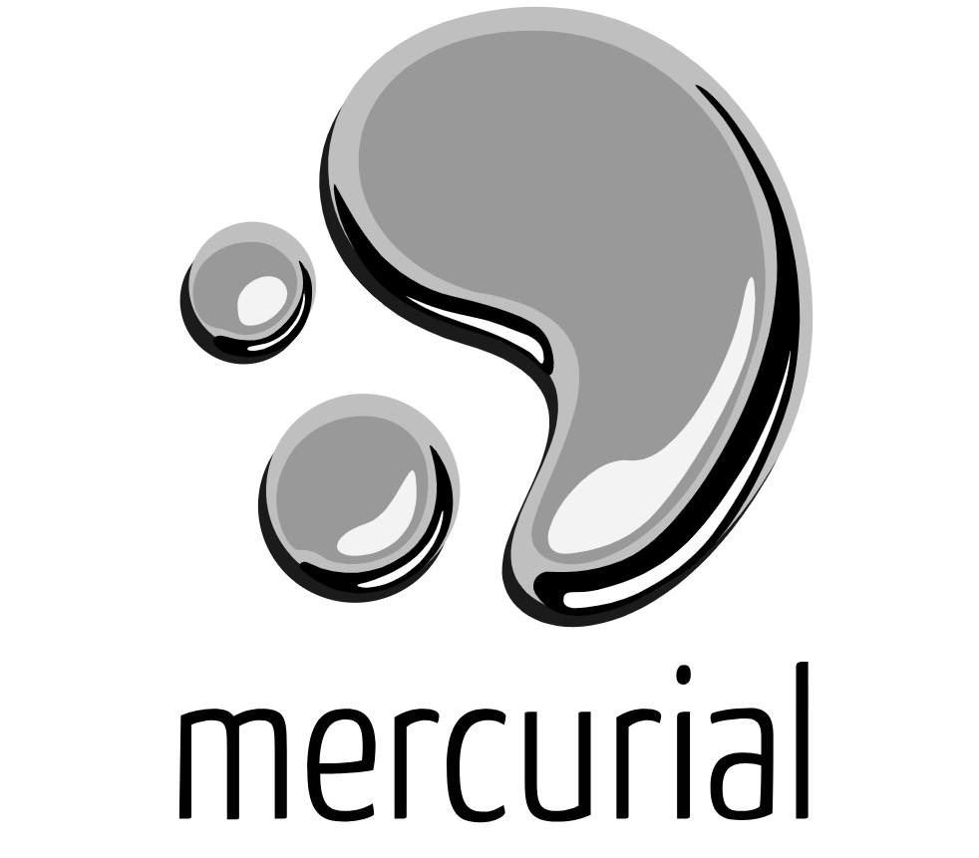

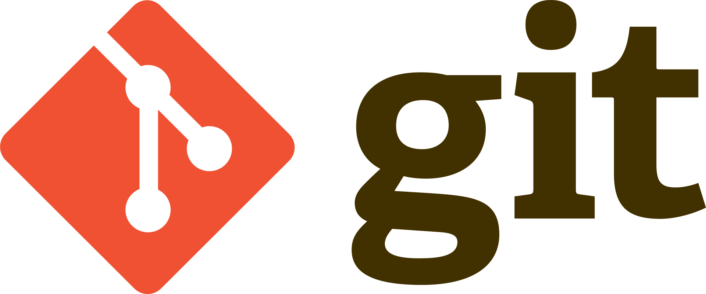
Overview
Version control system
Subversion
Mercurial
Git
Azure Devops

Slide 3

Relevance of the topic
A version control system allows users to keep track of the changes in software development projects, and enable them to collaborate on those projects. Using it, the developers can work together on code and separate their tasks through branches.
There can be several branches in a version control system, according to the number of collaborators. The branches maintain individuality as the code changes remain in a specified branches.

Slide 4
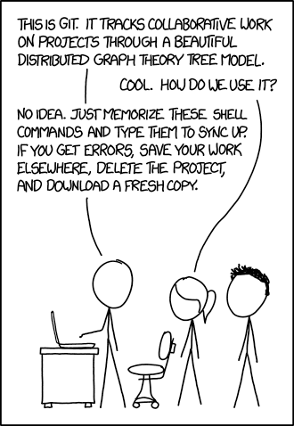

This is what happens if you do not use a version control system

Slide 5
Version control system - Subversion
SVN is a widely adopted centralized version control system. This system keeps all of a project’s files on a single codeline making it impossible to branch, so it’s easy to scale for large projects. It’s simple to learn and features folder security measures, so access to subfolders can be restricted.

Slide 6
Version control system - Mercurial
Mercurial is a distributed version control system that offers simple branching and merging capabilities. The system enables rapid scaling and collaborative development, with an intuitive interface. The flexible command line interface enables users to begin using the system immediately.

Slide 7
Version control system - Git
Git is the most popular option and has become synonymous with “source code management.” Git is an open source distributed system that is used for software projects of any size, making it a popular option for startups, enterprise, and everything in between.

Slide 8
Statistics that show the popularity of Git versus SVN
Years | Git | SVN | others
2013 | 26% | 57% | 17%
2014 | 27% | 54% | 19%
2015 | 38% | 46% | 16%
2016 | 37% | 48% | 15%
2017 | 39% | 46% | 15%
2018 | 51% | 41% | 8%
2019 | 61% | 33% | 6%
2020 | 69% | 26% | 5%
2021 | 70% | 25% | 5%

Slide 9
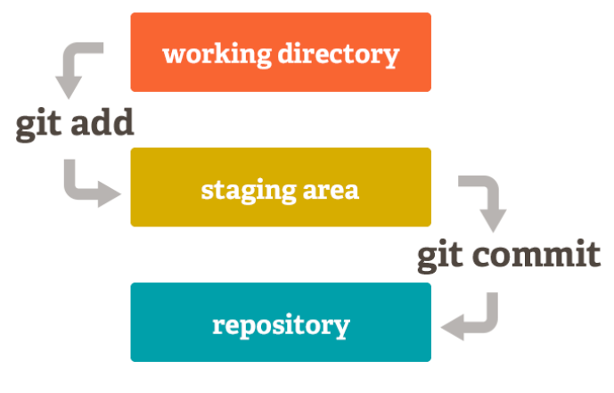
Working principles Git

Slide 10
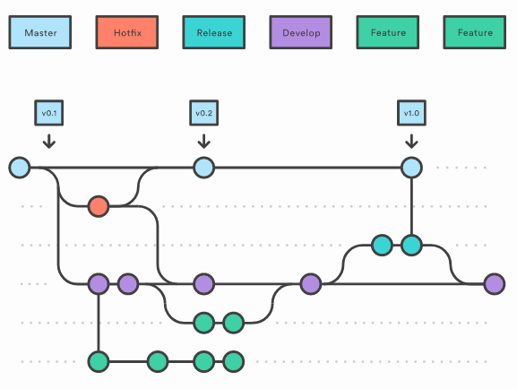
Git in production

Slide 11
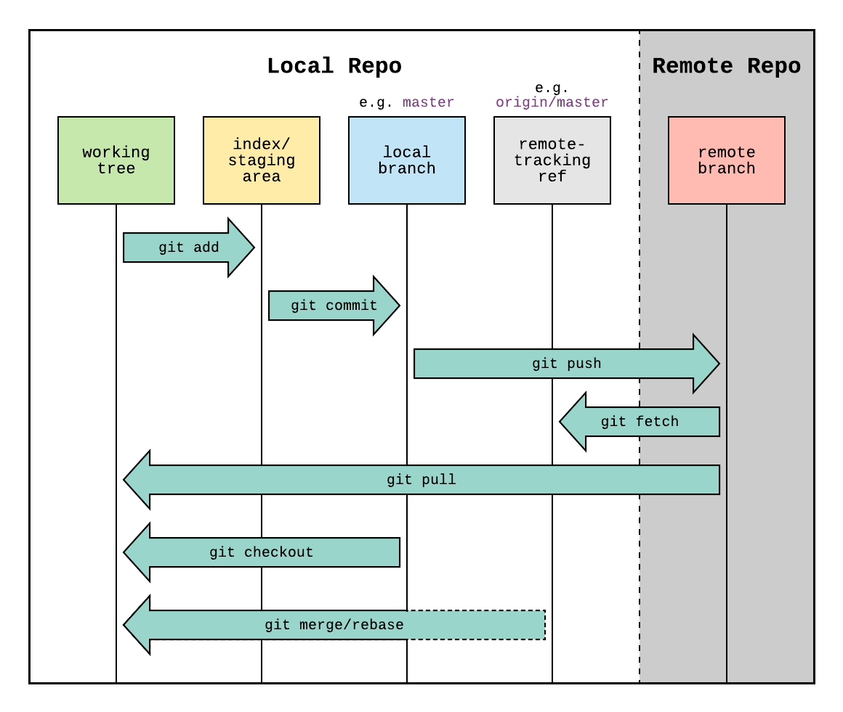

Theory of Git

Slide 12
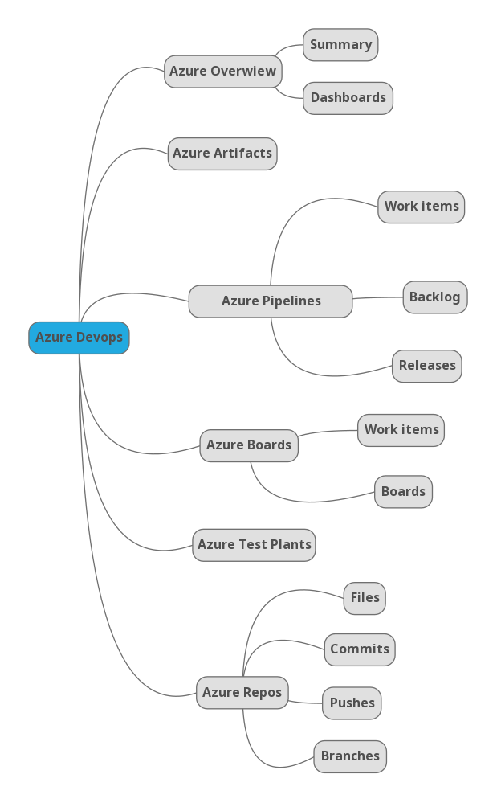
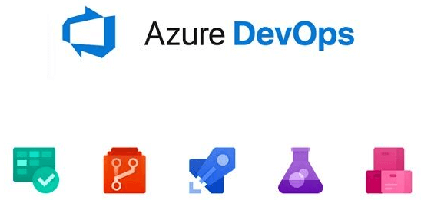
Components of Azure Devops

Slide 13
References
[1] What is version control?
https://about.gitlab.com/topics/version-control/.
[2] Scott Chacon and Ben Straub. Getting started - what is git?
https://git-scm.com/book/en/v2/Getting-Started-What-is-Git%3F.
[3] Jamie Cool. Azure devops.
https://azure.microsoft.com/en-us/blog/introducing-azure-devops/.
[4] Jacob Stopak. The evolution of version control system. https://initialcommit.com/blog/Technical-Guide-VCS-Internals.

Slide 14
Thank you for your attention!

