Slide 1
Bayesian Inference and Structured Gaussian Processes
Sergei V. Kalinin

Slide 2
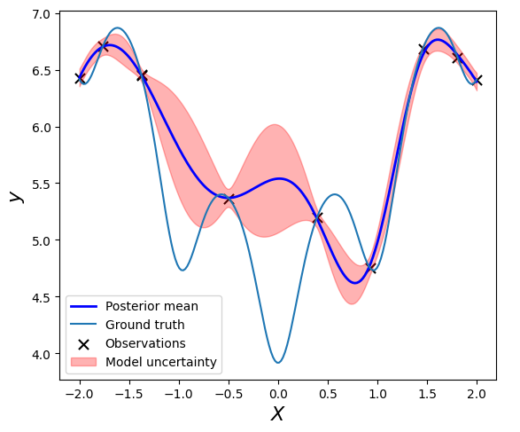
What have we learned from lecture 1
Gaussian Process
Kernel and kernel parameters
Kernel Priors
Noise Priors
Posteriors
Bayesian Optimization
Bayesian Optimization based on Gaussian Process
Acquisition Functions

Slide 3
What will we learn: Bayesian Inference Detour:
Bayesian Inference
Prior Distribution
Posterior Distribution
Least Square Fit
WAIC

Slide 4
Colab Bayesian Inference

Slide 5
Automated Experiment: … as a scientist…
Bayesian optimization:
1. Works only in low-dimensional spaces 2. The correlations are defined by the kernel function (very limiting) 3. We do not use any knowledge about physics of the system 4. We do not use cheap information available during the experiment (proxies)

Slide 6
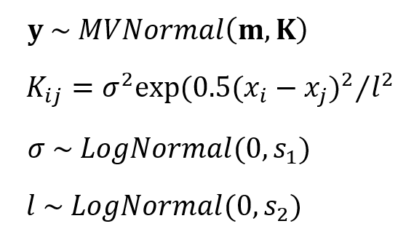
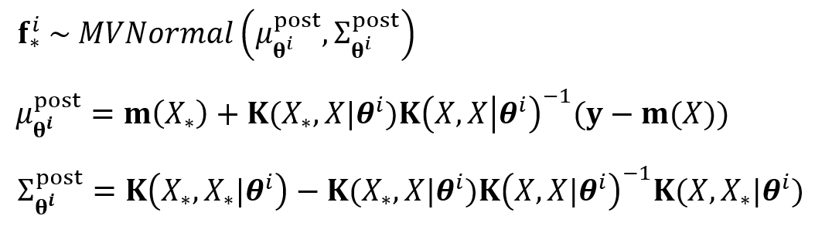
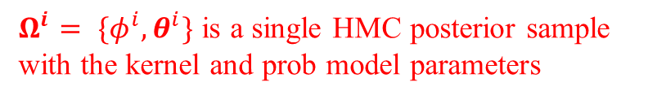
GP Augmented with Structural model
Define a probabilistic model:
We substitute a constant GP prior mean function m with a structured probabilistic model of the expected system’s behavior.
This probabilistic model reflects our prior knowledge about the system, but it does not have to be precise.
The model parameters are inferred together with the kernel parameters via the Hamiltonian Monte Carlo.
The fully Bayesian treatment of the model allows additional control over the optimization via the selection of priors for the model parameters.
Prediction on new data $X_{∗}$:
replaced with
$Ω^{i}= \{φ^{i},θ^{i}\}$ is a single HMC posterior sample with the kernel and prob model parameters

Slide 7
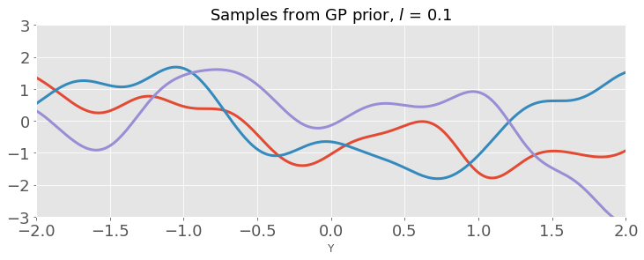
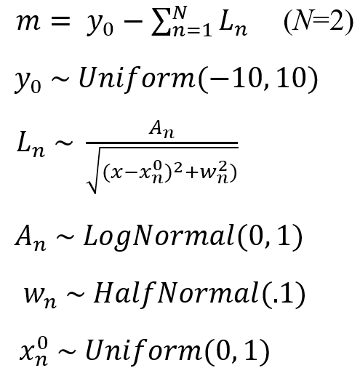
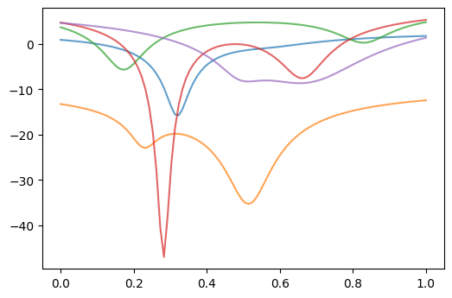
GP Augmented with Structural model
Prior predictive distribution: GP
Probabilistic model
Prior predictive distribution: sGP
This model simply tells us that there are two minima in our data but does not assume to have any prior knowledge about their relative depth, width, or distance

Slide 8
Simple GP search

Slide 9
Structured GP search

Slide 10
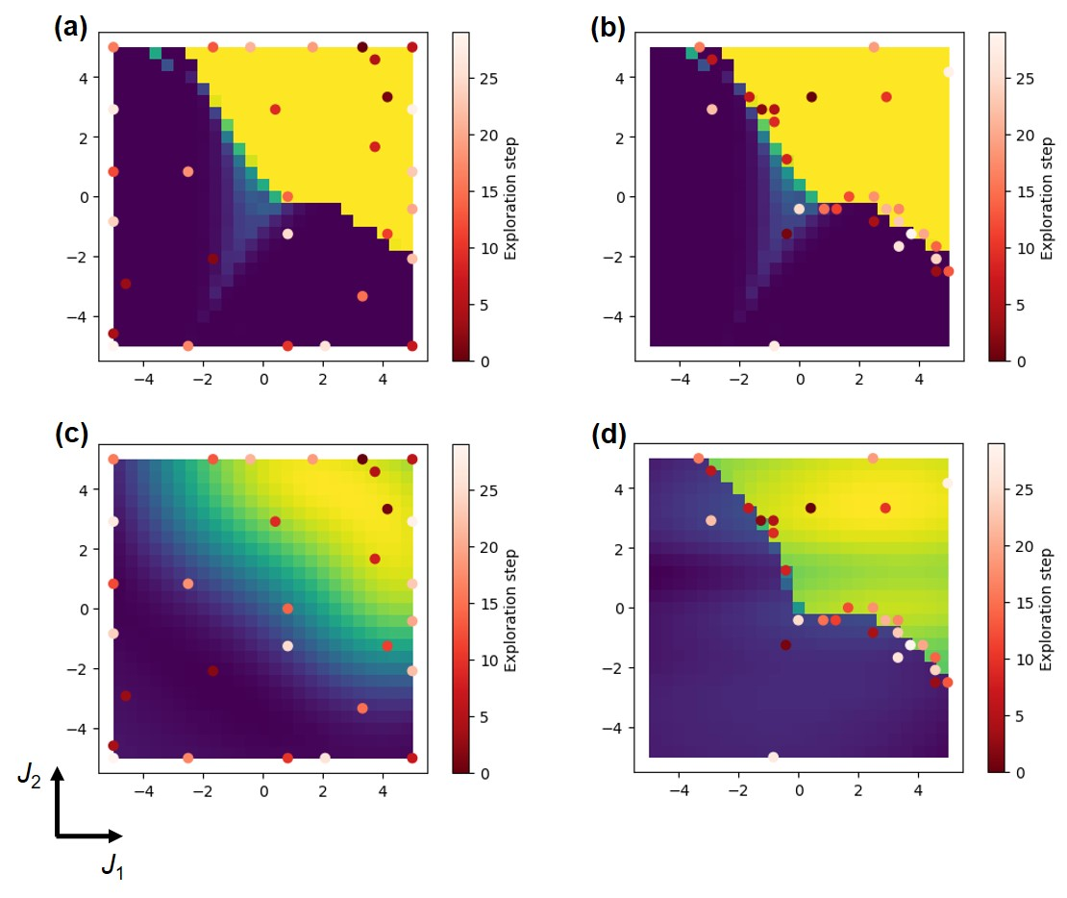
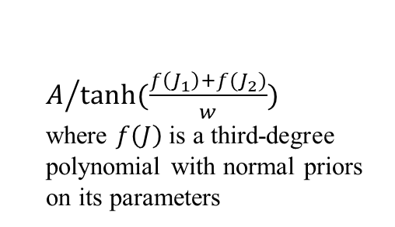
Application to Ising model
Vanilla GP-BO
overlay with ‘ground truth’
sGP-BO
overlay with ‘ground truth’
Probabilistic model
$A/{tanh⁡(\frac{f\left(J_{1}\right)+f(J_{2})}{w})}$
where $f\left(J\right)$ is a third-degree polynomial with normal priors on its parameters
overlay with prediction
overlay with prediction

Slide 11
Colab 2

