Slide 1
Welcome
Goldhill Publishing
Assemblage & Programming

Slide 2
Company profile
Who are we
Assembly development group
Specialized in AVR hardware

Slide 3

Our special offer
What do we have for you
Reliable
Self programmable
You can tell time with it
STK-Alarm clock

Slide 4
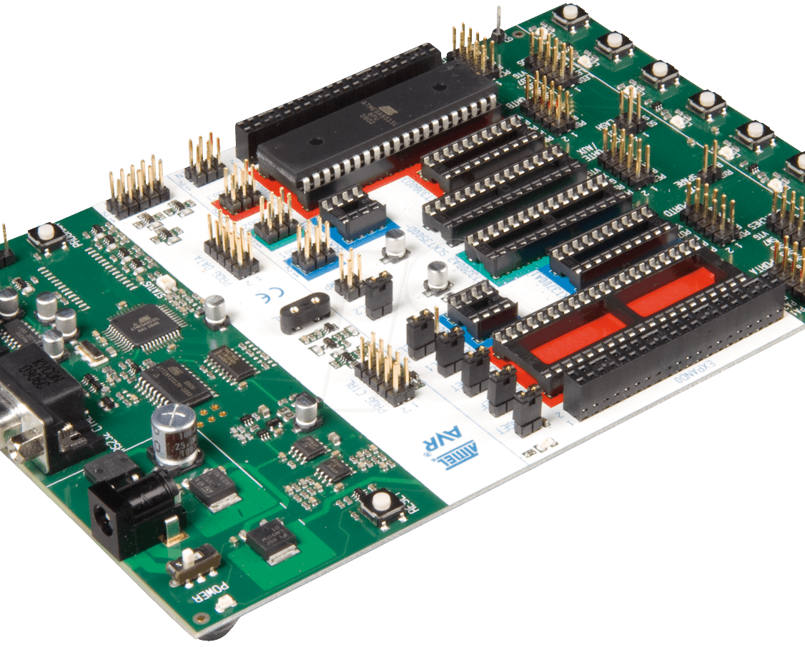
Hardware
What does the STK-Alarm clock run on
Latest version of the STK 500
Atmel Atmega32 processor
Crystal clock oscillator
RS232 connection

Slide 5
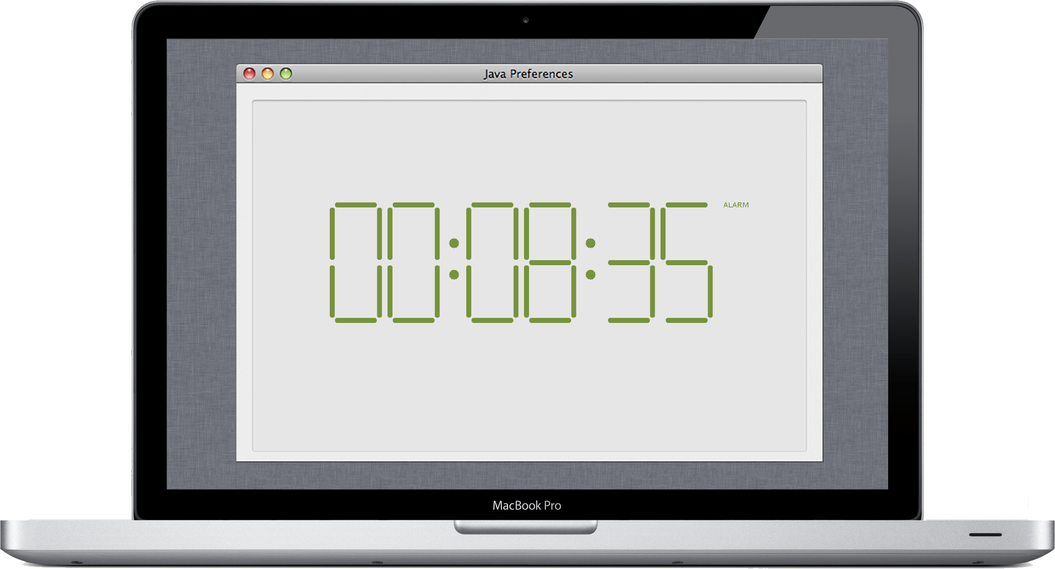
Software
Inside the STK-Alarm clock

Slide 6
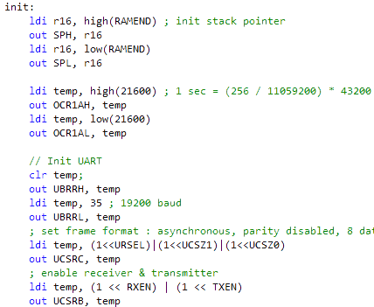
But how does it work?!
Inside the STK-Alarm clock
Ticks every half second
Switch bounce Wait-and-see method
Works with statusses
Only 14 registers used!

Slide 7
Functionality
How to control the STK-Alarm clock
Setting the time
Start the alarm clock
Press the SW0 button to increment hours/minutes/seconds
Press the SW1 button to switch between hours/minutes/seconds
Setting the alarm
Same way as setting time but only with hours and minutes
Turning the alarm on/off
While changing the time press SW0 to toggle the alarm status
Snooze
When the alarm is going off press SW1 to snooze or SW0 to turn it off

Slide 8
Summarizing
Reliable
Working
On time!

Slide 9
Thank you for your attention
Our contact information
E-Mail
Send a mail to Frank mulder
w.f.mulder@hanze.nl
Or a mail to Sergen Nurel
s.nurel@hanze.nl

