Slide 1


Moscow Metro Optimization
by BAE’24 students:
Sergej Ishmuratov and Andrey Strukov

Slide 2
The main ideas of the project:
To get and clear the data of the current distribution of trains by lines and of the passenger traffic;
Look for opportunities to minimize the overall average waiting time by moving a train from one line to another;
Compare the results with the current distribution

Slide 3
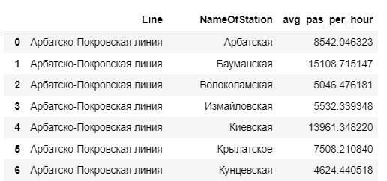

The data overview
After some work with data, we got a dataset with average number of passengers on each station per hour:
Source:

Slide 4
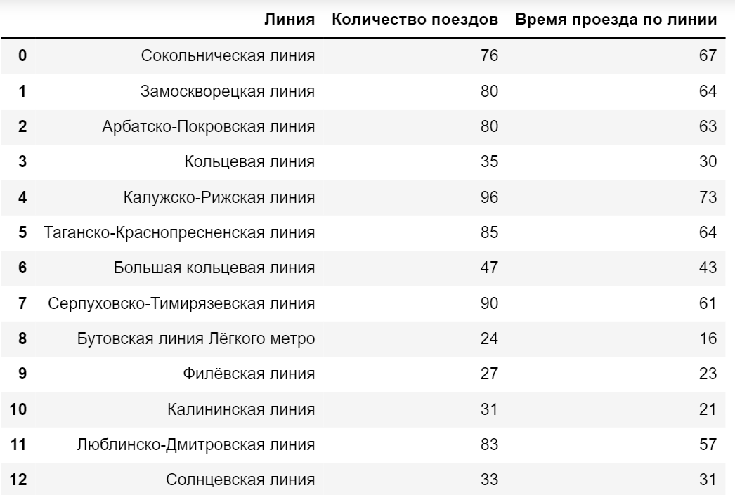
The data overview
After some work with data, we got this dataset with the current distribution of trains.
Source:

Slide 5
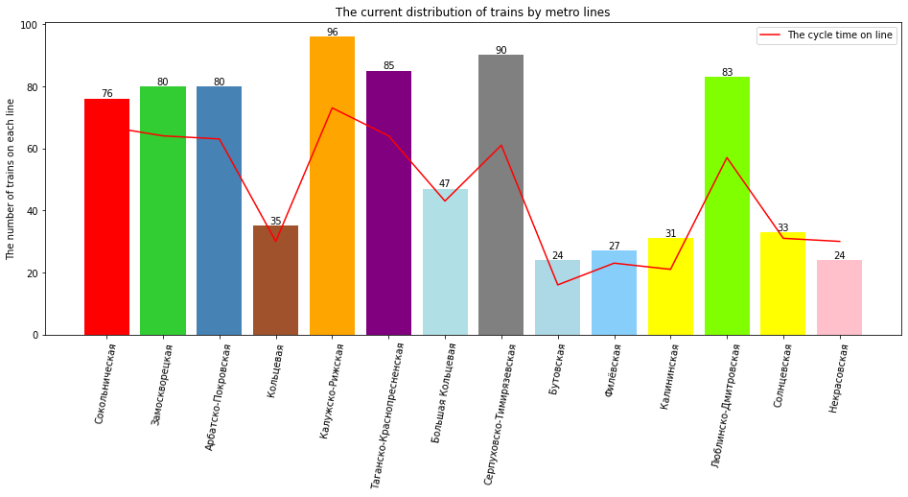
The current distribution

Slide 6


The model
The passenger comes to the station according to some arrival process.
The train stays on the station at the moment t=0.
The passenger waits for the next train and gets on this train.
The next train will come to the station after some fixed interval of time.

Slide 7

The intervals
The time of full cycle for this line
The interval =
=
The number of trains on the line

Slide 8
Step 1
Compute the average waiting time for the fixed distribution of trains
Compare cvxpy and numpy-only realization
Compare the uniform distribution for the arrival process and Poisson process.

Slide 9
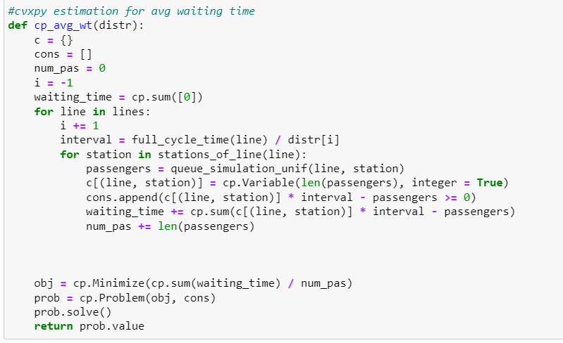
Estimation of waiting time: numpy vs cvxpy
Cvxpy based estimation:

Slide 10
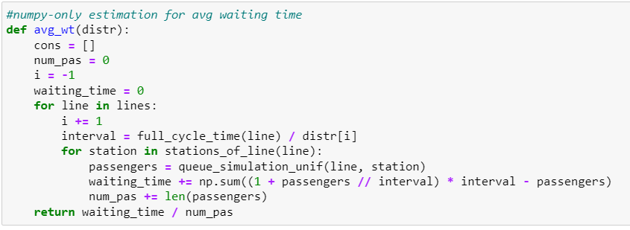
Estimation of waiting time: numpy vs cvxpy
Numpy based estimation:

Slide 11
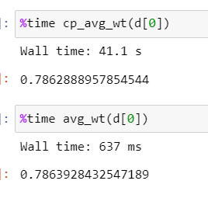
Estimation of waiting time: numpy vs cvxpy
Numpy is better!

Slide 12
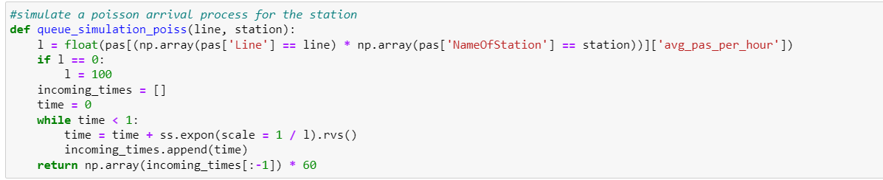
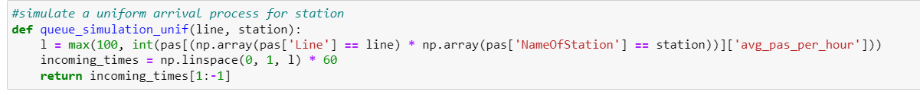
Poisson & Uniform arrival process, simulations

Slide 13
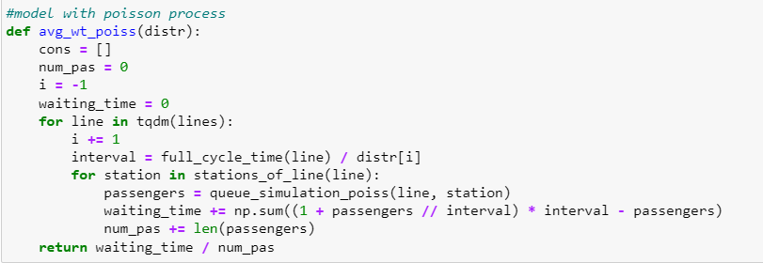
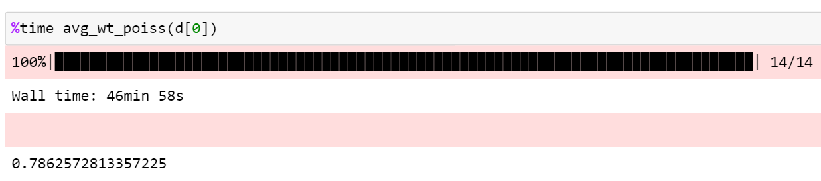
Poisson process or uniform distribution for the arrival?

Slide 14
Poisson process or uniform distribution for the arrival?
Poisson process and uniform distribution have almost the same effects, but Poisson process works much more slowly.
The final model: uniform distribution for arrivals + numpy – only realization.

Slide 15
Step 2
Find the distributions which has one train difference compared with the current distribution.
1
Find the best distribution among them.

Slide 16
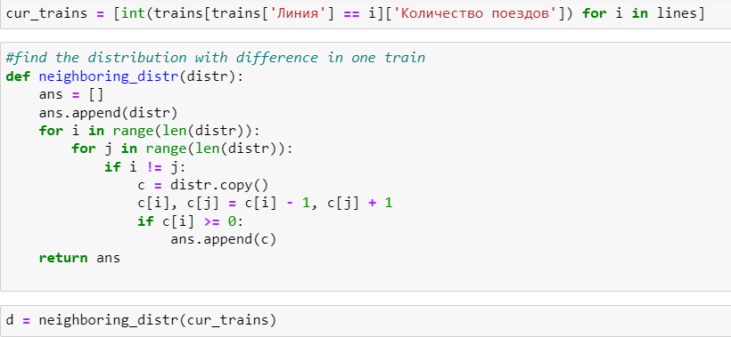

Slide 17
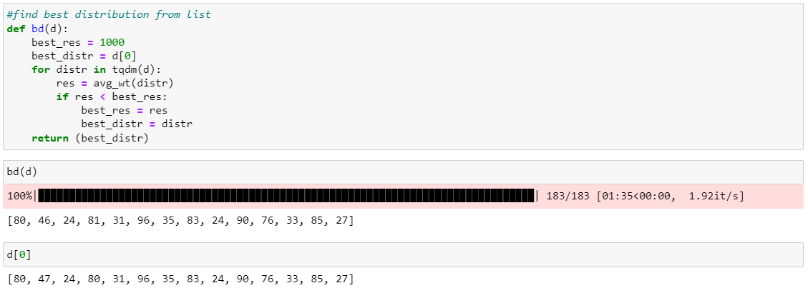
Moving the first train
The first suggestion is to move from Большая кольцевая линия to Замоскворецкая линия.

Slide 18
Step 3: Optimizing
Now let’s create an algorithm to move trains from line to line until the distribution becomes optimal:
Current distribution
Yes
Can you move one train to improve wt?
No
Let’s move it.
Stable “best” distribution

Slide 19
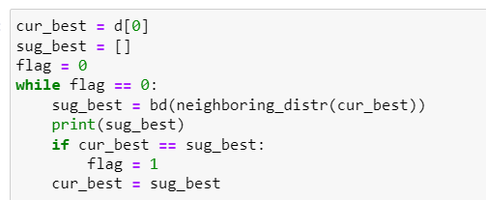
Optimizing
Now let’s create an algorithm to move trains from line to line until the distribution becomes optimal:

Slide 20
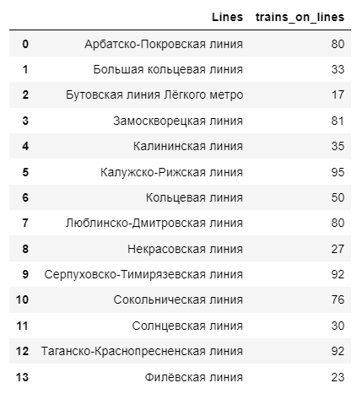
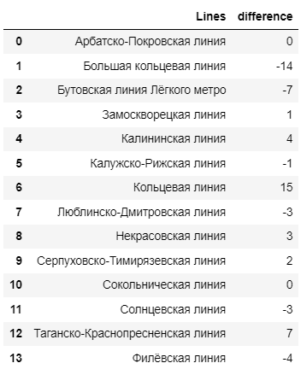
The results: optimal distribution

Slide 21
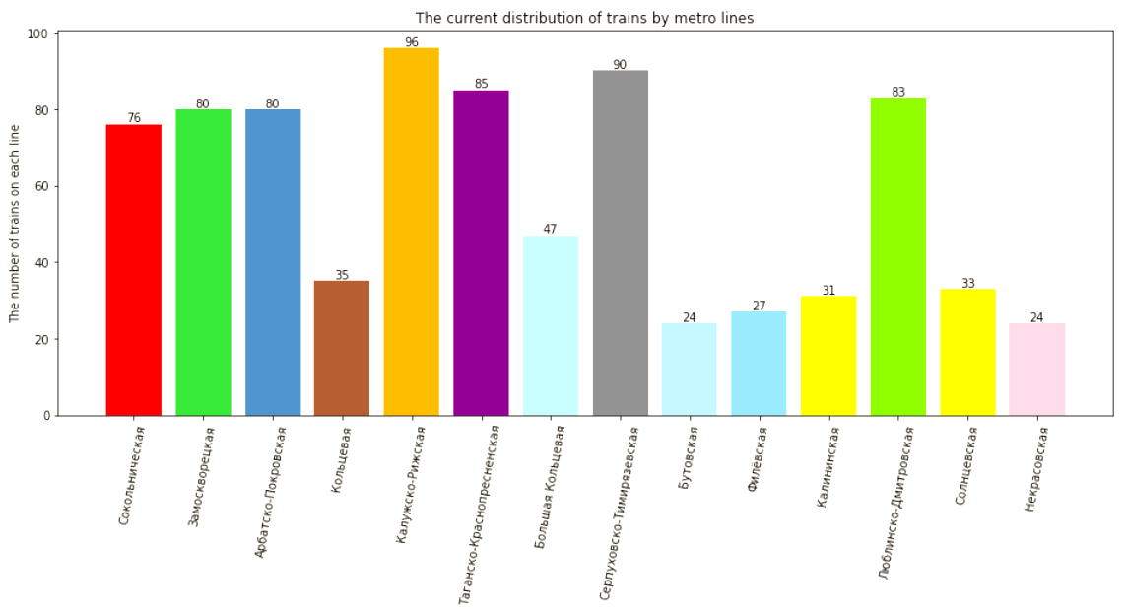
Current distribution

Slide 22
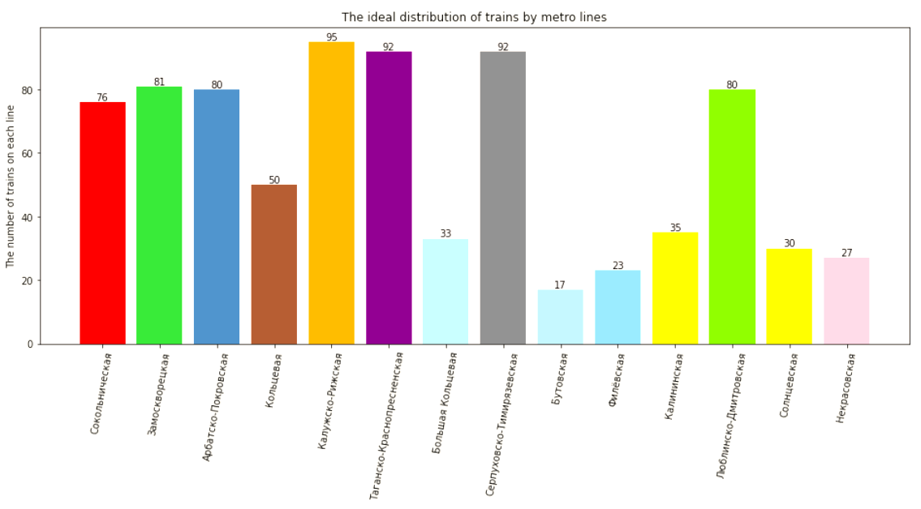
Optimal distribution

Slide 23
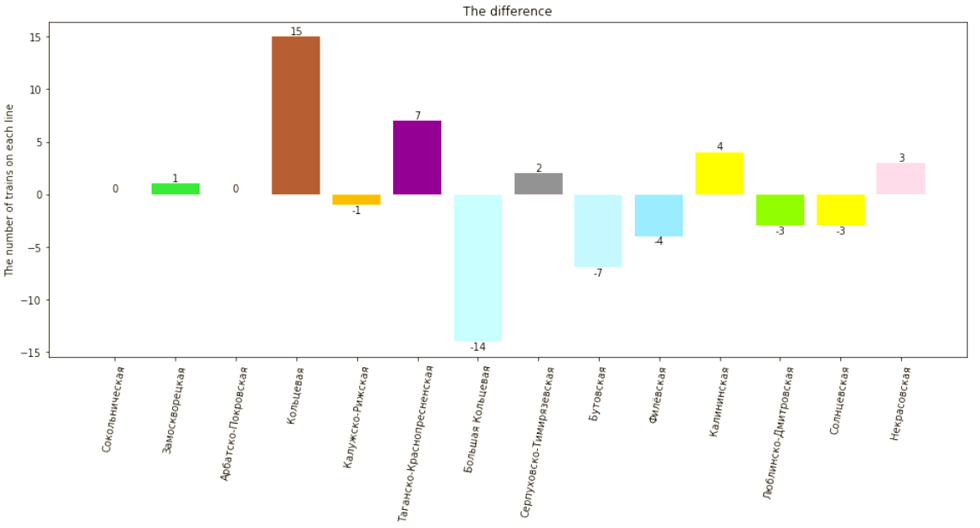
The difference in distributions

Slide 24
Discussion of the results
Overall, the current distribution is close to the ideal one on most lines.
However, it seems optimal to relocate more trains to the Кольцевая линия and reduce the number of trains on the Большая Кольцевая линия.
Why hasn’t that happened?
Possible explanations:
The technical issues regarding Кольцевая линия;
The government’s desire to popularize Большая Кольцевая линия, possibly as an alternative to more busy lines.

Slide 25
Questions?

