Slide 1

Park Sensor
Hüseyin Temizkan, Salih Erbalta, Sergey KUlikov

Slide 2

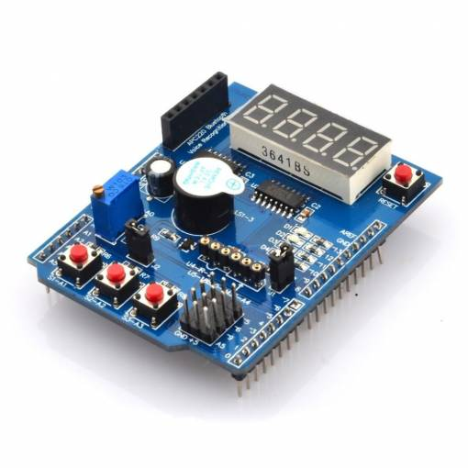
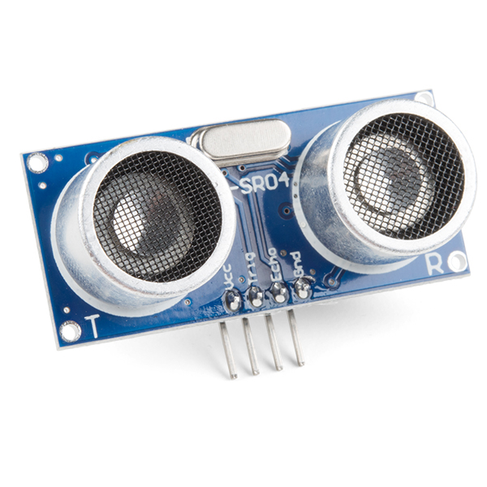
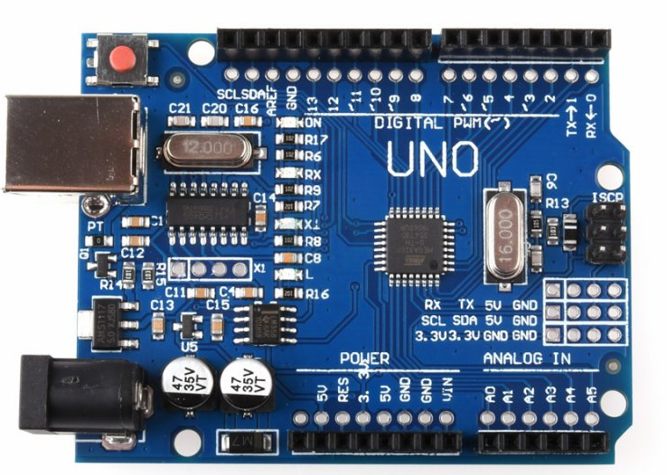



Used Hardware
Arduino UNO
Multifunction Shield
Ultrasonic Sensor – HC-SR04

Slide 3
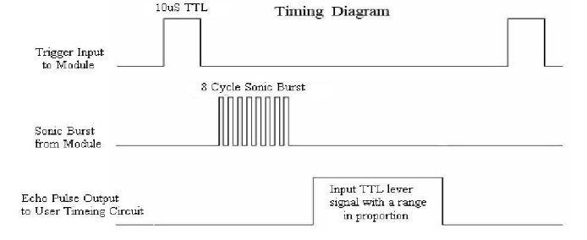
HC-SR04 Ultrasonic Sensor
The sensor will be triggered using 10µs of trigger signal.
An Input signal will be received through Echo pin.
Power will be provided using VCC and Ground pins

Slide 4
Calculating the Distance
The distance will be calculated using the time difference between the trigger and echo signal using timer overflows.
Basic Formula for the calculation:
Distance = number of overflows/ 58 cm
We count the number of overflows that are 16us and divide it by 58 to get the distance in cm.

Slide 5
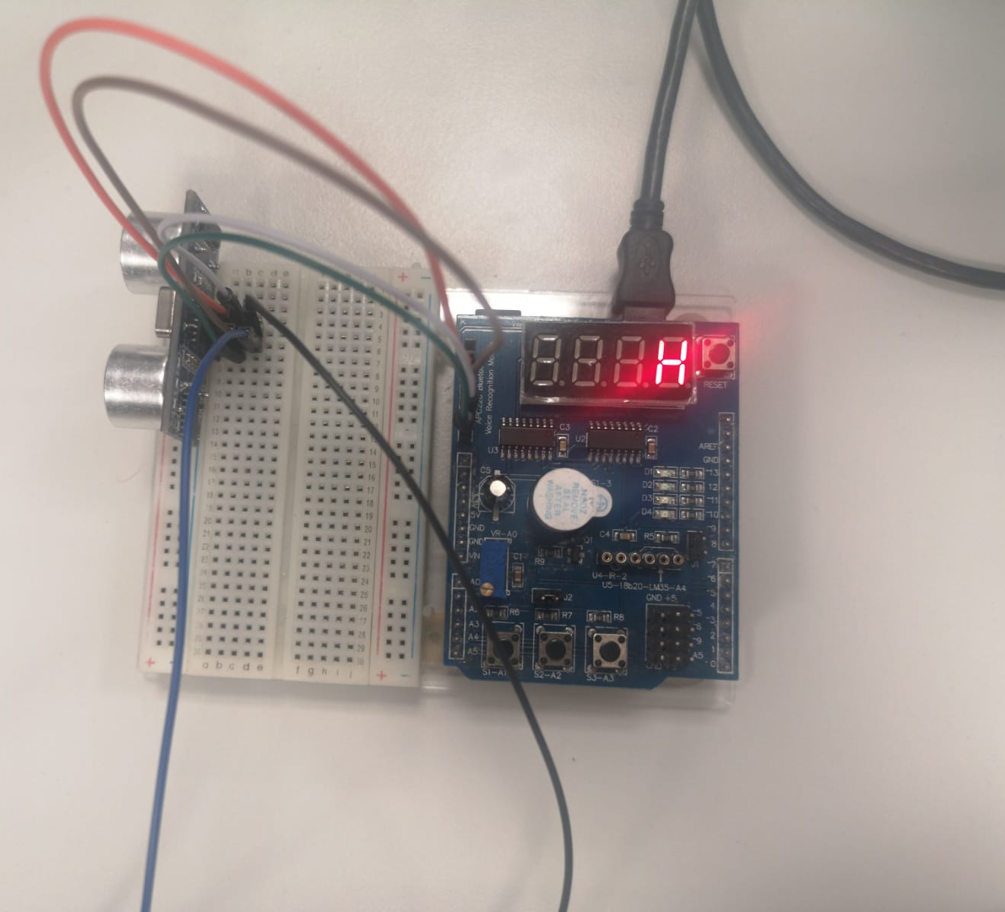
Circuit Schema
Trigger pin is connected to PD0 and set as output
Echo pin is connected to PD1 and set as input with no pullup resistor.
VCC and GND pins are connected accordingly.

Slide 6
Thank you for your attention!

