Slide 1
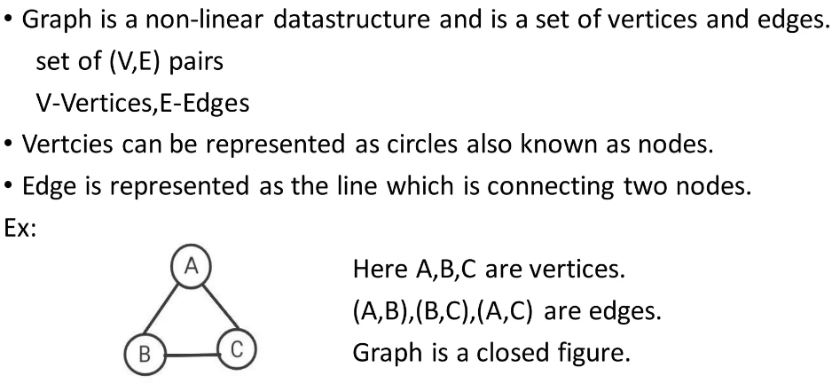
Graph

Slide 2
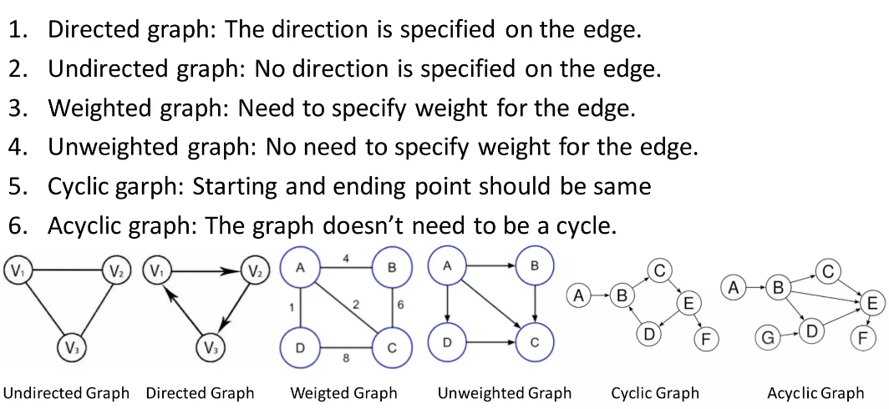
Types of Graphs

Slide 3
Adjacency Matrix

Slide 4
Adjacency List

Slide 5
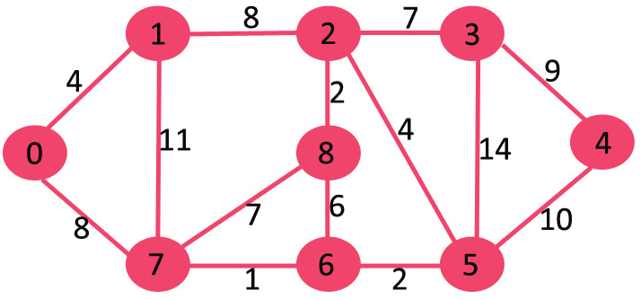
Shortest Path by Dijkstra

Slide 6
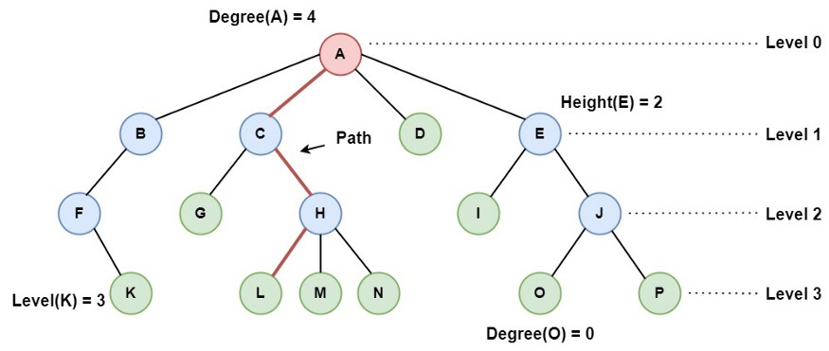
Tree Data Structure

Slide 7
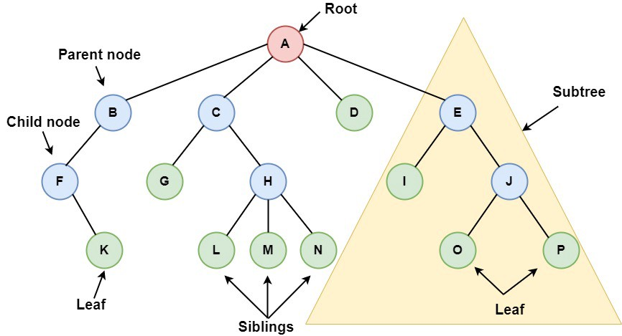
Tree Data Structure

Slide 8
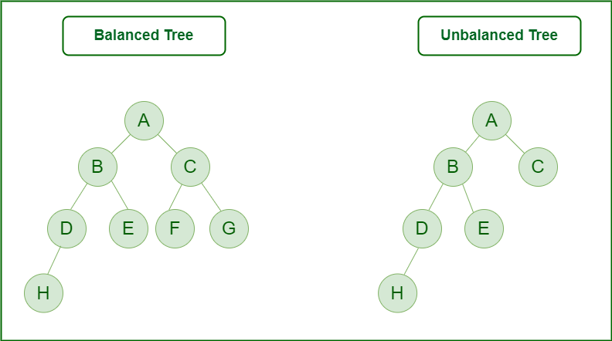
Binary Tree

Slide 9
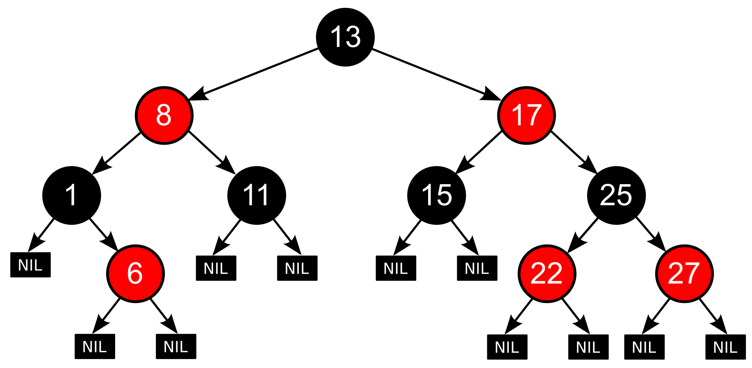
Red-Black Tree

Slide 10
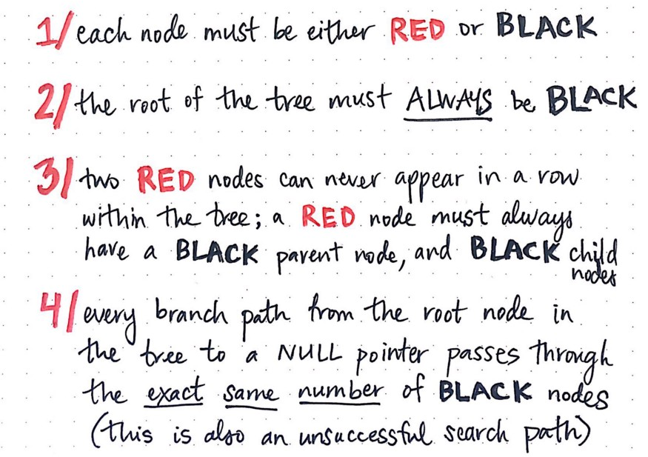
Red-Black Tree rules

Slide 11
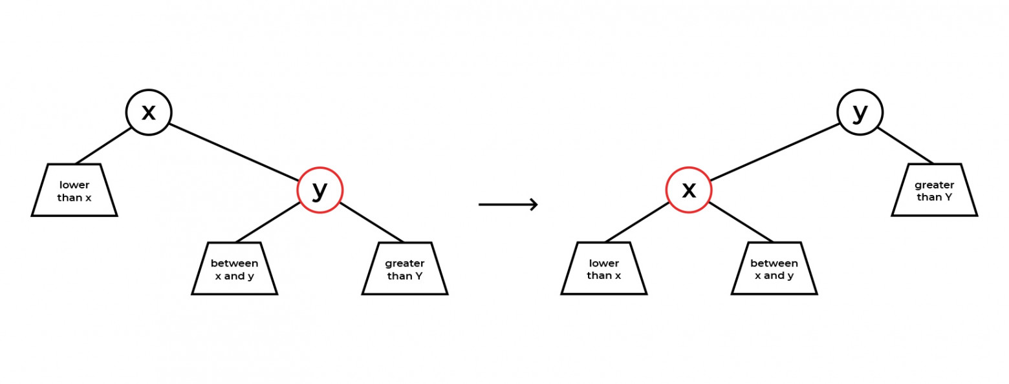
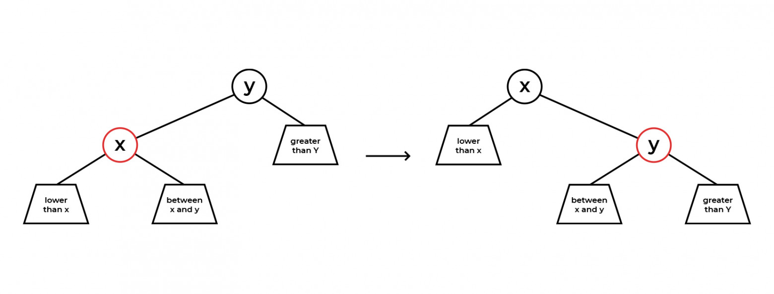
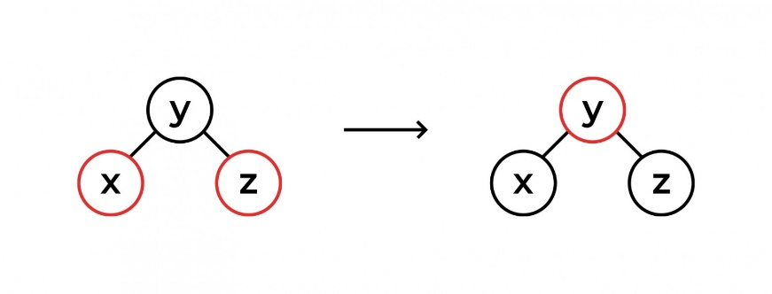
Red-Black Tree Operations

Slide 12
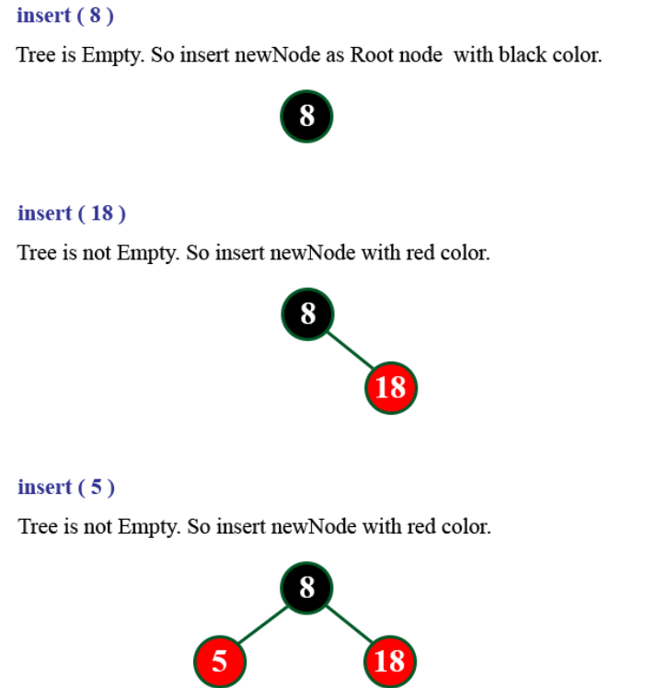
Red-Black 8,18, 5,15,17,25,40,80

Slide 13
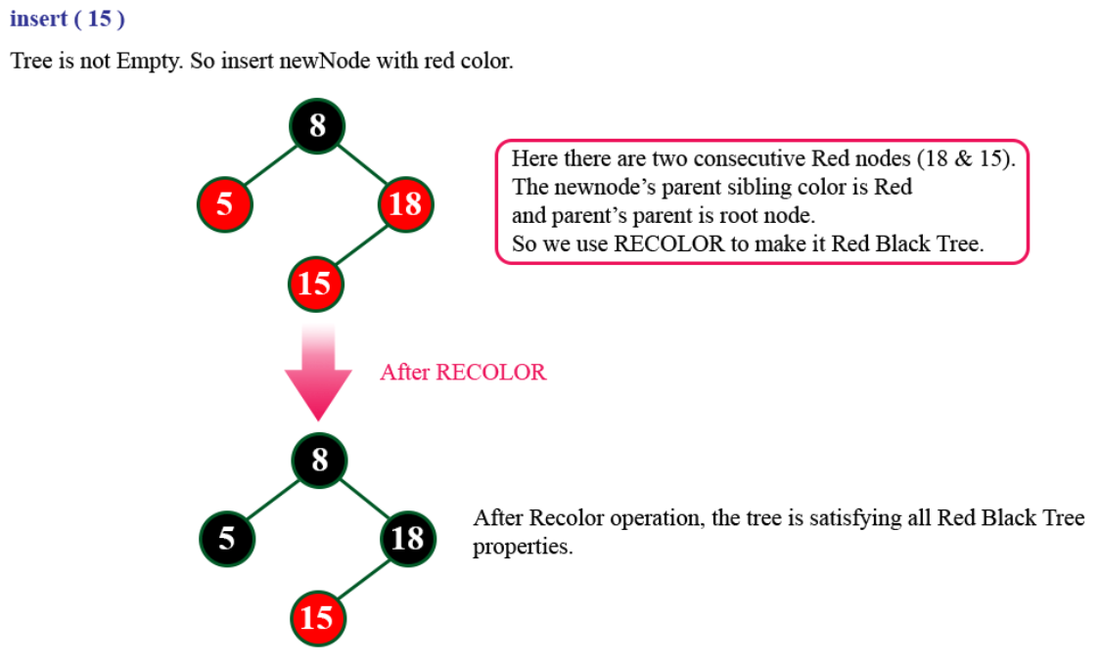
Red-Black 8,18, 5,15,17,25,40,80

Slide 14
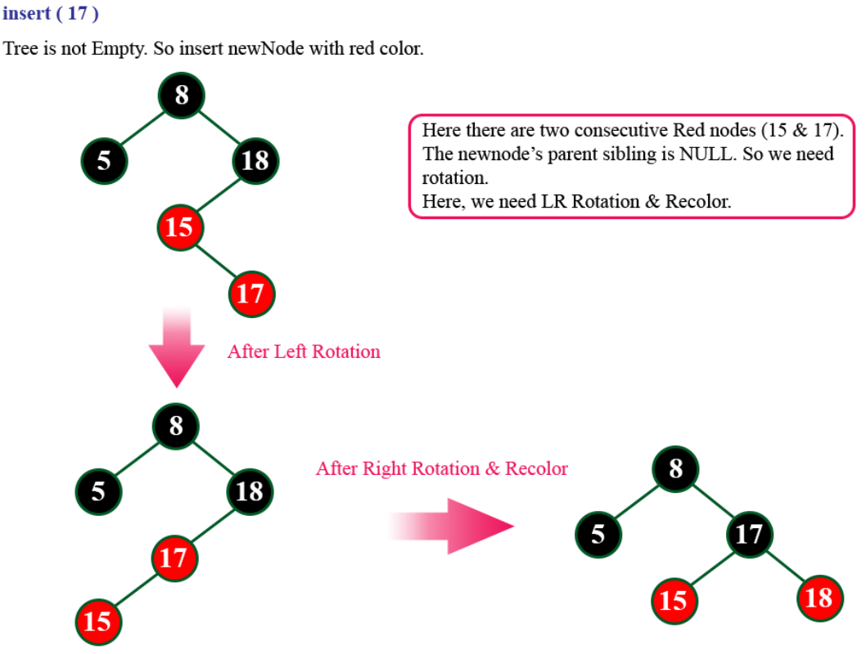
Red-Black 8,18, 5,15,17,25,40,80

Slide 15
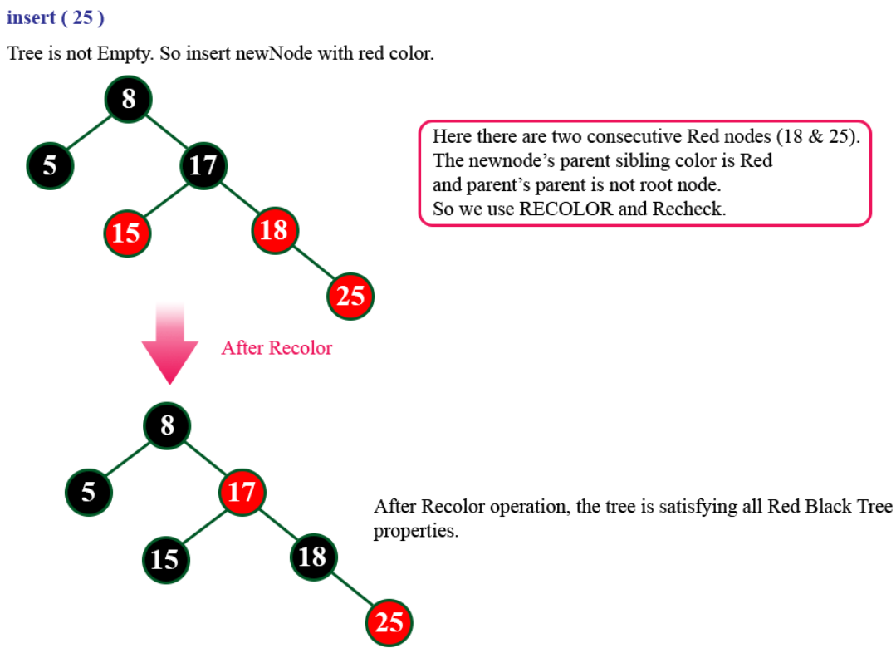
Red-Black 8,18, 5,15,17,25,40,80

Slide 16
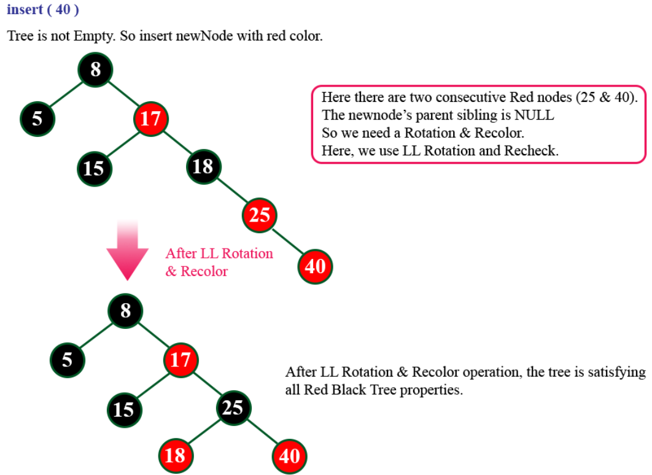
Red-Black 8,18, 5,15,17,25,40,80

Slide 17
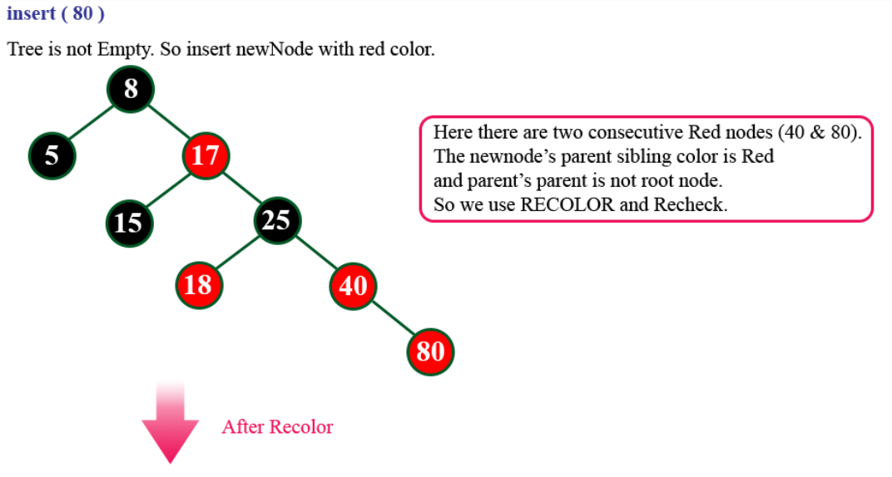
Red-Black 8,18, 5,15,17,25,40,80

Slide 18
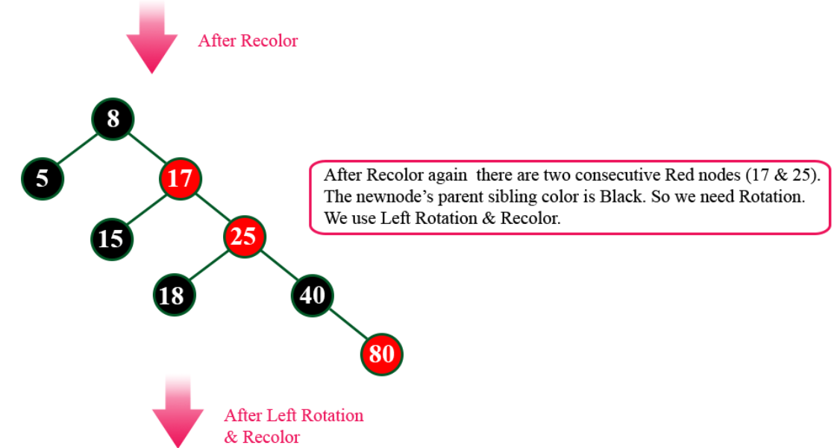
Red-Black 8,18, 5,15,17,25,40,80

Slide 19
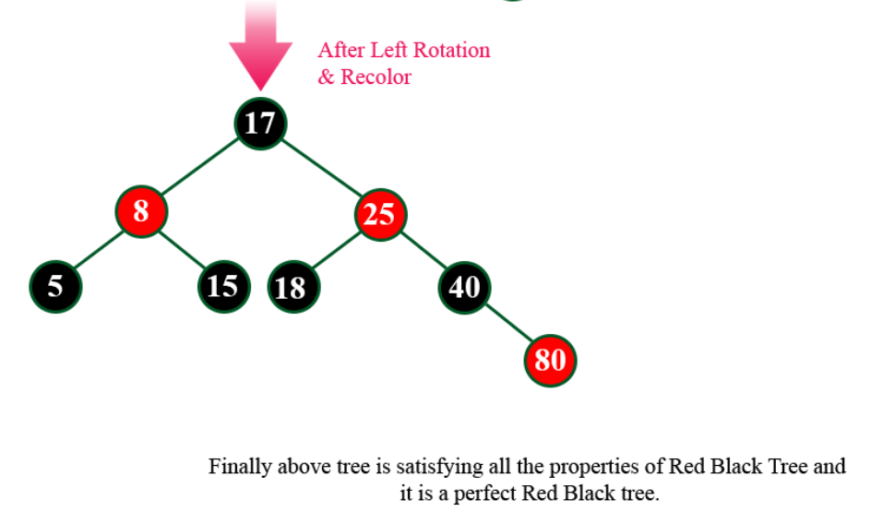
Red-Black 8,18, 5,15,17,25,40,80

