Slide 1
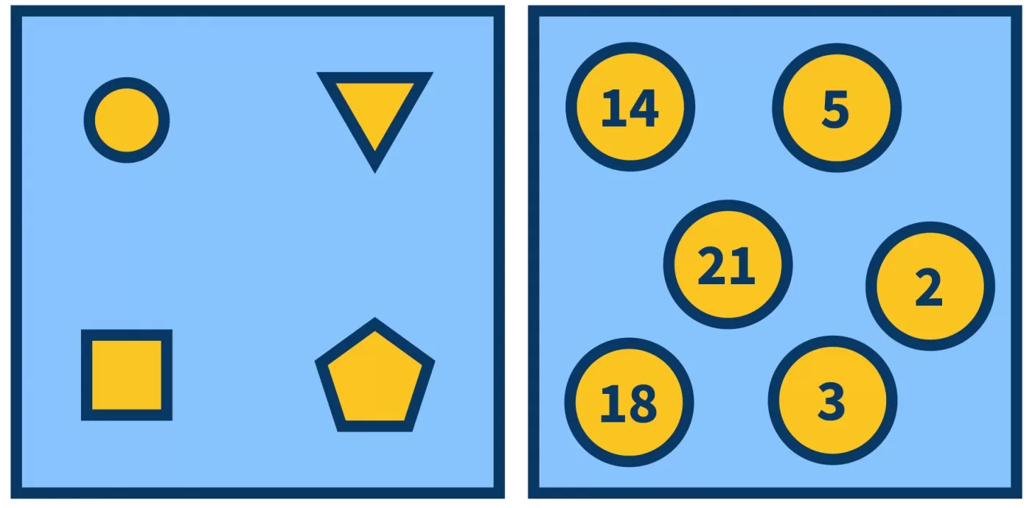
Set

Slide 2
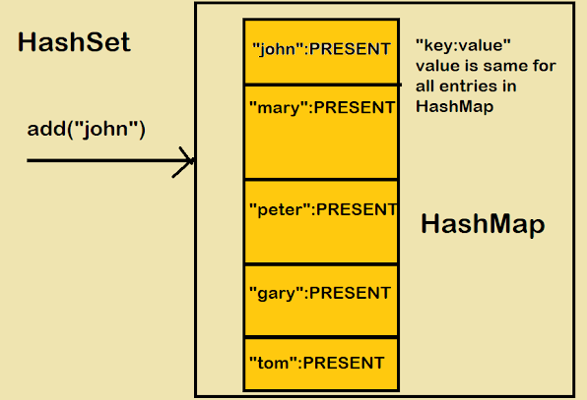
HashSet

Slide 3
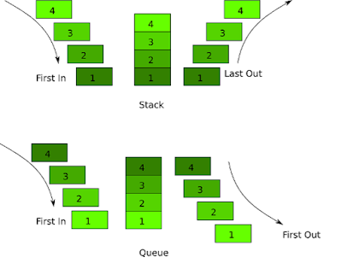
LIFO & FIFO logic

Slide 4
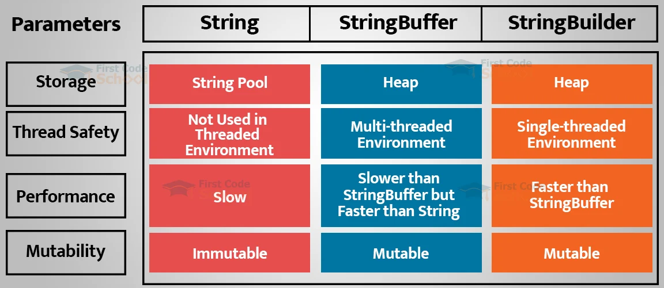
String/StringBuilder/StringBuffer

Slide 5
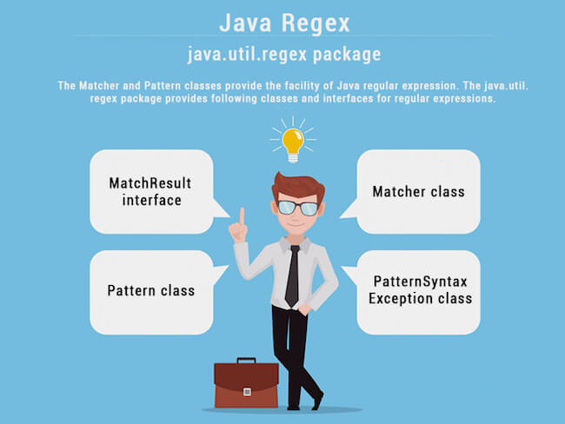
Regex

Slide 6
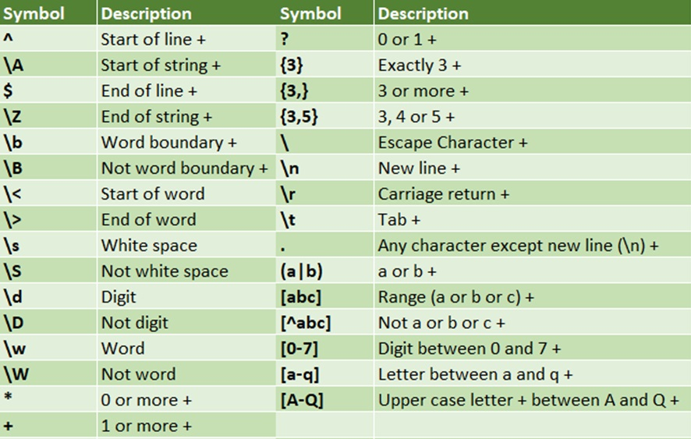
Regex expressions

Slide 7

Regex example

